Slide 1
Lecture 1 – Systematics and Phylogenetics
Mayr - “the theory and practice of classifying organisms”.
α - Taxonomy – includes species descriptions, taxonomic keys, and diagnoses.
β - Taxonomy – includes identification of natural groups and biological classes.
γ - Taxonomy – includes study of evolutionary processes and patterns.
Biosystematics
Society of Systematic Biologists
“The study of organismal diversity, including both the pattern of that diversity
and the processes that have generated it.”

Slide 2
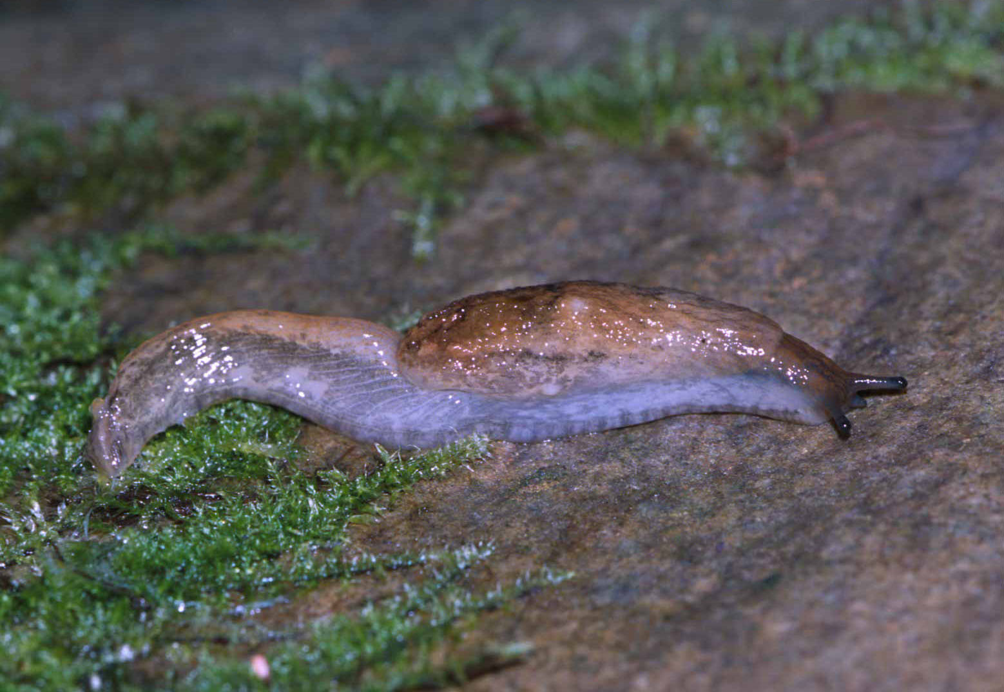
II. Roles of Systematics.
A. Provide α - taxonomy.
57% of the 150 most prescribed drugs contain active ingredients derived
from natural compounds.
There may be ~5-10 million extant species of macrobes on Earth (Costello et al. 2013),
and we’ve only described 1.5 million (maybe around 18 %) of them.
There may be ~1 trillion extant species of microbes on Earth (Locey and Lennon 2016).
B. Provide specimen identification
Indirectly, via keys.
Directly, via expert examination.

Slide 3
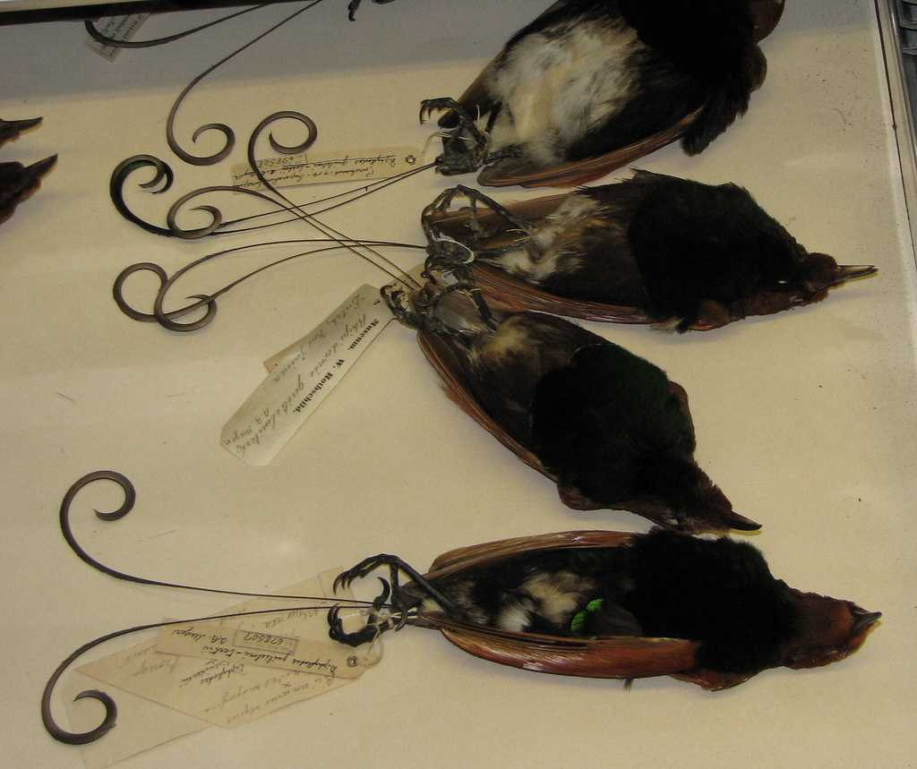
II. Roles of Systematics.
C. Maintain Collections
Provide reference for identifications.
Serve as permanent repository for important specimens.
Type specimens
Voucher specimens
Physical evidence of range shifts

Slide 4
II. Roles of Systematics.
D. Classification
Provide a hierarchy of names that is universal and that serves as the infrastructure for communication about biodiversity.
This must reflect evolutionary history – monophyletic groups
It also must be stable (we should resist change).
Do we want taxonomic ranks to be equilibrated across groups?
Pauley et al. (2009) versus Patterson & Norris (2016).

Slide 5
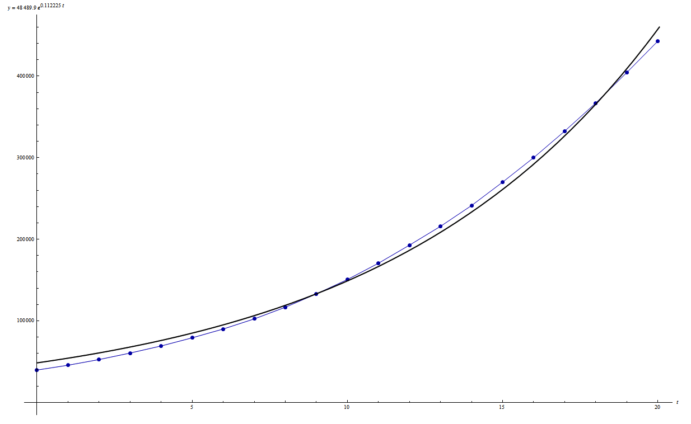
III. Roles of Phylogenies.
Google Scholar “phylogeny” >1,370,000 papers published.

Slide 6
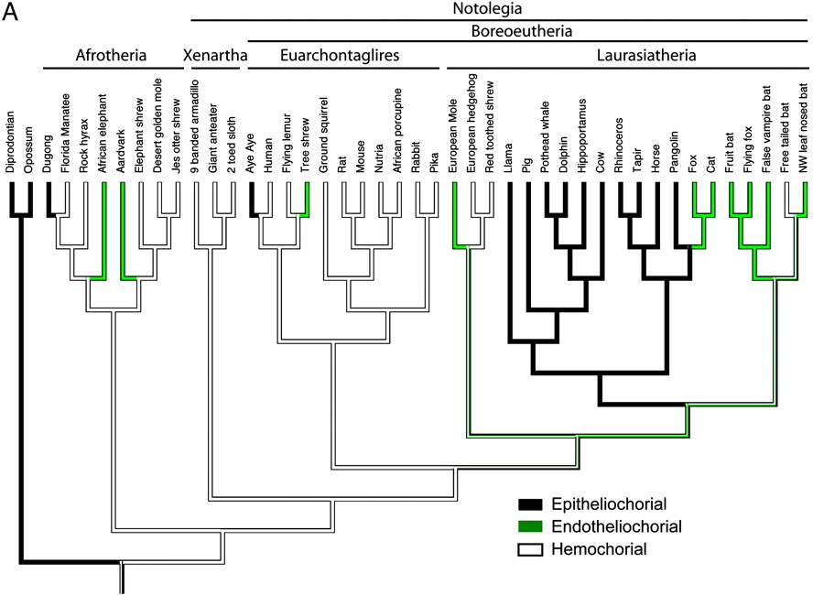
III. Roles of Phylogenies.
1. Understanding Adaptation
Placenta evolution in Eutherian mammals.
Least Efficient
Epithelioichorial
Moderately Efficient
Endotheliochorial
Most Efficient
Hemochorial
Wildman et al. (2006. PNAS, 103:3203-3208)

Slide 7
III. Roles of Phylogenies.
1. Understanding Adaptation
Placenta evolution in Eutherian mammals.
Least Efficient
Epithelioichorial
Moderately Efficient
Endotheliochorial
Most Efficient
Hemochorial
The less efficient placentae are the derived states and we need to explain their evolution
from hemochorial ancestors.

Slide 8
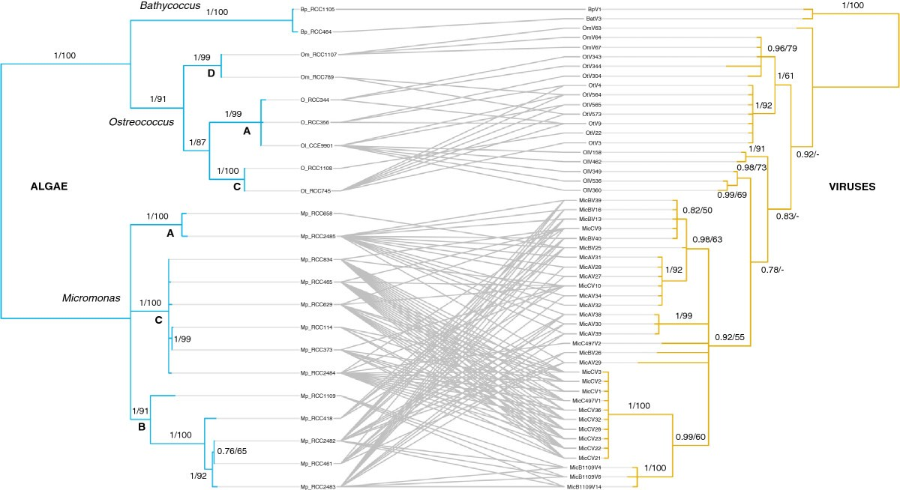
III. Roles of Phylogenies.
2. Co-speciation, for example between parasites and their hosts.
Bellec et al., 2014. BMC Evol. Biol., 14:59
Hughes et al., 2007. Syst. Biol. 56:232
Sometimes it’s not the case, as in this
study of algae and viruses.
Nearly perfect congruence indicates a long history of
co-speciation, with just two hypothesized
host-switching events.
A whole host of methods have been developed to infer co-speciation, host shifts, etc. from
comparisons of host and parasite phylogenies where they’re messy like this.

Slide 9
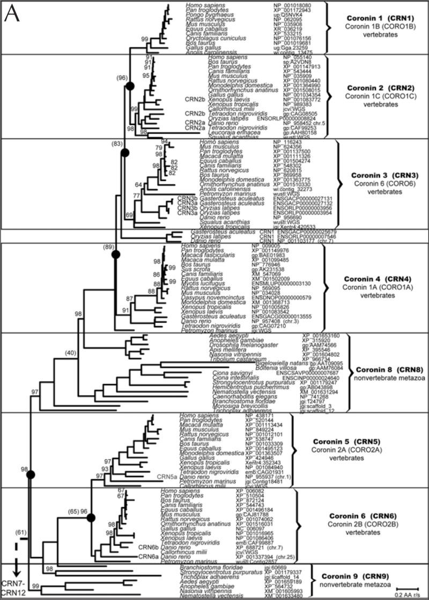
III. Roles of Phylogenies.
3. Gene Family Evolution
Gene duplication is a common source
of genetic variation, and lots of
important proteins are coded by gene
families.
This represents a phylogeny of the
Coronin family and there have been
at least 5 duplication events within
vertebrates.
The only way to reconstruct the history
of gene/genome duplication is via
phylogenetic analyses, as show here for
Coronin.
Morgan and Fernandez (2008. in
The Coronin Family of Proteins,
Clemen et al., eds).

Slide 10
III. Roles of Phylogenies.
4. Correlated Traits/Characters
Chen & Weins. 2020. Nature Comm. 11:359
Acoustic communication &
nocturnalty.
Chen & Weins reconstructed the evolution of both acoustic communication and nocturnality in tetrapods. Acoustic communication evolved 4 times independently, each time in an ancestor that is reconstructed
to have been nocturnal.

Slide 11
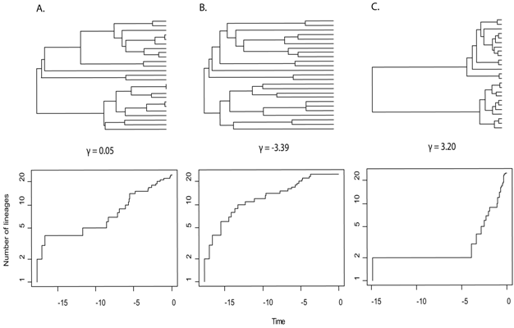
III. Roles of Phylogenies.
5. Diversification Rates
(Speciation – Extinction)
Same topology, but
different branch
lengths.
Lineages through
time plots.
A: Constant Rate
B: Early Burst
C: Long Fuse
(Myers & Burbrink. 2012. Nature Education Knowledge 3:23).

Slide 12
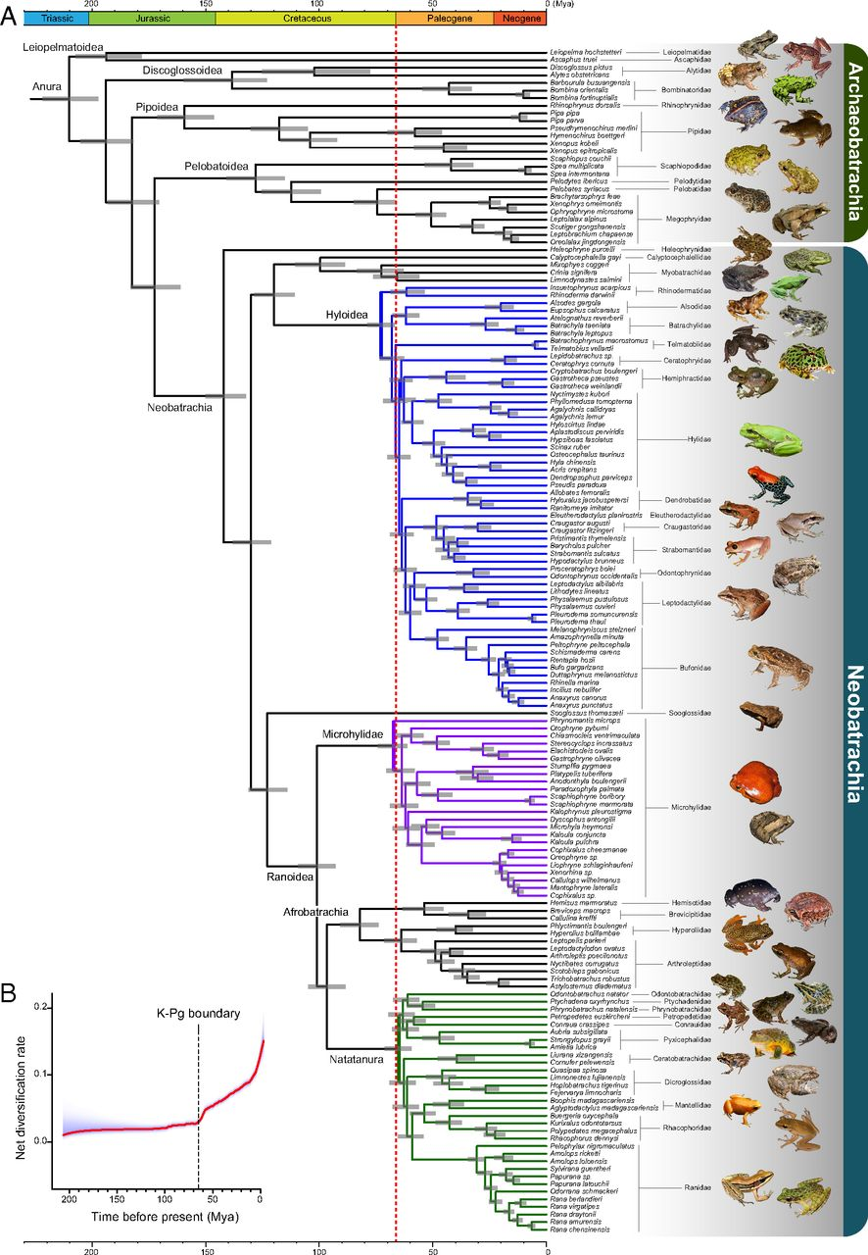
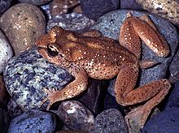
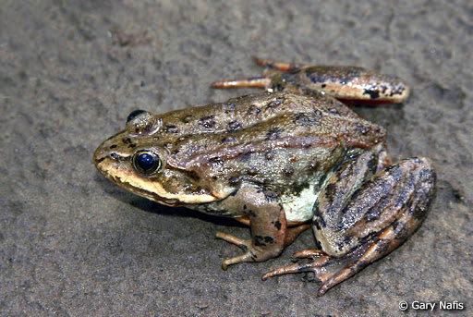
III. Roles of Phylogenies.
6. Conservation: Phylogenetic Diversity
Feng et al. (2017. PNAS, 114:E5864)
Two Cool Local Frogs
Ascaphus montanus
The genus has no close relatives.
Rana luteiventris
There are lots of close relatives.
Extinction of tailed frogs would deplete phylogenetic diversity far
more than extinction of Columbia spotted frogs.

Slide 13
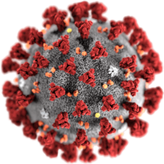
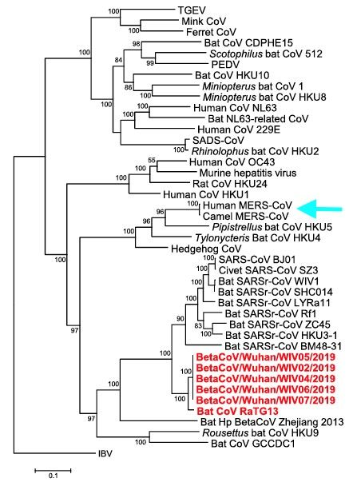
III. Roles of Phylogenies.
7. Human Health - Origin of Pathogens
Current Coronavirus
It has been transmitted from bats.
It’s most closely related to SARS.

Slide 14
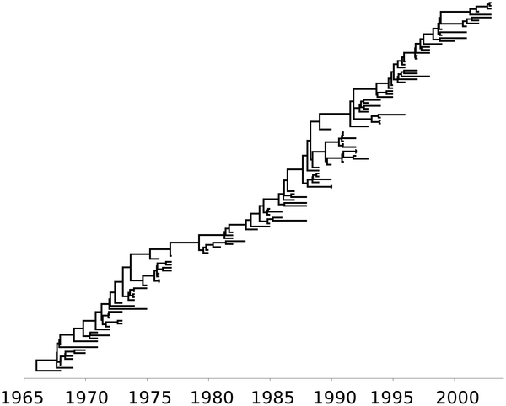
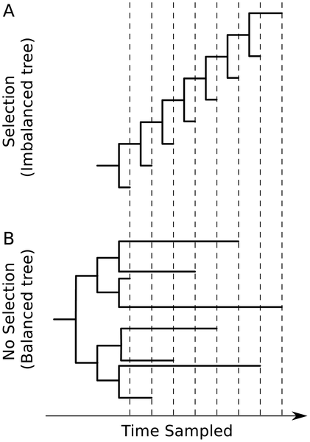
III. Roles of Phylogenies.
7. Human Health - Viral Phylodynamics
Phylogenetic effects of immune
escape.
Phylogeny of influenza A (H3N2) from viruses sampled
between 1968 and 2002.
Volz et al. (2013. PLoS Comp. Biol.doi:10.1371/journal.pcbi.1002947.g001)

Slide 15
III. Roles of Phylogenies.
8. Human Health - Molecular Epidemiology
HIV transmission in Edinburgh
Heterosexuals were contracting
HIV from IV Drug users.
HIV⁺ hemophiliacs formed two
separate clades.
Inferred that two donors infected the blood
supply.
Holmes et al. (1995. J. Infect. Diseases, 171:45)

Slide 16


III. Roles of Phylogenies.
9. Forensics
Louisiana v. Richard J. Schmidt
Richard Schmidt, M.D.
Janice Trahan
Schmidt was accused of intentionally injecting Trahan with HIV he
collected from his HIV⁺ patients.
This allegation predicts that HIV collected from Trahan should be very
closely related to HIV collected from one or more of his patients.
http://www.genomenewsnetwork.org/articles/01_03/hiv.shtml

Slide 17
III. Roles of Phylogenies.
8. Forensics
Trahan’s HIV
This (along with other evidence) lead to Schmidt’s conviction.

