Slide 1
Lecture 16 – Molecular Clocks
Fossil calibration
Up until recently, studies such as this one relied on sequence evolution to behave in a clock-like fashion, with a uniform rate across the topology.

Slide 2
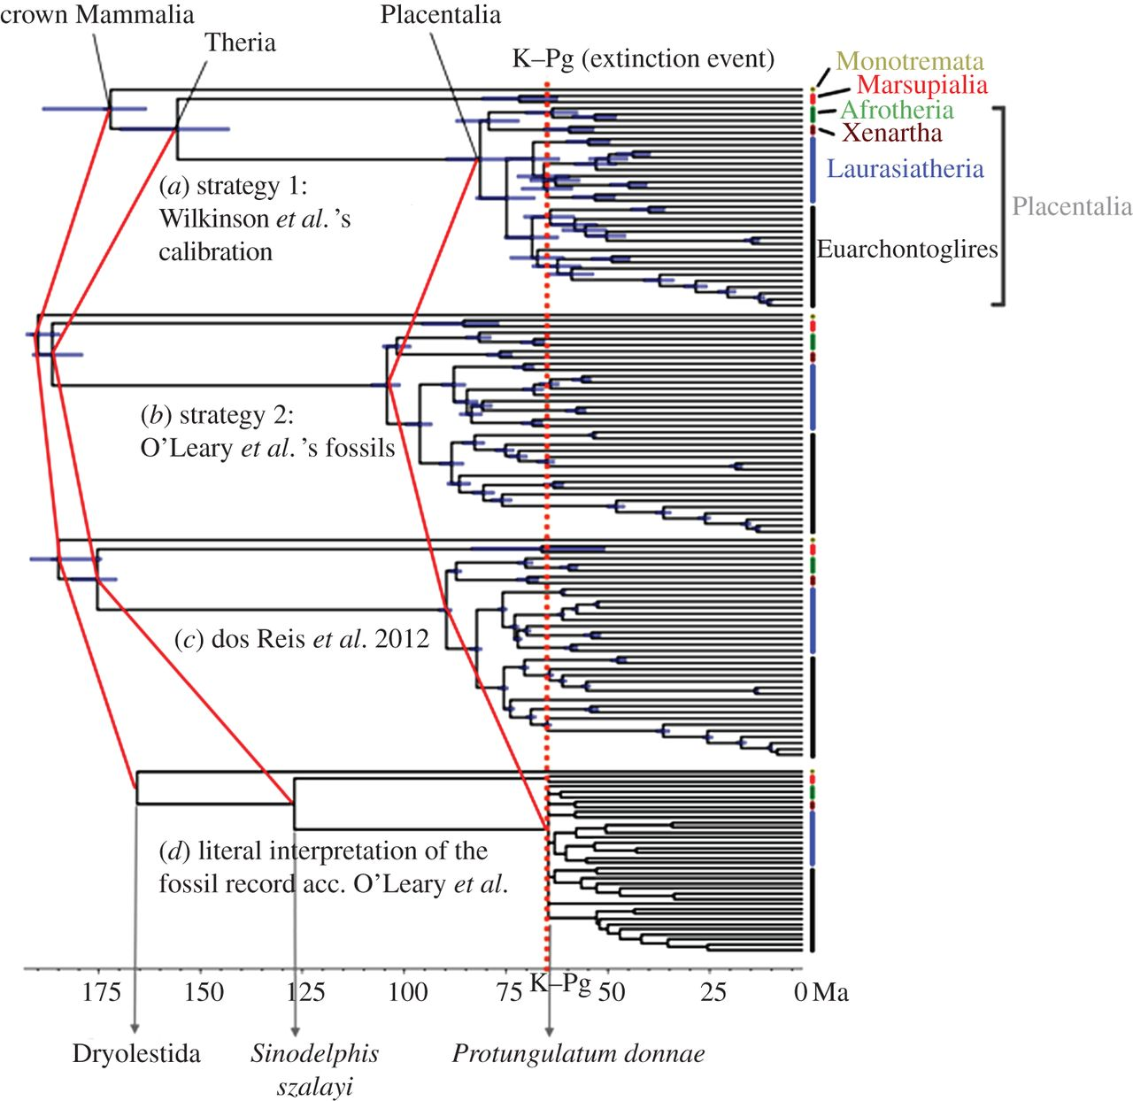
Method of Calibration Matters a Great Deal
(dos Reis et al. 2014. Biol. Lett. 10:20131003)
Stochastic Fossilization A
Stochastic Fossilization B
Stochastic Fossilization C
First occurrence as date

Slide 3
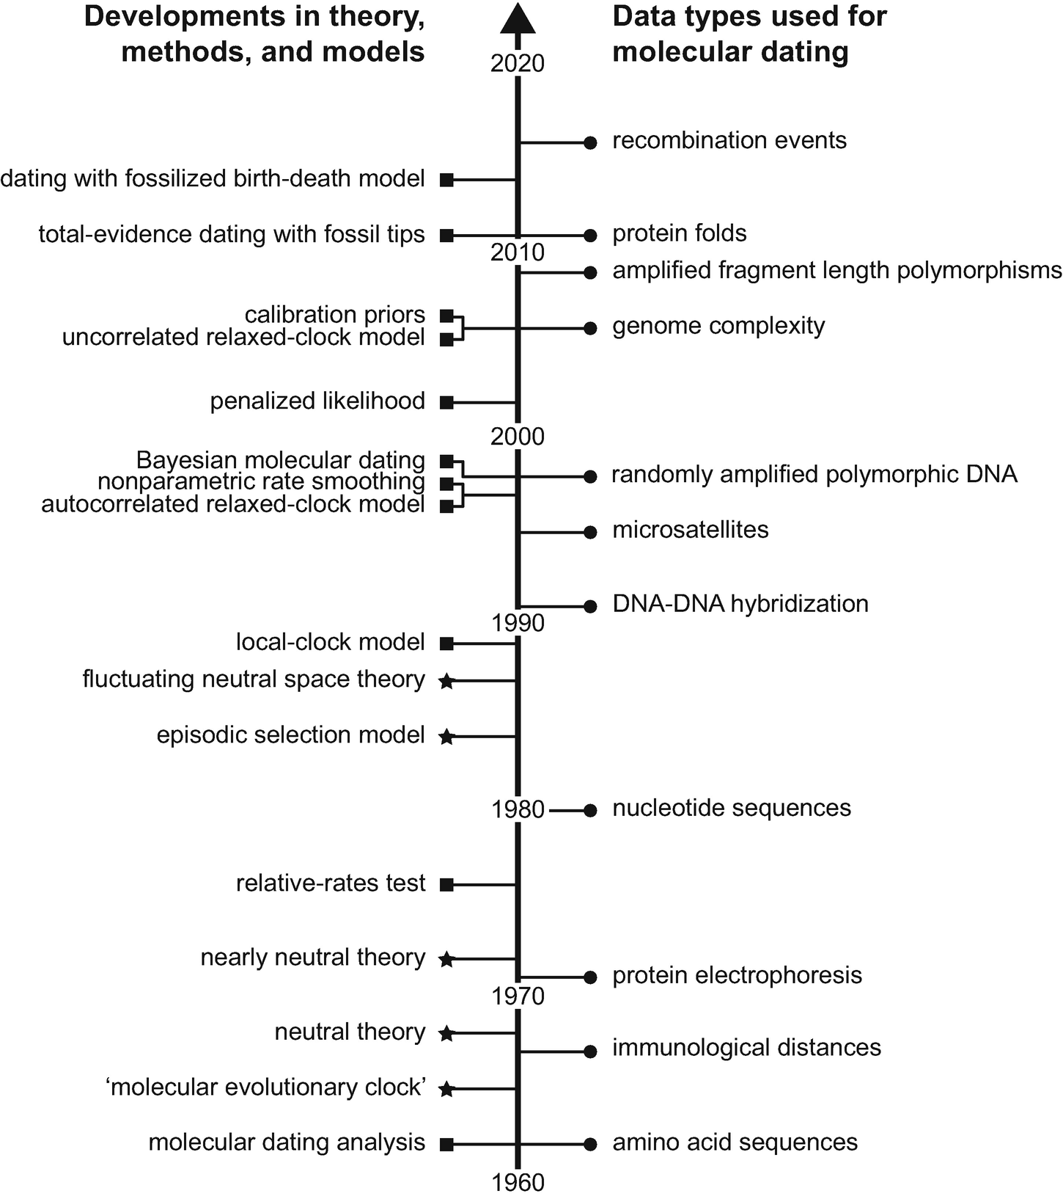
There’s a very long history of inquiry into molecular clocks.
Reviewed by Ho (2020) in introduction to The Molecular Evolutionary Clock: Theory and Practice.
Felsenstein’s Likelihood-Ratio Test
Sarich & Wilson
Zuckerkandl & Pauling

Slide 4
II. Tests of the Molecular Clock.
Two identical topologies, and they differ in (2n-3) branch lengths.
These trees converge when the following 2 conditions are met:
1) a = b; c = d; a + f = g + c
2) The root occurs along branch e, such that e’’ = e’ + g + c
So, in the clock tree, we focus on times of (n-1) nodes w, x, y, & z.

Slide 5
A. LRT of the Molecular Clock
The clock tree represents the special case (with branch lengths constrained as above) and the non-clock tree represents the general model.
δ = 2 [ lnL_{(non-clock)} – lnL_{(clock)}]
We use the asymptotic χ²-approximation, with d.f. equal to the difference in the number of parameters between the two models.
In the non-clock tree, there are 2n – 3 branch lengths, whereas in the clock tree, there are n – 1 node times to estimate.
(2n – 3) – (n – 1) = n – 2
Although I’ve only seen it done ocasionally (e.g., Lanfear et al. 2010. PNAS), one could use AIC
or BIC to compare clock to non-clock models in the same manner.

Slide 6
A. LRT of the Molecular Clock
The test statistic is: δ = 32.34. With 13 d.f., the p-value from the χ²-distribution is 0.0021.

Slide 7
A. LRT of the Molecular Clock
To conduct the parametric bootstrap, we would use the clock tree as the true tree and simulate data under a molecular clock.
This difference could be the result of either (or both) of two things.
It may be that in this case the asymptotic approximation of the χ²-distribution doesn’t work very well.
It also may be attributable to the fact that this data set mixes intraspecific and interspecific comparisons.

Slide 8
B. Relative-Rates Tests
m₁
m₂
y
x
x
y
x
x
Does d_{(A-E)} - d_{(B-E)} = 0 ?
Tajima (1993): If a clock holds, the number of sites that show the pattern yxx (m₁) should equal the number of sites showing the pattern xyx (m₂).
(m₁ – m₂)² / (m₁ + m₂)
Muse & Weir (1992) developed an RRT that uses LRT and also uses a χ² with one d.f.
Does d_{(A-E)} – d_{(C-E)} = 0 ? Does d_{(B-E)} – d_{(D-E)} = 0 ?
Does d_{(A-E)} – d_{(D-E)} = 0 ? Does d_{(C-E)} – d_{(D-E)} = 0 ?
Does d_{(B-E)} – d_{(C-E)} = 0 ? Does d_{(A-E)} – d_{(B-E)} = 0 ?

Slide 9
III. Estimating Divergence Times in the Absence of a Clock
A. Linearized Trees - RRT’s to identify offending species or a clade.
B. Local Clocks – Rate shifts may be pretty rare (Yoder & Yang. 2000. MB&E)
So here we have three local clocks and we would date divergences, say within the 4-taxon tree using rate 3 (Figure from Welch & Bromham, 2005. TREE, 20:320).
We need to locate rate shifts on the tree.

Slide 10
Random Local Clocks
Drummond & Suchard (2010. BMCBiol.) developed a RLC model that locates rate changes.
The rate of branch k: r_{k} = cρ x ρ_{pa(k)} x φ_{k}
cρ is a rate scaling constant
ρ_{pa(k)} is the rate of the parent branch of k
φ_{k} is the branch-specific rate multiplier.

Slide 11
C. Autocorrelation of Rates
Rates of closely related taxa are expected to be more similar than rates of more
distantly related taxa.
Non-parametric rate smoothing (Sanderson 1997) - The sum of squared differences
in local rates that are minimized, as follows:
Since r_{k} = b_{k}/t_{k}, NPRS used parsimony reconstructions as proxies for b_{k}’s and found the combination of internal node times (t₁, t₂, … t_{n-1}) that minimizes W.
Fully parametric versions have also been implemented.

Slide 12
C. Autocorrelation of Rates
Penalized Likelihoods (Sanderson 2002)
Saturated Model with all unique rates
ψ(θ_{SAT} | x₁, x₂ , …, x _{S+M}) = logL (θ_{SAT} | x₁, x₂ ,…, x _{S+M}) – λ Φ (r1, r2, …, r _{S+M} ),
logL (θ_{SAT} | x₁, x₂ ,…, x _{S+M}) is likelihood of the saturated model.
λ and Φ are smoothing and roughness parameters that govern the autocorrelation of rates.
TreePL is a widely used implementation of this.

Slide 13
D. Uncorrelated Rates
A group of approaches have relaxed the assumption of correlated rates.
Every branch can have a unique rate, these
are drawn from some distribution
Uncorrelated LogNormal (UCLN) approach of Drummond et al. (2006. PLoSBiology, 4:699.) rates are drawn from a discretized LogNormal Distribution

Slide 14
D. Uncorrelated Rates
Distributions other than LogNormal have been proposed: Inverse Gaussian, Exponential
Li & Drummond (2012. MB&E) developed an rjMCMC to treat the relaxed clock model
as a random variable and assess posterior probabilities of each of these three
models for 1056 mammalian data sets.
Most of these data sets don’t voice any preference for the models, so the model averaging this allows in divergence-time estimation is potentially important.

Slide 15
E. Inclusion of Fossils with Molecular Data
In using fossil dates to set priors on node ages, we need some idea of the topology
of the tree, and we need to know where the calibration points are.
An emerging approach that circumvents this uses RevBayes (Hohna et al. 2016. Syst. Biol. 65:726) to include fossil taxa in the character by taxon matrix. The data then include both morphological and molecular characters and separate models are applied to each data type in a single analysis.
One of the huge advances is that the locations of the dated nodes in the phylogeny (i.e., the ones pertaining to the fossils) are estimated from the data, and the uncertainty in these placements is incorporated into divergence time estimates across the chronogram (i.e., dated phylogeny).

Slide 16
Gavryushkina et al. (2016. Syst. Biol. 66:57)

Slide 17
F. A Note of Caution
Divergence times are important and interesting, and there seems to be euphoric
adoption of the relaxed-clock approaches.
Truth
Data simulated under a clock, but with biased detection of rate variation.

