Slide 1
Lecture 17 – Multiple Data Sets
(Partitions & Mixtures)
Combined vs. Separate Analyses
Should we combine all our data into a single analysis?
There are three historic and one emerging answer to this question:
a. “Of course, what an absurd question.”
b. “No, we should analyze each separately.”
c. “It depends.”
d. “Use multispecies coalescent approach.”
Total Evidence

Slide 2
Hidden Support
Amplification of signal
Interaction of characters and hidden support.

Slide 3
Separate Analysis
Miyamoto and Fitch (1995. Syst. Biol., 44:64) argue that different data sets are more likely to consist of characters that are mutually independent
1. One (or more) is subject to systematic error. They argue that systematic error should be restricted to a single data set, and should not persist across data sets. This may be the result of LBA, or perhaps selection. Thus, separate genes represent natural process partitions.
2. Different genes may actually have a different history. We’ll discuss the potential causes for this later, but if different genes have different histories, it makes little sense to combine them and thus force them to fit a single bifurcating tree. Only separate analyses (or analyses that permit cycles in the graph) will allow one to detect conflicting signal.

Slide 4
Conditional Combination

Slide 5
Partitioned Models & Concatenated Data
Influence of branch-length heterogeneity

Slide 6
Partitioned Models
This is the likelihood under a single partition, where a single model applies to all the sites.
We can partition the data (say by gene) and use a separate model for each of g partitions:
where w_{j} is he probability that site i is in partition g and the SSLs are weighted sums across partitions.
Often, we assign sites a priori and all w_{j}’s are either zero or 1.

Slide 7
Example from Lab Data Set
First Positions Second Positions Third positions
Tree 1 Tree 1 Tree 1
------------------ ------------------ ---------------
-ln L 1361.57931 -ln L 574.82758 -ln L 4014.14543
Base frequencies: Base frequencies: Base frequencies
A 0.297135 A 0.210392 A 0.435821
C 0.223702 C 0.228875 C 0.324911
G 0.235795 G 0.143413 G 0.030437
T 0.243369 T 0.417320 T 0.208831
Rate matrix R: Rate matrix R: Rate matrix R:
AC 1.15219 AC 4.2179e+08 AC 5.2290e-10
AG 3.38708 AG 2.7458e+08 AG 6506.44535
AT 0.78766 AT 1.0059e+08 AT 77.76142
CG 6.7725e-05 CG 9.0472e+07 CG 1.6437e-35
CT 8.99814 CT 4.0779e+08 CT 3272.68748
GT 1.00000 GT 1.00000 GT 1.00000
P_inv 0.289087 P_inv 0.738767 P_inv 0.00804384
Shape 0.336931 Shape 0.734197 Shape 0.464942
First, look at the variation in base frequencies across codon positions.
Second, we can simply sum the lnLs for each partition to get the score for the partitioned model:
(-1361.57931) + (-574.82758) + (-4014.14543) = -5950.55228

Slide 8
Example from Lab Data Set
A single-partition GTR+I+Γ.
Tree 1
------------------
-ln L 6467.45222
Base frequencies:
A 0.385640
C 0.329665
G 0.056255
T 0.228440
Rate matrix R:
AC 0.16037
AG 4.56668
AT 0.40618
CG 0.16011
CT 6.92991
GT 1.00000
P_inv 0.465785
Shape 0.489470
So, the un-partitioned lnL is 516.8999 units worse than the model partitioned by codons. We’ve gone from 10 to 30 parameters and compare the LRT
statistic to χ²_{[20]} and the p-value is <<0.001.

Slide 9
Example from Lab Data Set
No effect for many nodes
There is an effect for a few!

Slide 10
Selecting Partitioned Models
Castoe et al., 2004
Partitioned
They didn’t conduct formal model selection, but indicated that the 4 partitioned models all have about the same lnL so they chose the simplest of these.

Slide 11
Selecting Partitioned Models
McGuire et al. (2007) did a great job of assessing partitioned models.
DT Model
DT Model
AIC picks most complex, BIC picks petty simple and DT picks simplest.

Slide 12
Erecting Partitioned Models
Li et al. (2008) use multivariate analysis of model parameters to erect a
hierarchical partitioning scheme.
3 Partitions
2 Partitions

Slide 13
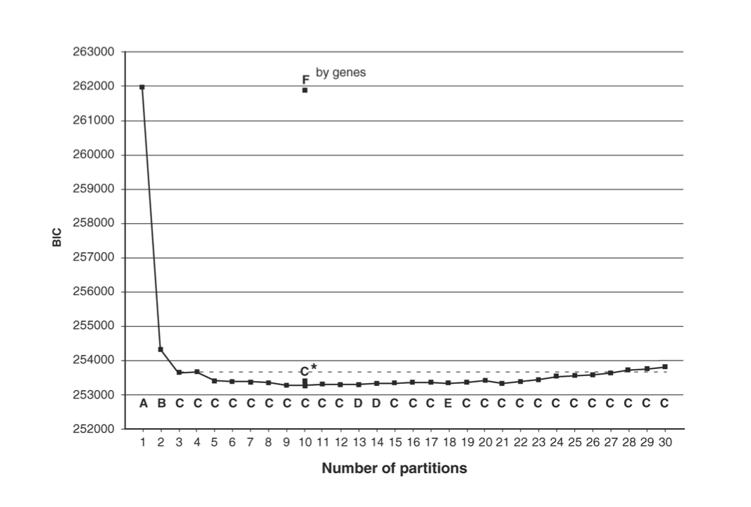
Erecting Partitioned Models
Li et al. (2008) use multivariate analysis of model parameters to erect a
hierarchical partitioning scheme.
The ml tree for each analysis is indicated by letters.
Lanfear et al.’s (2012, 2014, 2016) PartitionFinder automates and enhances this.

Slide 14
Mixture Models.
where the w_{j}’s are the probability that site i evolved under model j.
Pagel & Mead (2004)
Fit stem-loop structure of rRNA genes.

Slide 15
Mixture Models
where the w_{j}’s are the probability that site i evolved under model j.
How should we determine the degree of the mixture?
(i.e., how many Q-matrices should we allow)
A few papers have used rjMCMC to treat g as a random variable.
Venditti and Pagel (2008) allow a variable number of Q with a full GTR for each.
Evans & Sullivan (2012. Syst. Biol.) generalized that to permit special cases of
GTR in any of the Q-matrices.
All these mixture models (including partitioned models) assume ILS is absent.

