Slide 1
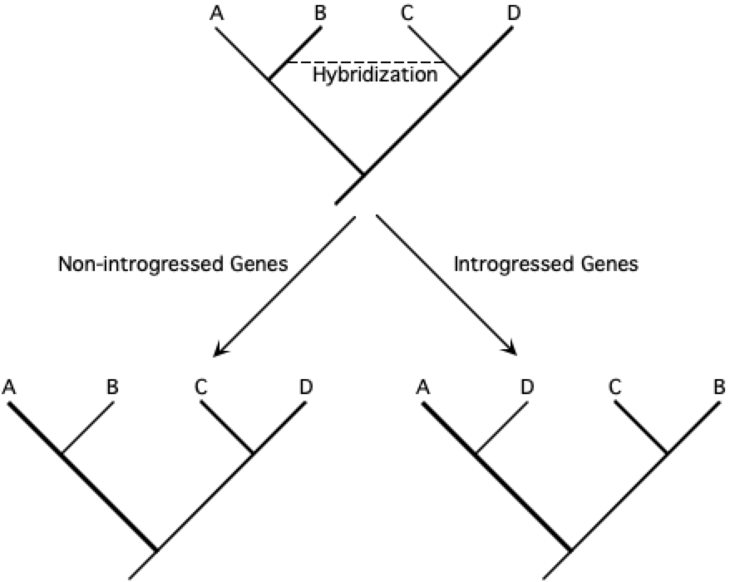
Lecture 19 – Non-tree Based Methods
Increasing molecular evidence indicates that hybridization is far more
common in animals than has traditionally been recognized.
Between Non-Sister Species
Between Sister Species
A
B
C
D
Hybridization
Non-Introgressed Genes
Introgressed Genes
A
B
C
D
A
B
C
D
High incongruence among gene trees.
High variance in coalescence times.

Slide 2
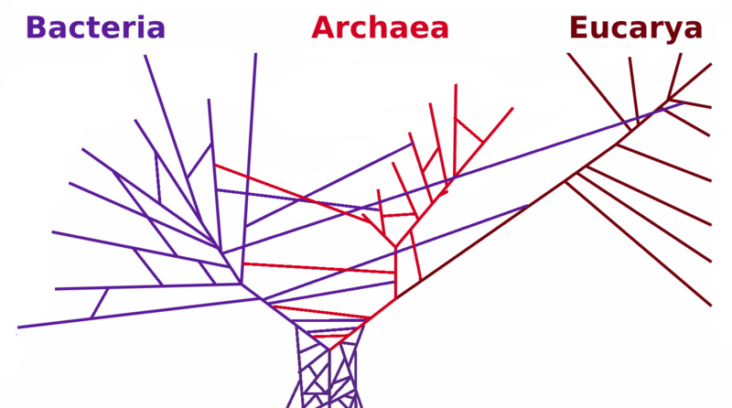
Horizontal Gene Transfer
HGT is usually used to refer to reticulations among potentially strongly diverged organisms (i.e., large spans of evolutionary time).
Among bacteria, this is often plasmid-mediated.

Slide 3
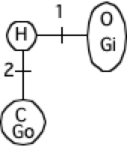
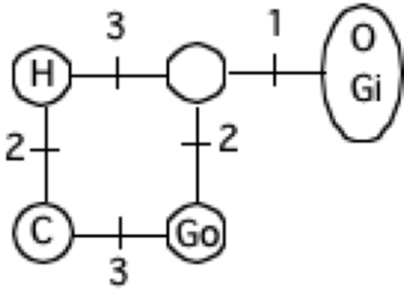
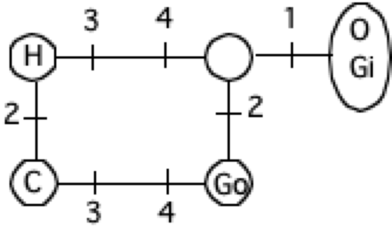
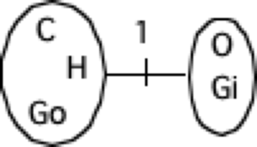
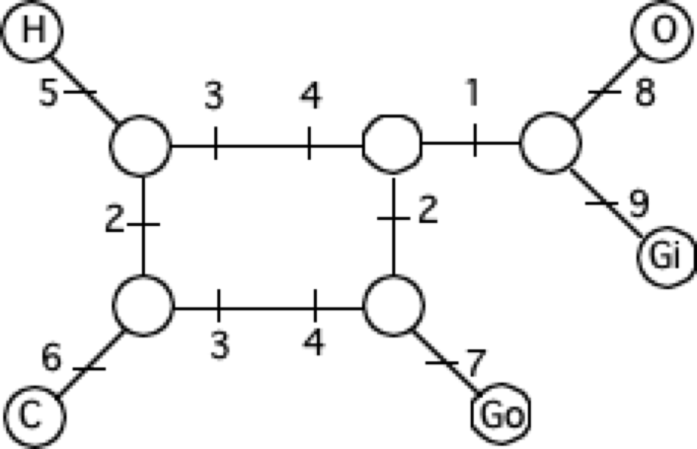
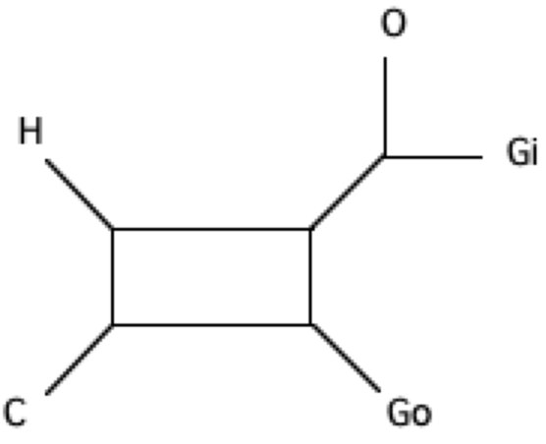
Split Decomposition
A network-based method that incorporates reticulations into the network at points where the data have conflicting signals.
Data are not forced to fit a single tree. Instead, each site is examined for the split that it supports.
Human T C C T T A A A A
Chimp T T C T A T A A A
Gorilla T T A C A A T A A
Oranutan C C A C A A A T A
Gibbon C C A C A A A A T

Slide 4
Split Decomposition
This network contains two bifurcating trees
H
C
O
Go
Gi
Go
H
O
C
Gi
Orange tree has more support.

Slide 5
Split Decomposition
These can get very complicated.

Slide 6
Split Decomposition
These can be rather simple and locate the deviation from a bifurcating tree.
Bamburger et al. (2022. Syst. Bio., 7:439)
This visualizes where the data are not tree-like, but not why.

Slide 7
Phylogenetic Networks
The idea is that different parts of the genome may be derived from different parent taxa and a network can “contain” several gene trees.
1
2
3
4
Infer the network with fewest
reticulations.
Several gene trees

Slide 8
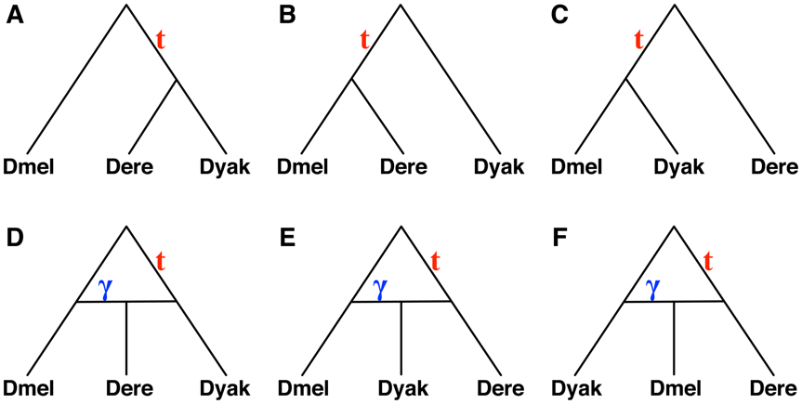
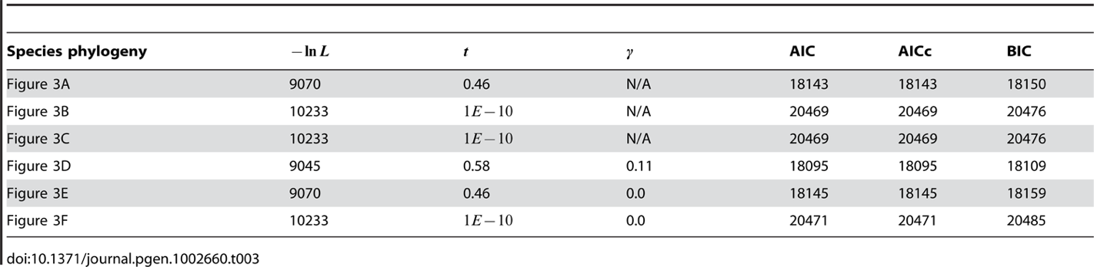
Phylogenetic Networks
Yu et al. (2012. PLoS Genetics) provided the likelihoods for gene trees evolving within a
phylogenetic network from the multispecies coalescent framework.
γ is portion of putative hybrid’s genome that is
introgressed.
Of course, adding reticulations will always improve the likelihood score, so some type of model selection is required.

Slide 9
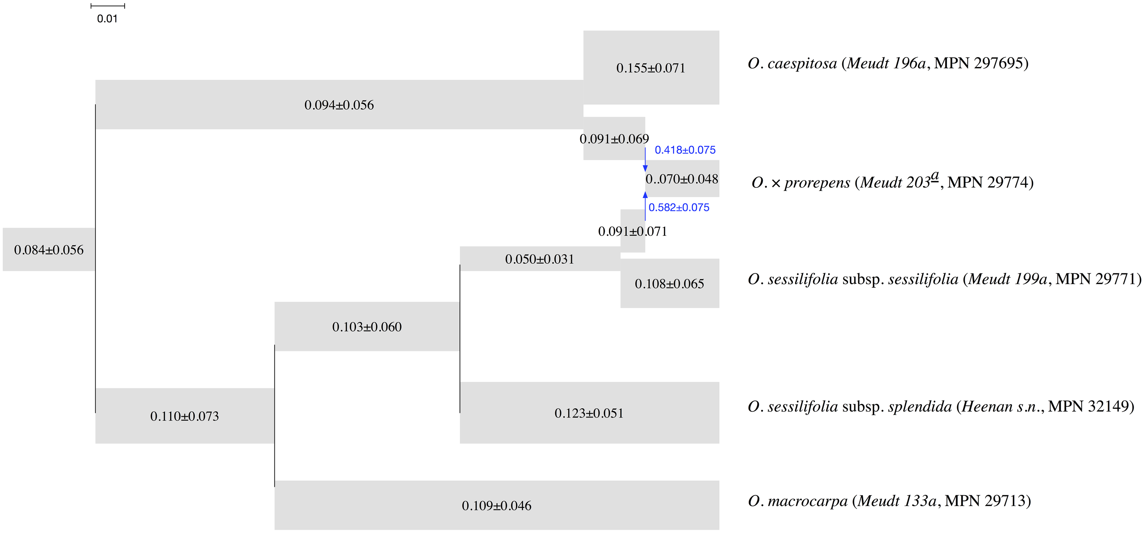
Phylogenetic Networks
PhyloNET includes a Bayesian implementation.
Zhu et al. (2018)
With number of reticulations set to 1, the multispecies coalescent allows for
inference of the species network.
Gamma (blue) represents the fraction of the genome derived from each parent
across a reticulation.

Slide 10
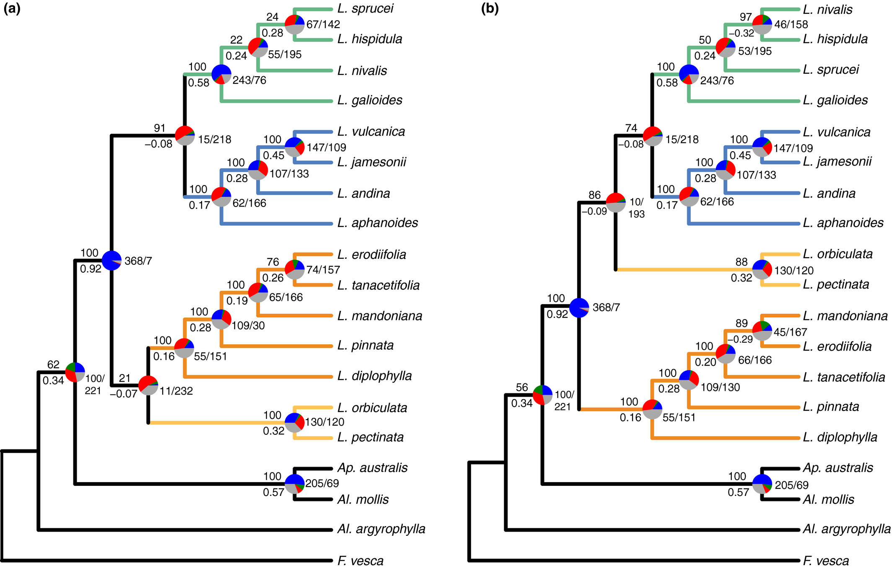
Phylogenetic Networks
More complicated histories (e.g., Morales-Biones et al. 2018).
ASTRAL
SVDQuartets

Slide 11
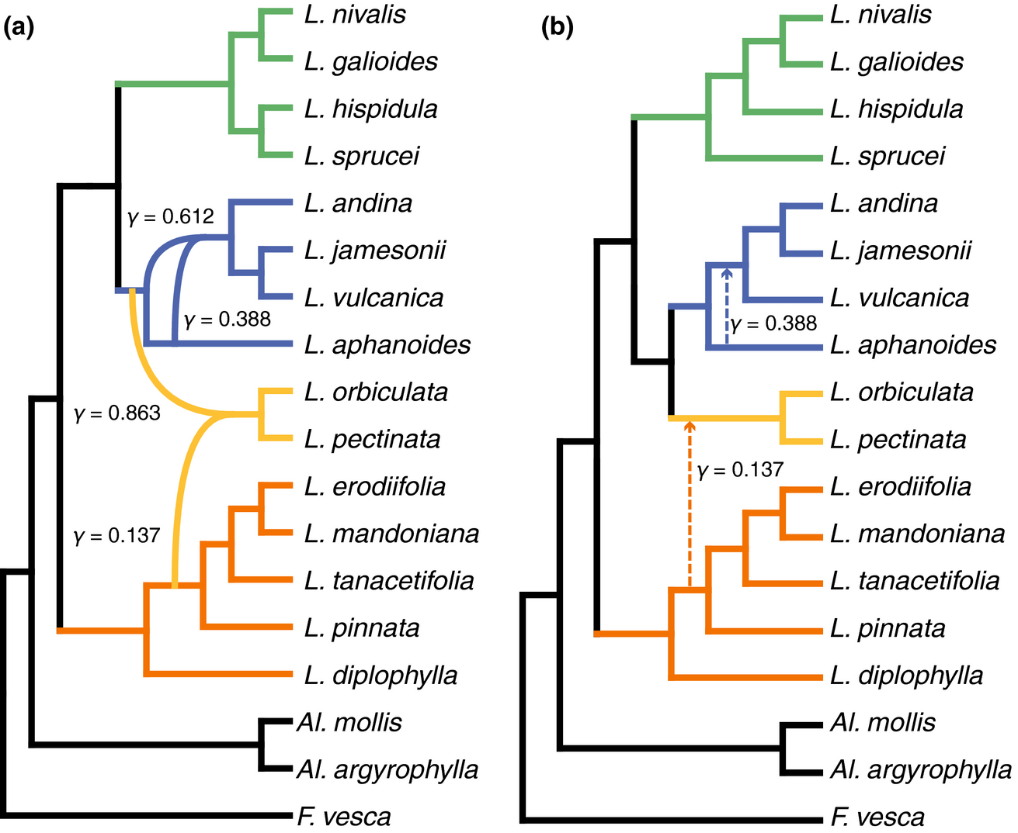
Phylogenetic Networks
More complicated histories (e.g., Morales-Biones et al. 2018).
Species network – two ancient hybridization events.

Slide 12
Quartet Methods for Detecting Hybridization
Ancestral polymorphism persists across two speciation events.
Species tree
Gene tree
Congruent
B
A
C
B
A
Incongruent
Incongruent
So, the two incongruent gene trees should have identical (low) support.

Slide 13
Quartet Methods for Detecting Hybridization
ABBA/BABA – Patterson’s D
Is the presence of shared alleles due to ILS or hybridization?
Under ILS, there should be no asymmetry in ABBA versus BABA frequencies.
Patterson’s D measures the deviation from equal frequencies:
D = C_{ABBA} – C_{BABA}/ C_{ABBA} +C_{BABA}
Assumption: Polymorphism is due to a single mutation
(i.e., there have been no multiple hits).

Slide 14
Quartet Methods for Detecting Hybridization
Estimation of Species Tree and Simultaneous
Inference of Hybridization
SVDQuartets & HyDe
40% of species
are involved in
introgression,
sometimes with
multiple partners.
(16)

Slide 15
Quartet Methods for Detecting Hybridization
quadrivittatus group
Free-love zone
for mtDNA
Sullivan et al. (2014)

Slide 16
Quartet Methods for Detecting Hybridization
T. quadrivittatus Species Group

Slide 17
231 individual
Cyt b sequences
T. quadrivittatus group mtDNA gene tree
Clade D – quadrivittatus
plus one dorsalis
Clade C – umbrinus & quadrivittatus
Front Range plus dorsalis
E. Flaming Gorge
a.k.a WTF?-1
T. dorsalis – Sky Islands
Clade B – T. rufus
cinereicollis & dorsalis
Clade A – T. canipes
Clade WTF?-2
New Mexico
umbrinus & dorsalis
cinereicollis
& dorsalis

Slide 18
mtDNA Genome Tree
1.0
Clade WTF-2 (New Mexico)
1.0
1.0
T. cinereicollis & T. dorsalis
1.0
1.0
T. umbrinus & T. dorsalis
1.0
1.0
1.0
1.0
1.0
T. dorsalis – Sky Islands
1.0
Clade D – T. quadrivittatus
plus one T. dorsalis
1.0
1.0
Clade C, a.k.a WTF-1 (Front Range)
1.0
Clade B – T. rufus
1.0
Clade A – T. canipes

Slide 19
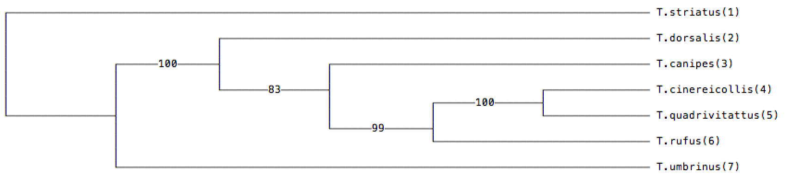
T. quadrivittatus group phylogenomics
Nuclear Genome Data (Sarver et al. 2021)
T. dorsalis
100
87
73
Species Tree
99
T. cinereicollis
T. striatus
100
83
T. dorsalis
100
99
T. canipes
T. quadrivittatus
T. cinereicollis
96
100
T. quadrivittatus
T. rufus
T. rufus
T. umbrinus
73
100
100
T. canipes
100
100
100
T. umbrinus
91
0.0001 substitutions/site

Slide 20
Quartets Analysis of Introgression
(SVDquartets & HyDe - Kubatko & Chifman 2019; Blischak et al. 2018)
Quartet Scores – Nuclear Data
Quartet Scores – Nuclear Plus mtDNA Data
mtDNA tree
Tst
Td-i
Td-ni
Tum
Tst
Tum
Td-i
Td-ni
Tst
Td-i
Tum
Td-ni
Species tree
Hils (test) Statistic = 0.230; p = 0.818441
Hils (test) Statistic = 7.132; p < 0.000001

Slide 21
Quartets Analysis of Introgression
(SVDquartets & HyDe - Kubatko & Chifman 2019; Blischak et al. 2018)
mtDNA tree
st 11
dor 201*
dor 713
umb 256
st 11
umb 256
dor 201*
dor 713
st 11
dor 201*
umb 256
dor 713
Species tree
Hils (test) Statistic = 0.301; p = 0.765122
Hils (test) Statistic = 8.177; p < 0.000001

Slide 22
Quartets Analysis of Introgression
(SVDquartets & HyDe - Kubatko & Chifman 2019; Blischak et al. 2018)
mtDNA tree
st 11
dor 605*
dor 713
umb 600
st 11
umb 600
dor 605*
dor 713
st 11
dor 605*
umb 600
dor 713
Species tree
Hils (test) Statistic = 1.346; p = 0.178457
Hils (test) Statistic = 5.411; p = 0.000004

Slide 23
Quartets Analysis of Introgression
(SVDquartets & HyDe - Kubatko & Chifman 2019; Blischak et al. 2018)
mtDNA tree
st 11
dor 582*
dor 713
umb 251
st 11
umb 251
dor 582*
dor 713
st 11
dor 582*
umb 251
dor 713
Species tree
Hils (test) Statistic = 1.532; p = 0.12527
Hils (test) Statistic = 5.309; p = 0.000005

Slide 24
Quartets Analysis of Introgression
(SVDquartets & HyDe - Kubatko & Chifman 2019; Blischak et al. 2018)
mtDNA tree
st 11
dor 236*
dor 713
cin 226
st 11
cin 226
dor 236*
dor 713
st 11
dor 236*
cin 226
dor 713
Species tree
Hils (test) Statistic = 1.005; p = 0.315148
Hils (test) Statistic = 6.813; p = 0.00000016

Slide 25
Quartets Analysis of Introgression
(SVDquartets & HyDe - Kubatko & Chifman 2019; Blischak et al. 2018)
mtDNA tree
st 11
dor 721*
dor 713
qua 85
st 11
qua 85
dor 721*
dor 713
st 11
dor 721*
qua 85
dor 713
Species tree
Hils (test) Statistic = 0.230; p = 0.818441
Hils (test) Statistic = 7.917; p < 0.000001

Slide 26
Quartets Analysis of Introgression
(SVDquartets & HyDe - Kubatko & Chifman 2019; Blischak et al. 2018)
Advantages (over Patterson’s D – ABBA/BABA tests).
1. Estimates species tree and assesses introgression simultaneously.
2. Doesn’t assume polymorphisms are due to single mutation.
3. Examines all site patterns, not just those of ABBA or BABA form.
But there’s not been much examination of robustness to deviations from
other assumptions of multi-species coalescent model.
Are there combinations of N_{e} and T_{div} across tree that generate false signals for introgression?

Slide 27
One More Caveat
Summary approaches (ABAB/BABA & HyDe) have low power (Ji et al. Accepted)
BPP detects gene flow in the Tamias data, where HyDe misses it.

