Slide 1
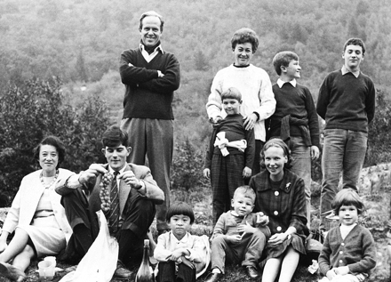
Lecture 4 – Characters: Molecular
First used by Luca Cavalli-Sforza
and Anthony Edwards
(in 1963)

Slide 2
Lecture 4 – Characters: Molecular
Pairwise distance matrix:
(n²-n)/2
cwk1056 eaa292 cwk1025 eaa448 dsr5032 eaa028 fac1117 cwk1007
cwk1056 ----------
eaa292 0.05840708 ----------
cwk1025 0.01769911 0.05398230 ----------
eaa448 0.08672567 0.08141593 0.08230089 ----------
dsr5032 0.02566372 0.05929204 0.01946903 0.08495575 ----------
eaa028 0.06725664 0.07433628 0.06371681 0.07522124 0.07168142 ----------
fac1117 0.02123894 0.05575221 0.00530973 0.08053097 0.02123894 0.0637168 ----------
cwk1007 0.05221239 0.02920354 0.05132743 0.08230089 0.05486726 0.07610620 0.05132743 ----------
eaa667 0.05840708 0.01238938 0.05221239 0.07787611 0.05752213 0.07433628 0.05398230 0.02743363
Here, n = 9, so there are 36 pairwise distances.
The units for these distances vary, but the matrix can then be subjected to a number
of potential phylogenetic analyses.
Information regarding comparative genomics may be presented as inherently
distance data.

Slide 3
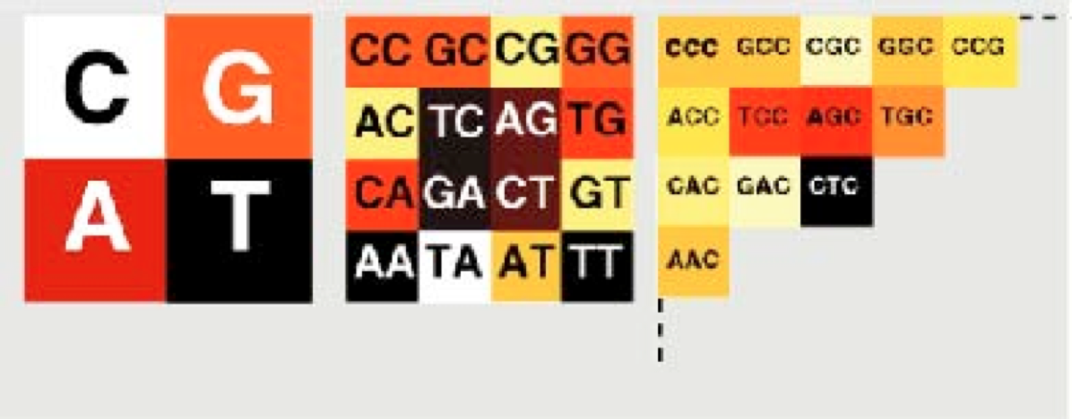
An example of a simple genomic distance.
(Edwards et al. 2002. Syst. Biol. 51:599 )
Large amounts of sequence data that is assumed to be a random sample from each
respective genome.
Begin by calculating the frequency of each of the 4^{n} bp words in each taxon, where
n is the length of the word.
n = 1, there are 4 words: G, A, T, C (data are the base frequencies).
n = 2, there are 16 possible dinucleotide words – 16 frequencies.

Slide 4
Edwards et al. (2002) use 5 bp words, so there are 4⁵ = 1024 possible words, and the frequency of each word is calculated from the genome sample for each OTU.
So, for each taxon, we have a vector of penta-nucleotide frequencies.
The Euclidian distance between each pair of genomes is calculated to
generate a distance matrix.
where f_{xi} is the frequency of word x in taxon i and f_{xj} is the frequency of word x in taxon j.

Slide 5
This matrix is then subjected to any of a number of tree-estimation methods.
Deep split in bird phylogeny (Paleognathous birds) is reflected in the genomic signature.

Slide 6
Potential Molecular Characters
1. Allozymes – Allelic forms of proteins (usually enzymes) that vary by a
charge changing amino-acid. Distance-based or character-based
analyses were conducted.
2. Chromosomal Inversions have a long history due to Diptera having
polytene chromosomes.
Can puzzle out order of inversions, and use events as characters.

Slide 7
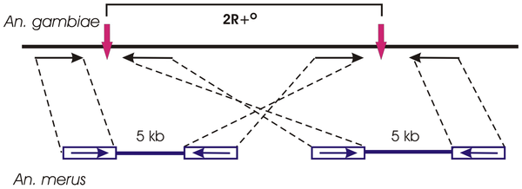
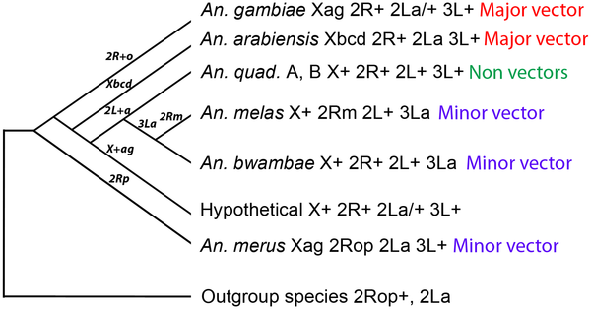
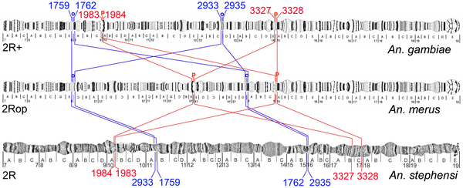
2. Chromosomal Inversions
(Kamail et al. 2012. PLoS Pathogens)

Slide 8
3. Sequence Data
a. Gene sequences – 4 possible character states.
b. Protein sequences - 20 possible character states.
Again, we’ll spend the rest of the semester with these data types.

Slide 9
4. Higher order molecular characters
(Rare Genomic Changes)
Rokas and Holland (2000. TREE, 15:454).

Slide 10
a. Insertions/Deletions in/of introns.
These are often applied to already existing phylogenetic hypotheses.
Murphy et al. (2007. Genome Res., 17: 413)

Slide 11
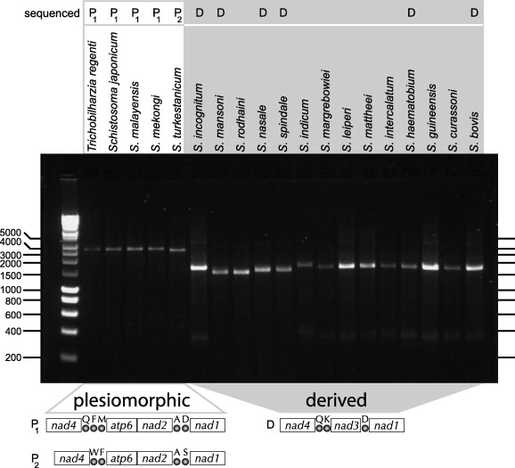
b. Gene-order data
Webster & Littlewood. 2012. Int. J. Parasit. 42:313-321.

Slide 12
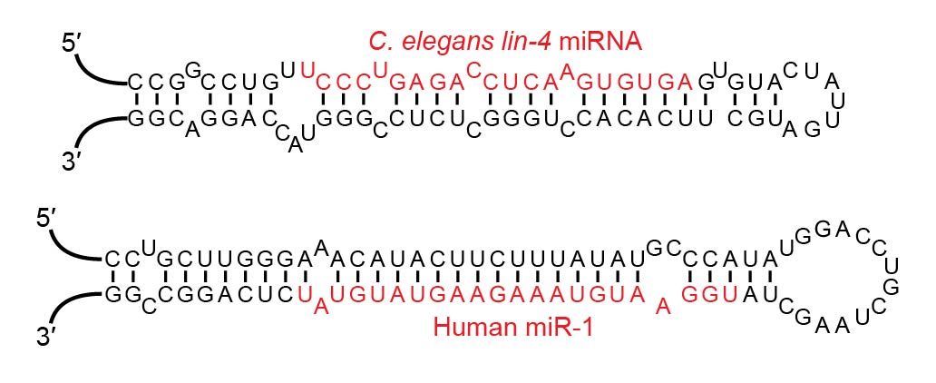
c. microRNA (miRNA) Profile
Tarver et al. (2013. Mol. Biol. Evol. 30:2369)

Slide 13
c. microRNA (miRNA) Profile
Losses are more frequent than reported, there is large heterogeneity in rates of gains and losses, there’s ascertainment bias, and model-based analyses that account for this can refute simple analyses.

Slide 14
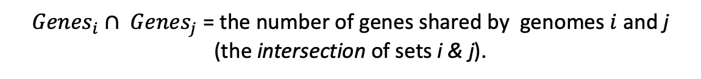
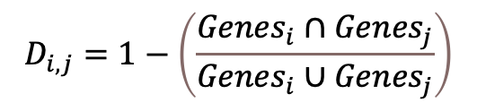
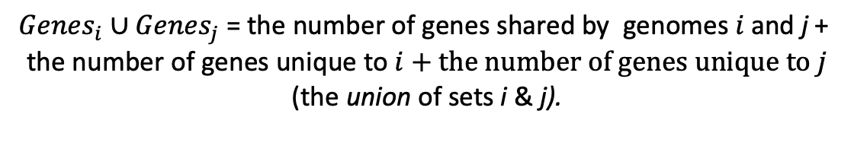
d. Genomic Distances from Gene Content
Increasingly, gene content data have been applied to the growing database
of prokaryotic genomes.
Some distances are simple comparisons of the number of shared genes:
$$D_{i,j}=1−\left(\frac{{Genes}_{i}∩{Genes}_{j}}{{Genes}_{i}∪{Genes}_{j}}\right)$$
${Genes}_{i}∩ {Genes}_{j}$ = the number of genes shared by genomes $i$ and j
(the intersection of sets i & j).
$${Genes}_{i}∪{Genes}_{j} \text{= }\text{the} \text{number} \text{of} \text{genes} \text{shared} \text{by} \text{genomes} i \text{and} \text{j}\text{ + }\text{the} \text{number} \text{of} \text{genes} \text{unique} \text{to} i+the number of genes unique to j$$
(the union of sets i & j).
Other distances try to measure the number of transformations (gene loss, duplications, gene gain via HGT, etc.) required for two genomes to be identical in terms of content.

Slide 15
Gene Homology
Remember that homology is sharing of the same feature due to inheritance from a common ancestor.
For gene families, we specify homology that traces to speciation event to be orthologous, and
homology that traces to a gene duplication to be paralogous.
A
B
C
A_{α}
A_{β}
B_{α}
B_{β}
C_{β}
C_{α}
Speciation
Speciation
α
β
Duplication
A_{α} & B_{α} are orthologues.
A_{α} & A_{β} are paralogues.
((A_{α,} B_{α}), C_{α}))
((A_{α,} C_{α}), B_{β}))

Slide 16
Gene Homology
Orthology assessment can be pretty easy.
A_{α}
A_{β}
B_{α}
B_{β}
C_{β}
C_{α}
Speciation 2
Speciation 1
= t_{D,S1}
α
β
Duplication
t_{D,S1} is long

Slide 17
Gene Homology
Orthology assessment can be really hard.
A_{α}
A_{β}
B_{α}
B_{β}
C_{α}
C_{β}
Speciation 2
α
β
Speciation 1
Duplication
= t_{D,S1}
t_{D,S1} is short

