Slide 1
Discovery of Mammalian Diversity
Burgin et al., 2018

Slide 2
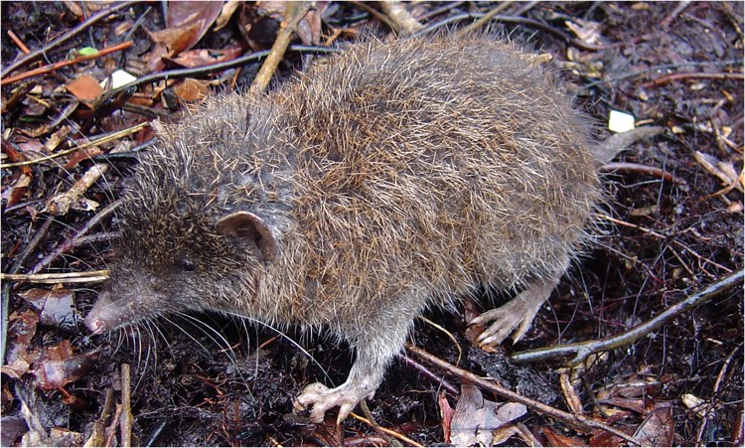
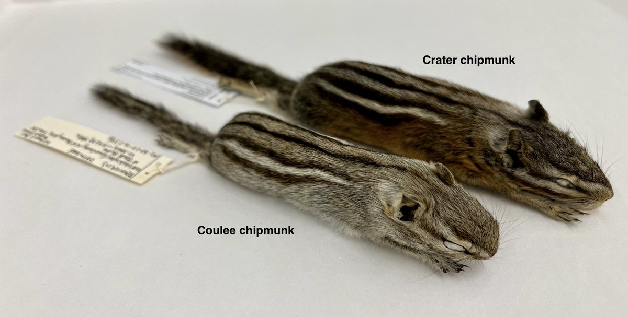
New discoveries within the the past year.
Balete et al. (2023) described a new
species of gymnure (Podogymnura
intermedia) found in the Philippines.
Last summer, Herrera et al. (2022) described two
new species of chipmunks: Tamias cratericus
(in central Idaho) and T. grisescens
(in central Washington).

Slide 3
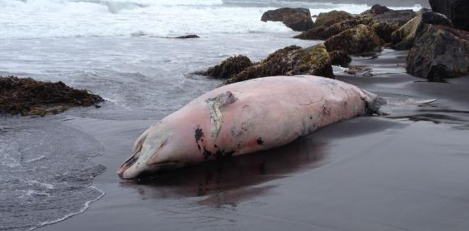
New discoveries within the the past few years.
A new species of beaked whale in the genus Berardius (Morin et al. 2016).

Slide 4
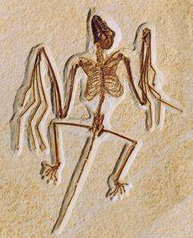


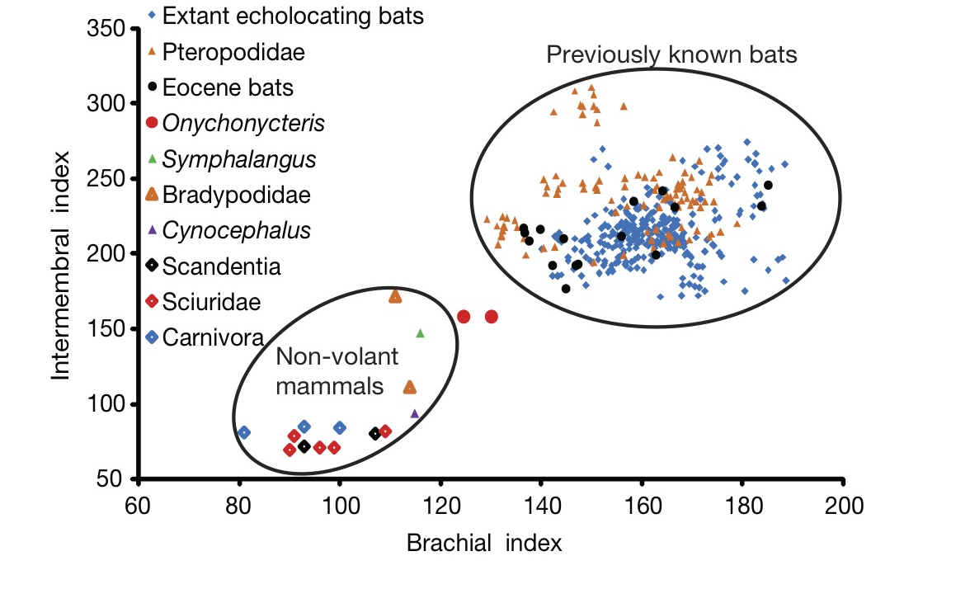
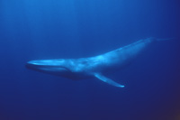
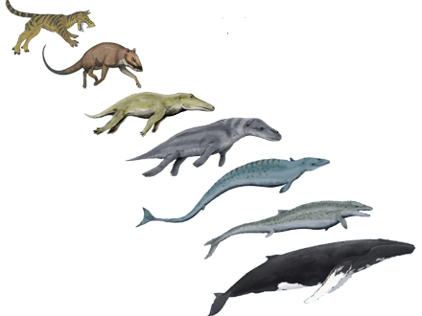
Craseonycteris thonglongyai
bumble-bee bat
< 2 grams
Simmons et al. 2008.
Nature, 451:818.
Balaenoptera musculus
blue whale
200 Million grams
Thewissen et al.1994. Science, 263:210.

Slide 5
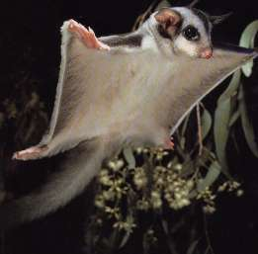
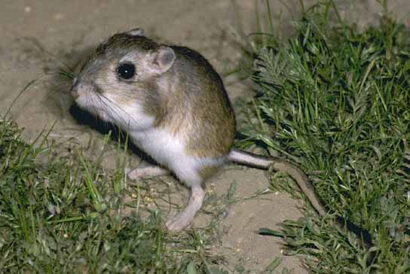
Gliding species (e.g., Petaurus breviceps)
Saltatorial species (e.g., Dipodomys ordi)

Slide 6
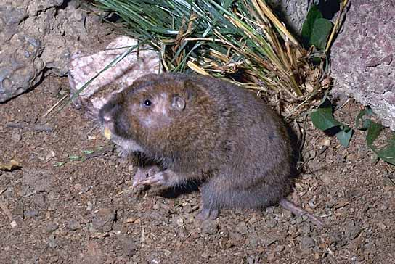
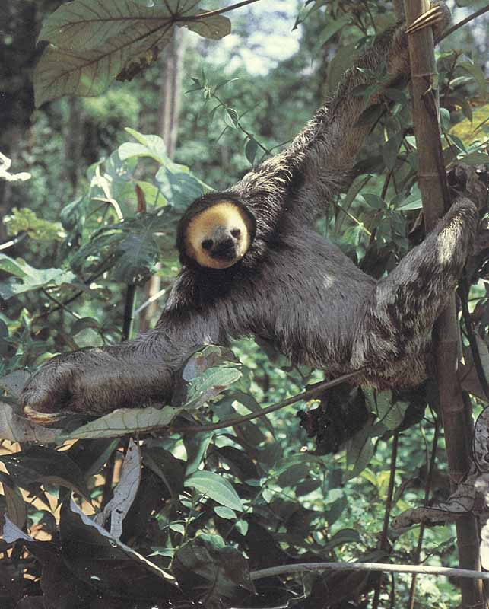
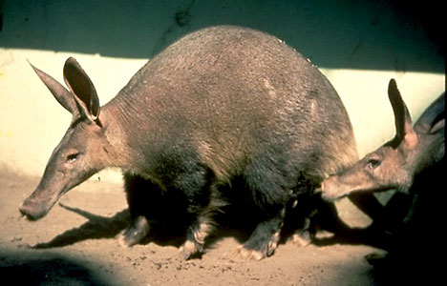
Fossorial forms (e.g., Thomomys bottae)
Arboreal forms (e.g., Bradypus tridactylus)
Myrmecophagous forms (e.g., Orycteropus afer)

Slide 7
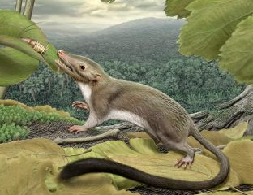
What is a Mammal?
Short Definition: A hairy, milk-producing, endotherm, that (usually) gives birth to live young.
As is often the case in biology, a short definition is inadequate,
especially for extinct taxa like Morganucodon.

Slide 8
Eleven Soft Anatomy Characters
1) *Lactation
2) Vivipary
3) *Hair
4) *Sweat/*Sebaceous Glands
5) Endothermy
6) 4-Chambered heart
7) *Annucleate RBCs
8) *Renal Artery
9) *Muscular Diaphragm
10) *Facial muscles
11) *Dorsal Pallium expands cerebrum

Slide 9
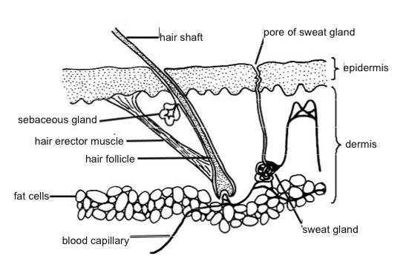
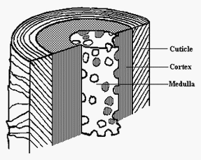
3. *Hair; 4.*Sebaceous & *Sweat glands

Slide 10
Eleven Soft Anatomy Characters
1) *Lactation
2) Vivipary
3) *Hair
4) *Sweat/*Sebaceous Glands
5) Endothermy
6) 4-Chambered heart
7) *Annucleate RBCs
8) *Renal Artery
9) *Muscular Diaphragm
10) *Facial muscles
11) *Dorsal Pallium expands cerebrum

Slide 11
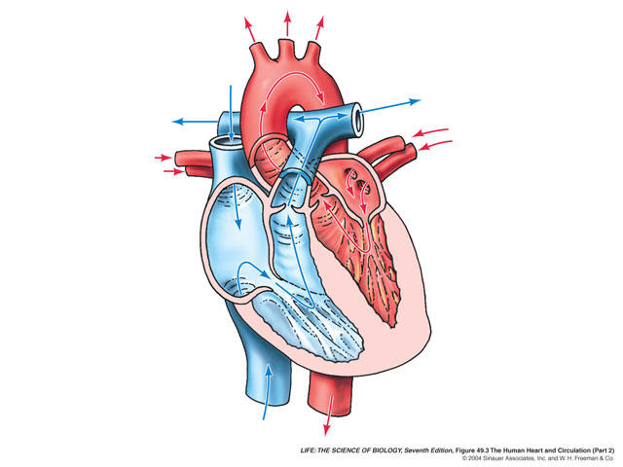
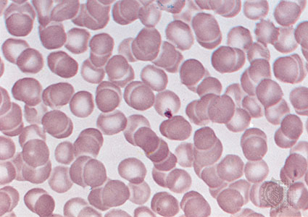
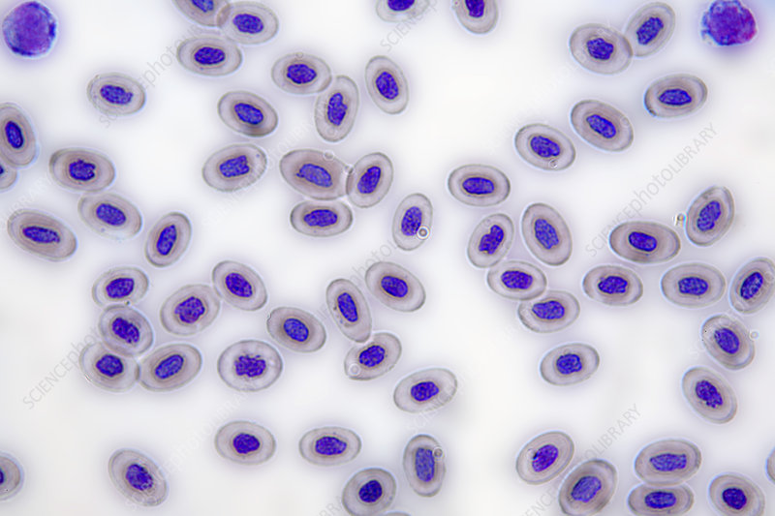
6. Four-chambered Heart
7. *Annucleate erythrocytes
Nucleated erythrocytes

Slide 12
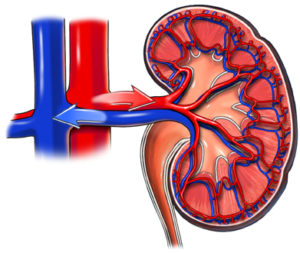
8. *Renal Artery and Vein
Many other vertebrates have a renal portal system.

Slide 13
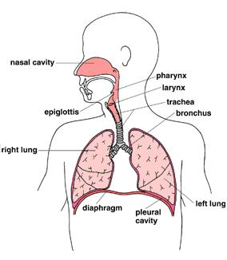
9. *Muscularized Diaphragm

Slide 14
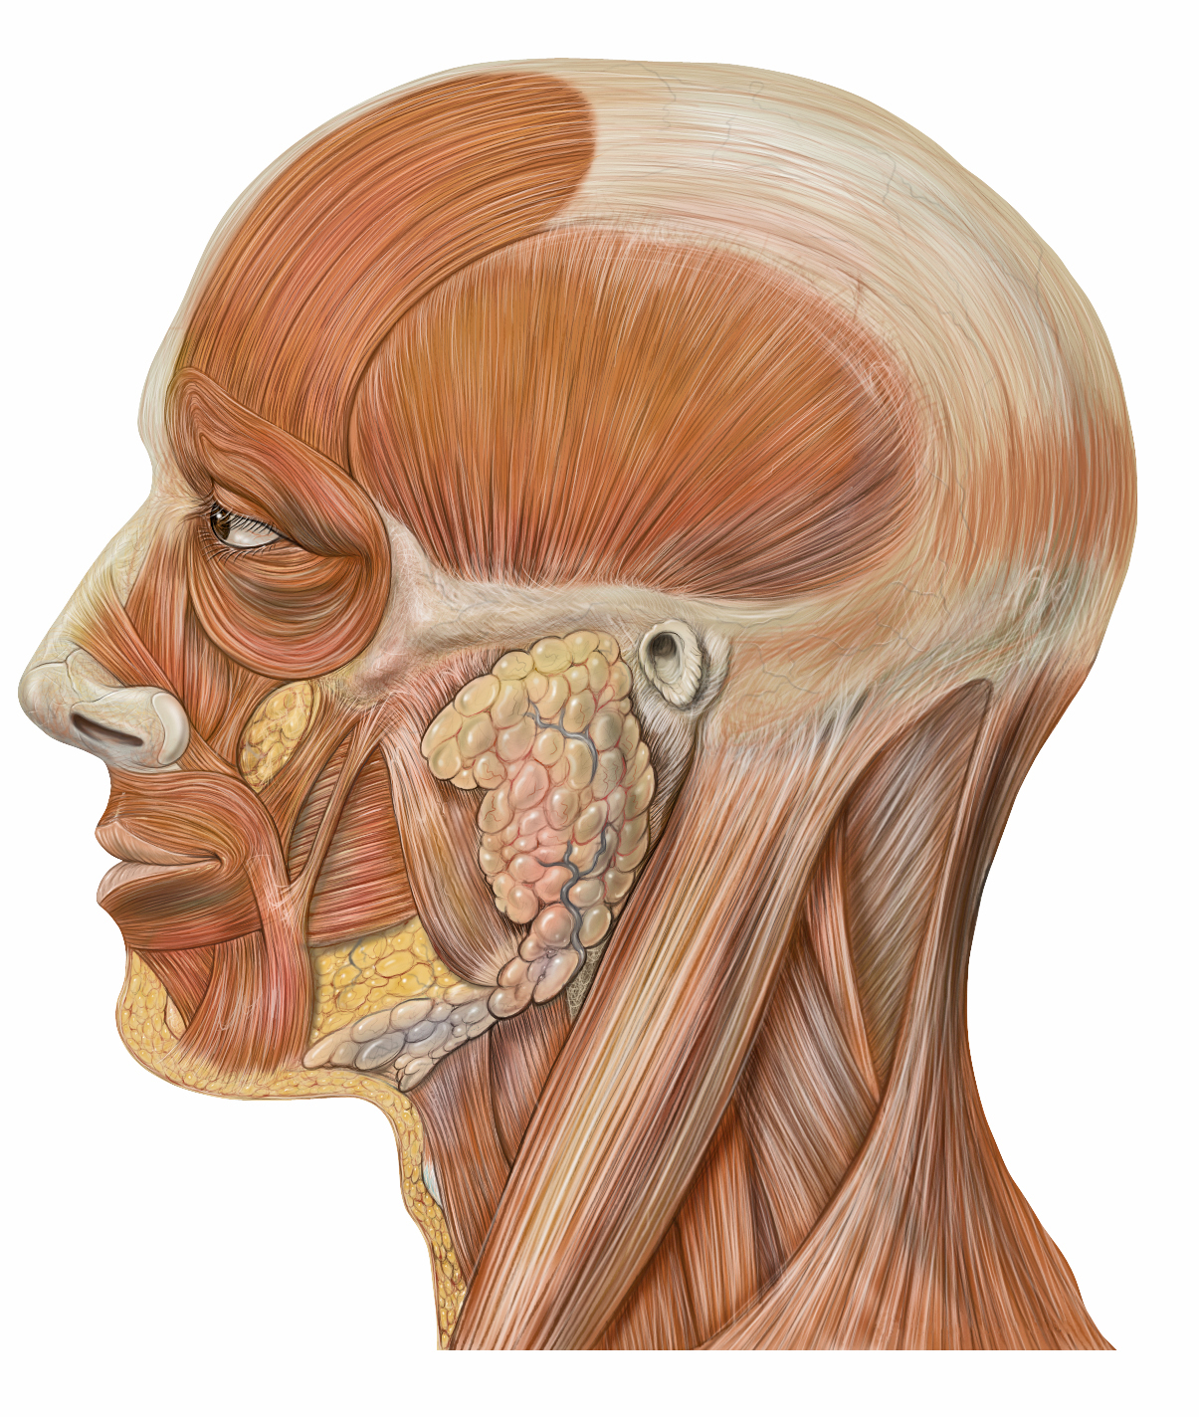
10. *Facial Muscles

Slide 15
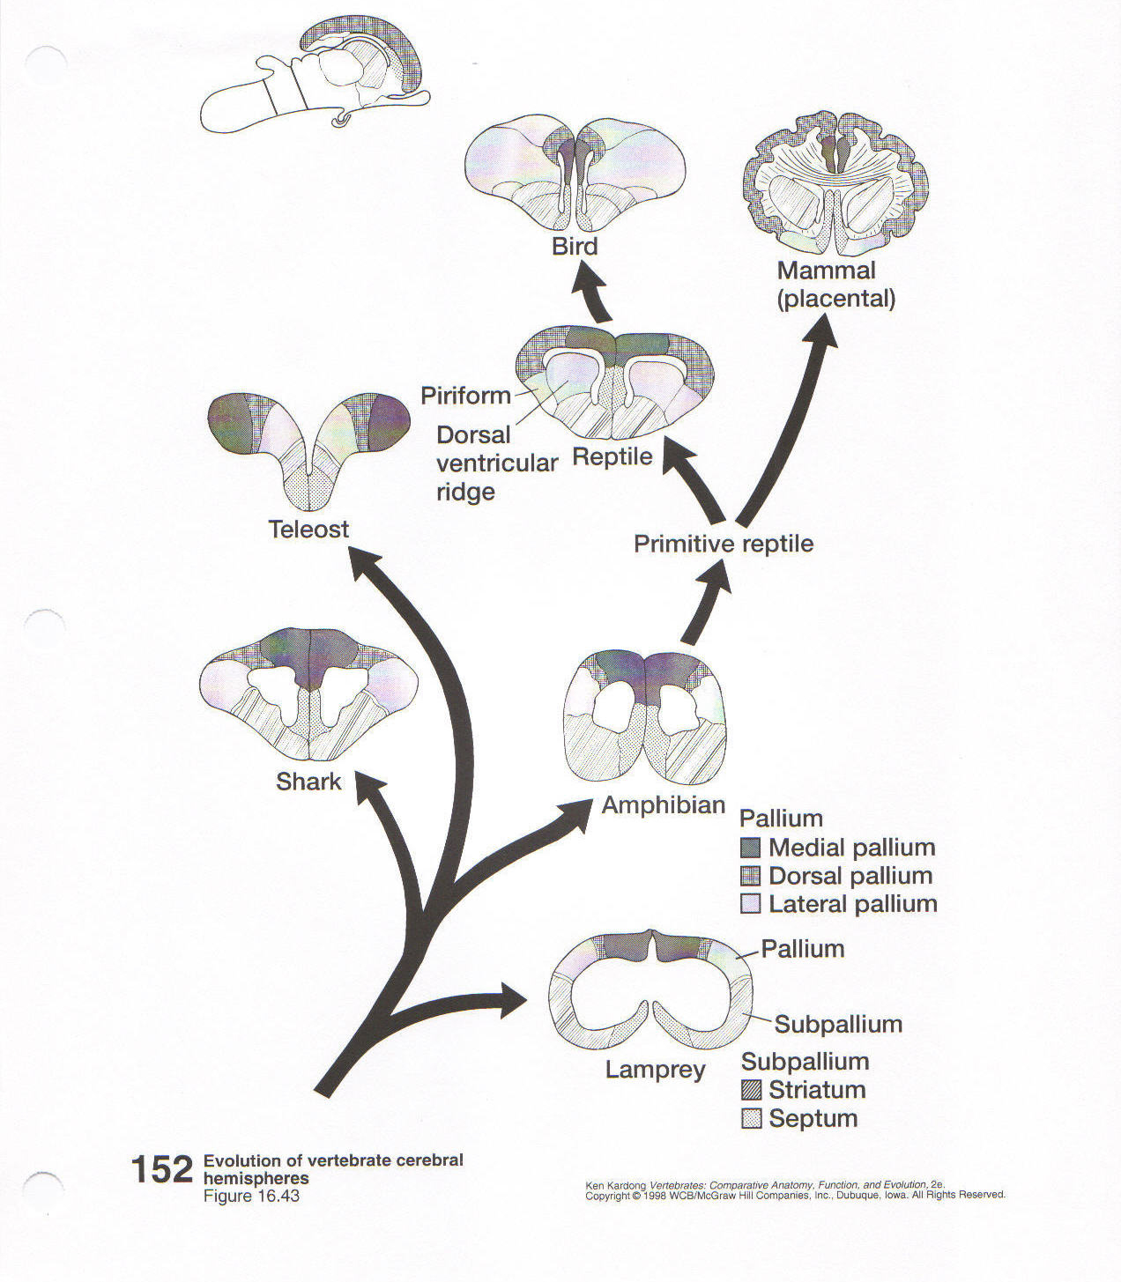
11. *Dorsal Pallium

Slide 16
8 Cranial Characters
Double occipital condyle
*Atlas/Axis complex
*Tympanic bone
*Three ear ossicles
*Dentary is only bone in mandible
Single external naris
Secondary palate
Respiratory turbinates

Slide 17
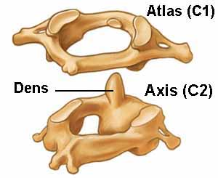
2. *Atlas/Axis Complex

Slide 18
8 Cranial Characters
Double occipital condyle
*Atlas/Axis complex
*Tympanic bone
*Three ear ossicles
*Dentary is only bone in mandible
Single external naris
Secondary palate
Respiratory turbinates

Slide 19
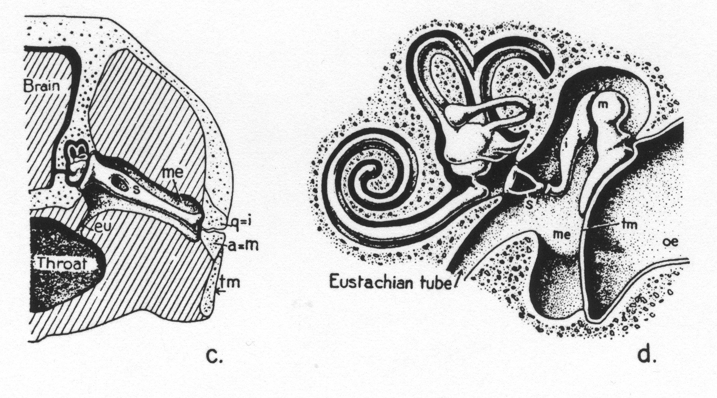
4. *3 Ear Ossicles
Ancestral
Mammalian

Slide 20
8 Cranial Characters
Double occipital condyle
*Atlas/Axis complex
*Tympanic bone
*Three ear ossicles
*Dentary is only bone in mandible
Single external naris
Secondary palate
Respiratory turbinates

Slide 21
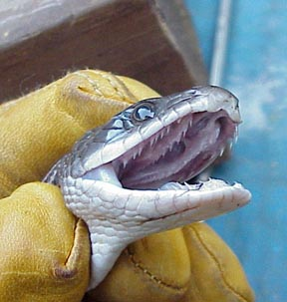
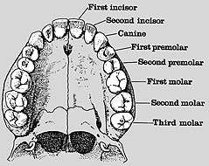
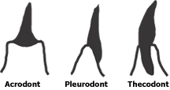
5 Dental Characters
Lack palatal teeth
*Diphyodont
Thecodont
Heterodont
Multicuspate

Slide 22
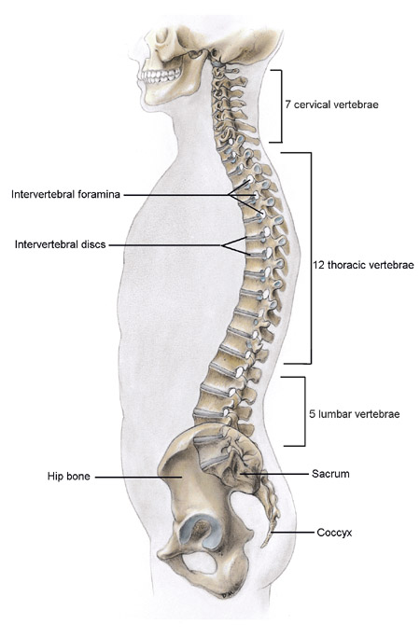
2 Axial Skeleton Characters
1. *Extreme regionalization
7 (9)
12 or 13
2. *Ribs only on
thoracic vertebrae
Variable

Slide 23
4 Appendicular Skeleton Characters
*Limb bones have epiphyses.
*Calcaneum.
*Reduction of elements in limb girdles.
Parasagittal limb posture.

Slide 24
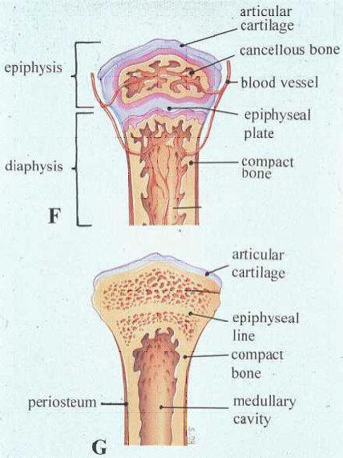
1. *Limb bones have epiphyses

Slide 25
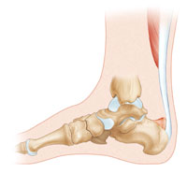
2. *Calcaneum (Heel bone)
Calcaneum

Slide 26
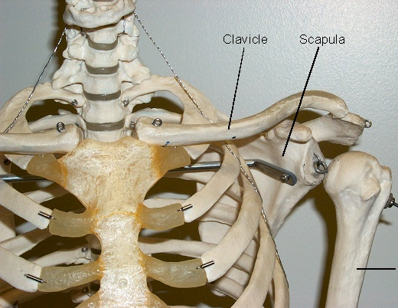
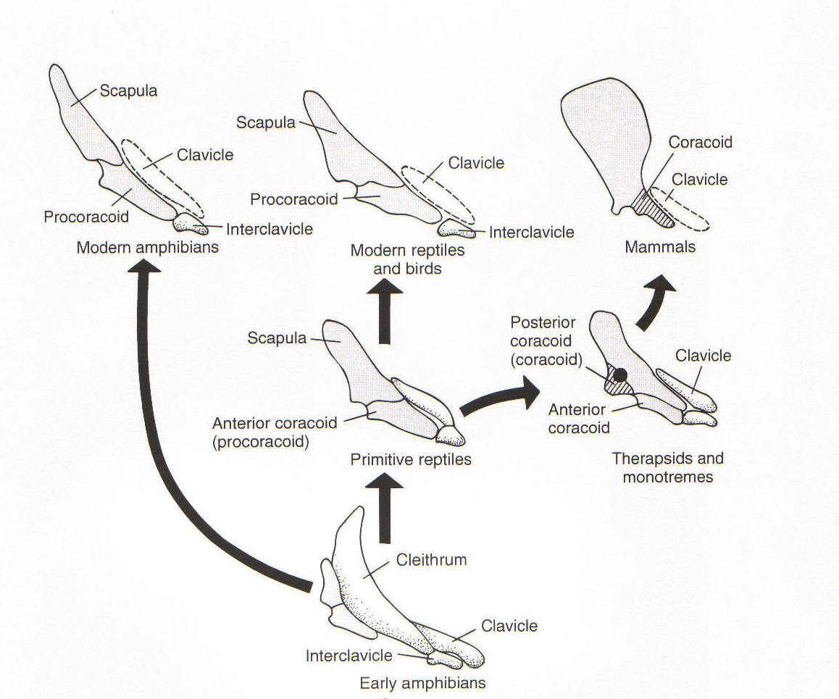
3a. *Pectoral Girdle
No anterior/posterior coracoids,
No interclavicle
Ancestrally, there was an
interclavicle, and both
anterior and posterior
coracoids.

Slide 27
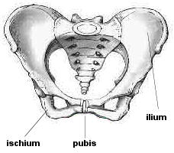
3b. Pelvic Girdle
Ilium, Ischium and Pubis fused
to form the Innominate bone.

Slide 28
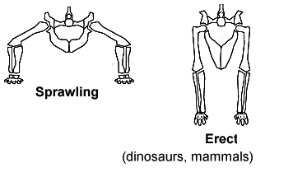
4. Limbs Rotate under Body
(Parasagittal posture)

