Slide 1
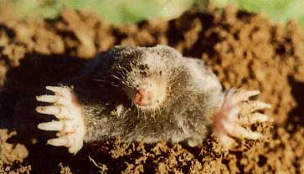
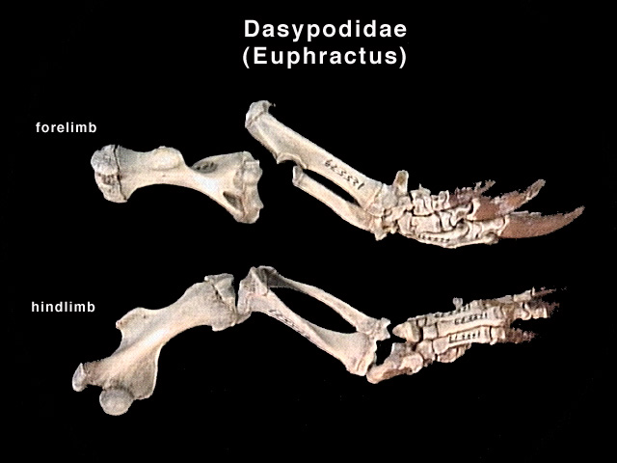
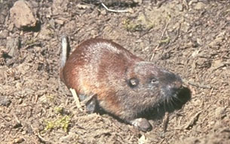
Optimization of F_{O}
Fossorial forms
Myrmecophagous forms
Talpidae Scapanus orarius: Pacific Mole
Geomyidae Thomomys talpoides: Northern Pocket Gopher

Slide 2
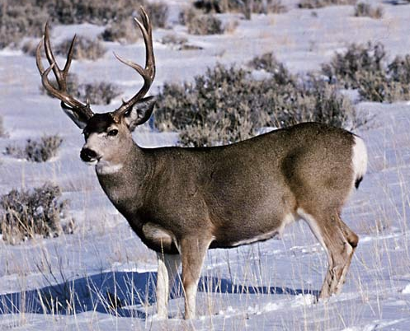
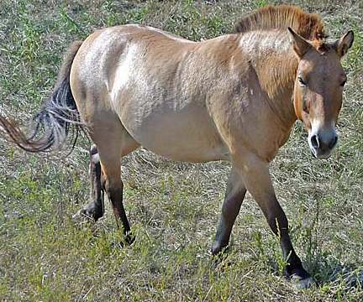
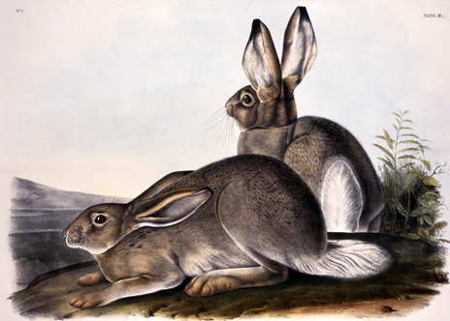
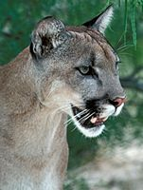
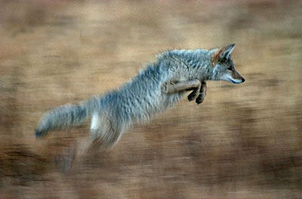
Optimization of V_{O}
Bovids
(e.g., Ovis canadensis)
Equids (e.g., Equus caballus)
Cervids
(e.g., Odocoileus)
Leporids
(e.g., Lepus townsendii)
Felids (e.g., Puma concolor) and Canids (e.g., Canis latrans)

