Slide 1
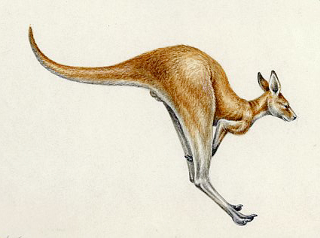
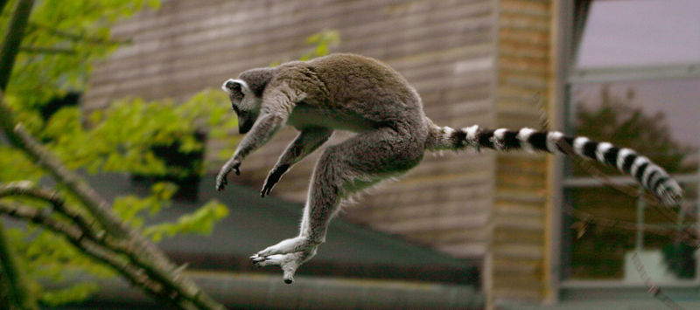
Examples of Saltatorial Mammals
Macropodidae
Lemuridae

Slide 2
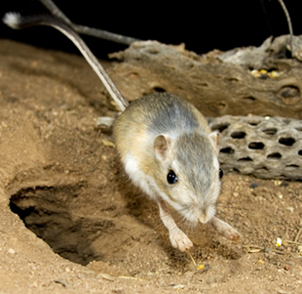
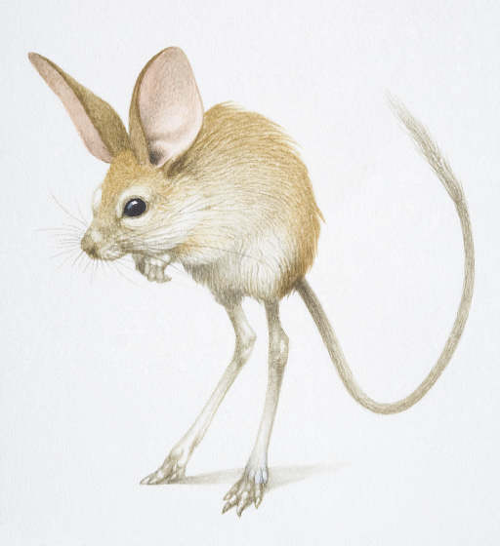
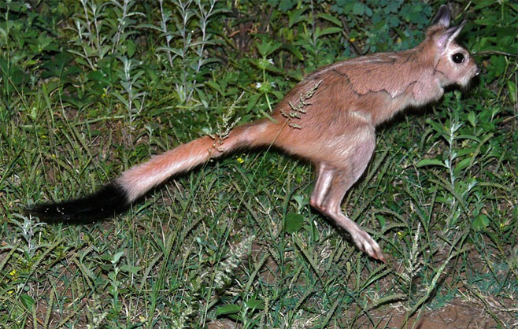
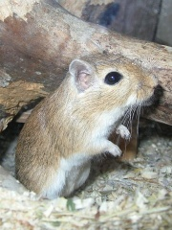
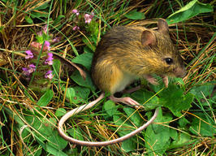
Saltatorial Rodents
Euchoreutes naso: long-eared jerboa
Pedetidae
Pedetes capensis: Cape springhare
Heteromyidae
Dipodomys ingens: giant kangaroo rat
Dipodidiae
Zapus princeps: western jumping mouse
Muridae: Gerbillinae

Slide 3
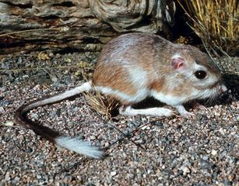
Saltatorial Adaptations
All these forms have very long hind limbs: selection has optimized
V_{o} & they have very long out levers on their hind limbs.
B. They have large hind limb musculature to compensate.
There often is a reduction in number of digits in the hind limb.
The front limb is almost always very generalized, and is used in feeding,
grooming, etc.
C. Other Adaptations
Stiffening of axial skeleton.
Elastic energy storage mechanisms.
Long counter-balancing tail.
D. Advantages:
rapid acceleration
extreme maneuverability.

Slide 4
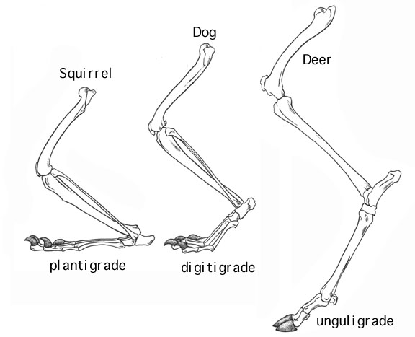
Cursorial Adaptations:
Increase Stride Length
1. Increase length of distal elements.
2. Change in foot posture.

Slide 5
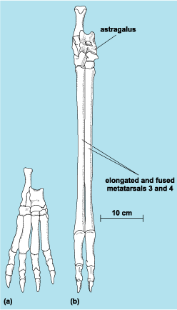
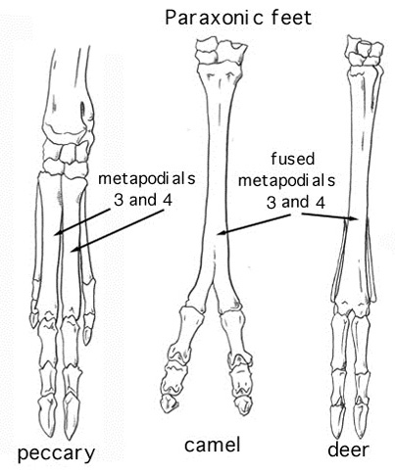
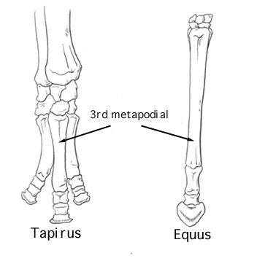
Cursorial Adaptations: Increase Stride Length
Fused metapodials – cannon bone
Cetartiodactyls
Perrisodactyls

Slide 6
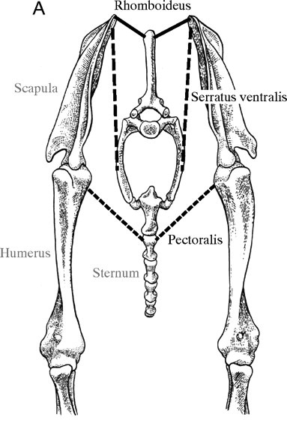
Cursorial Adaptations: Increase Stride Length
3. Loss/Reduction of clavicle – allows scapula to rotate during stride.
Suspension of front limb in muscular sling

Slide 7
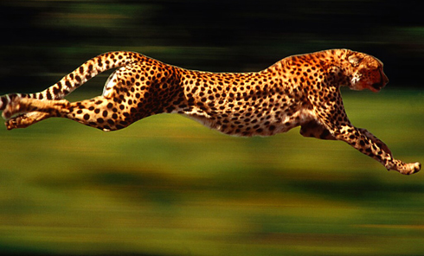
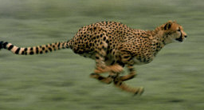
Cursorial Adaptations: Increase Stride Length
4. Increased dorso-ventral flexion of spine.
Incurs a huge energetic cost.

Slide 8
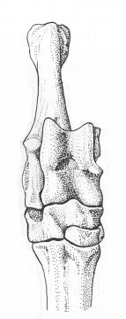
Cursorial Adaptations: Increase Stride Rate
Optimize V_{o}
1. Short in-levers and long out-levers.
2. Increase the number of joints: V_{o} Total = Sum of all V_{o} in limb
V_{o(Total)} = V_{o(Scapula)} + V_{o(Humerus)} + V_{o(Ulna)} + V_{o(Cannon Bone)} + V_{o(Hoof)}
3. Decrease inertia of limb distally
Loss of peripheral digits.
Confine movement to a single plane – astragalus.
Concentrate muscles to proximal portion of limb.

Slide 9
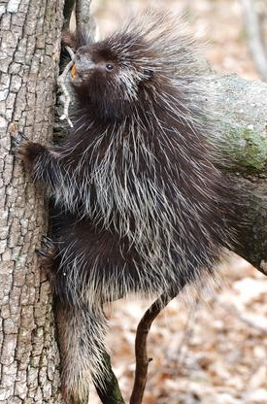
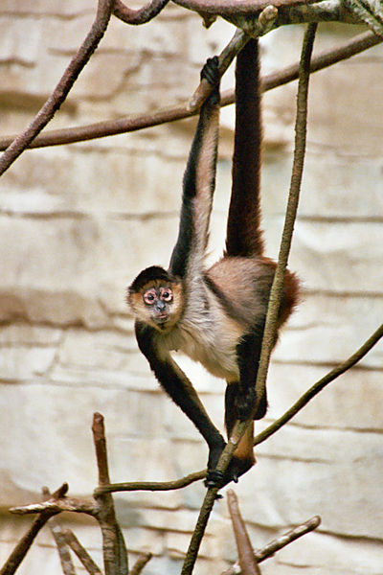
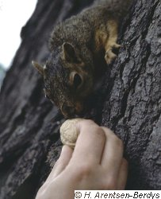
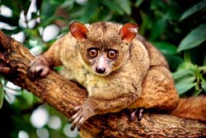
Friction Pads
Scansorial Mammals
Erethizon
Prehensile Organs
Claws
Sciurus
Sciurus carolinensis: American grey squirrel
Galago
Galago crassicaudatus: greater bushbaby
Ateles
Ateles geoffroyi: Geoffroys’s spider monkey

Slide 10
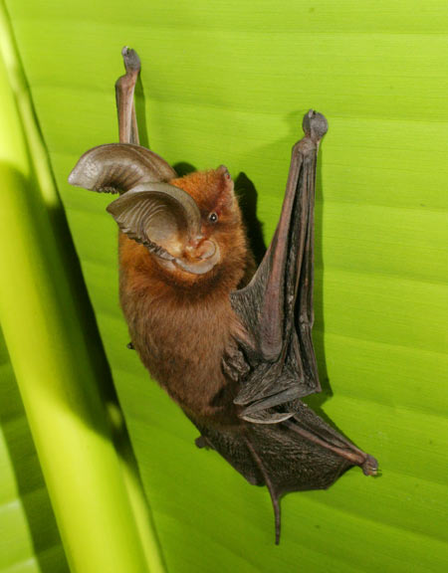
Myzopoda aurita (sucker-footed bat)

Slide 11
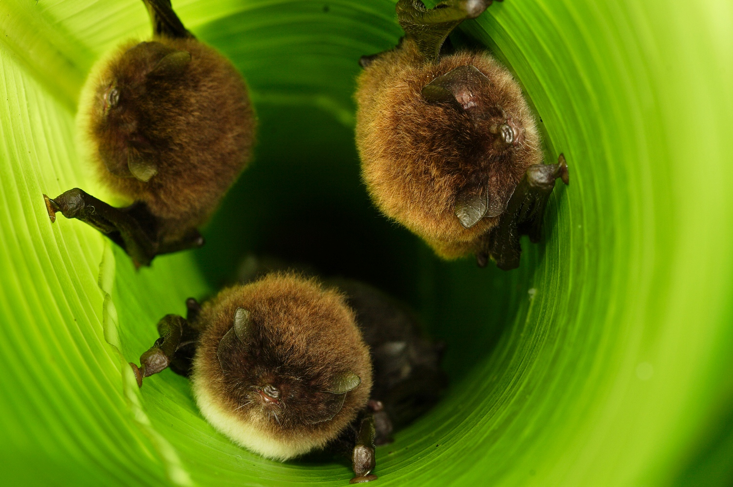

Slide 12
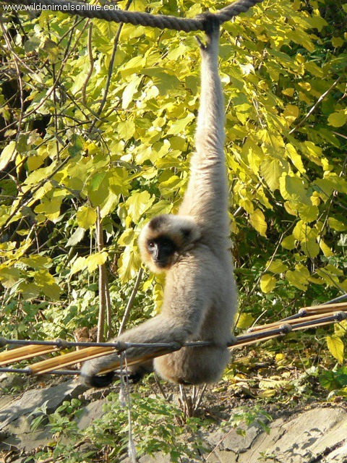
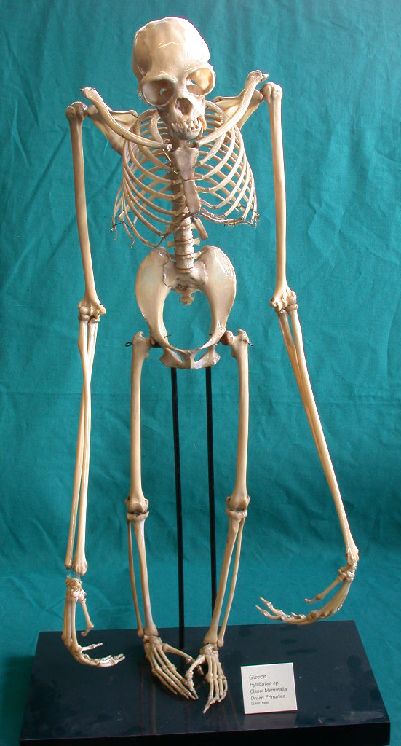
Scansorial - Brachiation
Hylobates

Slide 13
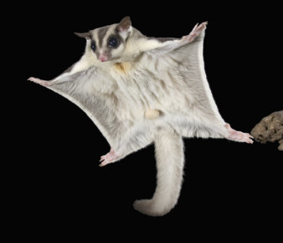
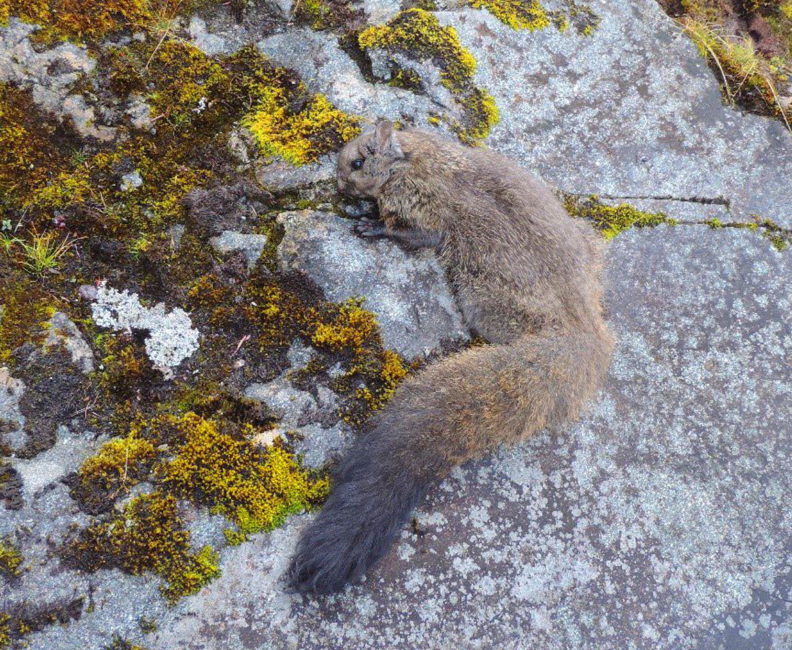
Gliding
Petaurus
Eupetaurus

Slide 14
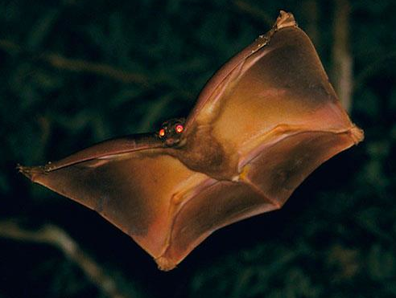
Cynocephalus

Slide 15
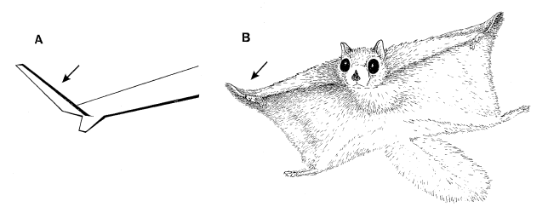
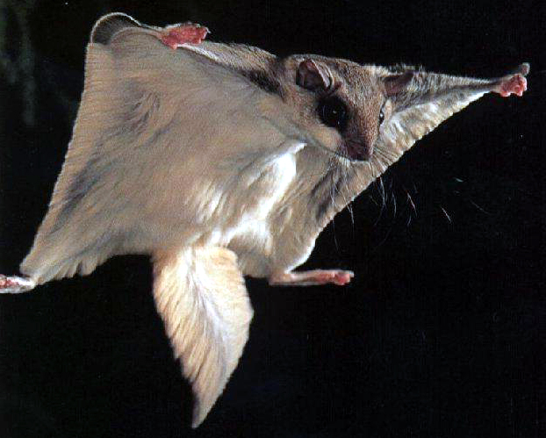
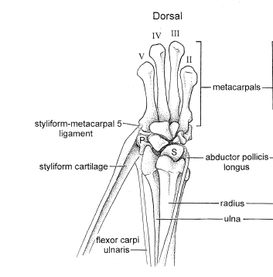
Gliding
Stylar cartilage
Thorington et al. Journal of Mammalogy, Vol. 79, No. 1 pp. 245-250.

Slide 16
Eupetaurus - wooly flying squirrels
Jackson et al. 2022. Biol. J. Linn. Soc. 194:502

Slide 17
Swimming
Pressure Drag – Displace water through which animal is swimming.
Proportional to the cross-sectional area of the animal.
For a given mass, a long, thin rod minimizes this.
Frictional Drag – Friction between parallel stream of water during laminar flow.
Proportional to the total surface area of the animal.
For a given mass, a sphere minimizes this.
A spindle shape optimizes this trade-off.

Slide 18
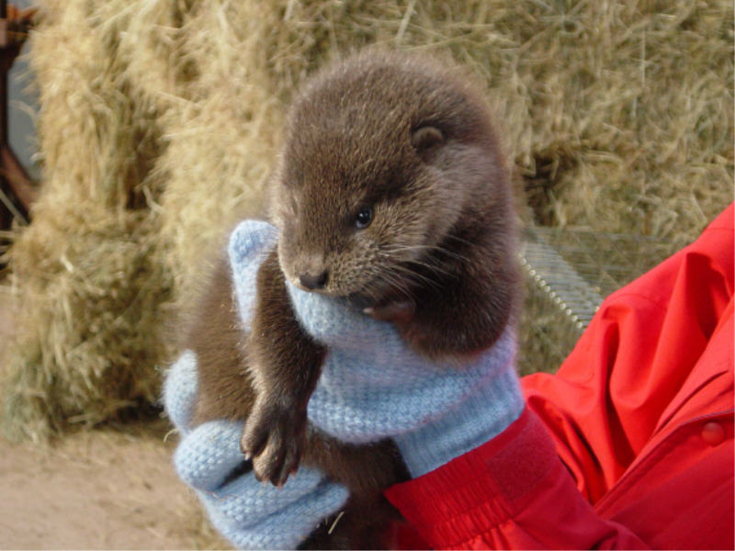
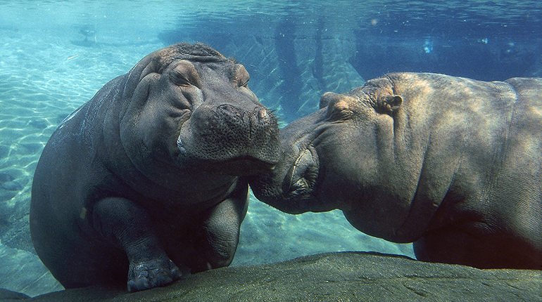
Swimming: Semi-aquatic
Hippopotamids
Lutrines (Mustelidae)
Lontra canadensis
Hippopotamus amphibius

Slide 19
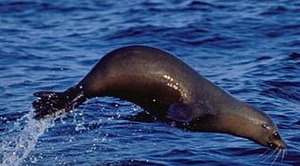
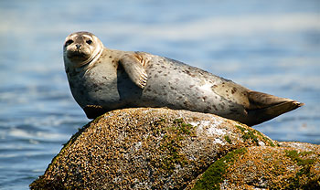
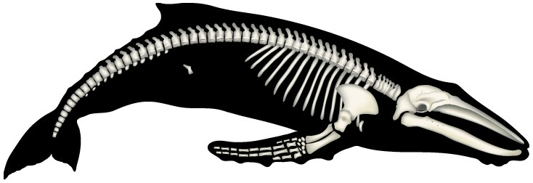
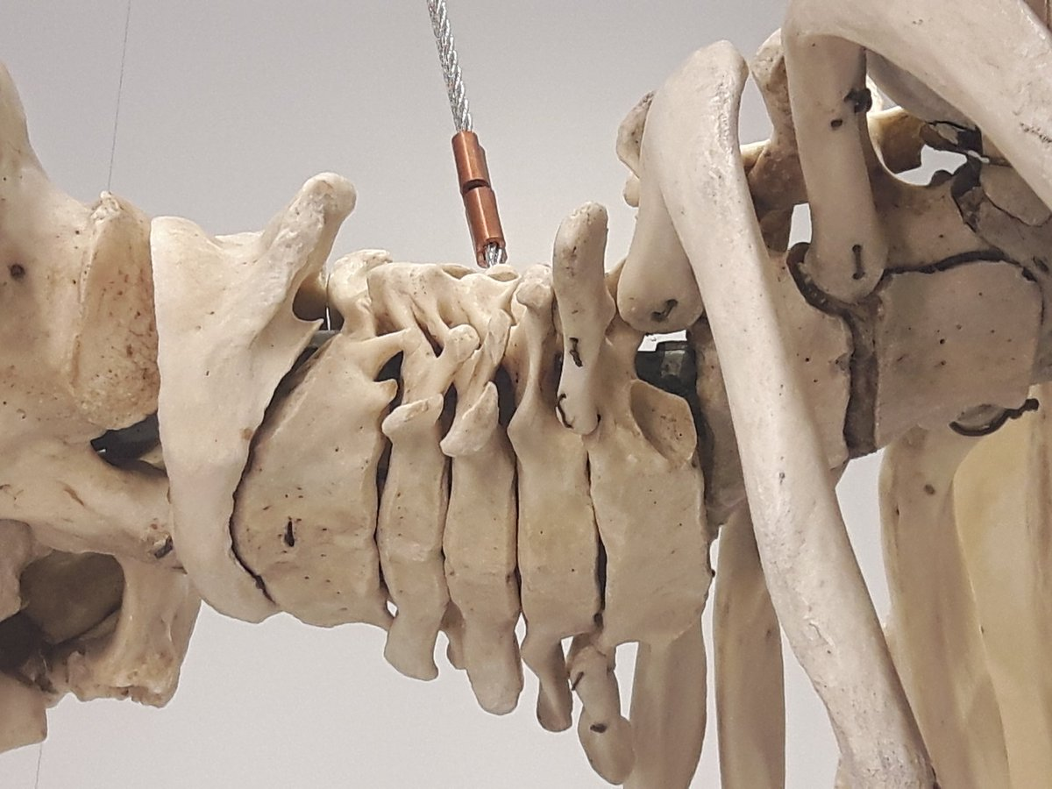
Swimming: Aquatic/Marine
Otariids
Phocids
Zalophus californicus
Phoca vitulina
Megaptera
Compressed
Cervical vertebrae
Trichechus

Slide 20
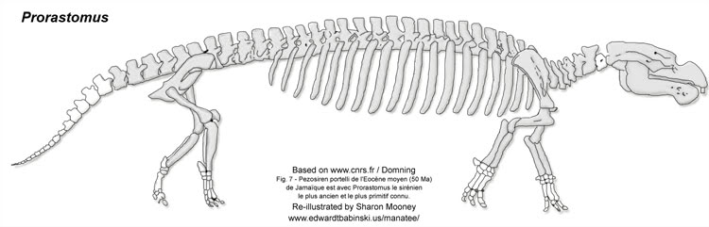
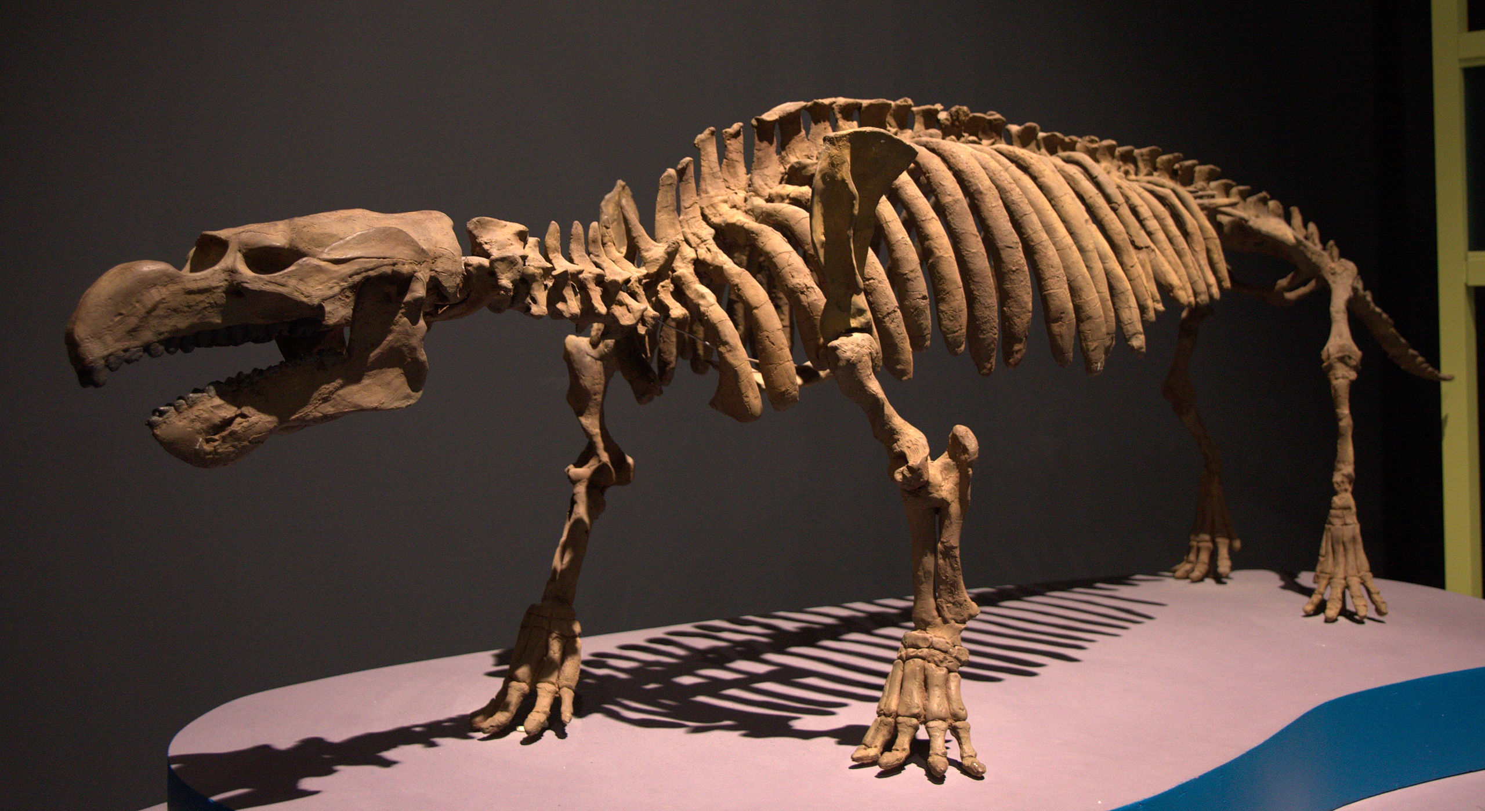
Transitional sirenian fossils
Prorastomus
Pezosiren
Domning (2001. Nature)

Slide 21
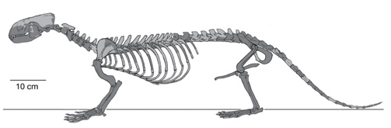
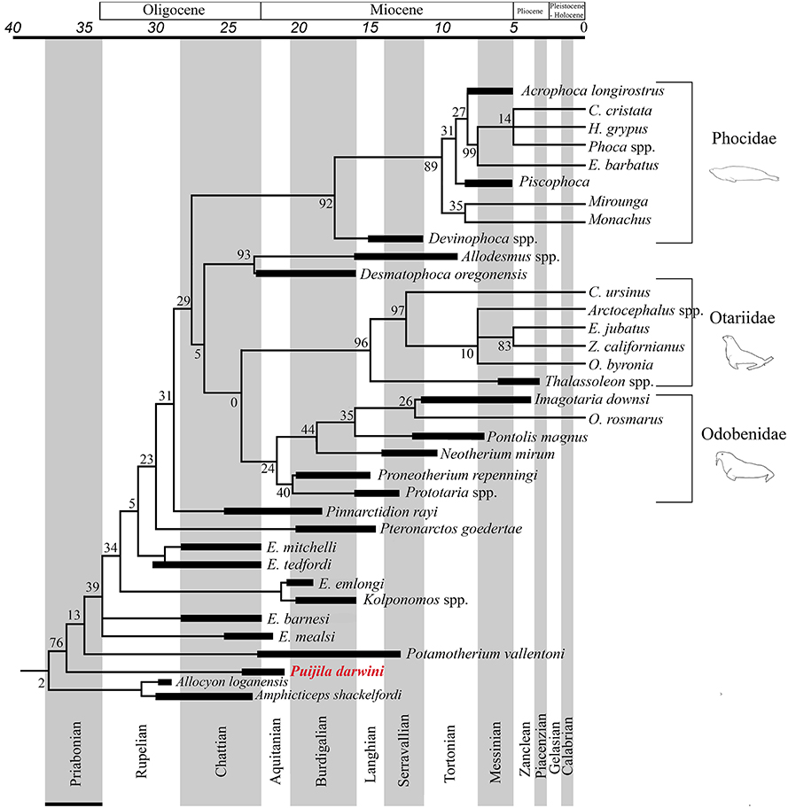
Transitional pinniped carnivoran fossils:
Puijila (Rybczynski et al. 2009. Nature)
Enaliarctos (Berta et al. 1989. Science)
Enaliarctos
Puijila
Patterson et al.
(2021. Front. Ecol. Evol., 17)

Slide 22
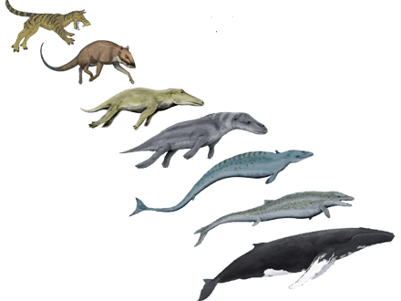
Transition in Whales

Slide 23
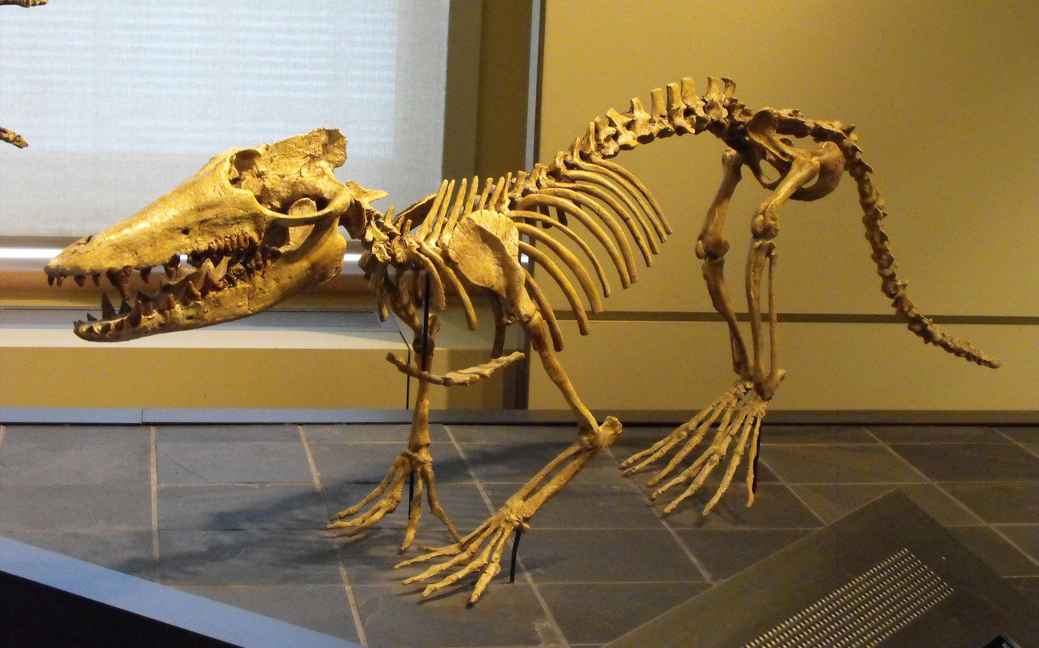
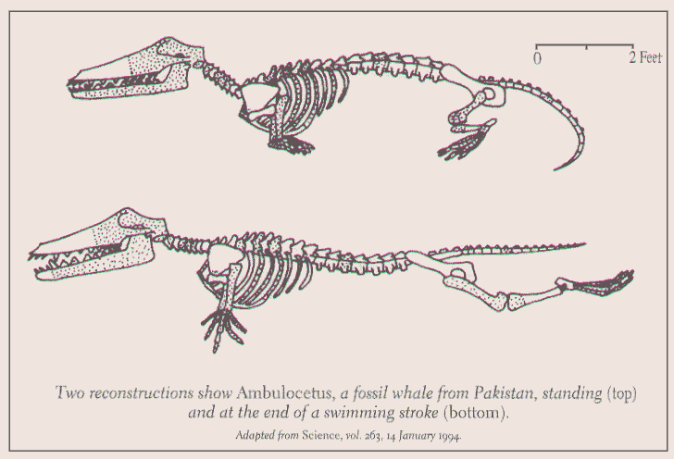
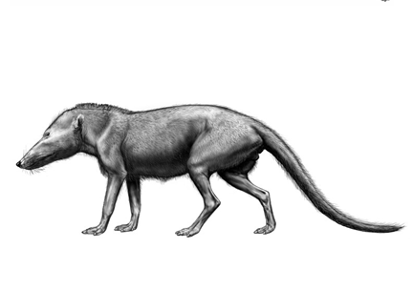
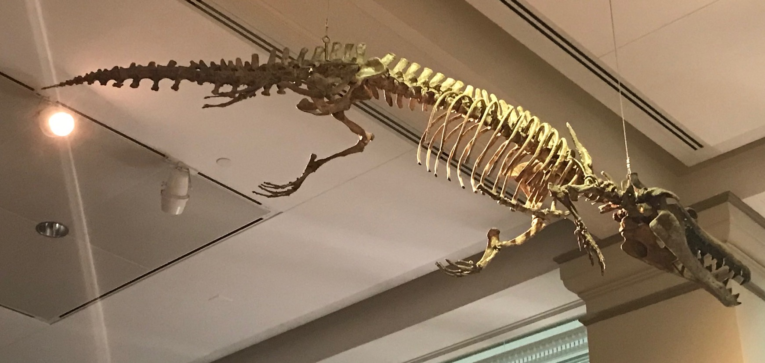
Some fossil cetaceans
Ambulocetus
Pakicetus

Slide 24
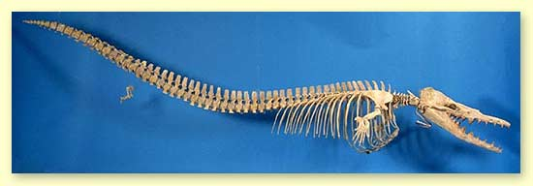
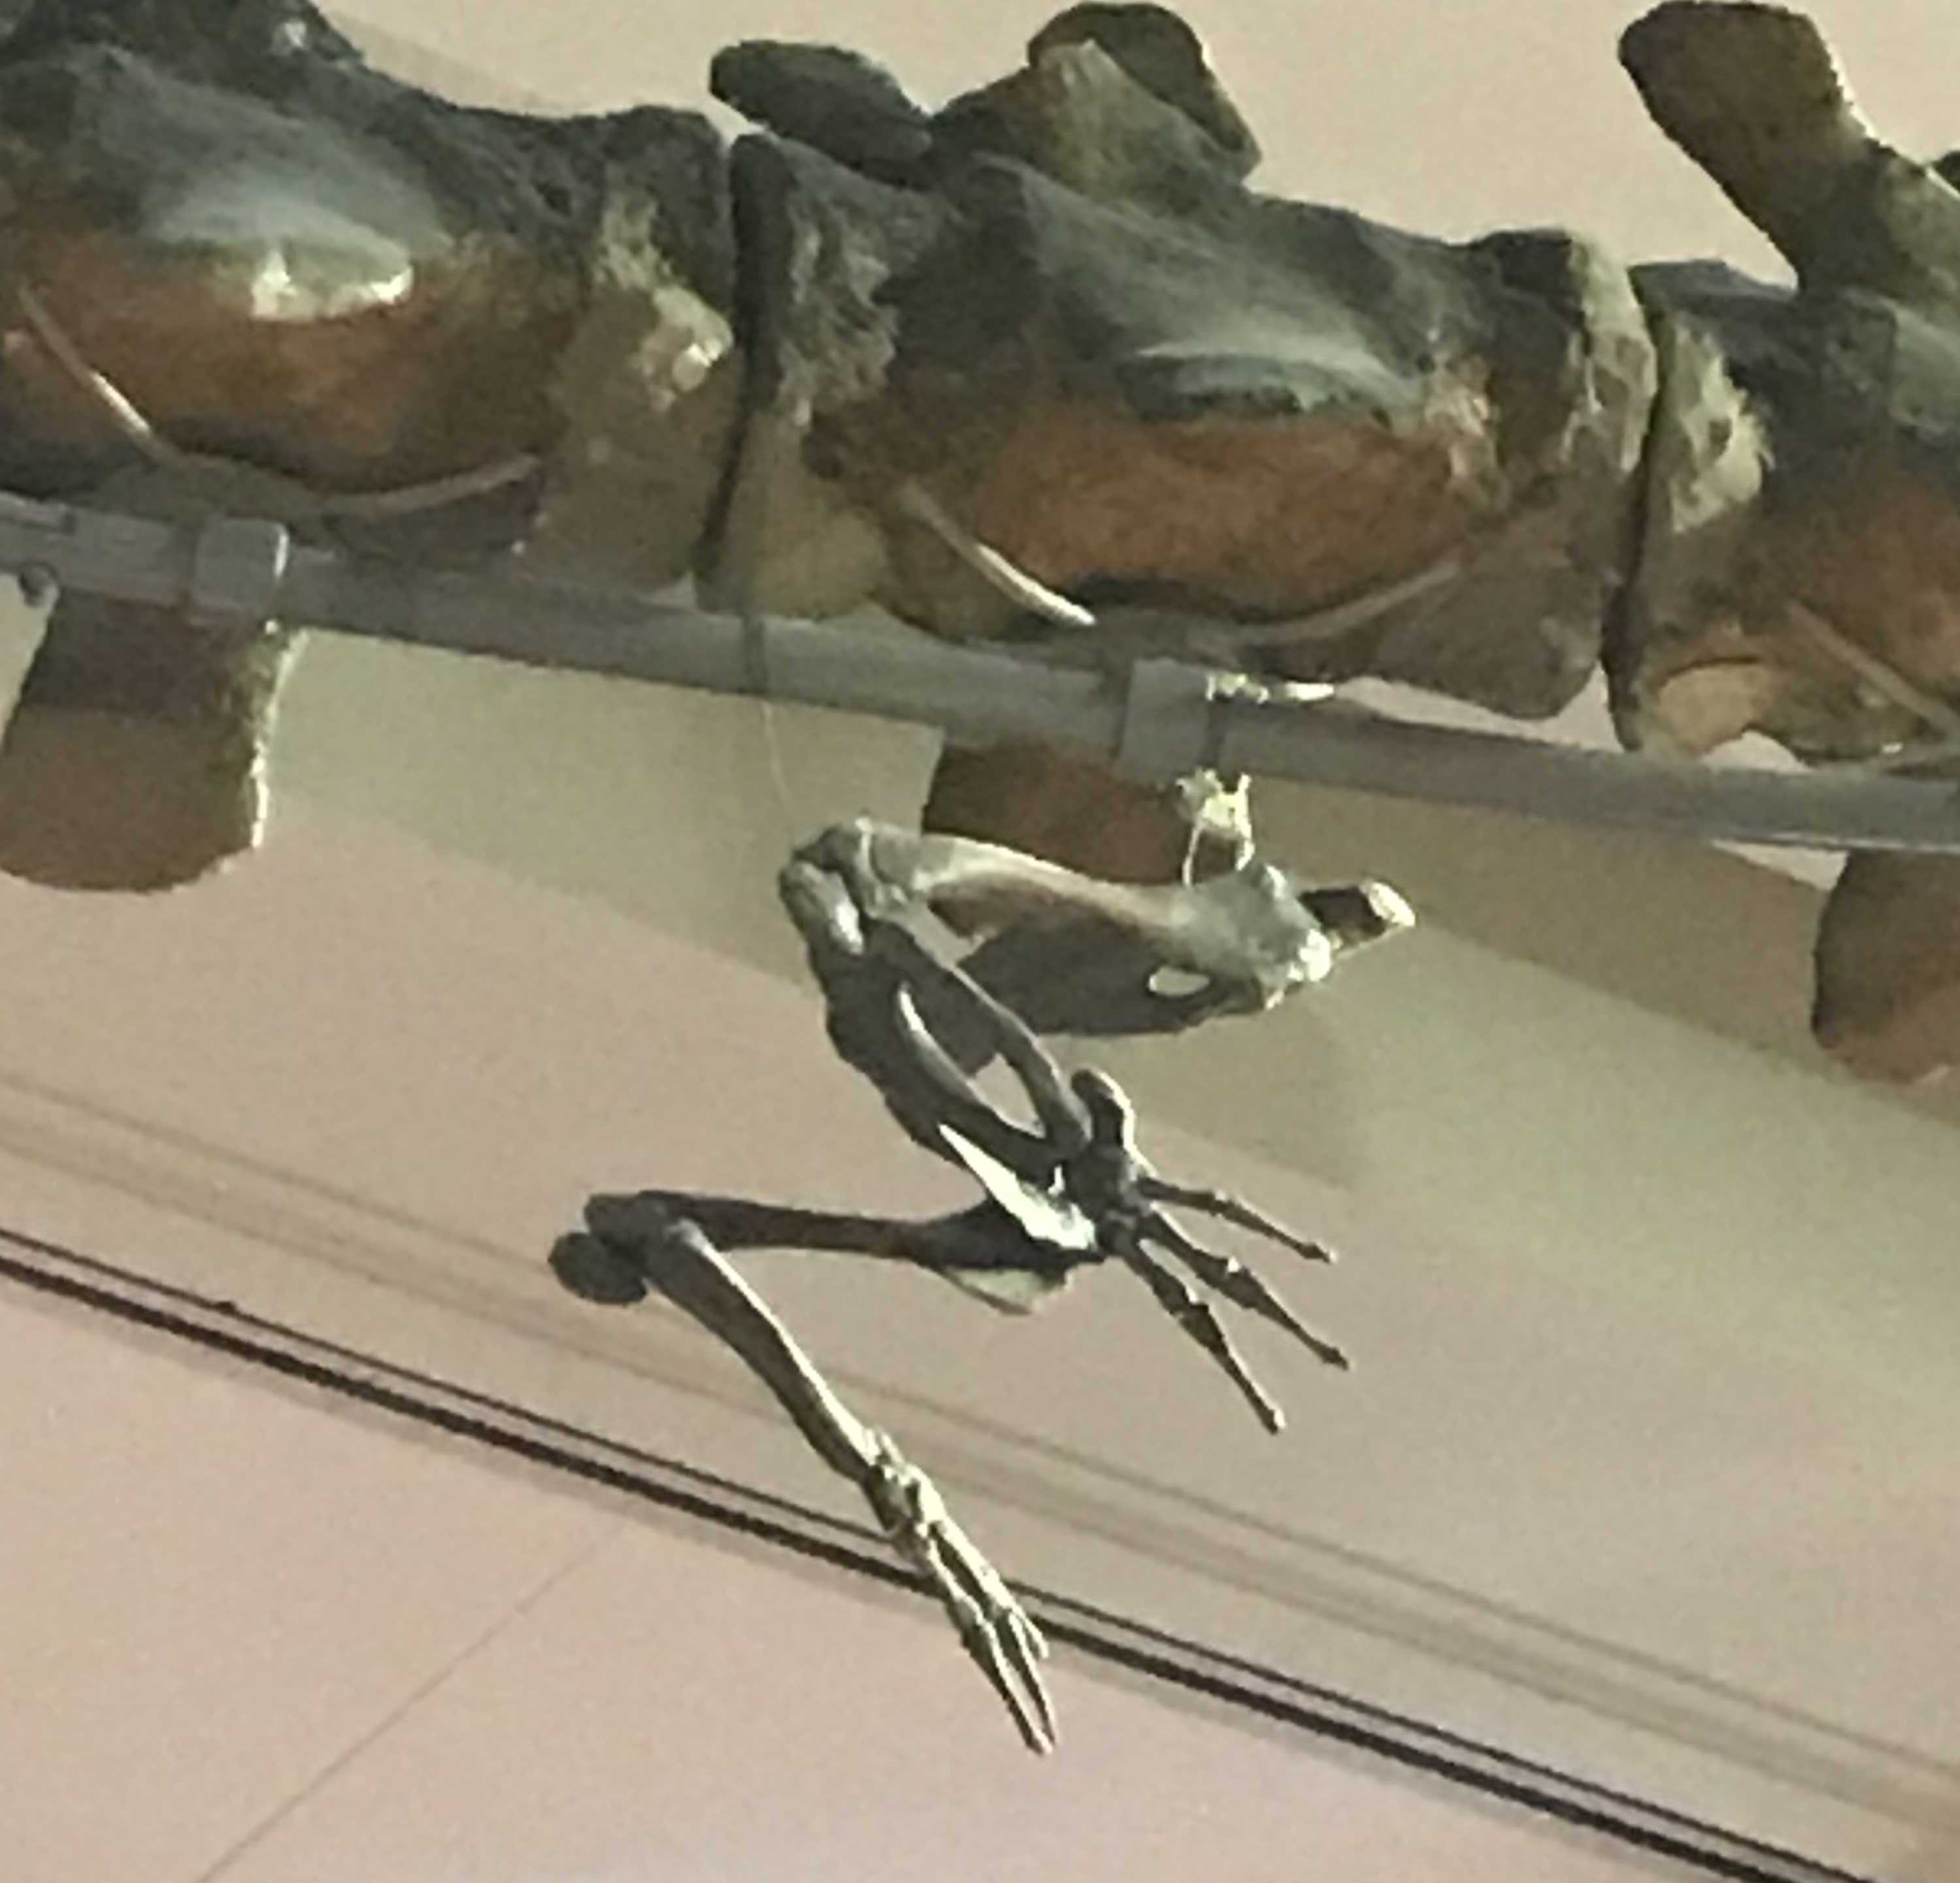
Basilosaurus
Hind limb
Megaptera

