Slide 1
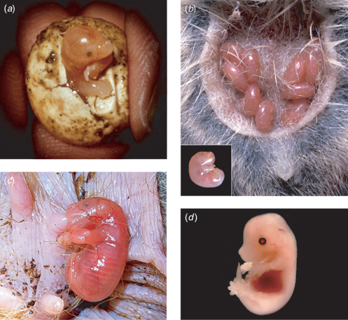
Reproduction I: General Patterns
Fig. 5. Mammalian neonates. (a) Monotreme (echidna) hatching from its egg. (b) Newborn marsupials (Antechinus agilis) attached to mother’s teats in pouch. Inset, individual neonate. (c) Newborn marsupial (tammary wallaby) attached to mother’s teat in pouch. (d) A 14.5-day post-coitus mouse fetus dissected from the uterus.

Slide 2
Placenta Formation in Metatherians and Eutherians
For both groups, at least initial embryonic growth is intrauterine.
Placentas are formed from three layers in both groups.
1) A single maternal layer is the endometrium.
The inner lining of the uterus is highly vascularized, and this is what is shed
during human menstruation.
2) The chorion is the outer embryonic layer, which is derived primarily from
the trophoblast.
3) An inner embryonic layer that varies: There are two options.
vitelline (yolk sac) in metatherians.
Choriovitelline placenta
allantois in eutherians.
Chorioallantic placenta

Slide 3
Placenta Formation in Metatherians and Eutherians
Chorion
Extra-embryonic
coelom
Amnion
Embryo
Vitelline
Allantios

Slide 4
Metatherians
Vitelline expands
embryo
recedes

Slide 5
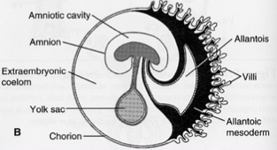
Eutherians
Vitelline functions early, but then recedes.
Embryo implants into uterine wall.
Chorion develops villi that further penetrate the uterine wall.
Allantois expands, contacts the chorion, and extends into the villi.
Allantois expands
Vitelline recedes
More intimate contact between maternal and fetal circulation.

Slide 6
Tissues Separating Maternal and Fetal Circulation
Endothelial cells of maternal
capillary
Uterine wall
(epithelial calls)
Maternal connective tissue
Fetal connective tissue
Chorionic villus
Endothelial cells of fetal
capillary
Epitheliochorial

Slide 7
Tissues Separating Maternal and Fetal Circulation
Uterine wall
(epithelial calls)
Endothelial cells of maternal
capillary
Fetal connective tissue
Chorionic villus
Endothelial cells of fetal
capillary
Endotheliochorial

Slide 8
Tissues Separating Maternal and Fetal Circulation
Uterine wall
(epithelial calls)
Fetal connective tissue
Chorionic villus
Endothelial cells of fetal
capillary
Hemochorial

Slide 9
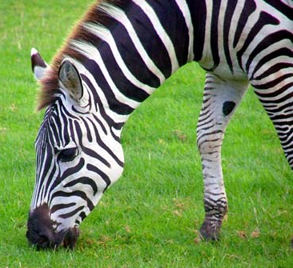
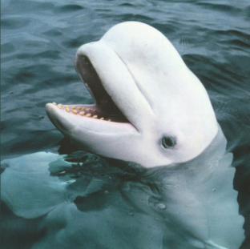
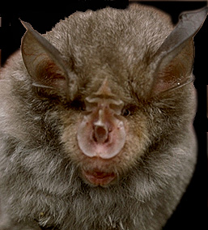
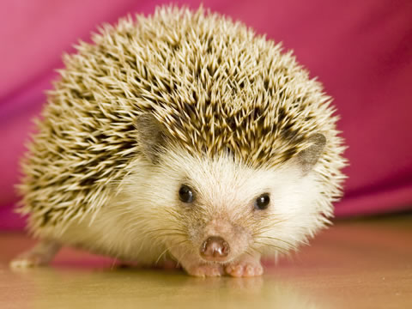
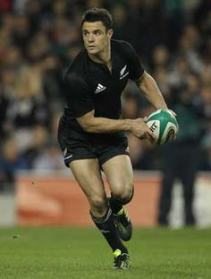
Epitheliochorial
Minimal endometrial erosion
Pocket around chorionic villi
Endotheliochorial
Epithelium and connective tissue erode
Chorionic villi in direct contact with maternal capillaries
Hemochorial
All maternal tissue erodes
Chorionic villi bathed in maternal blood

Slide 10
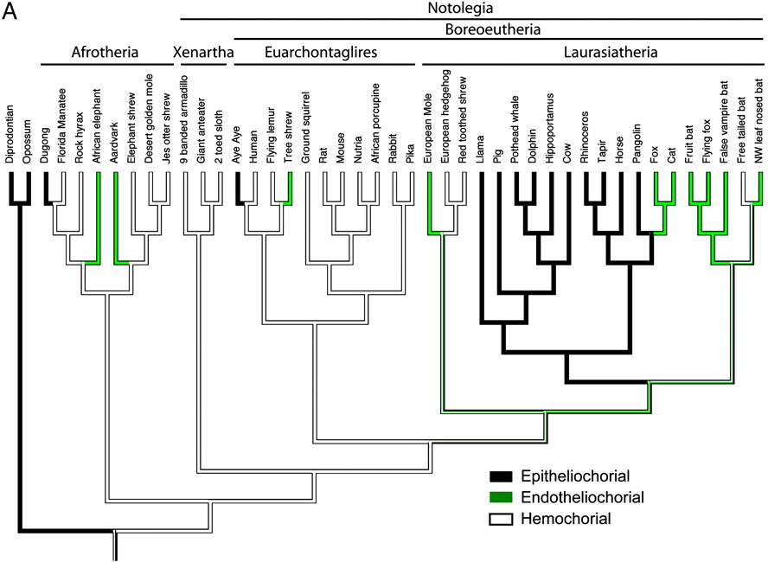
Placenta Evolution in Eutherian Mammals.
Original Hypothesis
Least Efficient
Epithelioichorial
Moderately Efficient
Endotheliochorial
Most Efficient
Hemochorial
Wildman D. E. et.al. 2006. PNAS, 103:3203-3208

Slide 11
Placenta Evolution in Eutherian Mammals.
Least Efficient
Epitheliochorial
Moderately Efficient
Endotheliochorial
Most Efficient
Hemochorial
Notes:
The evolution of morphological placental features in mammals. Parsimony reconstructions of internal nodes are shown for three morphological features (see Materials and Methods for details of reconstruction methodology). Taxon names and branching order are identical in all panels of the figure. Only the Afrotheria + Notolegia tree (i.e., 9) is shown. The data for all tree topologies examined is available as supporting information. (A) The placental interface describes the degree of invasiveness of fetal (i.e., placental) tissue into maternal tissue, with epitheliochorial being least invasive and hemochorial being most invasive. (B) The shape of the contact zone between fetal and uterine tissues. (C) The form of interdigitation between fetal and maternal tissues. Parsimony and Markov model likelihood reconstructions were constructed by using the data file available as supporting information.

