Slide 1
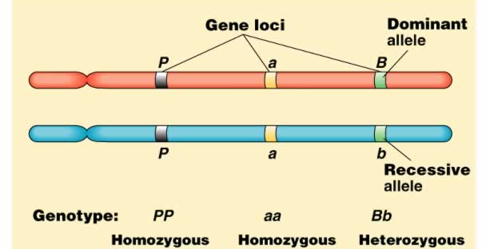
Genetic Diversity and Conservation

Slide 2
Allele Frequencies
The total number of copies of an allele divided by (for mammals) 2N.
Aa
AA
aa
Aa
AA
aa
Aa
Aa
Aa
Aa
AA
aa
AA
p = 14/26 = 0.53; q = 12/26 = 0.47

Slide 3
Heterozygosity – Index of Genetic Diversity
Population
Aa
AA
aa
Aa
AA
aa
Aa
Aa
Aa
Aa
AA
aa
AA
Individual
Aa
BB
cc
Dd
H_{I} – The percentage of loci at which an individual is heterozygous
H_{P} – The average heterozygosity in a population.
H_{P} = 0.461
H_{I} = 0.5
For multiple loci, we average across loci .

Slide 4
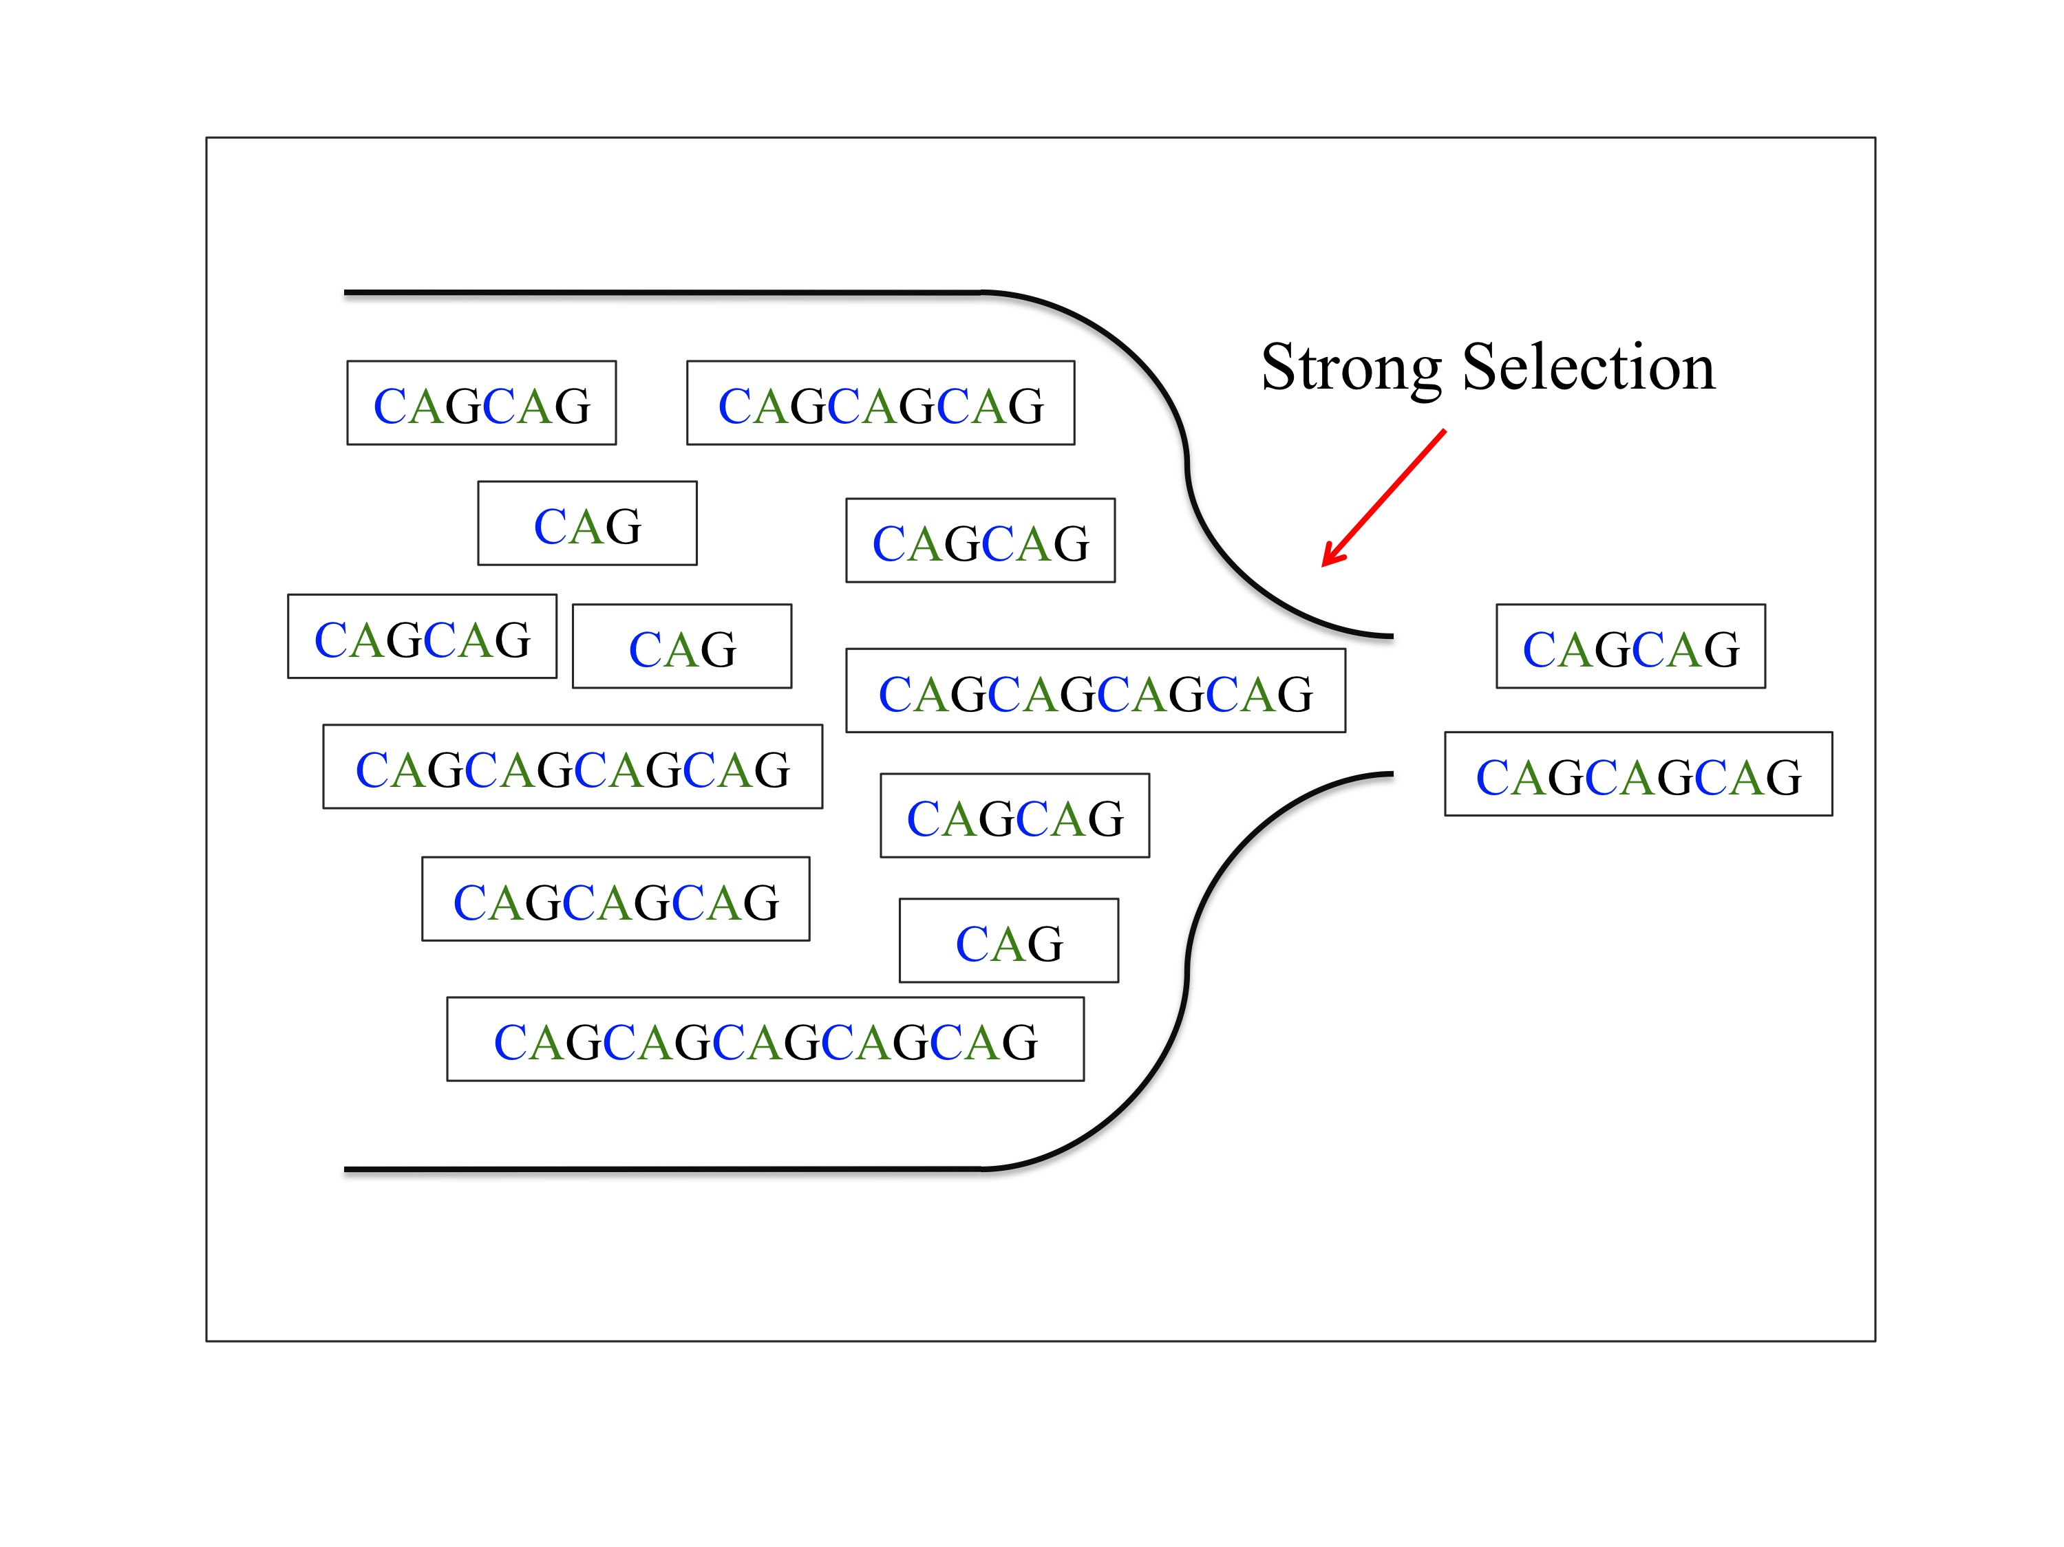
Genetic Diversity and Conservation
Population bottlenecks lead to low genetic diversity.
1 – Genetic drift
2 - Inbreeding
Loss of diversity increases with length of time the population remains small.

Slide 5
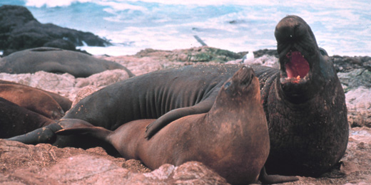
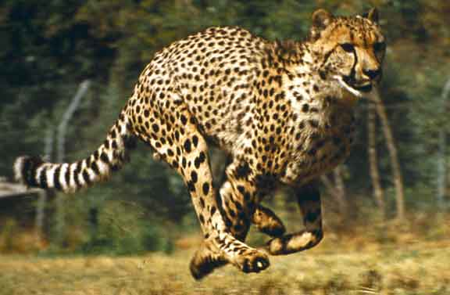
Genetic Diversity and Conservation
Population bottlenecks lead to low genetic diversity.
Classic Examples
Mirounga angustirostris (e.g., Sanvito et al. 2013)
Acinonyx jubatus
(e.g., Terrell et al. 2016; Schmidt-Kuntzel et al. 2018)

Slide 6
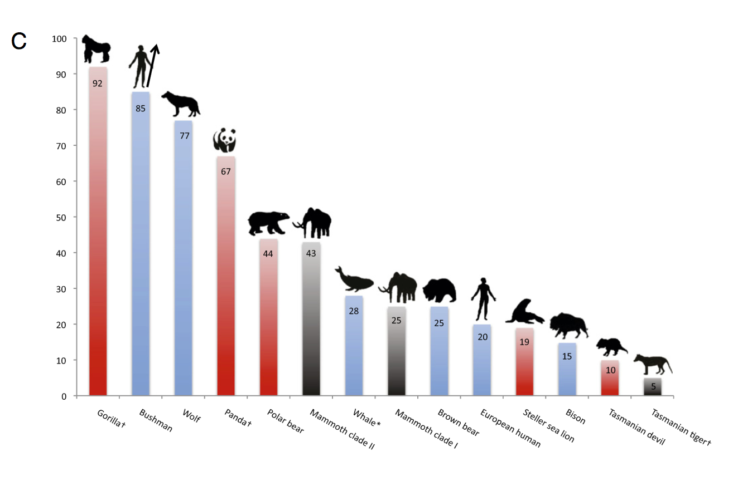
Genetic Diversity and Conservation
The classical view in conservation is that population viability is intimately
linked with genetic variation, especially as measured by heterozygosity.
Genetically depauperate species:
Will be very susceptible to disease and parasites
(reviewed by Gibson 2021. Evolution).
DFTD in Sarcophilus
Miller et al. (2011) PNAS. 108.

Slide 7
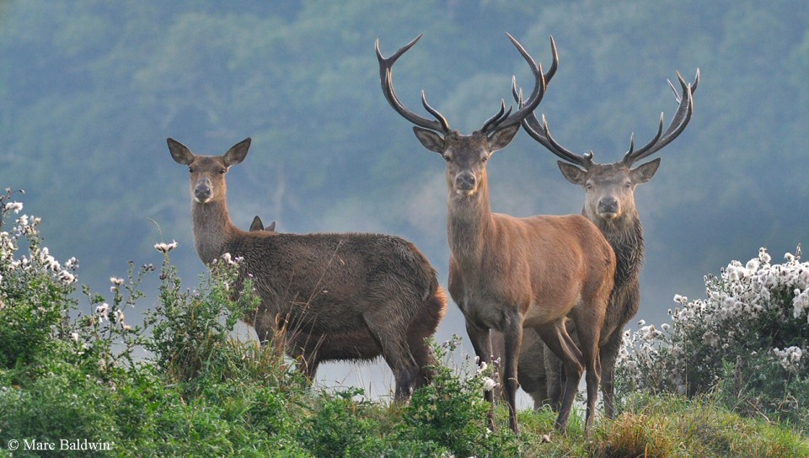
Genetic Diversity and Conservation
The classical view in conservation is that population viability is intimately
linked with genetic variation, especially as measured by heterozygosity.
Genetically depauperate species:
2) Will be subject to inbreeding depression
-- decreased growth rates
-- lower survivorship to maturity
-- decreased sperm viability
-- fluctuating asymmetry
-- decreased ability to raise offspring (Huisman et al. 2016. PNAS, 113:3585.).
3) Have decreased evolutionary potential.
Even though Sarcophilus have reduced genetic diversity, they have retained
alleles that confer resistance and these seem to be sweeping through
post-disease populations (Epstien et al. 2016. Nature Comm. 7.).
50/500 Rule for Minimum Viable Population (e.g., Jamieson and Allendorf, 2012. TREE 27)

Slide 8
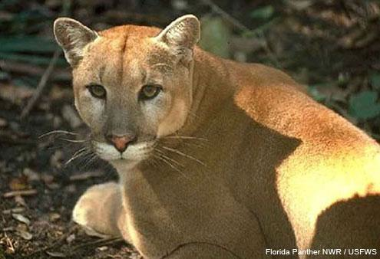
Genetic Rescue
Florida panther
Puma concolor coryi
A population genetic study (Culver et al. 2008. Animal Conservation, 11:104) estimated that there had been as few as 6 breeding individuals.
This persisted for approximately 80 years, leading
to dramatic inbreeding depression (low sperm
count, malformed sperm, abdominal testes,
heart deformations).
In 1995, eight females from Texas were introduced to the population in an attempt
to inject greater genetic diversity into the population.
Hybrid kittens have a 3-fold higher survival rate than the purebred kittens
(Pimm et al. 2006; Animal Conservation), and the population is
recovering (Johnson et al. 2010. Science. 329:1641).
A meta-analysis of 156 cases (Frankham 2015. Mol. Ecol. 24:2610) found a
large and consistent benefit to genetic rescue.

Slide 9
Caveats to the Classical View
Low levels of variability may be not ne lethal. The poster children of low genetic
diversity are persisting.
In cheetahs, genetic diversity has been low for 10,000 years and the
species hasn’t gone extinct.
“The most notable and still poorly understood feature of cheetah evolutionary history is how the cheetah has persisted in spite of remarkably low levels of genetic variation.”
(Schmidt-Kuntzel et al. 2018)
Similarly, elephant seals numbers have rebounded in spite of low genetic diversity.
(Abadio-Cordoso et al. 2017)

Slide 10
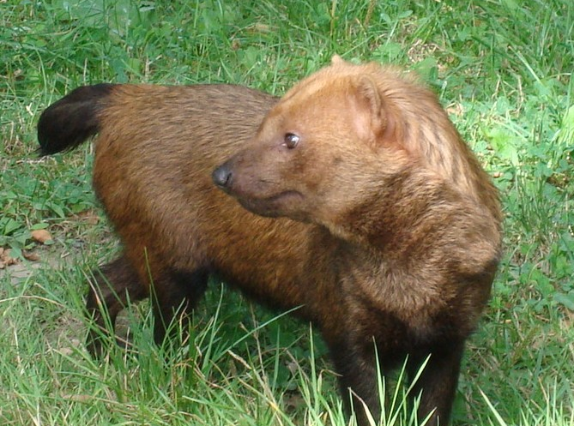
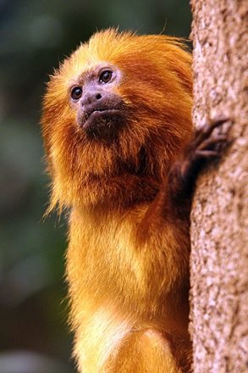
Caveats to the Classical View
2) There is evidence that some species withstand inbreeding with no depression
(Rall et al. 1998).
Canis lupus and other canids, such as the bush dog Speothos.
Leontopithecus rosalia (Golden lion tamarin) exhibits great deal of inbreeding with no apparent depression.

Slide 11
Caveats to the Classical View
3) Inbreeding can actually increase the fitness of a population in the long run.
a. It is possible to increase the variation available to respond to selection,
especially for polygenic traits (traits that are governed by several genes).
For polygenic traits, we examine phenotypic variance, V_{P} , with quantitative genetics.
V_{P} = V_{G} + V_{E} + V_{GxE} ,
where V_{G} is genetic variance, V_{E} is environmental variance, and V_{GxE} is gene-by-environment interactions.
V_{G} = V_{A} + V_{Epi} + V_{D}
V_{A} is additive variance: the effects of single alleles at a single loci.
V_{Epi} is epistatic variance: the effects of interactions among loci.
V_{D} is dominance variance: the effects of interactions among alleles at each locus.
A bottleneck (and associated inbreeding) converts epistatic and dominance effects to additive effects.
Naciri-Graven & Goudet (2003) and Mularo et al. (2022).

Slide 12
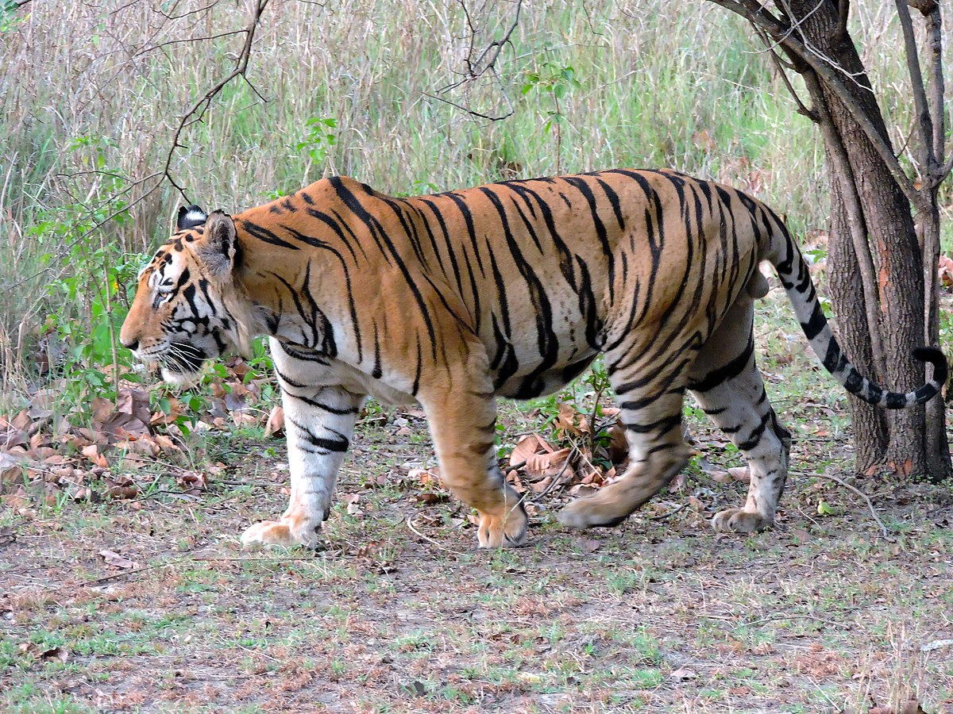
Caveats to the Classical View
3) Inbreeding can actually increase the fitness of a population in the long run.
b. Inbreeding can result in a decrease in genetic load, the cumulative,
fitness-decreasing effect of deleterious recessive alleles that can’t be
purged by selection.
In an out-bred population, most of the deleterious alleles will be present in heterozygotes, Aa, and therefore won’t be removed by selection.
In inbred populations, deleterious recessive alleles will be expressed more frequently as homozygotes, and therefore will be purged by selection
(Garcia-Dorado. 2015. Heredity. 115).
Decreased genetic load – cool example (Khan et al. 2021)
Small inbred populations have fewer
deleterious recessive alleles
than large populations.
But deleterious alleles are at
higher frequency in inbred
populations.

Slide 13
Caveats to the Classical View
4) The alleles that are usually lost are low frequency alleles that are likely to be lost due to drift anyway. Therefore, future adaptation is not very not likely to be compromised.
5) In even the most genetically depauperate species, the cheetah, the danger of
extinction is very much higher from non-genetic threats (e.g., habitat
destruction; Purchase et al. 2007).

Slide 14
So, is genetic diversity important?
A couple years ago a pair of papers promoted two very different views:
Teixeira and Huber. 2021. The inflated significance of neutral genetic diversity in conservation genetics. PNAS, 18:10. e2015096118.
DeWoody et al. 2021. The long-standing significance of genetic diversity in conservation. Molecular Ecology, 30:4141-4154.
Expecting that it is important is a reasonable null hypothesis.
It’s worth testing in any specific case.

