Slide 1
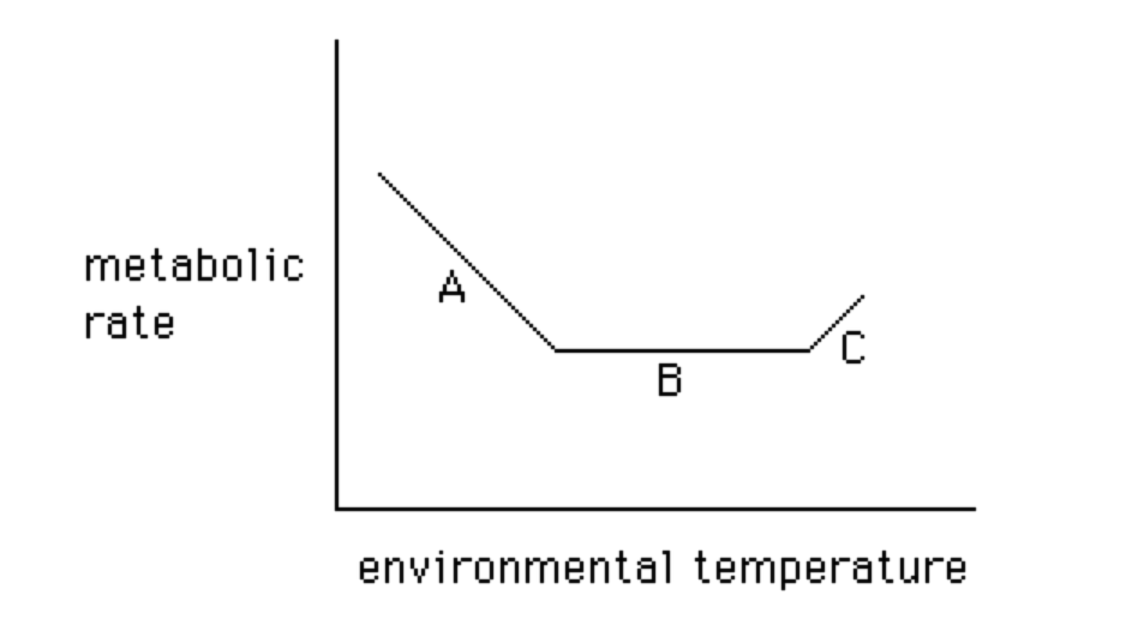
Thermoregulation & Water Balance
Obviously, mammals are endotherms; we regulate body temperature via
metabolic processes & burn calories to do so.
T_{LC}
T_{UC}
B: Thermal Neutral Zone
Zhao et al. (2014) demonstrated that the TNZ can shift in some species.
Liao et al. (2022) showed that it only expand downward to cooler temperatures.

Slide 2
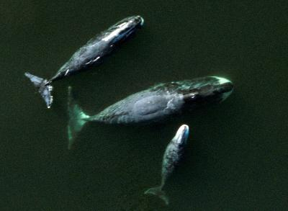
Adaptations for Cold
Large size; this relates to thermal inertia.

Slide 3
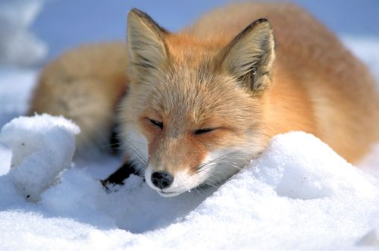
Adaptations for Cold
High mass-specific metabolic rate.

Slide 4
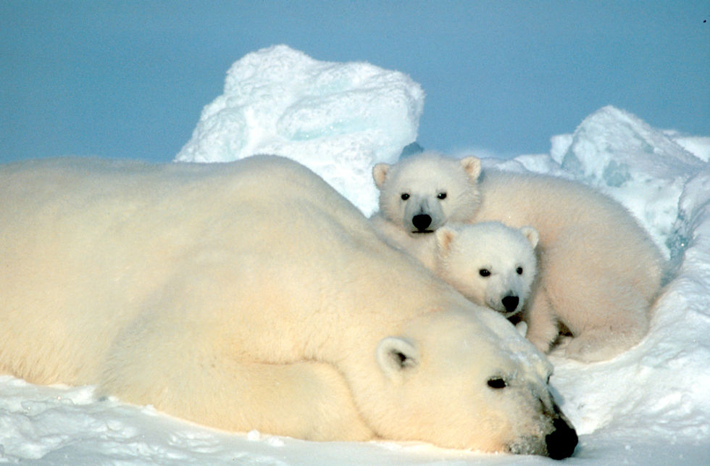
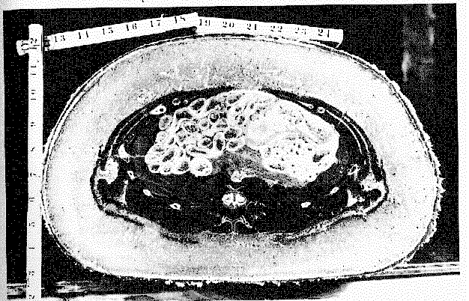
Adaptations to Cold
Insulation
Hair
Subcutaneous fat

Slide 5
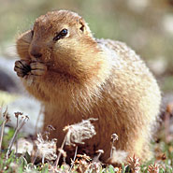
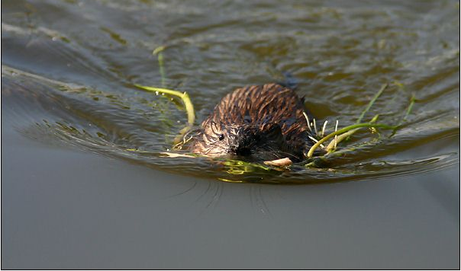
Adaptations to Cold
Regional Heterothermy
Urocitellus parryii
Ondatra zibethicus

Slide 6

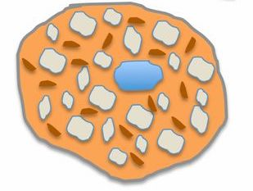
Adaptations to Cold
Systemic Heterothermy (a.k.a. Adaptive Hypothermia)
Characterized by:
- Decreased body temperature
- Decreased heart rate
- Vasoconstriction - severe reduction of blood flow to the extremities
- Decreased breathing rate
- Suppression of shivering
- Decreased oxygen consumption (decreased metabolic rate)
Maintenance of high T_{B} at very low temperatures is energetically costly and without
adaptive hypothermia, many small mammals would be unable to persist in
many cold localities.
Cost: Thermogenic fat (brown fat) is required to arouse from hypothermia.

Slide 7
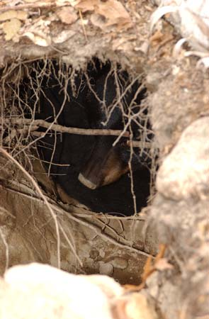
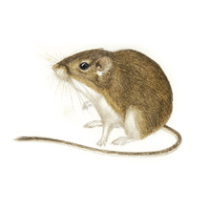
Classification of Adaptive Hypothermia
Shallow (Torpor) vs. Deep (Hibernation)
Perognathus parvus (Great Basin pocket mouse) – ca. 2-3ºC
Ursus americanus - ca. 30ºC

Slide 8
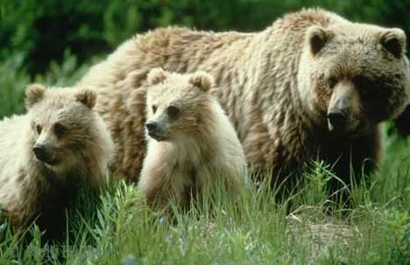
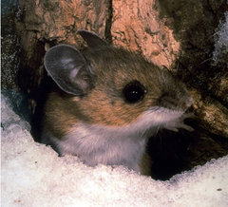
Classification of Adaptive Hypothermia
Seasonal vs. Daily
Ursus arctos
(Seasonal)
Peromyscus maniculatus
(Daily)

Slide 9
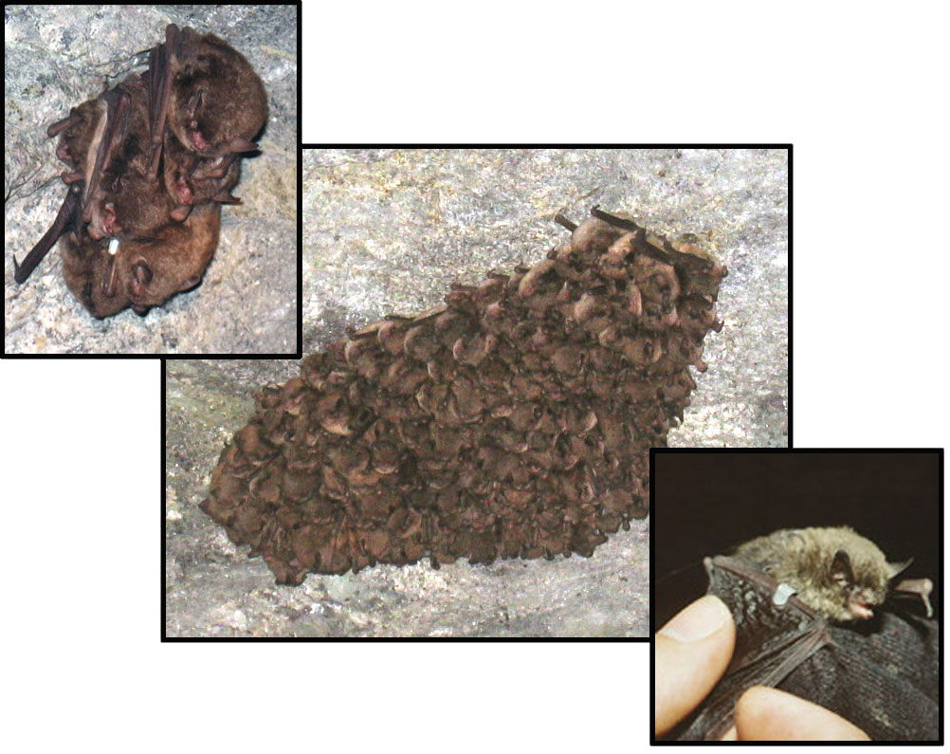
Bats combine strategies.

Slide 10
Adaptations for Heat
T_{UC}

Slide 11
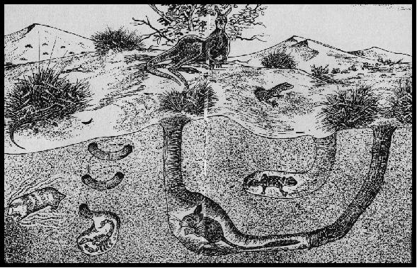
Adaptations for Heat
Avoid Exposure
Nocturnal
Fossorial

Slide 12
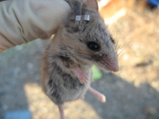
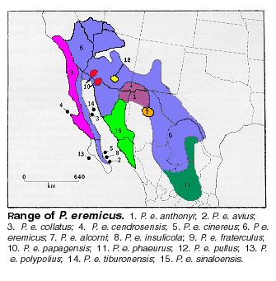
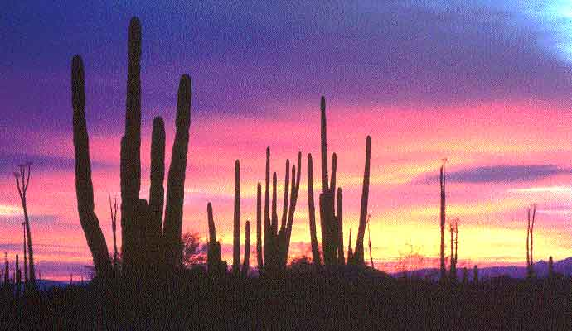
Adaptations for Heat
Avoid Exposure
Periods of inactivity – Estivation (aestivation)
Peromyscus eremicus

Slide 13
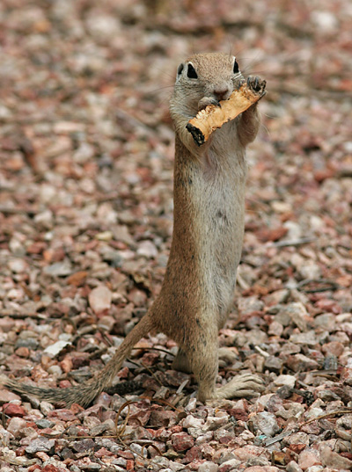
Adaptations for Heat
Lower than expected BRM

Slide 14
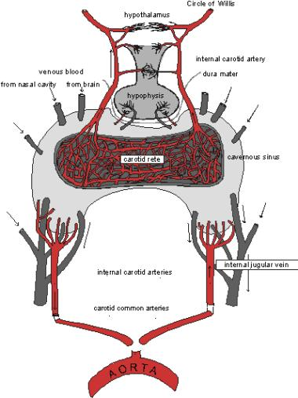
Adaptations for Heat
Brain Cooling
The carotid artery passes through a rete mirabile - complex series of capillaries.
Temp in carotid is high
Venous blood passes through the olfactory epithelium where it is cooled by evaporation off the mucous membranes in the nasal cavities.
This cooled venous blood passes the rete mirabile and the hyperthermic arterial blood in the carotid artery dumps its heat to the cool venous blood. This is the site of a counter-current heat exchange.

Slide 15
Adaptations for Heat
Brain Cooling
Bovids
Equids
Mitchell & Lust (2008. Biol. Lett. 4:415)

Slide 16
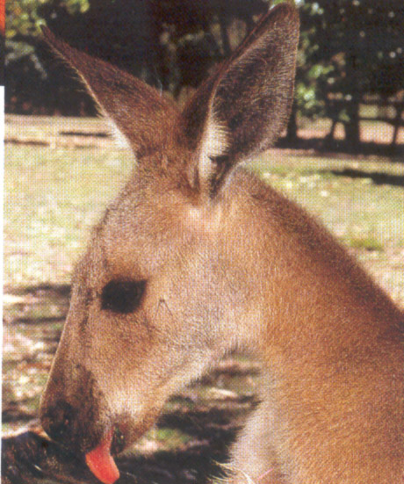
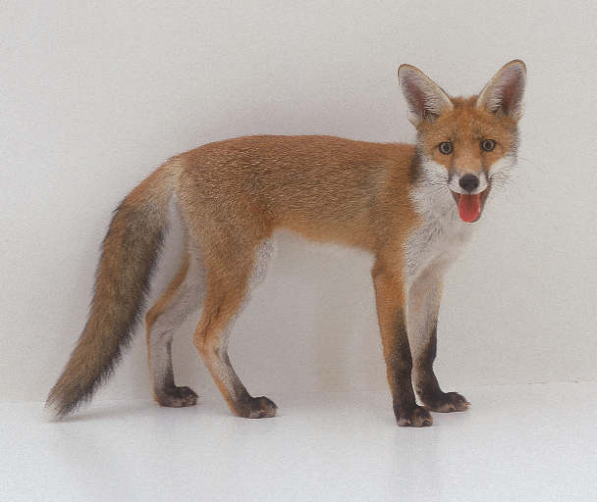
Adaptations for Heat
Evaporative cooling
Sweating is the most common method of evaporative cooling
Spreading saliva
Panting – Pulmonary evaporation

Slide 17
Water Balance
A. Loss Occurs Via
1. Evaporation from body via sweat: cutaneous evaporation.
2. Evaporation from respiratory system, including lungs and mucous
membranes: pulmonary evaporation.
3. Waste both in both urine and feces
4. Lactation

Slide 18
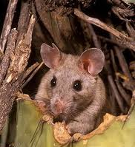
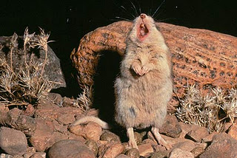
Water Balance
B. Sources of Water
Drink free water - Water that is freely available in the desert is very rare. Many desert-adapted rodents have consequently lost the ability to drink free water.
2. Preformed (Dietary) Water - Water in tissues of food.
Many plants are hygroscopic; they take up water during the evenings when there is a little more moisture.
Many desert rodents, such as Neotoma lepida, feed on Opuntia cactus.
Carnivorous desert mammals obtain all the water they require from their prey - Onychomys leucogaster.

Slide 19
3. Metabolic Water – Water formed as a by-product of metabolizing nutrients.
The amount of metabolic water produced depends on both the amount of food eaten and the composition of the diet.
Metabolism of protein -- 0.396 g H₂0/g protein
carbohydrate -- 0.556 g H₂0/g carbs
fat -- 1.071 g H₂0/g fats
We might expect desert species to eat lots of fatty foods, but they
actually tend not to because of the high energy-cost of metabolizing
lipids. It’s more efficient to eat a lot of carbohydrates.
Many desert rodents (e.g., Heteromyids) rely exclusively on metabolic water production and preformed water.

Slide 20
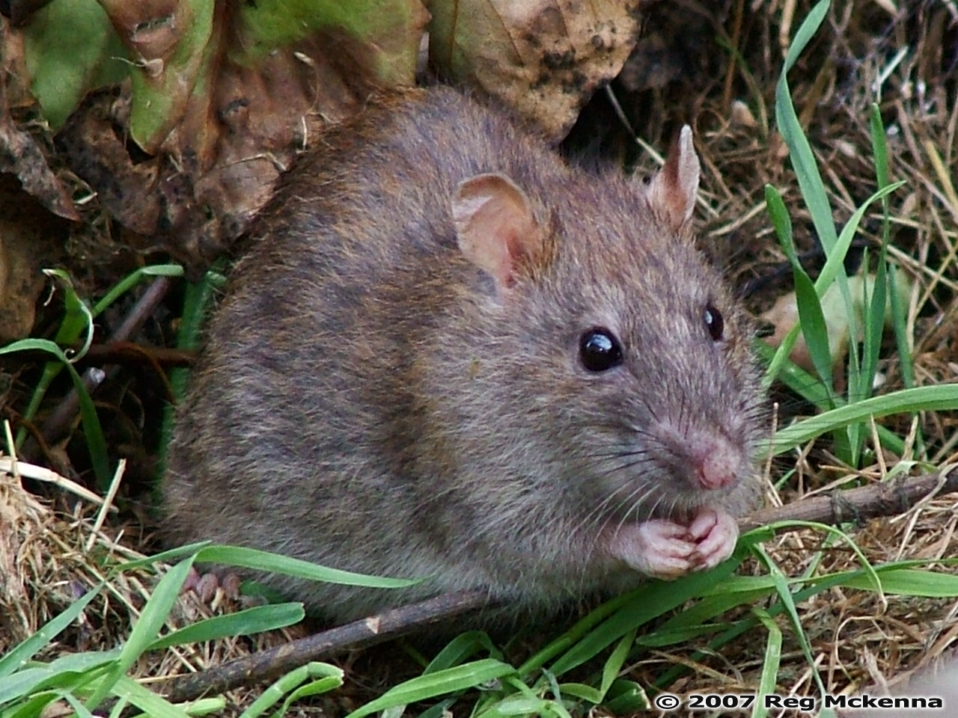
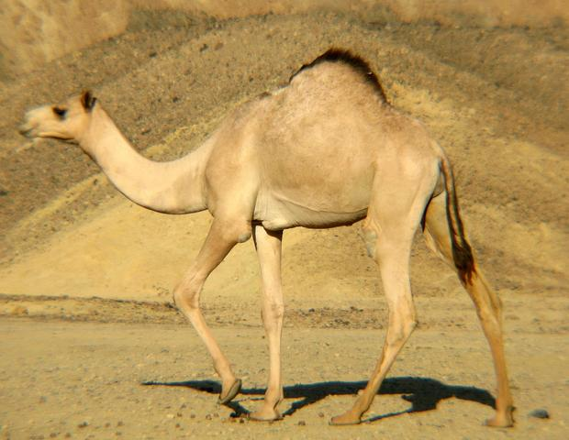
Over the long term, gains must equal losses.
Desert-adapted forms have the ability to withstand short-term dehydration.
Generalized forms (e.g., Homo, Rattus) can only survive loss of 10-14% of
body weight in water.
Desert-adapted forms such as camels (Camelus dromedarius) can survive loss
of 25% of body weight.

Slide 21
Adaptations for Conservation of Water
Obviously, some of the same strategies for avoiding heat stress will also result in water conservation by eliminating the need for evaporative cooling.
1. Nocturnal – This not only avoids the need for evaporative cooling, but many forms feed only at night. This is the most humid part of the day and vegetation absorbs moisture from the relatively humid night air.
Oryx gazella

Slide 22
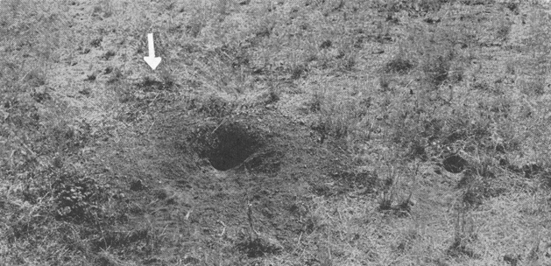
Adaptations for Conservation of Water
2. Fossorial - We’ve discussed that it’s cooler in burrows than on the surface.
In addition, many desert rodents plug some burrows. This traps respired moisture and the relative humidity in burrows is up to 76% relative humidity, much higher than outside.
Dry seeds are usually stored in humid burrows, where they actually absorb respired moisture from the humid air in the burrows.
This absorbed water may actually account for up to 30% of a kangaroo rat’s daily water requirement.

Slide 23
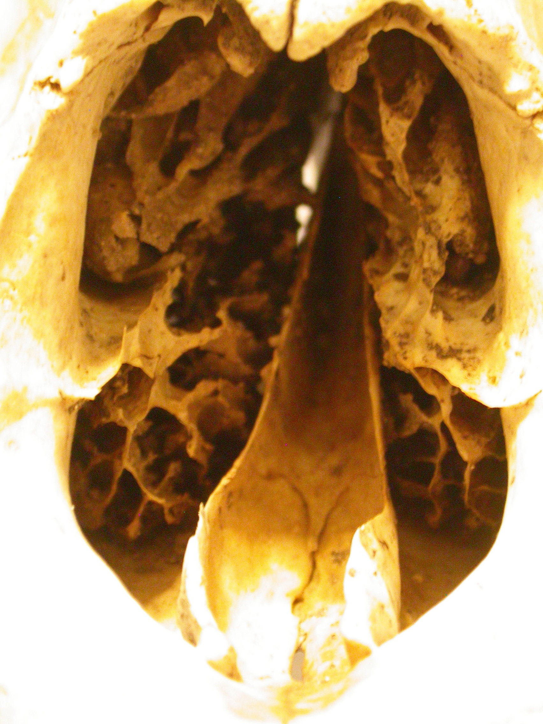
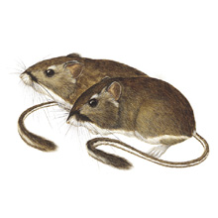
Adaptations for Conservation of Water
3. Nasal Recycling – Critical for desert rodents.
Exhaled air is actually cooler than body temperature in these forms.
They have a long, narrow rostrum with large mucosa, the membrane that produces nasal mucus.
As air is inhaled, mucus evaporates from the mucosa. This slight loss of
water results in evaporative cooling of the mucous membrane.
Once in the lungs, inspired air becomes warmed to body temperature and
saturated with water vapor (pulmonary evaporation).
On exhalation, this warm, moist air passes the cool mucosa. This cools the air and the moisture from pulmonary evaporation condenses onto the mucosa.
- Much of this condensed water is then absorbed through the mucosa.
With this strategy, Dipodomys recover 80% of the pulmonary evaporation.

Slide 24
Adaptations for Conservation of Water
4. Concentrate urine – All desert species have this ability to some degree.
Very long Loops of Henle permit a great deal of resorption of water and therefore the production of concentrated urine.
In desert-adapted rodents, the long Loops of Henle are relatively longer than in generalized mammals. In addition, a higher percentage of nephrons have these very long Loops of Henle.

Slide 25
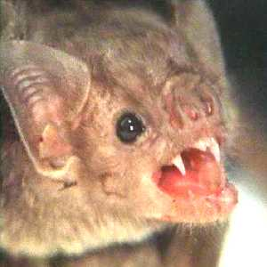
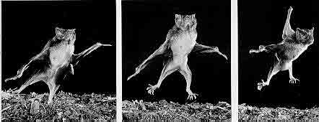
Renal Flexibility
Sanguinivorous

