Slide 1
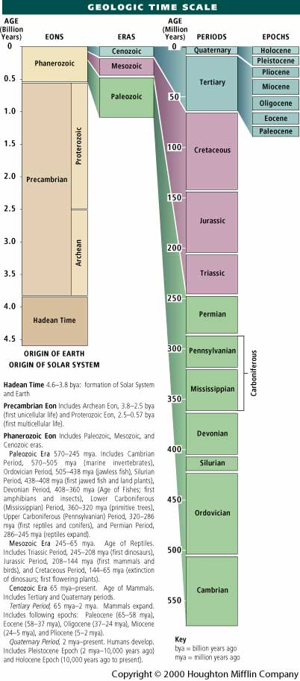
I don’t expect you to know this, but knowing
the order of the geological periods can help
you make sense of what we’ll be discussing.
What helped me was this little mnemonic.
Come Over Some Day, Might Play Poker. Three
Jacks Covers Two Queens.
~360 MYA
See http://geology.com/time.htm

Slide 2
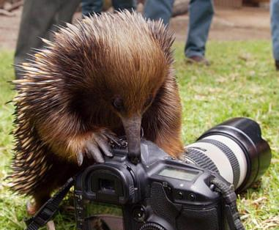
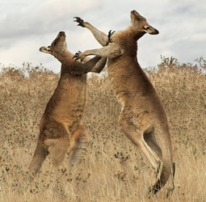
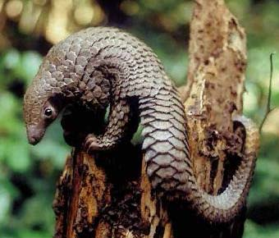
3 Living Groups of Mammals
Monotremes
Metatherians
Eutherians

Slide 3
Monotremes
Metatherians (Marsupials)
Eutherians (Placentals)
Node - Divergence Event
Branch - Common Ancestor
Depth represents relative time.

Slide 4
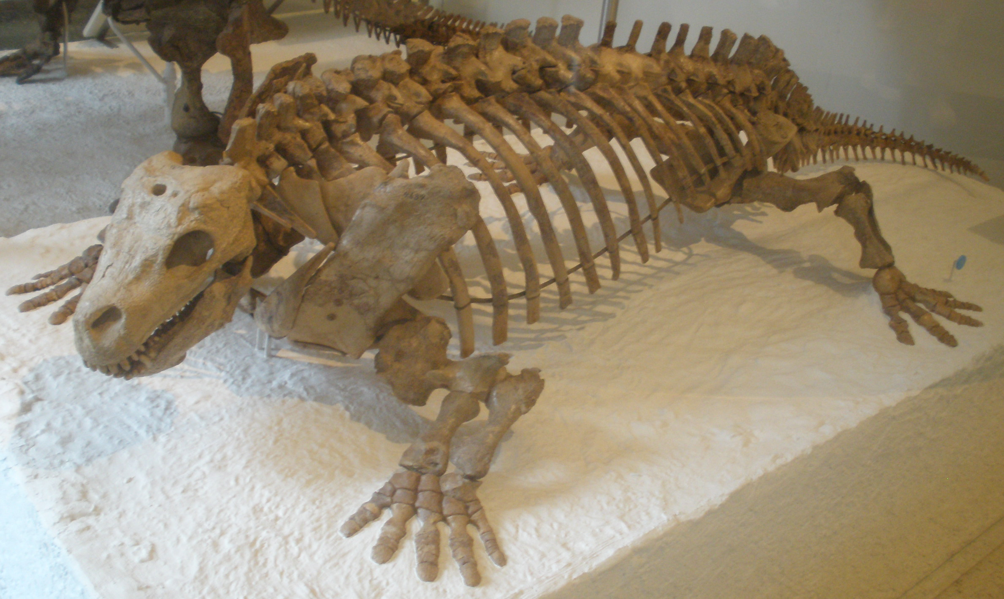
Tetrapod Phylogeny
Amphibians
Mammals
Squamates
(Lizards & Snakes)
Crocodylians
Dinosaur I
Dinosaur II
Turtles
Birds
Synapsids
Stem Amniotes
Amnion
Evolution of Limbs
Diadectes – a stem amniote

Slide 5
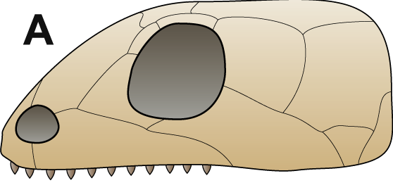
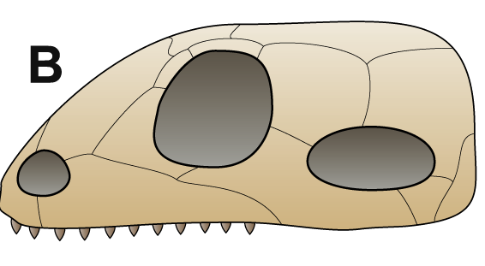
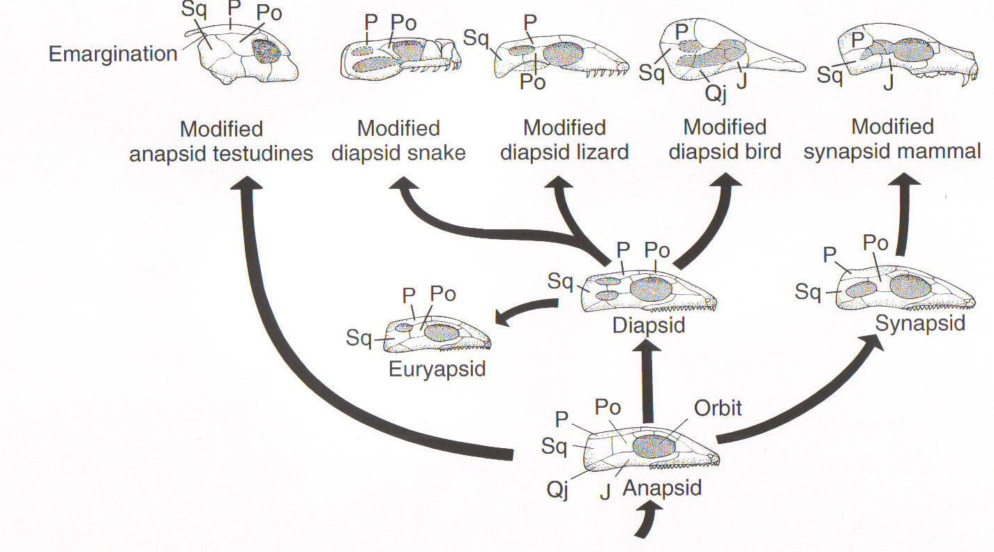
Temporal Fenestrae
Anapsid
Synapsid
Temporal fenestra
Naris
Orbit
Naris
Orbit
Postorbital
Postorbital
Squamosal
Squamosal
Stem Amniote

Slide 6
Synapsid Phylogeny
~ 323 Ma

Slide 7
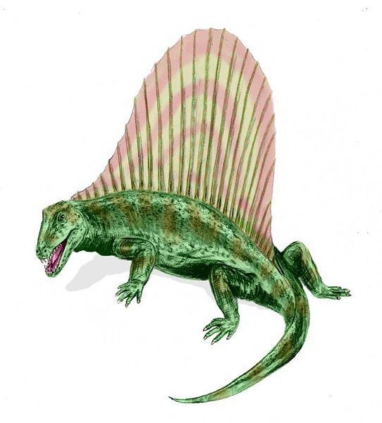
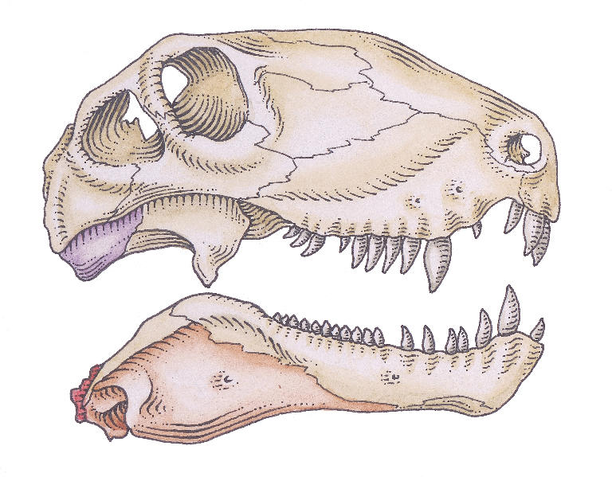
“Pelycosaurs”
(Early synapsids)
Carboniferous (~323 MYA) and persisted through Permian.
Some had a large dorsal sail (thermoregulatory? Mate choice?)
Rather large (~ 3 meters)
Range of Ancestral Characters
Dimetrodon
Weakly heterodont
Small temporal fenestra
Angular/articular in mandible
Quadrate/articular jaw joint
Two nares - no secondary palate
Single occipital condyle

Slide 8
Synapsid Phylogeny
Middle Permian (~270 Ma)

Slide 9
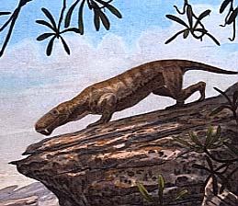
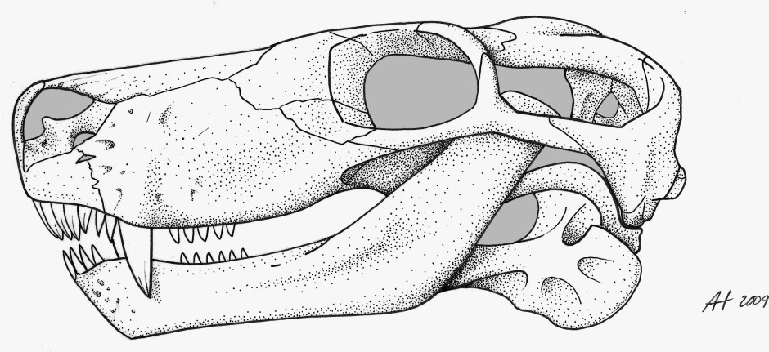
Early Therapsids
Middle Permian (ca. 270 MYA)
Most were large (3-5 M)
Lycaenops
Active and diverse (4 major lineages)
Dominant terrestrial life form (*significant later)
Most went extinct during Permo-Triassic extinction event
Mixture of Ancestral vs. Derived Characters
Enlarged temporal fenestra
Deeply thecodont teeth
Partial, gradually evolving secondary palate
Sweeping changes to skull and jaw structure in one lineage.

Slide 10
Synapsid Phylogeny
Permo-Triassic Mass Extinction

Slide 11
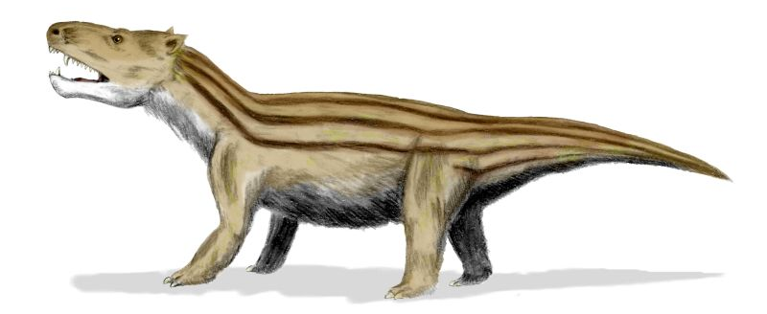
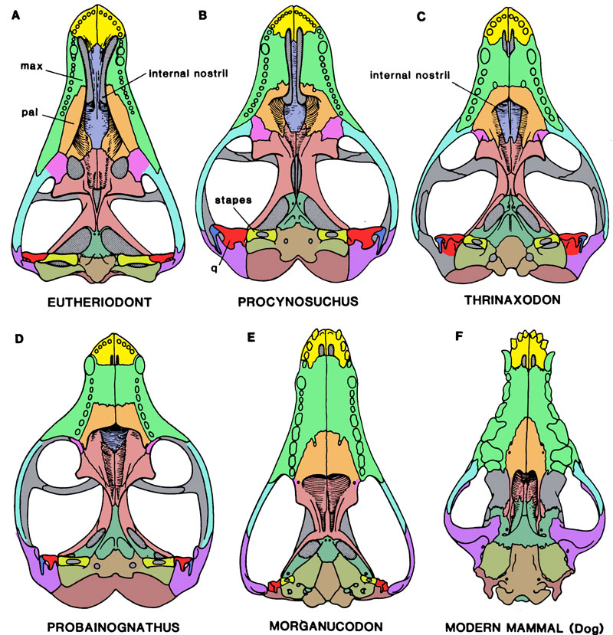
Cynodonts*: Advanced Theraspids
(*’dog teeth’)
Cynognathus
Evolution of mammalian characters
Many transitional fossils
Complete secondary palate
Two occipital condyles
Gradual enlargement of dentary / shrinking of post-dentary bones
Vast expansion of temporal fenestra
Strongly heterodont dentition

Slide 12
Cynodonts*: Advanced Theraspids
(*’dog teeth’)
Cynognathus
Evolution of mammalian characters
Many transitional fossils
Complete secondary palate
Two occipital condyles
Gradual enlargement of dentary / shrinking of post-dentary bones
Vast expansion of temporal fenestra.
Strongly heterodont dentition
Very late Permian & survived
the P-T extinction
Direct interaction with dinosaurs
By late Triassic, most were small
and inconspicuous
Extinction of dinosaurs (end of
Cretaceous) lead to radiation

Slide 13
Some broad questions in mammalian evolution
What are the key cynodont groups, and how are they related?
Which of the cynodont groups are ‘mammals’?
Why and how did mammalian characters evolve?

Slide 14
Simplified Cynodont Phylogeny (Following Huttenlocker et al. 2018)
Monotremes
Metatherians
Eutherians
Multituberculates ⁺
Triconodonts ⁺
Haramiyids⁺
Morganucodonts⁺
Probainognathus ⁺
Docodonts⁺
Sinocodon⁺
Tritylodonts⁺
Early Cynodonts

Slide 15
The Key-character Approach.
Which bones comprise the jaw joint?
Dentary and Squamosal → Mammal
Quadrate and Articular → Non-mammalian cynodont

Slide 16
The Key-character Approach.
Monotremes
Metatherians
Eutherians
Multituberculates ⁺
Triconodonts ⁺
Haramiyids⁺
Morganucodonts⁺
Probainognathus ⁺
Docodonts⁺
Sinocodon⁺
Tritylodonts⁺
D-S
Q-A
Early Cynodonts

Slide 17
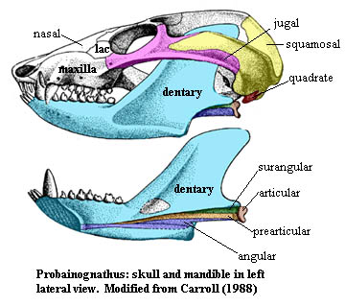
Fossils with both jaw joints!
Probainognathus - Middle Triassic
D/S Jaw Joint
Q/A Jaw Joint
Image from http://www.palaeos.com/Vertebrates/Units/Unit420/420.300.html

Slide 18
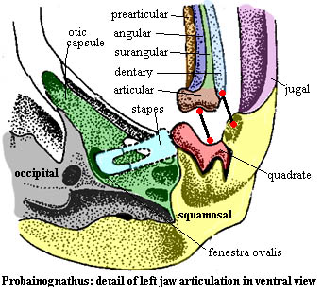
Ventral View
D/S Joint
Q/A Joint

Slide 19
Diarthrognathus –Another late cynodont with both jaw joints.
Clearly, the key-character approach isn’t applicable.

Slide 20
Shift to a ‘Suite-of-Characters’ approach…
(Mammalogy texts often use this)
1) D-S jaw joint
2) Strongly heterodont dentition
3) Molar surfaces complex, with wear facets. --Occlusion--
4) Alternate side chewing, implying complex jaw musculature
5) Well-developed inner ear region.
6) Small
7) Axial skeletal characters - dorso-ventral flexion, placement of ribs, etc.
Rowe (1988 – pdf on website) lists several authors’ suites-of-characters.

Slide 21
The Suite-of-characters Approach.
Monotremes
Metatherians
Eutherians
Multituberculates ⁺
Triconodonts ⁺
Haramiyids⁺
Morganucodonts⁺
Probainognathus ⁺
Docodonts⁺
Sinocodon⁺
Tritylodonts⁺
Mammal
Not a mammal
Early Cynodonts

Slide 22
Both approaches (‘Key character’, ‘Suite of Characters’) are referred to as ‘Grade-based’ definitions.
Problems:
Evolution is a continuum (many transitional fossils)
Traits may evolve at multiple locations on a phylogeny
So, ideally, what makes for a useful and appropriate classification?
Classifications should reflect evolutionary history.
Classifications should be stable.
Where these conflict, priority goes to evolutionary history.

Slide 23
Reptilia
Amphibians
Mammals
Squamates
Crocodylians
Dinosaur I
Dinosaur II
Turtles
Birds
Archosauria
Reptilia - a grade-based group
Scales
Lack of feathers
Lack of hair
Archosuaria – Clade-based group
4-Chambered heart
Parental Care
Vocal Communication

Slide 24
Clade-based definitions of Mammalia
Monotremes
Metatherians
Eutherians
Multituberculates ⁺
Triconodonts ⁺
Haramiyids⁺
Morganucodonts⁺
Probainognathus ⁺
Docodonts⁺
Sinocodon⁺
Tritylodonts⁺
Crown-group definition:
Rowe (1988).
Most stable definition:
Ruta et al. (2013).
Early Cynodonts

Slide 25
Size-Refugium Hypothesis.
Relationship between body size, S/V, and thermal inertia.
Surface area is a squared dimension
Volume is a cubed dimension
Radius = 5
Surface area = 314
Volume = 524
Surface area/volume = 0.6
Radius = 10
Surface area = 1256
Volume = 4187
S/V= 0.30
S/V ratio decreases as organisms gain body size
Lower S/V ratio equates to higher thermal inertia

Slide 26
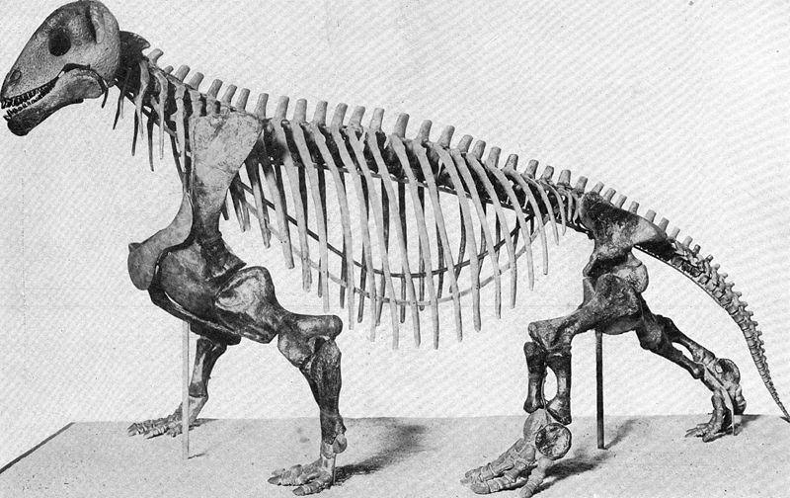
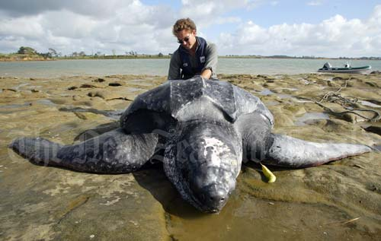
Size-Refugium Hypothesis.
Early therapsids were very large and were ectotherms.
They had very high thermal inertia.
Gigantothermic. Once warm,
they stayed warm; they were
homeotherms.
A modern gigantotherm.
Moschops (a therapsid)– 5 m
(Note cervical and lumbar ribs)

Slide 27
Size-Refugium Hypothesis.
Gigantothermy evolved around the early Permian.
This condition persisted for tens of millions of years.
The hypothesis posits that this long period of
gigantothermy resulted in physiological adaptation
to high and constant body temperature.
Selection during the Permian favored large body sizes.

Slide 28
Size-Refugium Hypothesis.
Dinosaurs radiated in the late Triassic.
Dinosaurs competed with and/or preyed upon cynodont
therapsids.
Selective pressures then changed, and cynodonts
became smaller and escaped predation/competition.
Thus, cynodonts lost the thermal inertia characteristic
of earlier ancestors.

Slide 29
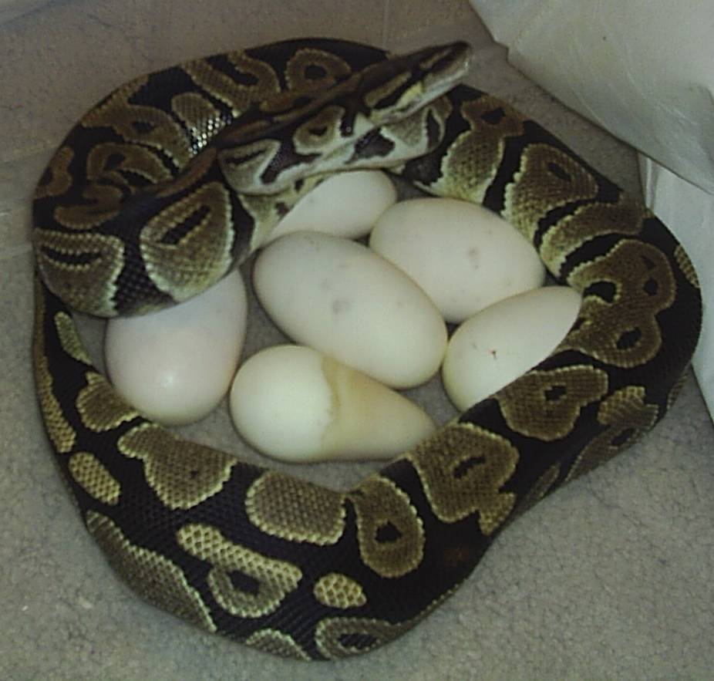
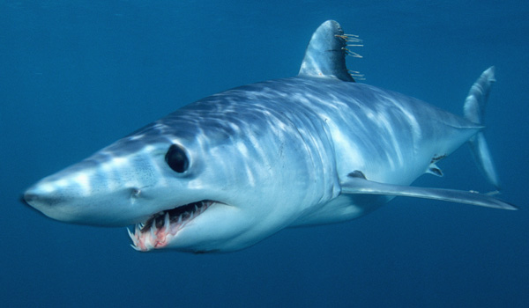
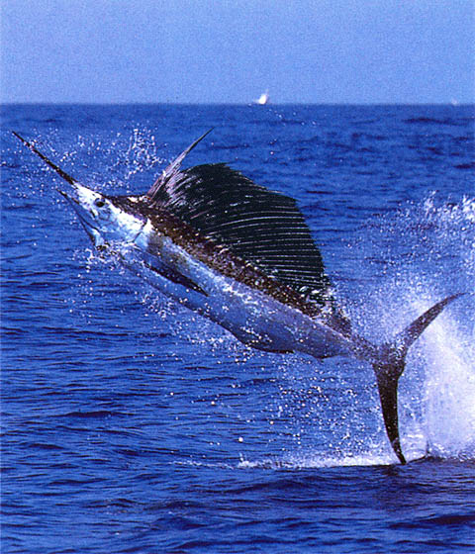
Size-Refugium Hypothesis.
Because of the physiological constraint to high and constant T_{body}, selection
favored groups that could produce their own heat.
This favored the evolution of endothermy.
Several vertebrates are partial/facultative endotherms (a.k.a mesotherms).

Slide 30
Size-Refugium Hypothesis.
Gradual evolution of endothermy in Triassic cynodonts.
Benton (2021)

Slide 31
Implications of Endothermy
A. Energy Requirements – Endotherm requires 10X energy as a similar sized ectotherm.
Therefore, selection favored
Efficiency in food processing
Dentition (specialized, precise)
Evolution of masseter
Formation of secondary palate
Cardiopulmonary efficiency
Extrusion of nuclei from red blood cells
Separation of oxygenated/deoxygenated blood
Muscular diaphragm
Thoracic ribs
Respiratory turbinates

Slide 32
Implications of Endothermy
B. Behavioral Implication – Because endotherms can generate own heat, they can be active at cold temperatures.
Endothermy permitted nocturnality.
Selection favored:
i. Hair for insulation
ii. Development of olfactory and auditory capabilities
The evolution of endothermy generated the selective forces that favored most of the traits we consider to be mammalian traits.

Slide 33
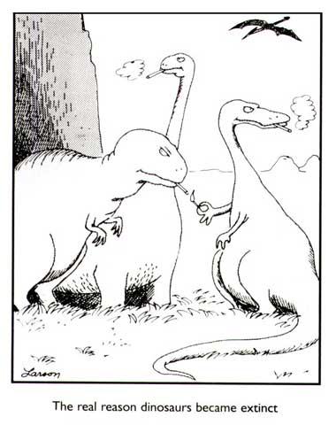
Classic Idea.
Extinction of dinosaurs at the end of the Cretaceous permitted the radiation of
mammals, resulting in modern mammalian diversity.
Lots of current studies are testing this notion by estimating the timing of mammalian
radiation (e.g., O’Leary et al., 2013 vs. Springer et al., 2013).

