Slide 1
Lecture 3 – Mammalian Diversity: Mammaliaformes, Mesozoic Mammals & Monotremes
(Lou et al., 2015. PNAS, e7101-e7109)
Node labeled “b” indicates most stable clade-based definition of Mammalia.
Node “a” is the commonly used crown-clade definition.

Slide 2
Luo et al. (2015).
Morganucodontids
We’ll look first at the Morganucodontids.
From the latest Triassic and early Jurassic.

Slide 3
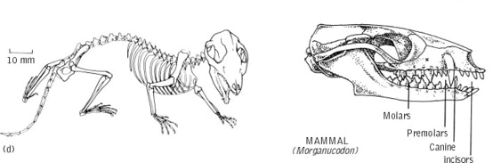
Best known from the genus Morganucodon.
Small – The skull length was around 3 cm and total length around 10 cm.
Skull had large nasal cavity. Respiratory turbinates were present.
Well-developed inner ear region.
Very large eye sockets
Primitive limb girdles.

Slide 4
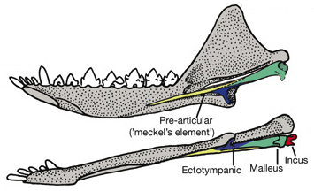
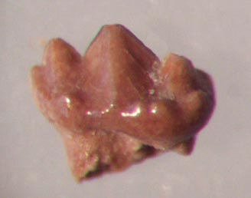
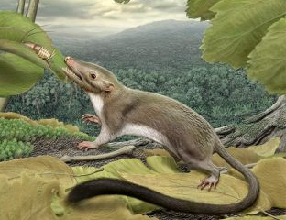
Best known from the genus Morganucodon.
Dentary was greatly expanded.
Cheek teeth had three cusps
Alternate-side chewing.
Articular was small and still present.
Insectivorous.
The angular was on mandible
Vibrissae

Slide 5
Luo et al. (2015).
Docodonts
We’ll next look at the Docodonts, another early-diverging group

Slide 6
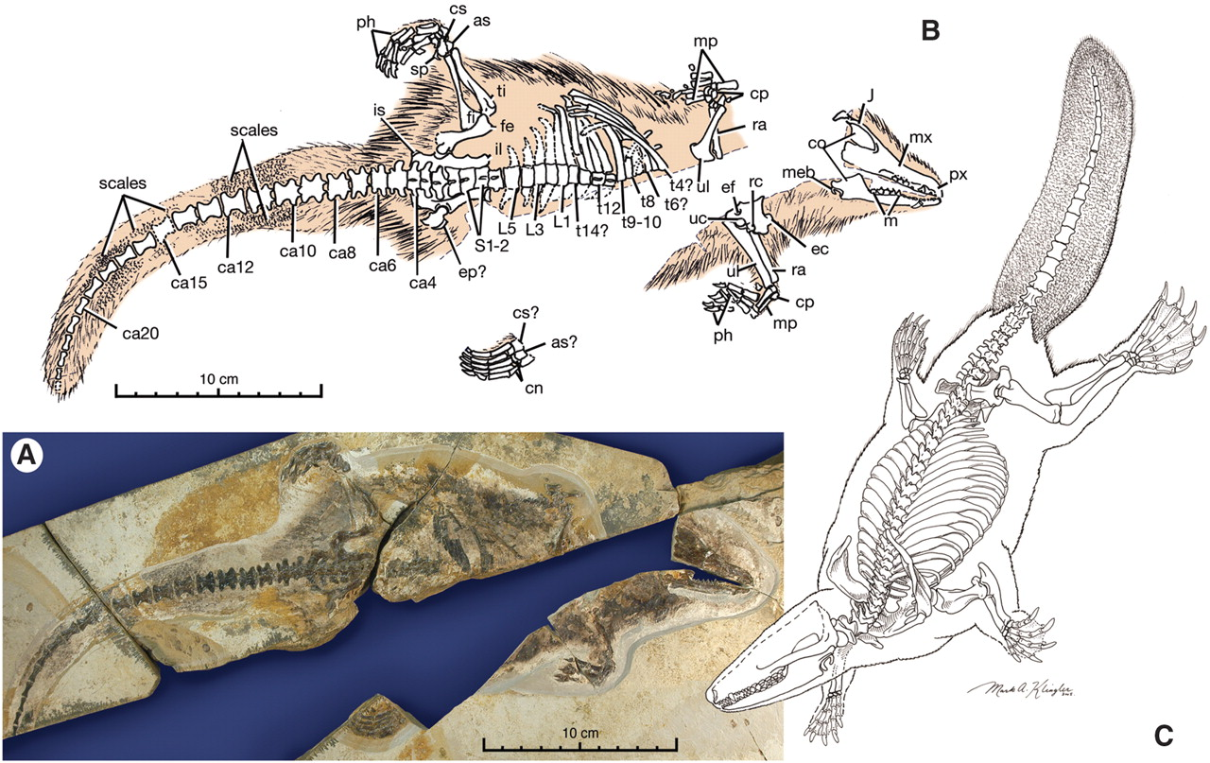
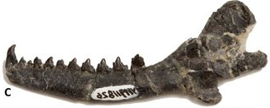
Docodonts
Castoricauda
Middle Jurassic, discovered in 1880.
Docodon victor
Microdocodon
Hyoid apparatus
(Lactation?)

Slide 7
Luo et al. (2015).
We’ll next look at the Haramiyidans.

Slide 8
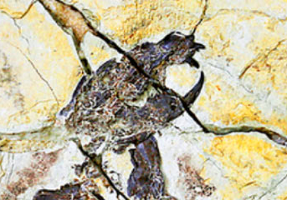
Haramiyidans
First appear ~220 MYA & persisted for ~80 MY.
Chisel-like incisors and a diastema (gap between incisors and cheek teeth) -
Herbivorous
Retained a single ear ossicle (stapes).
Quite diverse and many were arboreal and squirrel-like.

Slide 9
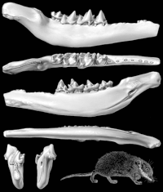
Australosphenids
Bishops
Ausktribosphenos
Early Cretaceous (~115 MYA) – Have eutherian-like tribosphenic molars.

Slide 10
Australosphenida
Australosphenida
Actually, these are related to Monotremes, implying
a dual origin for bifunctional teeth.

Slide 11
Luo et al. (2015).
Triconodonts
We’ll next look at the Triconodonts.

Slide 12
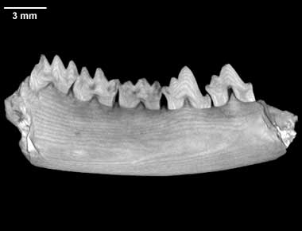
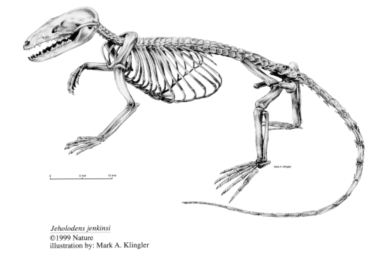
Triconodonts
Teeth similar to Morganucodontids but
cusps are linearized.
Mammalian pectoral girdle.
Pelvic girdle is still ancestral.
Had a very sprawling posture.
Great example of mosaic evolution.

Slide 13
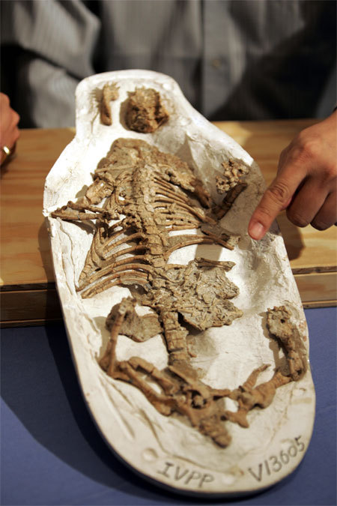
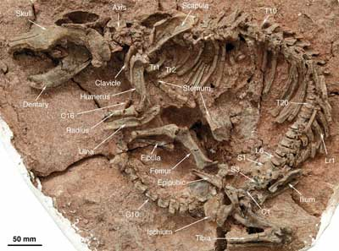
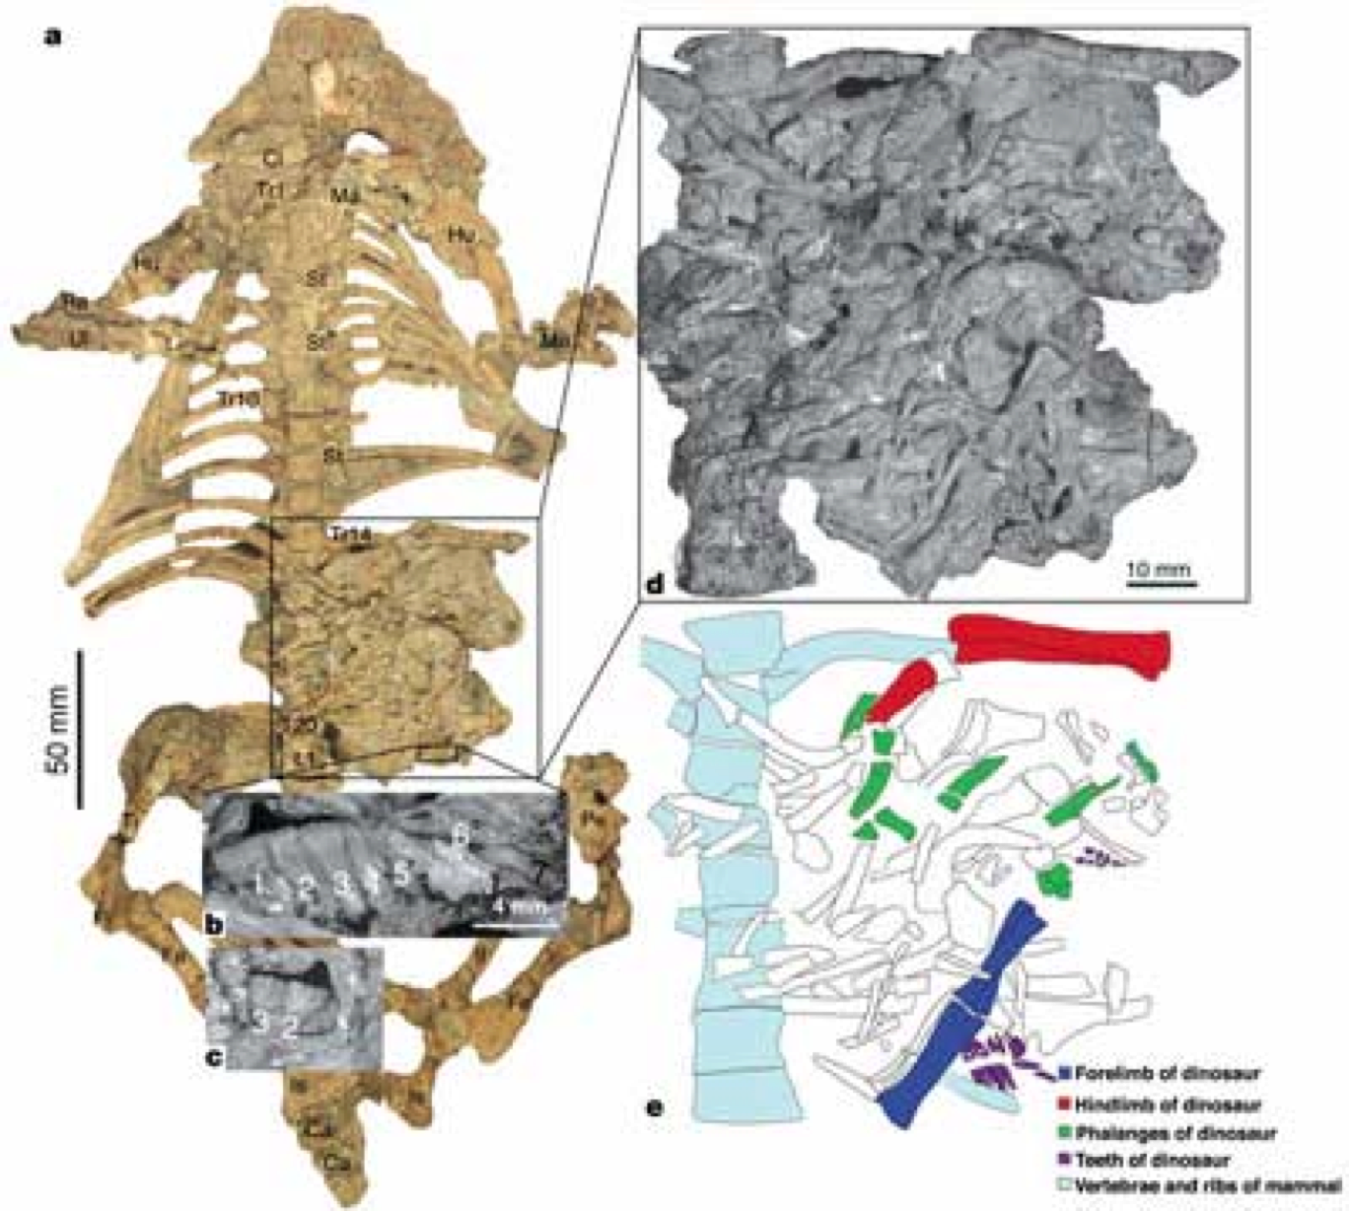
Triconodonts
Repenomamus.
About a meter long, and probably was carnivorous.
Derived pectoral girdle & ancestral pelvic girdle.
Hu et al. (2005, Science, 433:139.).

Slide 14
Multituberculates
Multituberculates
“Rodents of the Mesozoic”
(Luo et al. 2015)

Slide 15
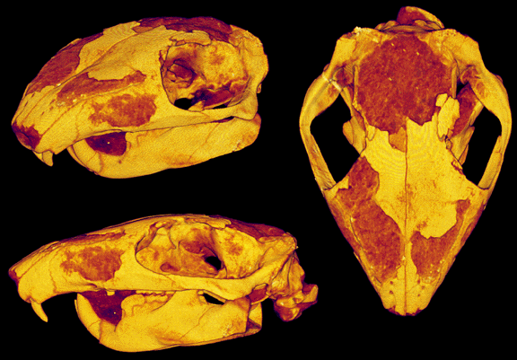
Multituberculates
Diverse and persistent group
  Date from upper Jurassic, span Cretaceous-Tertiary, & coextisted with modern mammals
  Mouse-sized to marmot-sized
Named for their dentition
  Chisel-like incisors
  Large diastema
  Complex, grinding molars (source of name)

Slide 16
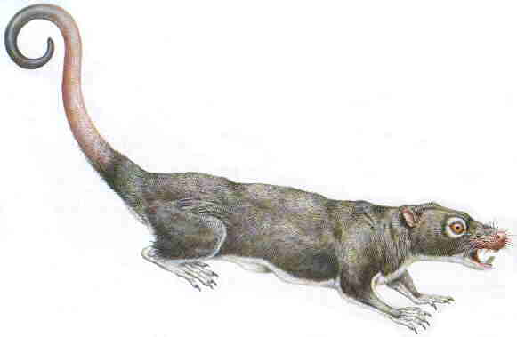
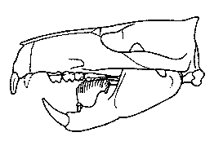
Multituberculates
There’s controversy in the literature, but they probably retained the ancestral
sprawling posture (Keilan-Jaworowska & Hurum 2006).
There’s good evidence that at lest some of the multituberculates were arboreal.
Their diversification coincides with the early Cretaceous diversification of
flowering plants (angiosperms).

Slide 17
Hadrocodium
195 MYA
Three ear ossicles!

Slide 18
Hadrocodium
This pushes the date for the origin of mammal(iaforme)s back.

Slide 19
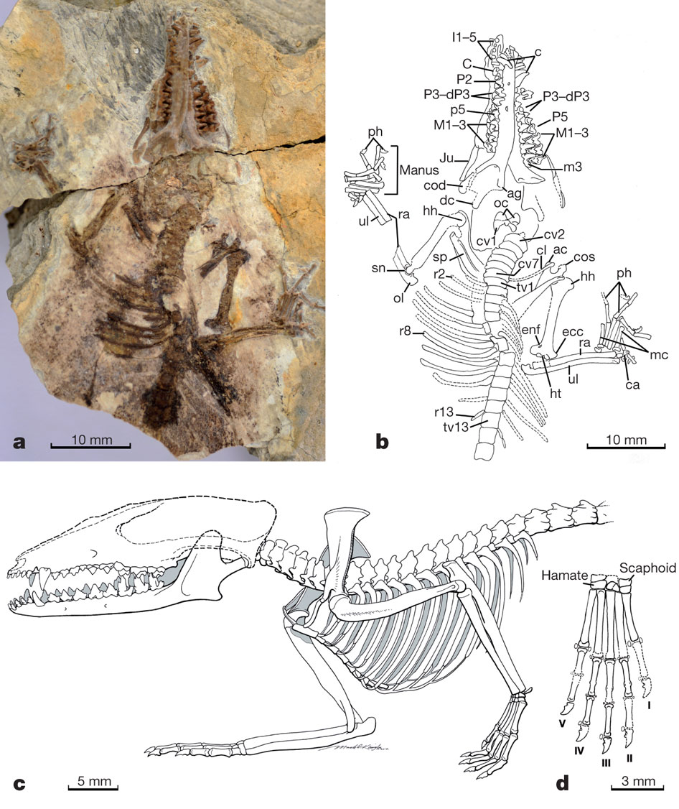
Juramaia sinensis
The oldest eutherian (placental mammal) ~ 160 MYA
Luo et al. Nature 476, 442-445 (2011) doi:10.1038/nature10291

Slide 20
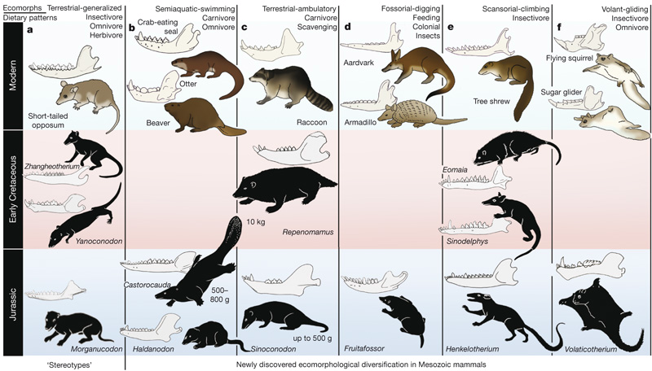
In last several years, more diversity has been discovered among Mesozoic mammals.
Luo (2007. Nature, 450:1011)

Slide 21
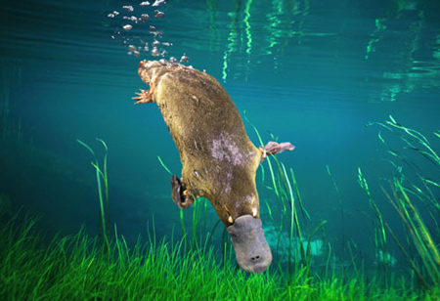
Monotremes – egg-laying mammals.
Order - Monotremata: ‘One hole’
  Cloaca (sewer) - single opening for urinary, digestive, & reproductive tracts.
  Earliest fossils from Cretaceous (>120 MYA, record poor, but increasing)

Slide 22
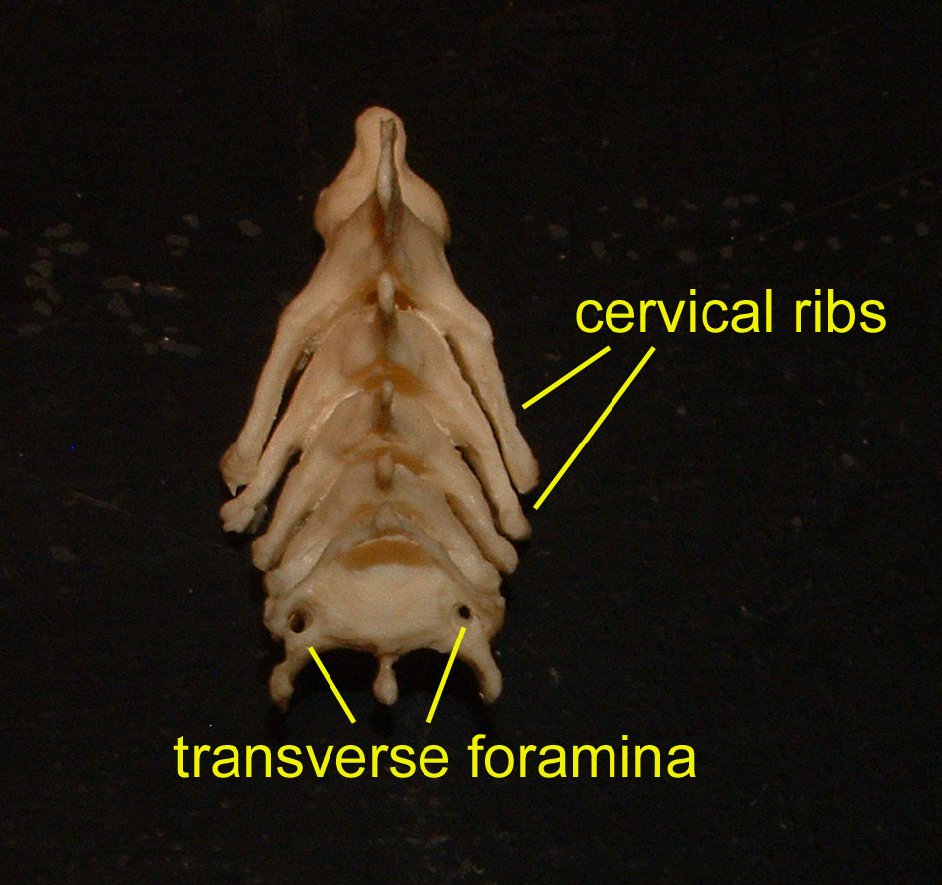
Monotremes – Mosaic of primitive and derived characters.
Primitive Characters
Cloaca
Skull characters - possess pre- and post frontal bones.
- no auditory bulla
- lacrimal bones absent
Pectoral girdle
Epipubic bones.
Cervical ribs.

Slide 23
Monotremes – Mosaic of primitive and derived characters.
Primitive Characters
Reproductive characters
    - oviparous
- eggs have huge amount of yolk relative to therians
- eggs are shelled - have a shell gland
- mammary glands have separate openings, no nipple, and
young lap milk from tufts of fur rather than suckling.
- male lacks a scrotum, and testes remain in the abdominal cavity.
- males lack seminal vessicles

Slide 24
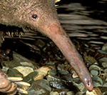
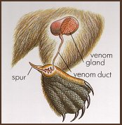
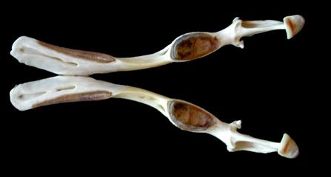
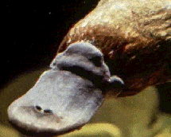
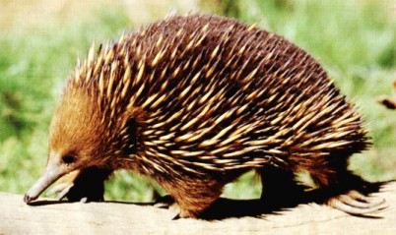
Monotremes – Mosaic of primitive and derived characters.
Derived Characters
Leathery bill or beak.
Venom
Raspy pads instead of teeth (as adults).
Electroreceptors in bill of platypuses
Echidnas have spines.

Slide 25
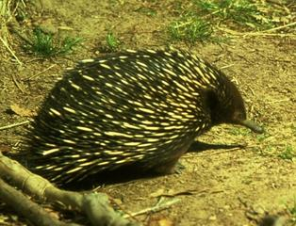
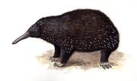
Order Monotremata, Family Tachyglossidae
Tachyglossus - short-beaked echidna
Zaglossus - long-beaked echidna

Slide 26
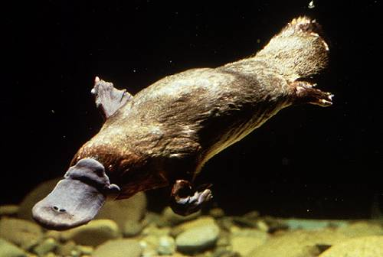
Order Monotremata, Family Ornithorhynchidae
Ornithorhynchus - platypus

