Slide 1
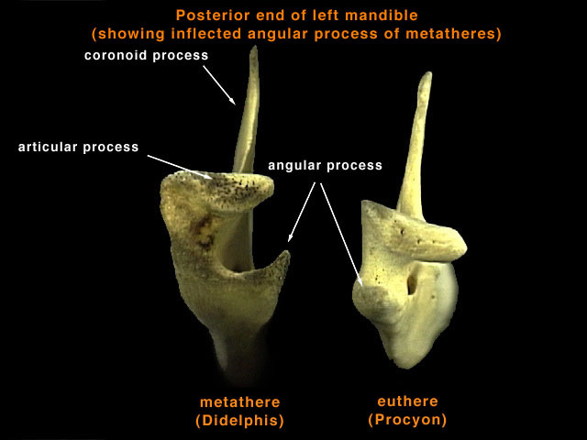
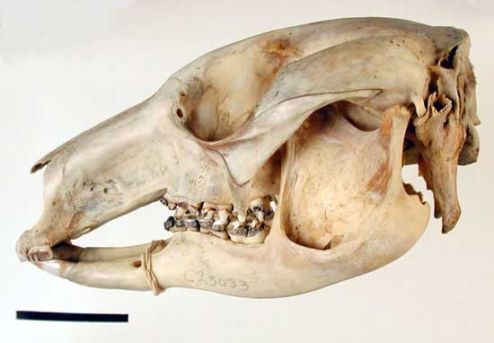
Metatheria: Marsupial Mammals
Jugal extends back to mandibular fossa.

Slide 2
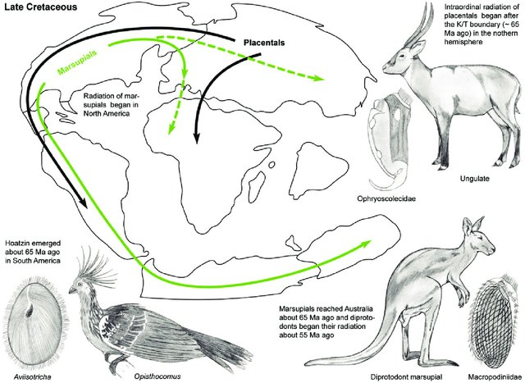
Hypothesized Single Dispersal to Australia
First fossils are from Laursia ~ 125 MYA.
Complex biogeography, related to the formation and rupture of Gondwanaland

Slide 3
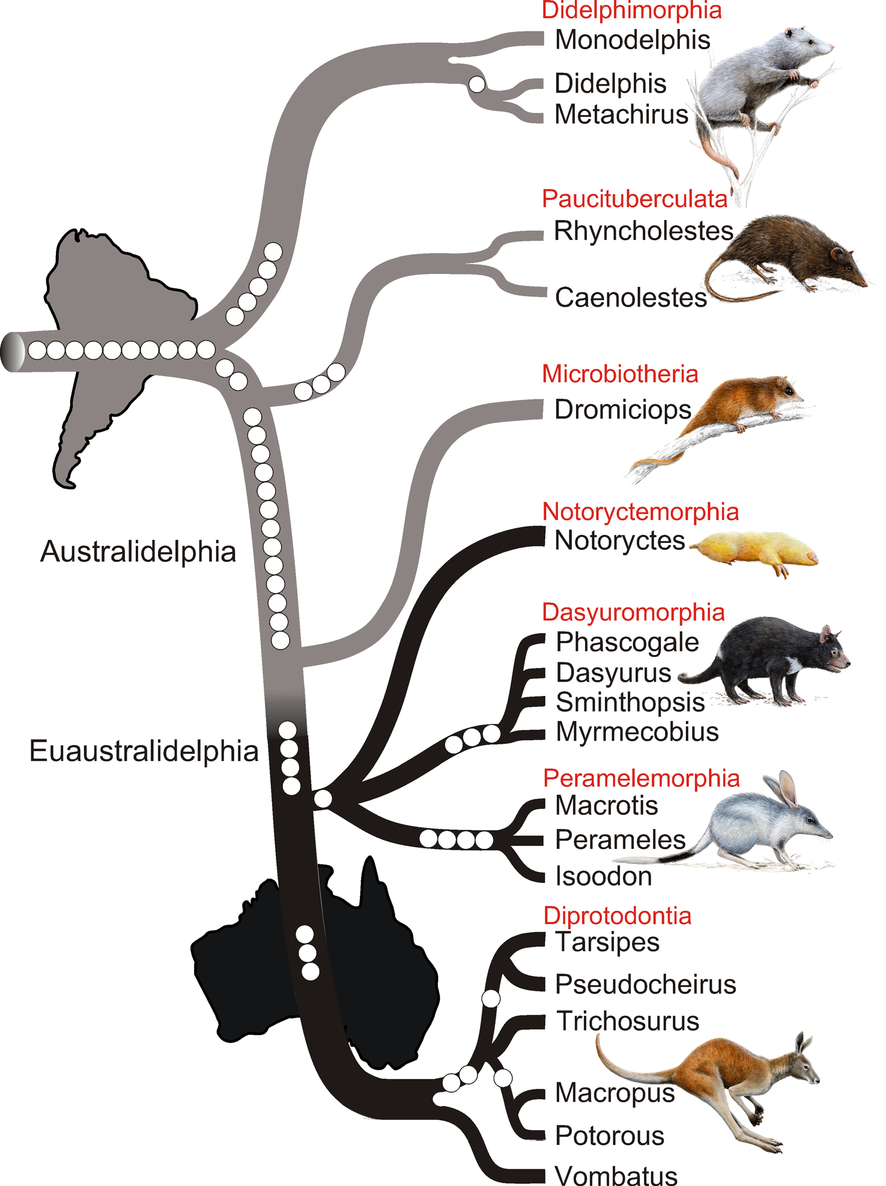
Metatheria: Marsupial Mammals
Single Dispersal Hypothesis
Supported from transposable elements:
(Nilsson et al. 2010. PLoS Biology)
Also supported by phylogenomics:
(Duchene et al. 2018. Syst. Biol.)

Slide 4
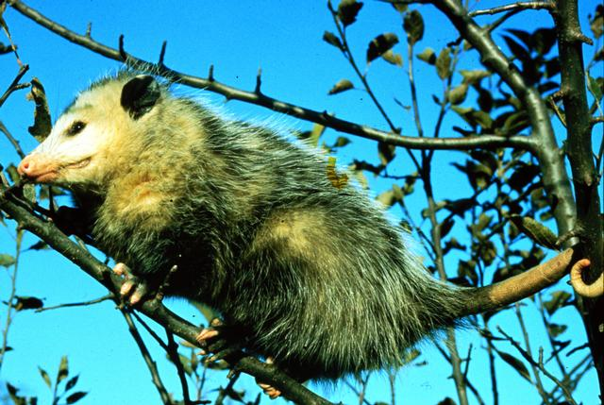
Order Didelphimorphia, Family Didelphidae
Didelphis - American opossum

Slide 5
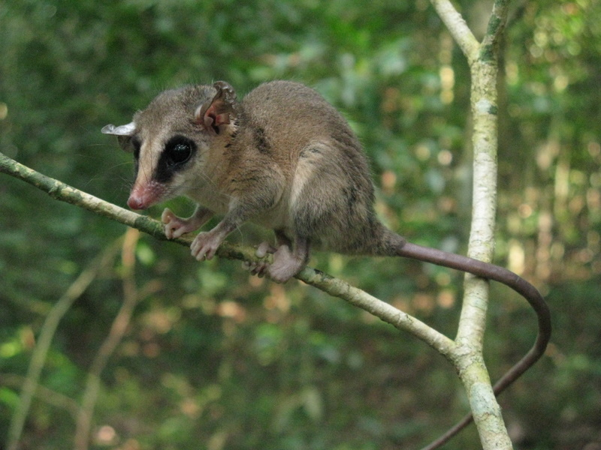
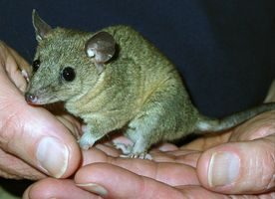
Order Didelphimorphia, Family Didelphidae
Marmosa: mouse opossum
Monodelphis:
short-tailed opossums

Slide 6
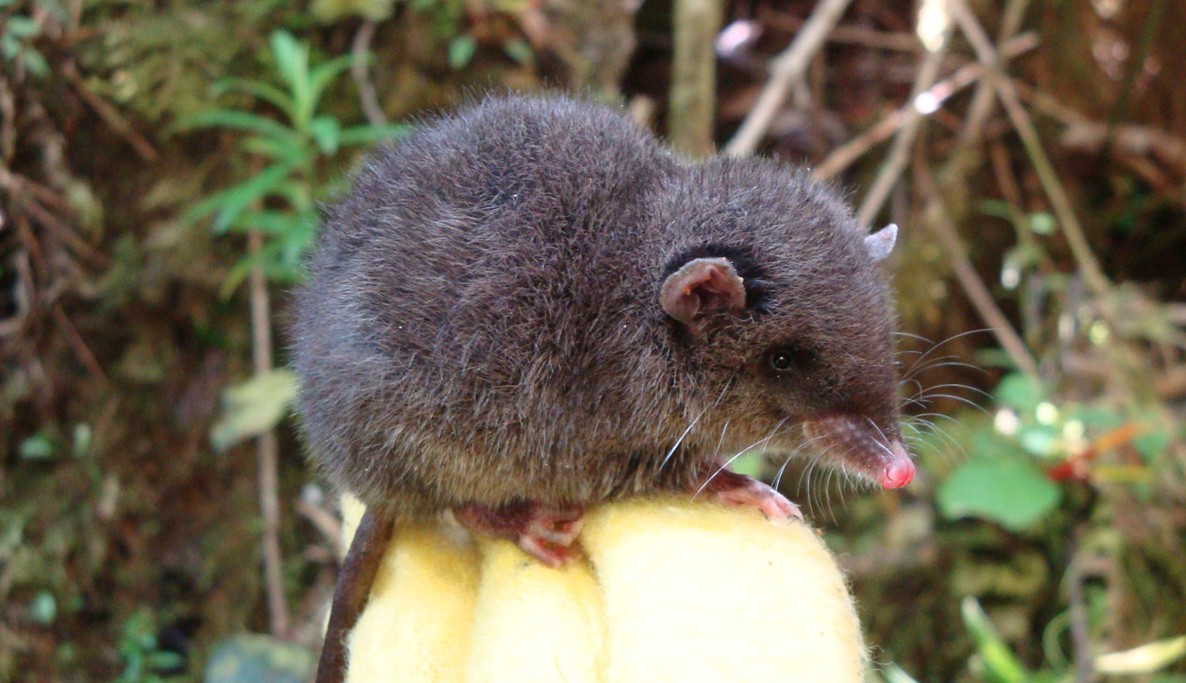
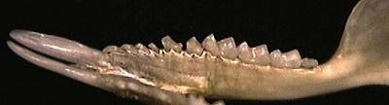
Order Paucituberculata, Family Caenolestidae
Caenolestes - shrew opossums

Slide 7
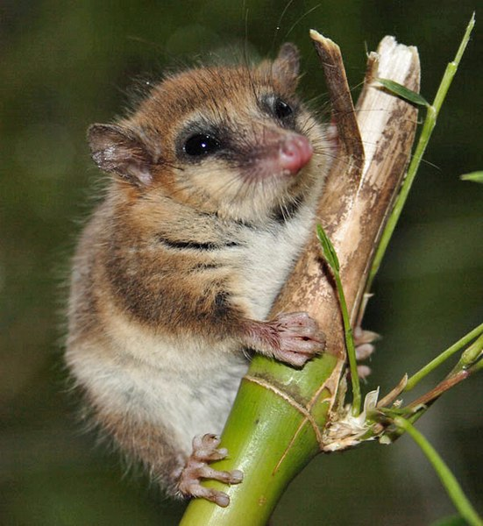
Order Microbiotheria, Family Microbiotheriidae
Dromiciops – Monito del monte

Slide 8
Australian Groups

Slide 9
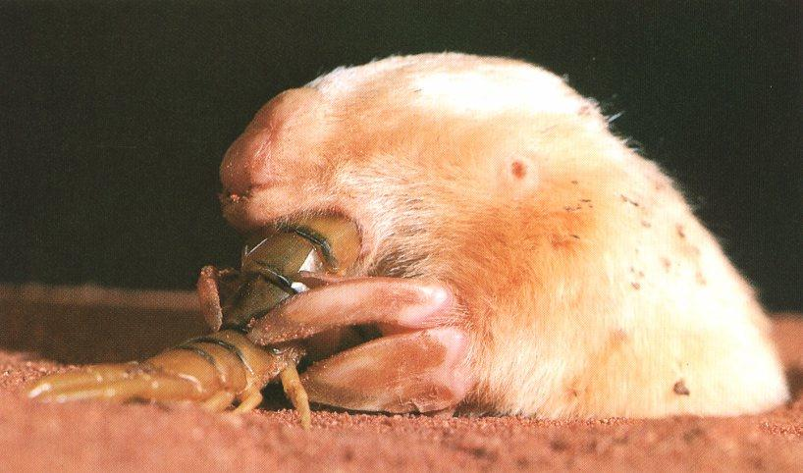
Order Notoryctemorphia, Family Notoryctidae
Notoryctes - marsupial mole
    Fossorial Adaptations
    Small eyes and small pinnae
    Fur is velvety – doesn’t lie in one direction
    Fusiform body with a short tail
Forelimbs modified for digging (in this case, the claws on 3rd & 4th digits)

Slide 10
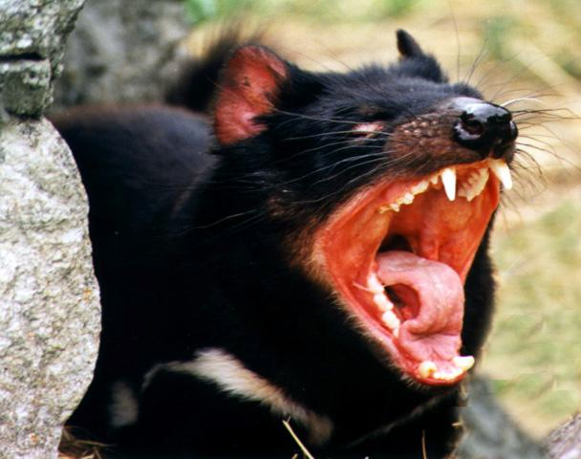
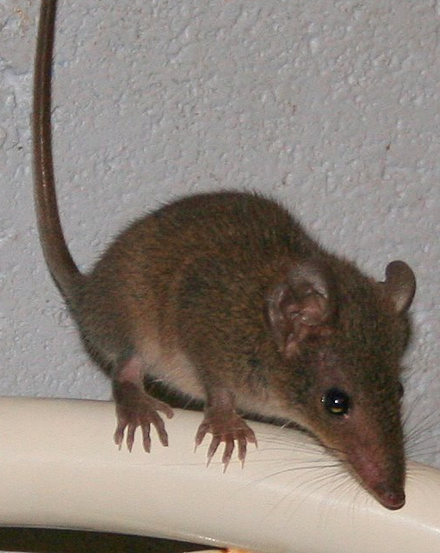
Order Dasyuromorphia, Family Dasyuridae
Sarcophilus - Tasmanian devil
Antechinus – Marsupial mouse

Slide 11
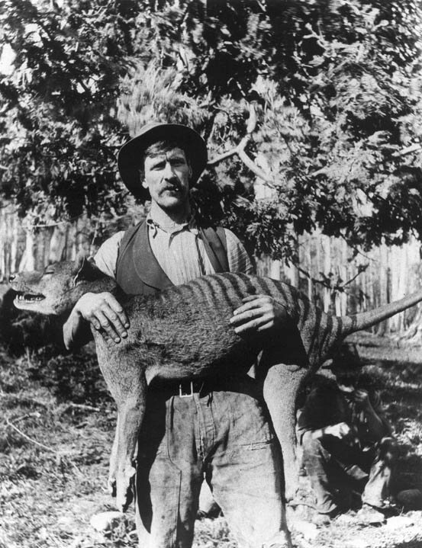
Order Dasyuromorphia, Family Thylacinidae
Thylacinus cynocephalus - Tasmanian wolf

Slide 12
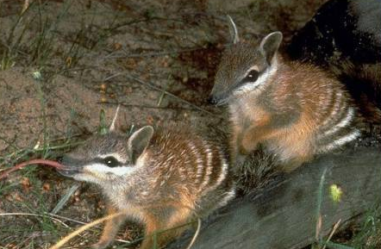
Order Dasyuromorphia, Family Myrmecobiidae
Myrmecobius - numbat
Myrmecophagus adaptations:
Long rostrum Long, protrusible tongue
Delicate dentary Copious, sticky saliva
Teeth reduced/absent Forelimbs modified for digging

Slide 13
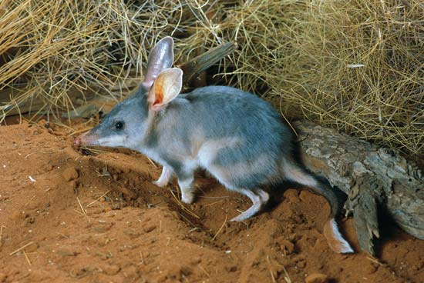
Order Peramelemorphia, Family Peramelidae
Macrotis - rabbit-eared bandicoot (bilby)
Syndactylous - one sheath of skin for >1 digit (2nd & 3rd).

Slide 14
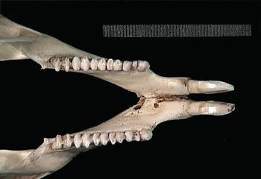
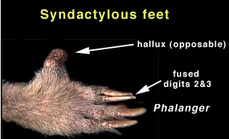
Order Diprotodontia
Largest order: 10 Families
Most forms have just two lower incisors.
These are syndactylous.

Slide 15
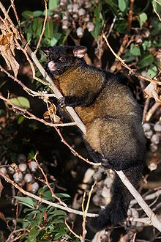
Order Diprotodontia, Family Phalangeridae
Trichosurus vulpecula – Common brush-tailed possum

Slide 16
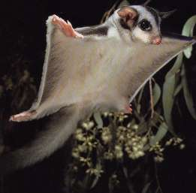
Order Diprotodontia, Family Petauridae
Petaurus breviceps - sugar glider

Slide 17
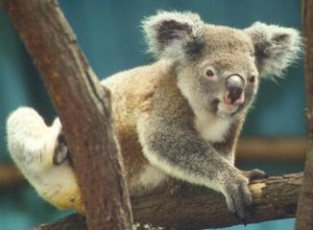
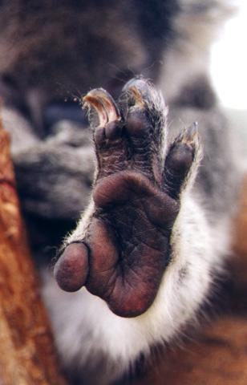
Order Diprotodontia, Family Phascolarctidae
Phascolarctus cinereus - koala
2nd & 3rd digits syndactylous

Slide 18
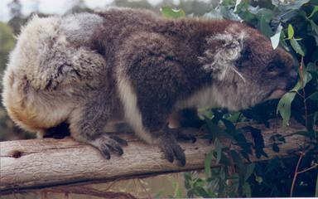
Order Diprotodontia, Family Phascolarctidae
Phascolarctus cinereus - koala
    - Our first example of an arboreal foliavore
      low quality food
      eat almost constantly while awake
      sleep to digest
      low metabolism
      heterothermic
      dense fur to retain body heat

Slide 19
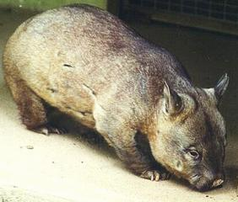
Order Diprotodontia, Family Vombatidae
Lasiorhinus - hairy-nosed wombat

Slide 20
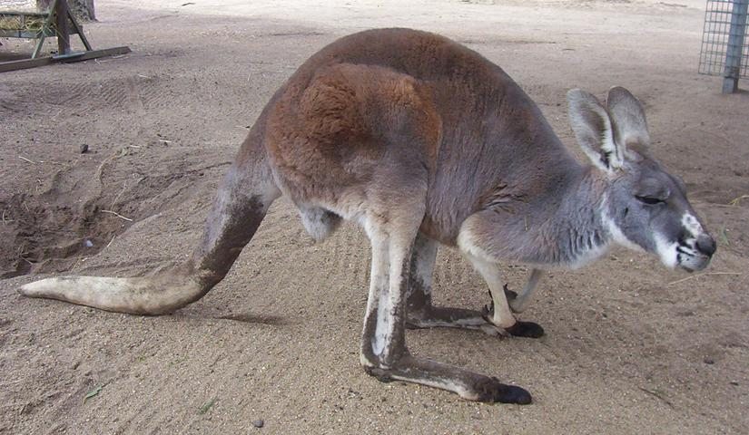
Order Diprotodontia, Family Macropodidae
Macropus rufus - red kangaroo
Extreme adaptations for saltation (bipedal hopping)

Slide 21
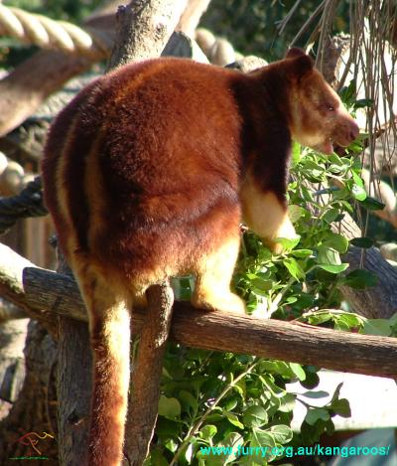
Order Diprotodontia, Family Macropodidae
Dendrolagus - tree kangaroo

Slide 22
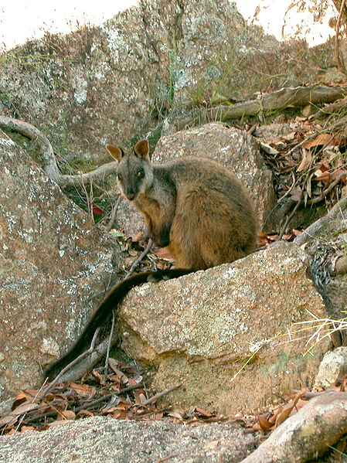
Order Diprotodontia, Family Macropodidae
Petrogale - rock wallaby

