Slide 1
Disparity in Diversity between Metatherians and Eutherians
Species Diversity
Metatherians: ~379 species (<5%)
Eutherians: ~6111 species (>95%)
Morphological Diversity
Several fully aquatic species in two
(or three) separate orders.
No fully aquatic species.
No species capable of powered
flight.
Bats have evolved powered flight.

Slide 2
Front Limb Morphology
Antelope
Bat
Dolphin
Bandicoot
Kangaroo
Cooper & Steppan (2010)
Rate of front-limb evolution is faster in eutherians than in metatherians.

Slide 3
Eutherian Blastocyst
from Selwood & Johnson (2006. Bioassays. 28:128-145.)
Embryoblast
Inner cell mass (Yellow)
Trophoblast
Outer layer of cells (Blue)
Zona pellucida
1) Production of chorionic gonadotropins
Cause cell death of the T-cells of the maternal immune system.
Signal the Corpus Luteum (of the ovary) to halt the uterine cycle.
2) Some cells of the trophoblast fuse to form a syncytio-trophobalst.
Mediated by syncytins, genes captured from an endogenous retrovirus.
(Lavialle et al. 2013 – pdf on course website)

Slide 4
Repeated Capture of Syncytins in Eutherians
(Imakawa et al. 2022)
Euarchontoglires
Laurasiatheria
Afrotheria
Marsupials
Monotremes

Slide 5
Metatherian Blastocyst
from Selwood & Johnson (2006. Bioassays. 28:128-145.)
Embryoblast
(Yellow)
Trophoblast
(Blue)
Shell membrane
Yolk sac
The trophoblast doesn’t surround the embryonic tissues completely.
There is less fusing of trophoblastic cells into the syncytio-trophoblast
There are fewer syncytin genes (Cornelis et al. 2015 – pdf on website).
There appears to be no signaling by chorionic gonadotropins to the Corpus
Luteum, and the estrous cycle is not halted.
As a result, marsupials have short gestation periods and give birth to insanely
altricial young.

Slide 6
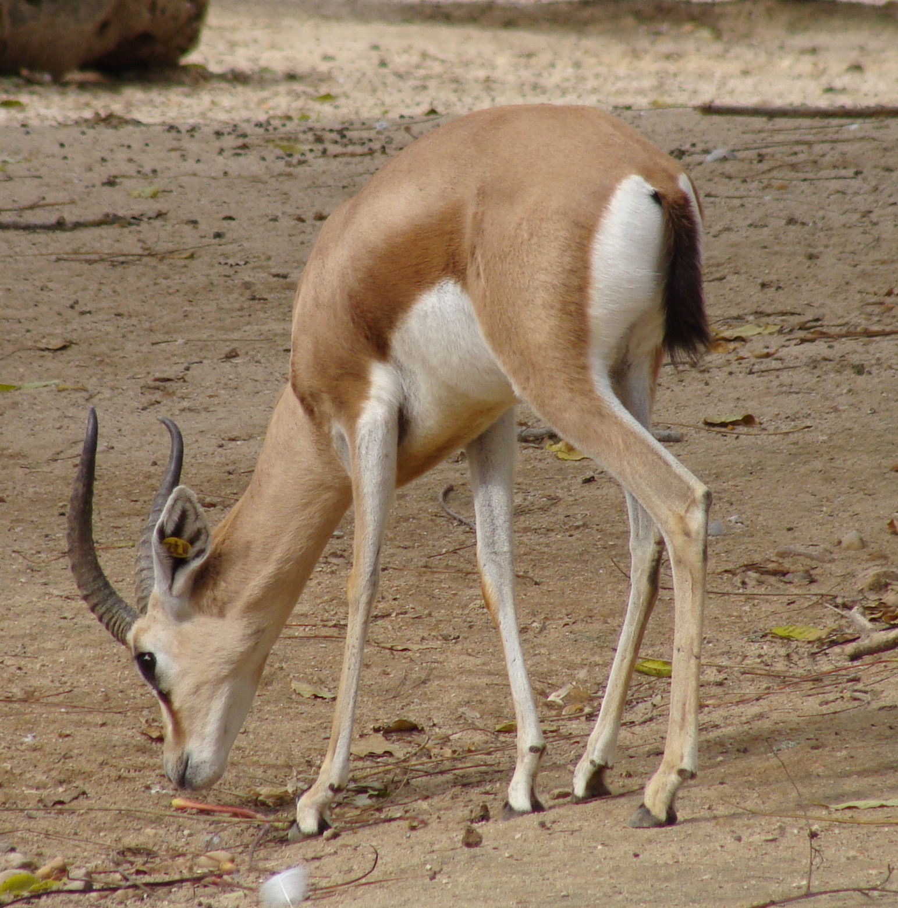
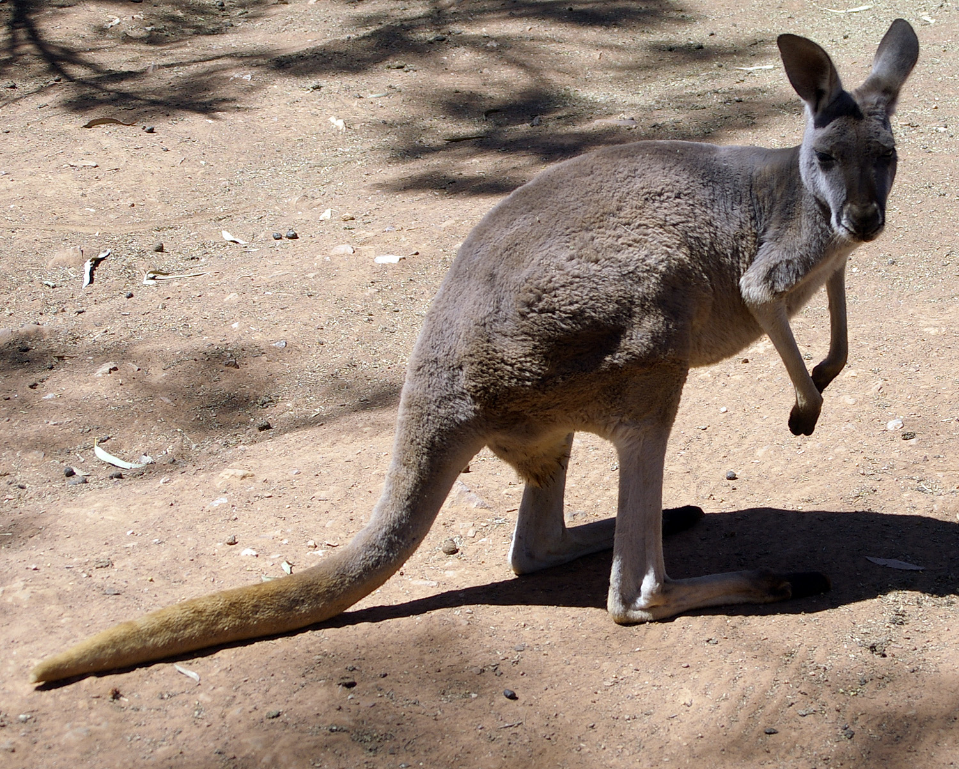
Metatherians have very short gestation periods
This has two effects on energetics of reproduction:
1) Metatherians have a much longer overall period from conception to weaning
2) In metatherians, a higher percentage of time is spent lactating.
Lactation is about twice as energetically costly than gestation.
Therefore, eutherians experience a lower overall energy cost of reproduction and may
have a competitive advantage over metatherians.

Slide 7
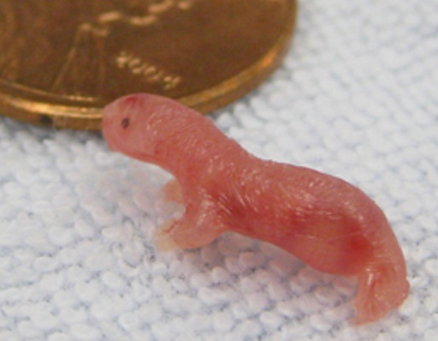
Metatherian Neonate
Monodelphis

Slide 8
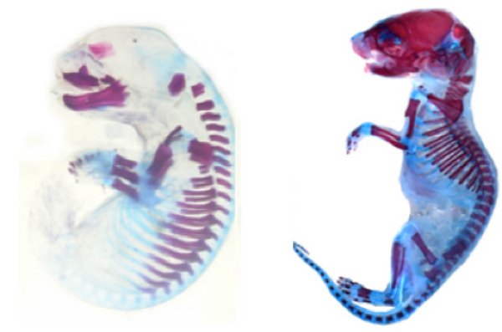
Neonatal Ossification
Wallaby
Mouse

