Slide 1
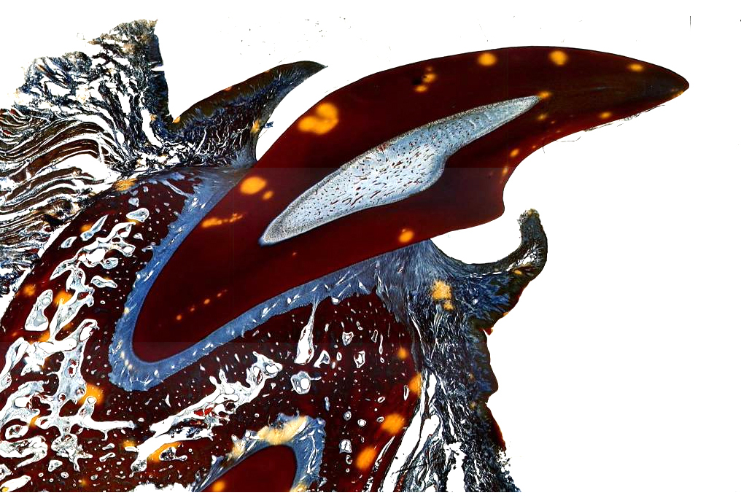
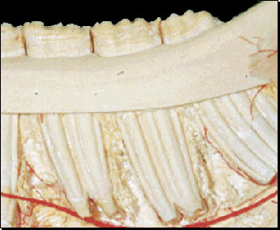
Lecture 6 - Dentition
Pulp Cavity
Crown
Brachydont
Hypsodont
Enamel – Hard outer layer
Root
Dentin – Softer layer under enamel

Slide 2
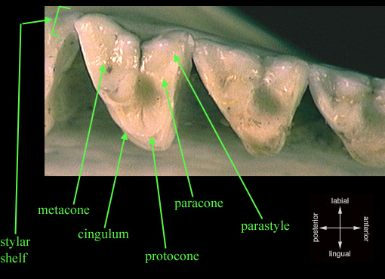
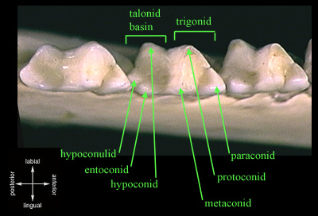
Metatherian Upper Tribosphenic
Molar
Metatherian Lower Tribosphenic
Molar

Slide 3
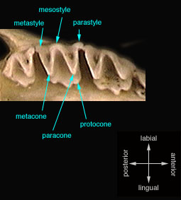
Dilambdodont Molars

Slide 4
Secodont or Sectorial Teeth
Carnassials are P⁴/M₁

Slide 5
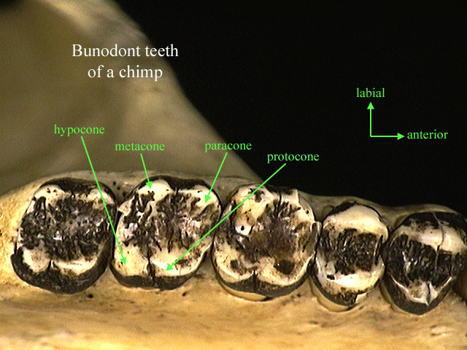

Slide 8
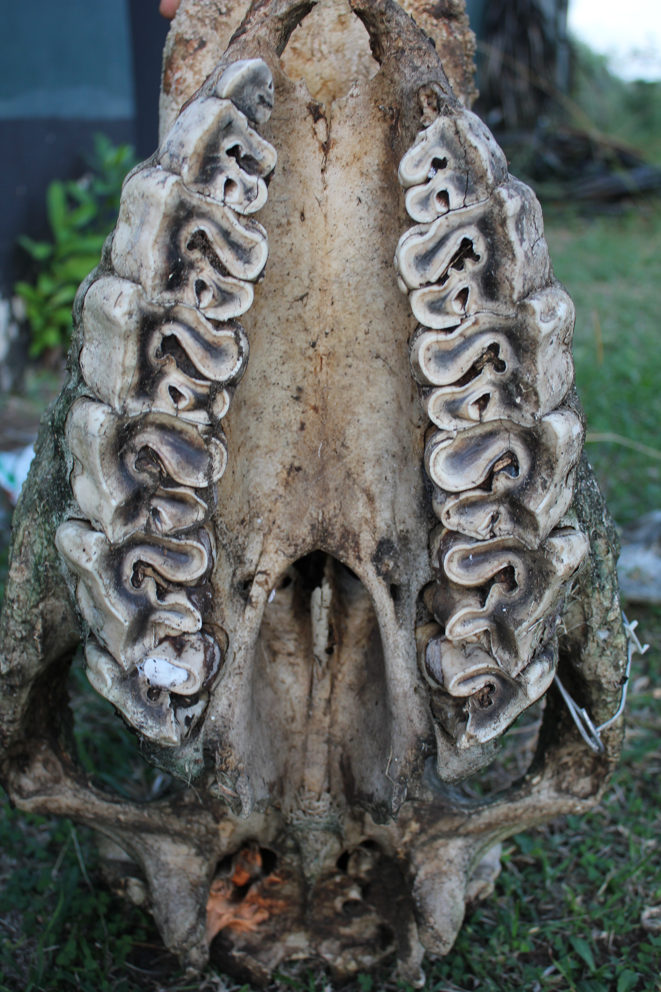
Selenolophodont teeth of a Rhino

