Slide 1
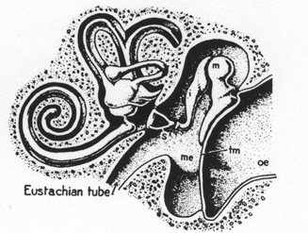
Lecture 8 – Evolution of Ear Ossicles
Definitive Mammalian Middle Ear (DMME)
Semicircular Canals
Sensory cells for balance
3 Ear Ossicles
Malleus
Incus
Stapes
Chochlea
Sensory cells for hearing
Tympanum
Chain of transmission:
Tympanum → Malleus → Incus →Stapes → Inner Ear

Slide 2
Characteristics of Evolution Demonstrated by Ear Ossicles/Jaw Joint
1. Gradualism → Evolution is often very gradual. We’ll see change from one
morphology to a very different one in a finely graded set of steps.
2. Modification of existing structures → For the most part, evolution modifies
what’s already there, and when new structures arise (masseter) they split
off existing structures.
3. Constraints & Exaptations → Organisms are integrated wholes, and changes to
a particular system don’t occur in a vacuum; characters are non-independent
and functions change over time. An exaptation currently serves a different
function than its original function.
Functional Morphology
In equilibrium, any force that is being exerted is resisted by an equal and
opposite force.
2. Resolve force vectors.

Slide 3
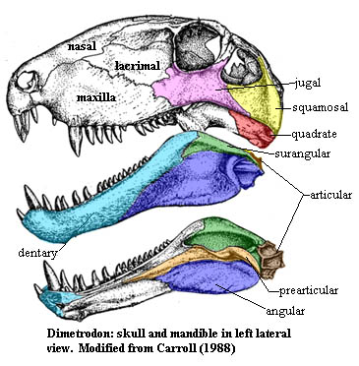
Early Synapsids
Chain of transmission:
Dentary → Angular → Articular → {JJ} → Quadrate →Stapes → Inner Ear

Slide 4
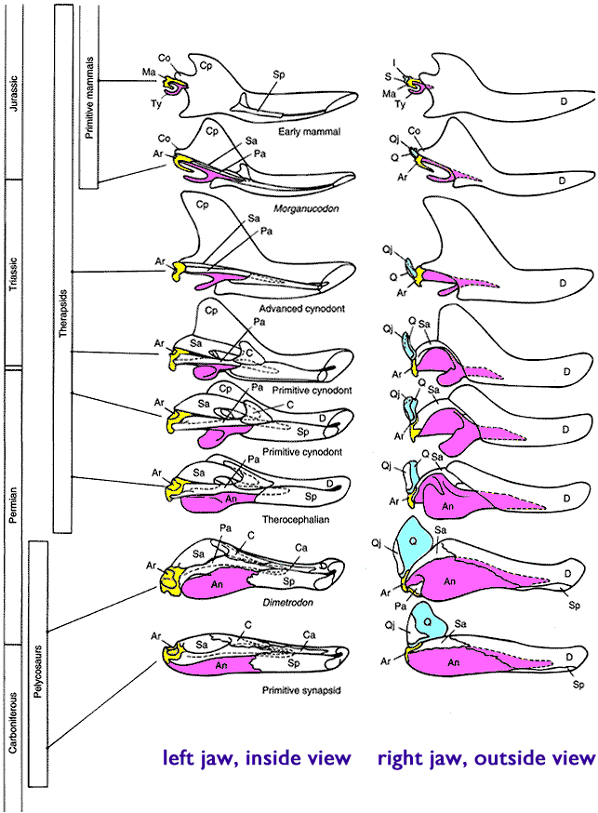
Transition from state in early synapsids to cynodont state (MMEC).
MMEC

Slide 5
Transition from Mandibular Middle Ear of Cynodonts (MMEC)
to DMME of Mammals through an Intermediate (PMME)
MMEC
PMME
PMME to DMME
Ossified Meckel’s Cartilage deteriorates
during development.
Ossified Meckel’s
Cartilage
Ossified Meckel’s
Cartilage
(Triconodont)
From Meng et al. 2011. Nature, 472:181.

Slide 6
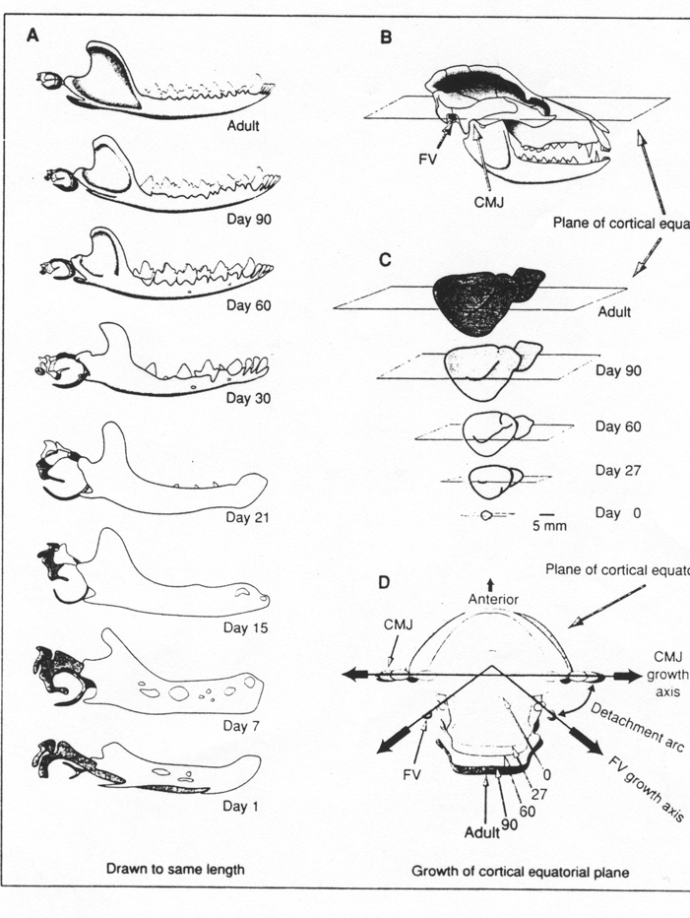
Development of Ear Ossicles in Didelphis
Malleus
Meckle’s
cartilage

Slide 7
Independent Evolution of DMME from MMEC/PMME
Subsequent reversal
From Luo (2011). Ann. Rev. Ecol. Evol. Syst. 42:355.

