Slide 1
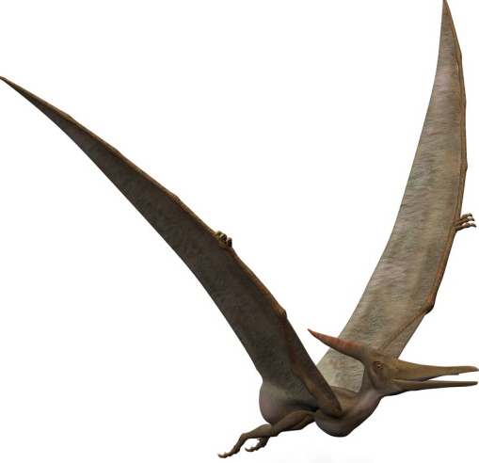
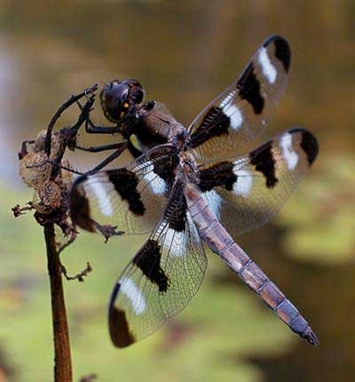
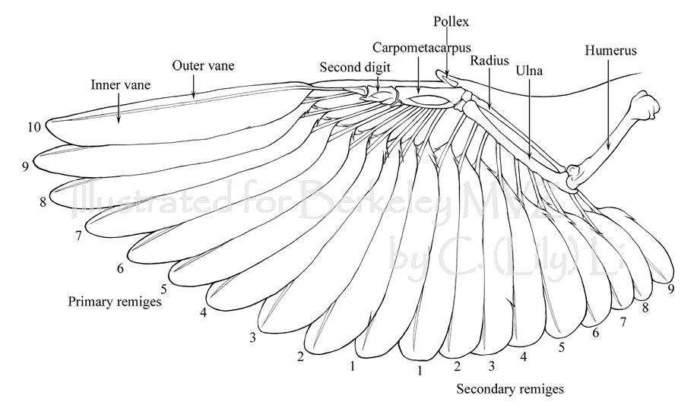
Lecture 9 – Locomotion: Flight
Powered flight has evolved several times in animals:
Pterosaurs
Insects
Birds

Slide 2
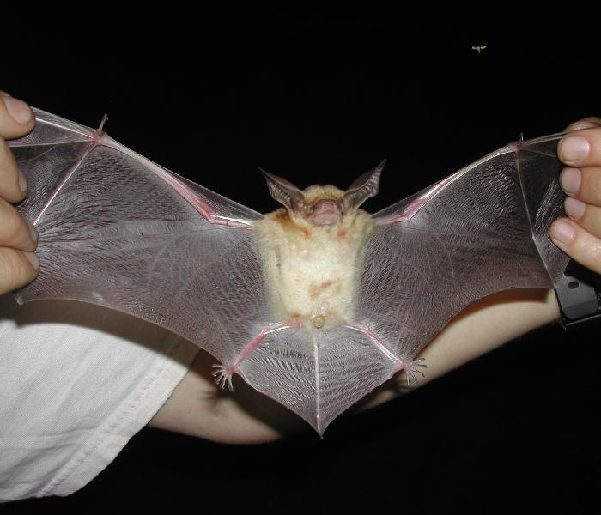
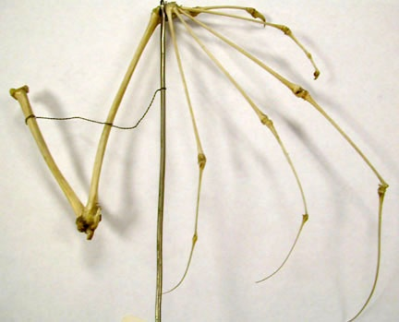
Powered Flight : Bats
Supported by digits 2-5
Skin forms patagium.

Slide 3
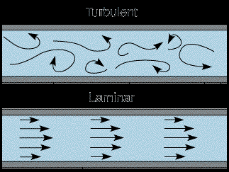
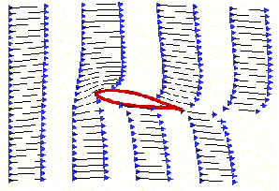
Generation of Lift
Laminar flow – parallel movement of air streams
Velocity across top is higher than bottom.
Turbulent Flow
Laminar Flow
Bernoulli’s Theorem
Lift = P_{(Lower)} – P_{(Upper)}
P is air pressure.
C is a constant.
d is the density of air, and V is velocity.

Slide 4
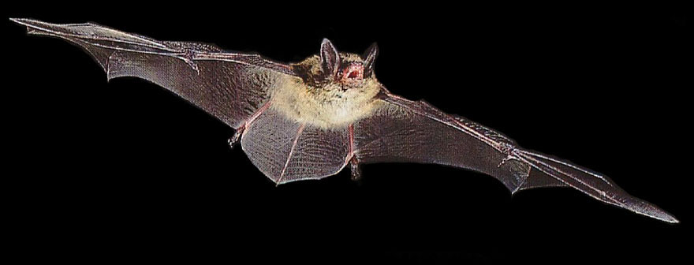
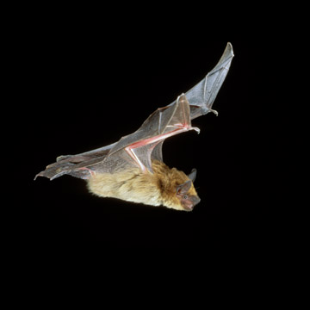
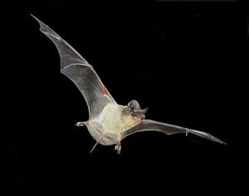
Bats tend to be slow fliers.
Myotis lucifugus (little brown bat) - 20 MPH
Eptesicus fuscus (big brown bat) - 40 MPH
Tadarida brasiliensis (Brazilian free-tailed bat) – regularly up to 60 MPH

Slide 5
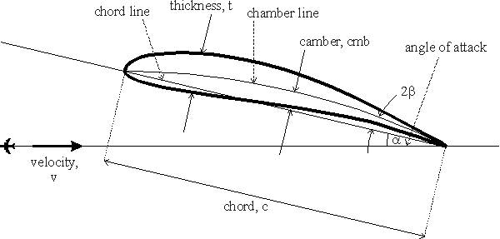
Generation of lift at low flight speeds.
1. Increase camber, or curvature of the wing.
Chaney et al. (2017. J. Anatomy, 230:510)

Slide 6
Generation of lift at low flight speeds.
2. Increase angle of attack (even a symmetric airfoil can generate lift this way)

Slide 7
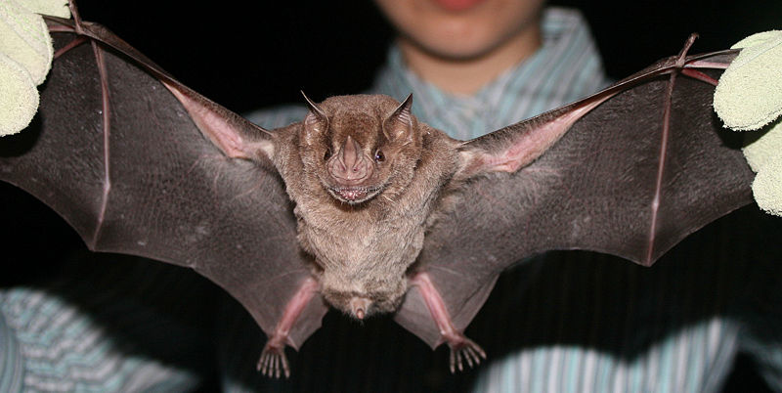
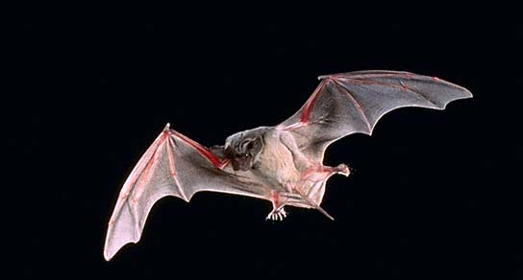
Generation of lift at low flight speeds.
3. Wing size and shape.
Wing loading: Body weight /surface area.
Body Weight Surface Area Wing Load
House wren 11.0 g 48.4 cm² 0.24 g/ cm²
Glossophaga 10.6 g 99.3 cm² 0.11 g/ cm²
Myotis 4.2 g 67.6 cm² 0.06 g/ cm²
b. Aspect ratio - length / width
Artibeus – low aspect ratio
Tadarida – high aspect ratio

Slide 8
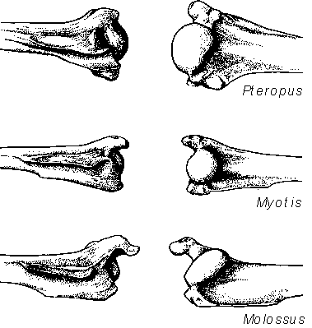
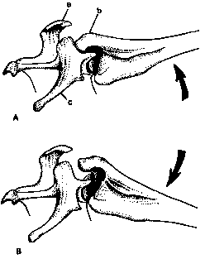
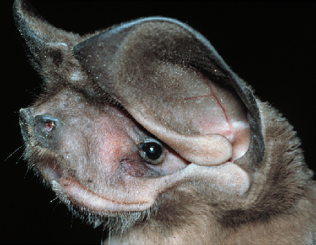
Stopping the up-stroke: Shoulder-locking mechanism
Greater tuberosity of humerus
Mollossids
Vespertilionids also.
Eumops perotis
western bonneted bat

Slide 9
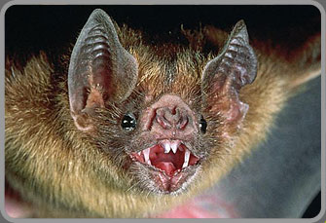
Moderately well-developed shoulder locking.
Modest greater tuberosity
*Situation similar in phyllostomids

Slide 10
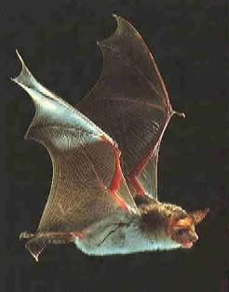
Poorly developed shoulder locking mechanism: entirely muscular.
Sac-winged bats – Emballonuridae.

Slide 11
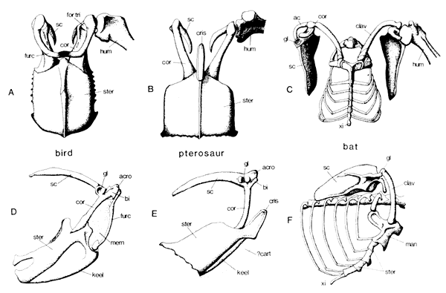
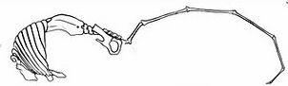
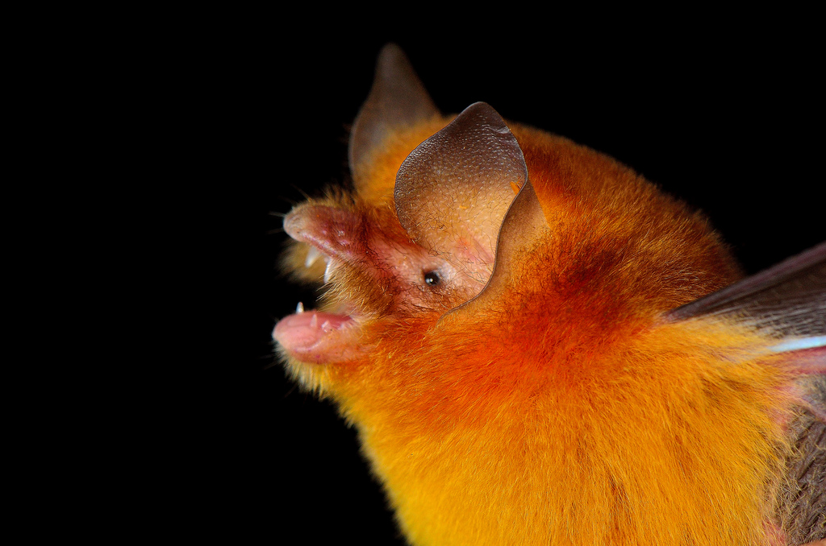
Other Adaptations for Flight
Keeled manubrium of sternum.
Some (Natalidae) have rigid axial skeleton.
1. Compressed thoracic vertebrae - not fused, but very tightly interconnecting
2. Fused sacral vertebrae and fused lumbar vertebrae

