Slide 1
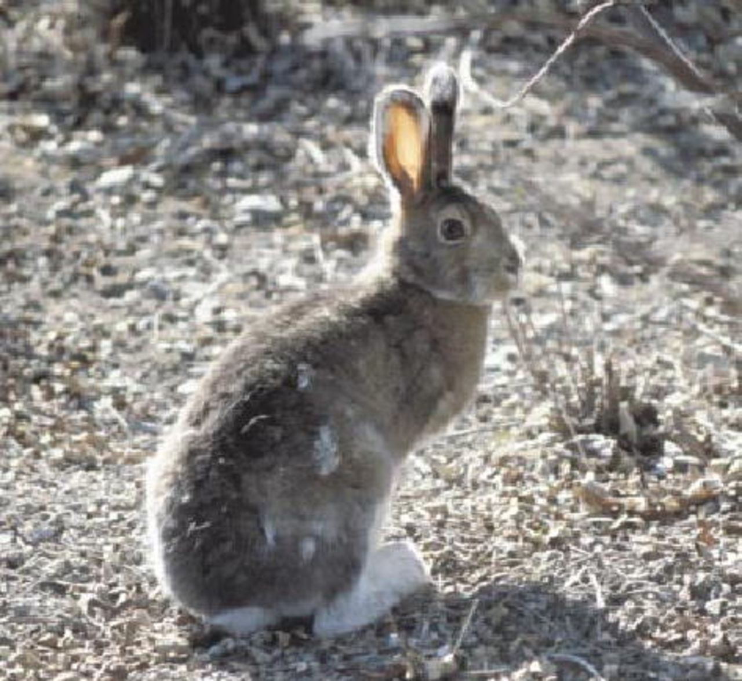
Predator-prey relationships drive in-phase 10 year cycles in Lynx canadensis
and Lepus americanus.
Notes:
Canada lynx fur returns from the Northern Department of the Hudson's Bay Company from 1821 to 1910. The Northern Department occupied most of western Canada. The cycle for these data averages 9.6 years. Data are from Elton and Nicholson (1942). Photo: Mark O'Donoghue

Slide 2
Predator-prey relationships drive in-phase 10 year cycles in Lynx canadensis
and Lepus americanus.
Krebs et al. (2018. J. Anim. Ecol.)

Slide 3
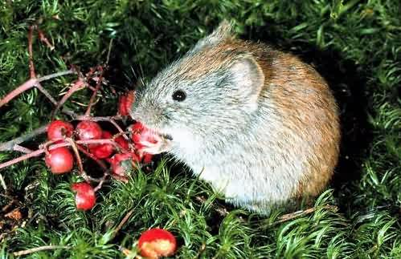
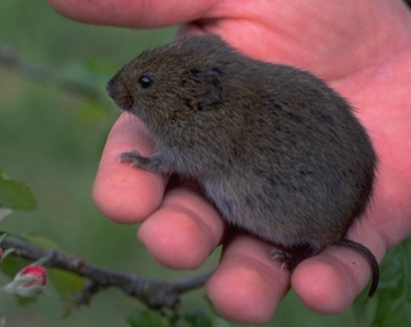
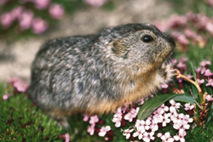
Arvicoline Population Cycles
Myodes rufocanus (gray-sided vole)
Microtus pennsylvanicus
Dicrostonyx groenlandicus (collared lemming)

Slide 4
Characteristics of arvicoline cycles
1) They have a huge amplitude.
2) Growth phase is very rapid.
3) The crash is very abrupt.
4) There is a lag, or low period.
5) The periodicity seems to be fairly regular.
6) There’s a latitudinal effect.

Slide 5
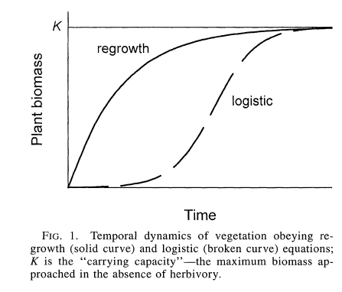
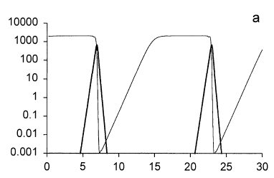
Extrinsic Hypotheses: Food
At low vole densities, plants are unaffected by herbivory.
At high densities, there is a selective reduction of plant biomass.
This triggers production of chemical defenses by plants.
Which, in turn, compromises the quality of forage available to voles,
causing the crash.
The time lag is explained as the time that plant populations take to recover.
Turchin & Batzli 2001. Ecology 82:1521.

Slide 6
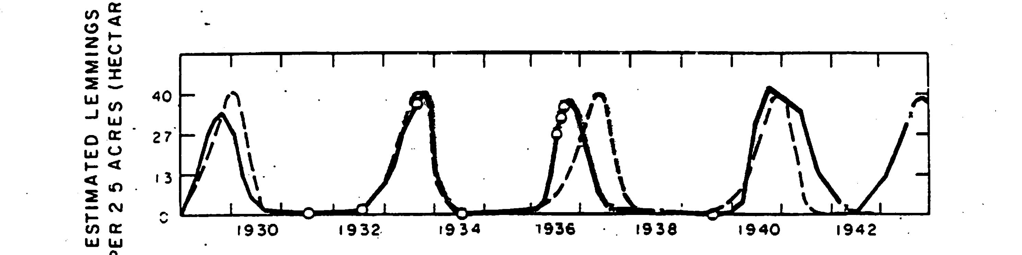
Extrinsic Hypotheses: Food
From Cole & Batzli (1978. J. Mammal. 58:809)

Slide 7
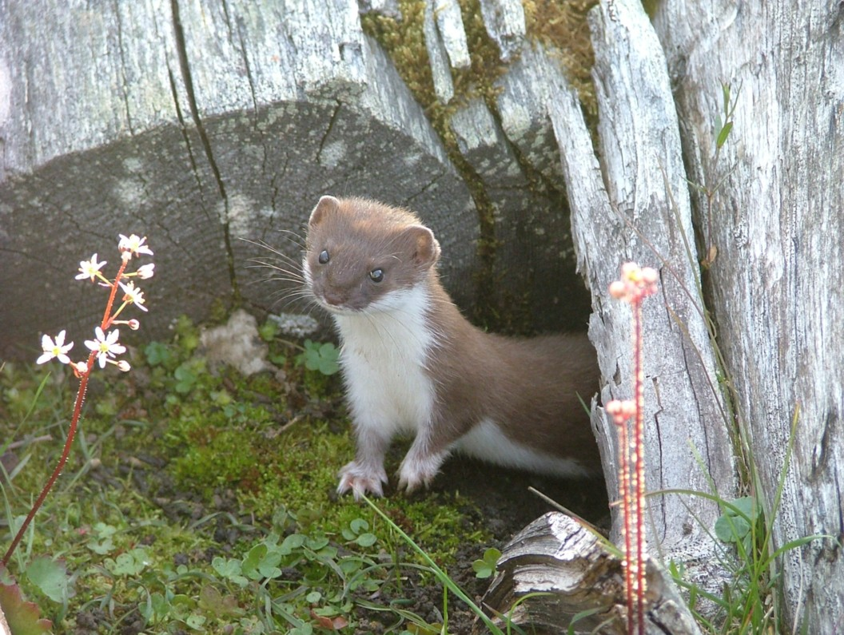
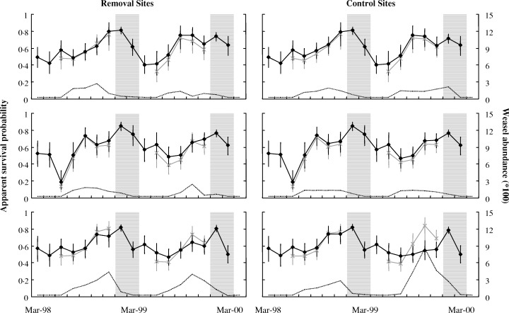
Extrinsic Hypotheses: Predators (Hanski et al. 1991, 2001)
In northern Scandinavia, there are specialist predators, Mustela nivalis and M. erminea.
Mustela nivalis
Graham & Lambin
(2002. J. Anim. Ecol)
Lots of studies have raised voles in predator-free enclosures and populations always crash.

Slide 8
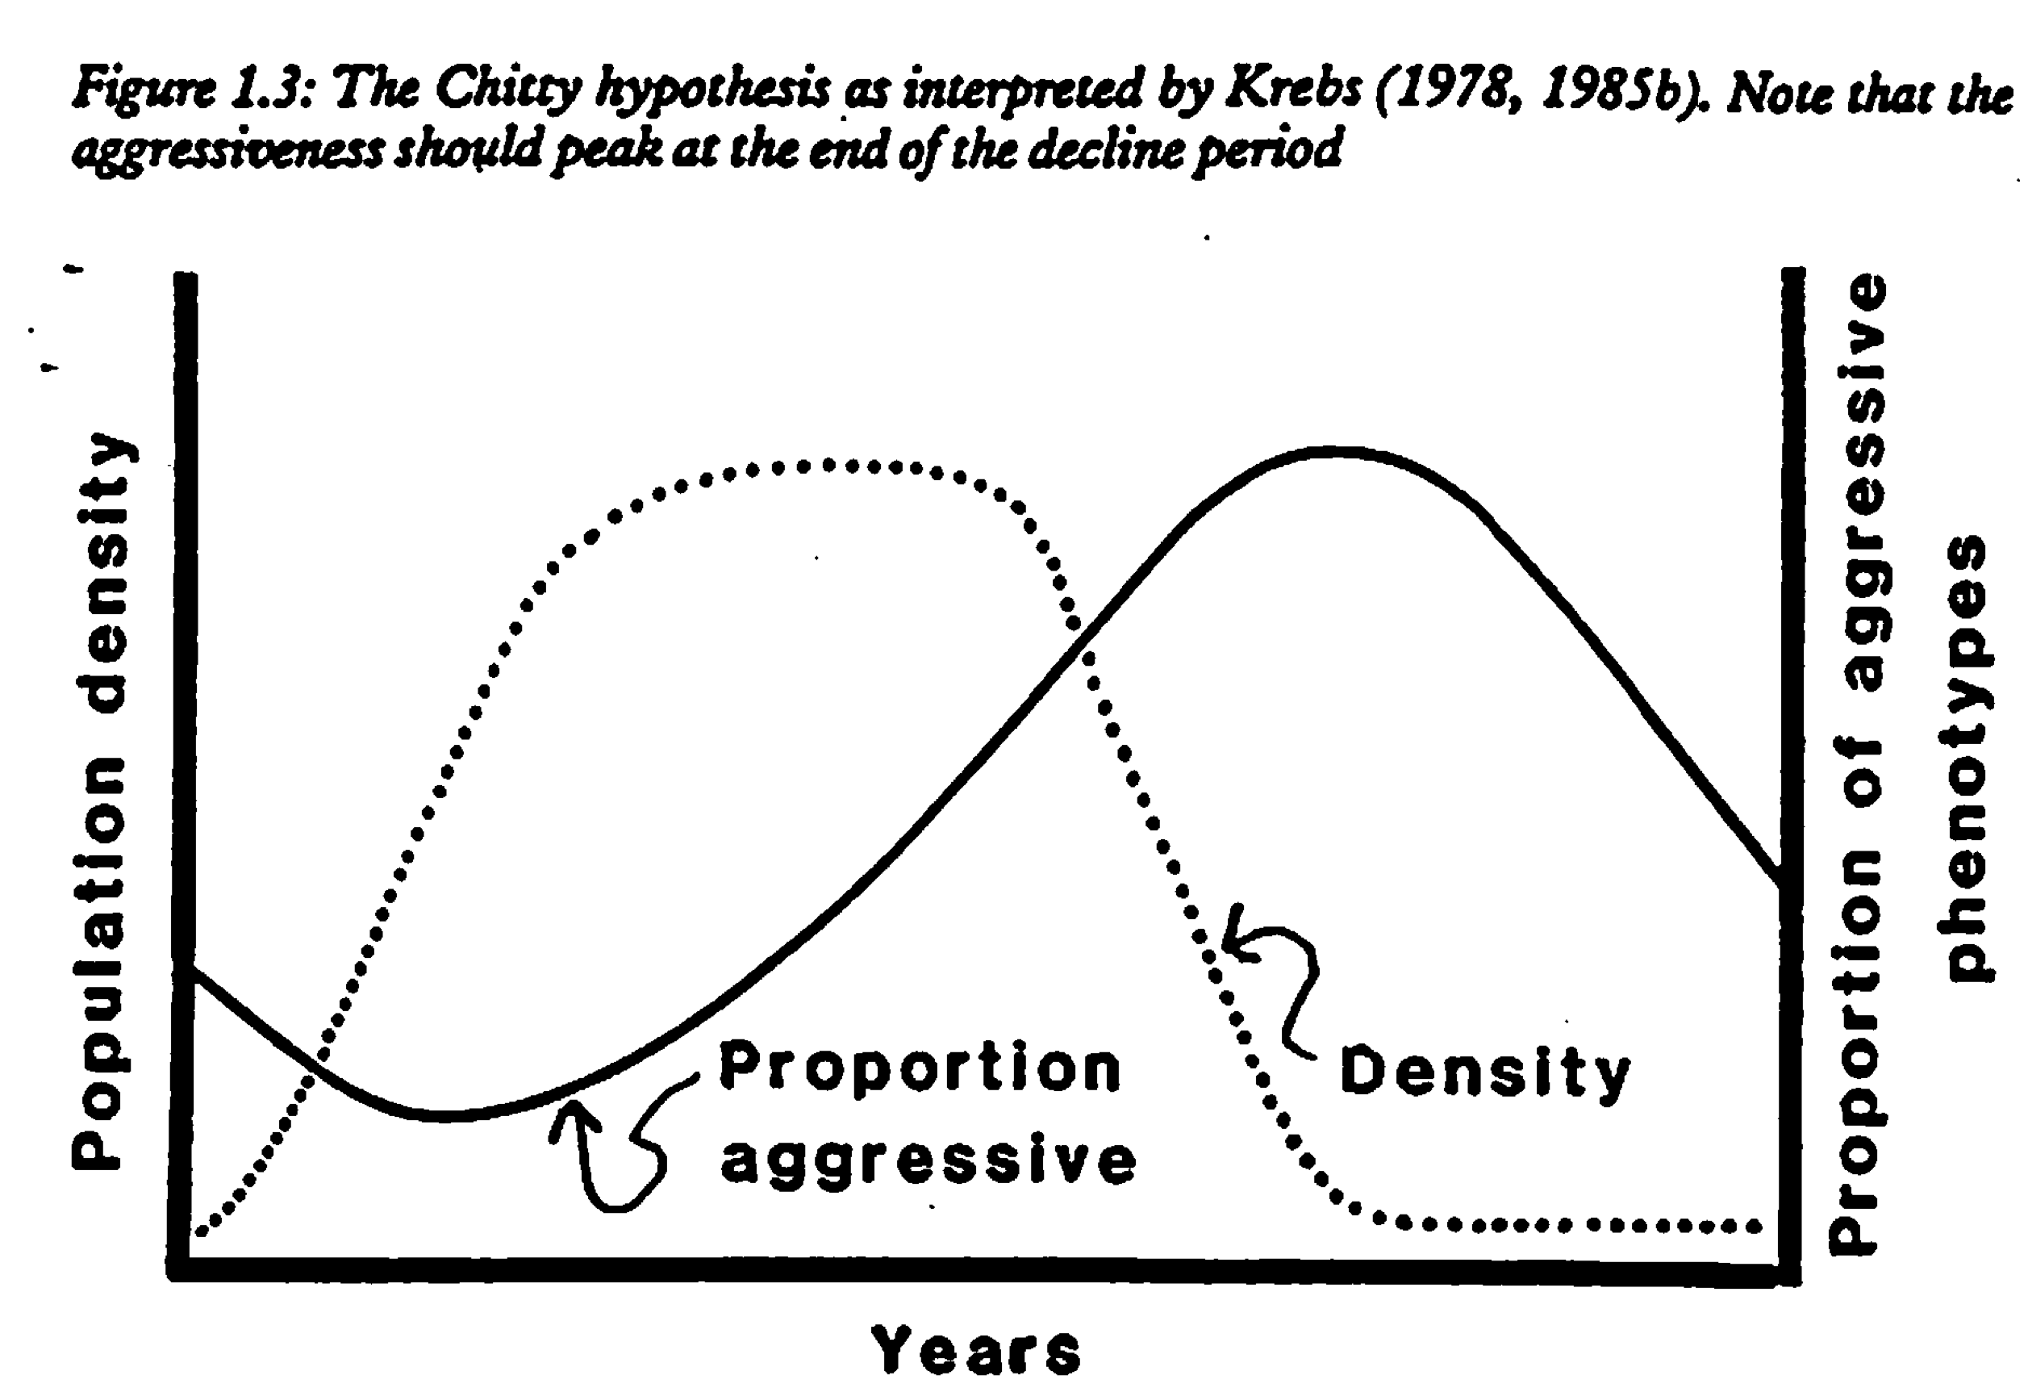
Intrinsic Hypothesis: Chitty Hypothesis
(Behavioral genetics hypothesis)
There is a high proportion of large aggressive voles in peak populations.
The idea is that there is a genetic basis to both size and aggressive behavior.
Selection is operating within a cycle.
Small, amicable
voles.
Large, aggressive
voles.

Slide 9
Intrinsic Hypothesis: Chitty Hypothesis
(Behavioral genetics hypothesis)
At first, the Chitty hypothesis was criticized on the grounds that a single cycle is
too short a time period for selection to operate.
Allele frequencies in a sample from a trough can be significantly different
than those in a sample from a peak.
However, large size and aggressive behavior have very low heritability
(Boonstra & Boag. 1987. Evolution. 41:929).
The response to selection is only possible if traits are heritable;
this is not true for the crucial traits.

Slide 10
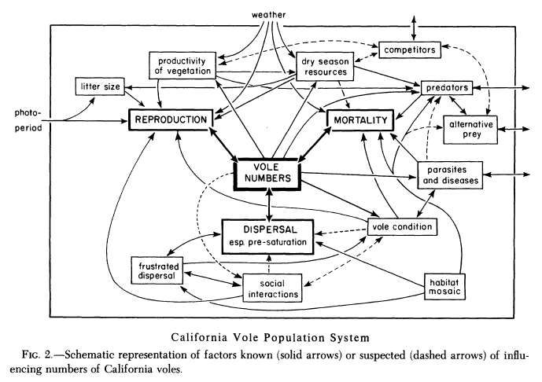
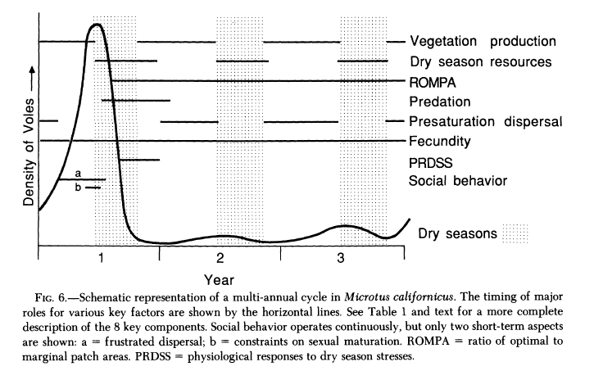
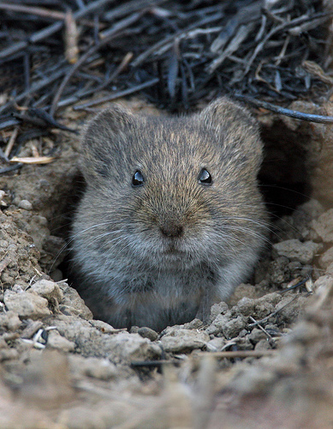
Multi-factorial models
Lidicker’s Model
At least 8 factors influence vole numbers.
Intrinsic: dispersal, reproduction, mortality,
condition.
Extrinsic: parasites, predators, seasonal
influences on vegetation.
These act at different stages during a cycle.
Microtus californicus

Slide 11
Multi-factorial models
Social Fence – Hestebeck (1982)
Intrinsic factors
dominate
Extrinsic factors
dominate
“Social fence”

