Slide 1
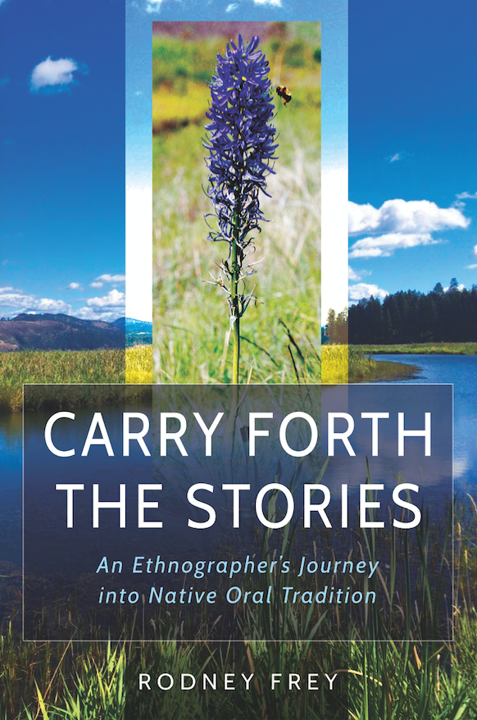
The Intersection of the Indigenous, the Humanities and the Sciences
25 August 2017

Slide 2
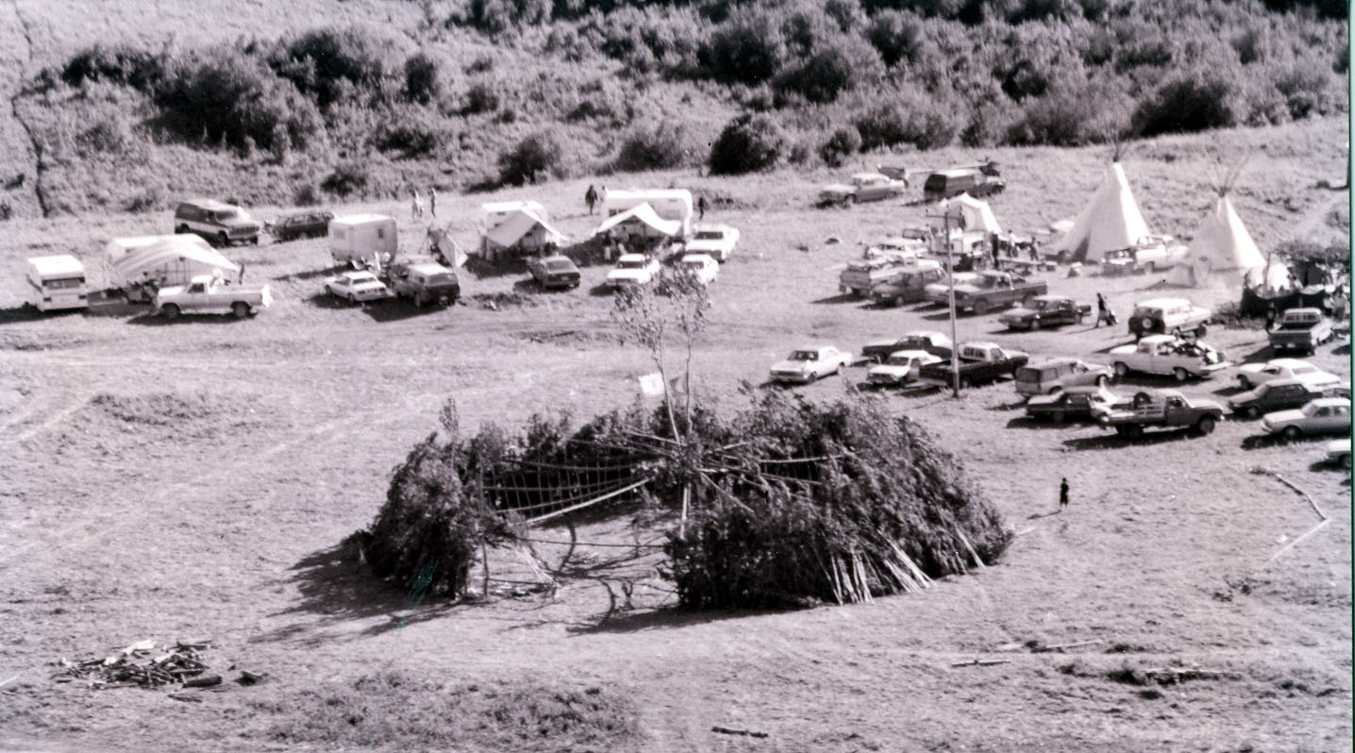
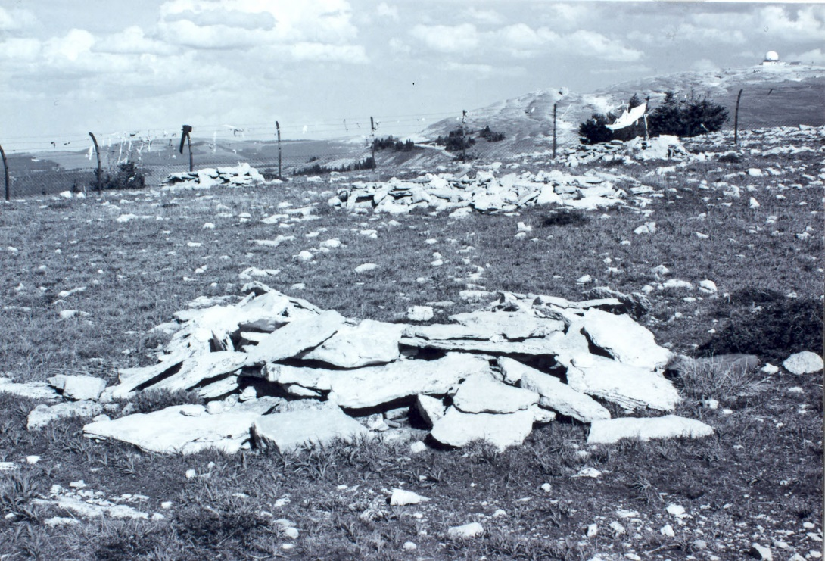
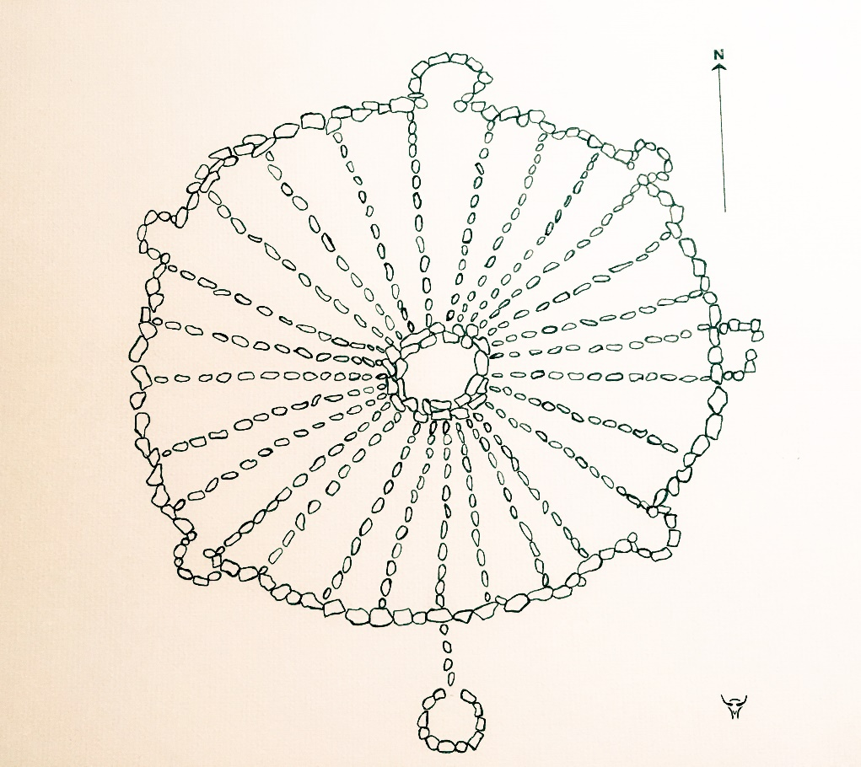
Tom’s story of Burnt Face, the Little People and Medicine Wheel, in the Lives of Tom and Susie Yellowtail

Slide 3
The Sundance and Matt

Slide 4
The Center Pole: A Woman’s Yell and the Tree’s Water.

Slide 5
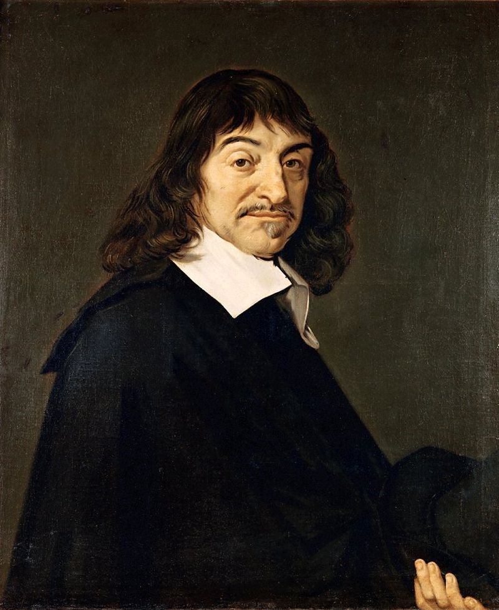
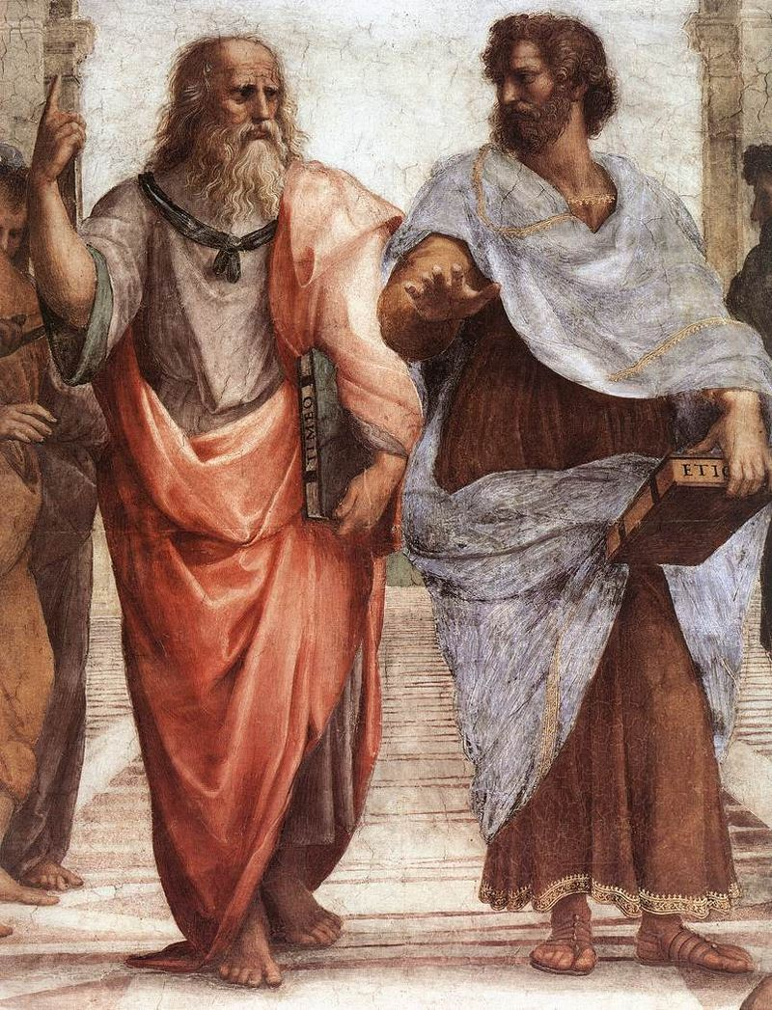
Science

Slide 6
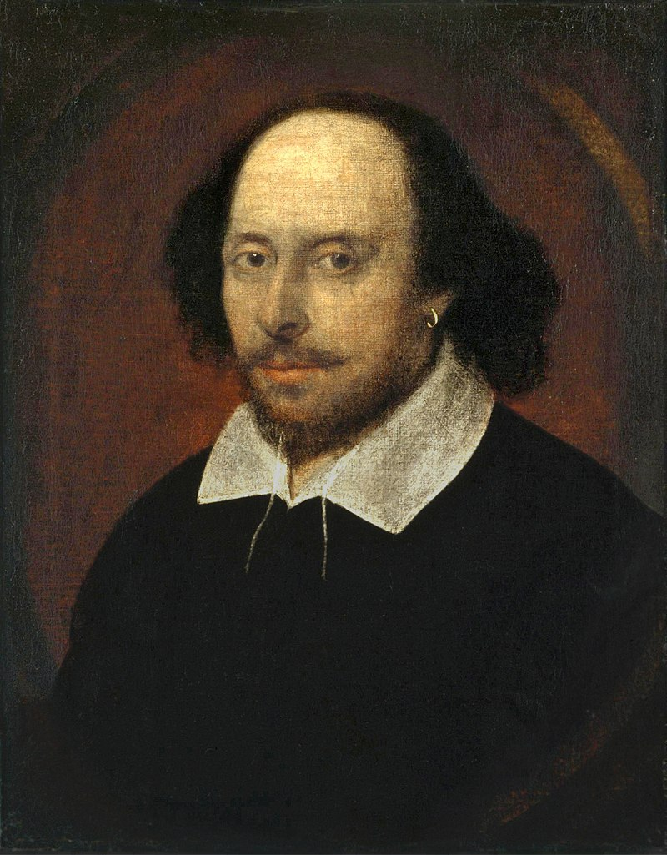
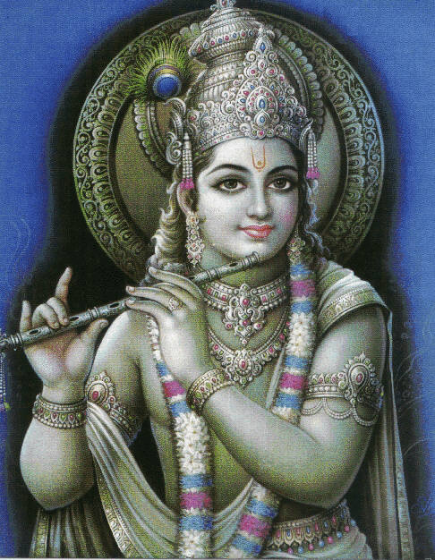
Humanities “thick description”

Slide 7
Burnt Face and the Little People?
Water from a Tree?
Embedded in the act of re-telling of the stories of Coyote and Salmon, of Changing Woman and Spider Grandmother, of Raven and Sedna
Hnkhwelkhwlnet “our ways of life in the world,”
and often referred to by elders as “Heart Knowledge”
(in contrast with “Head Knowledge”)

Slide 8
Summary
Sciences:
discrete material objects
thick glass pane
logical reasoning (deductive methods)
standardized empiricism (inductive method)
tests of validity and reliability
skepticism
Humanities:
holistic (not compartmentalized and reductionist)
interpretive (not analytical)
narrative (not formal, objective)
wisdom (not knowledge per se)
“thick description”
cracks and holes in thick glass pane
Indigenous:
transitory intersection of those participating - human, animal, ancestor, spirit - all anchored to place-based oral traditions, to the miyp teachings
spiritual origination and perpetuation of the physical world
a participant, a part of, not apart from, no glass pane separations

Slide 9
Sciences: seeks to formulate precise descriptions of the physical reality to generate new knowledge. A²=B²=C²
Humanities: seeks to “suspend disbelief,” and through the “experiential imagination,” identify and describe
“wisdom truths.”
Indigenous: in the act of oral tradition storytelling, reality is brought forth and perpetuated, its “teachings” revealed.
Not a “suspending of disbelief,” but a renewing of reality. Stories are not a description of reality, but reality itself.

