Slide 1
CATIA Machining Seminar
Originally created by Edwin Anderson
Updated by Cam Stefanic (Spring 2011)

Slide 2
General Machining Terminology
NC - Numerically controlled
G Code - Coding language our CNC machines read
PO - Part Operation
MO - Machine Operation
Notes:
Haas and Bridgeport Pics

Slide 3
Two Schools of CNC Machining Thought
Solidworks
Solid Model
MasterCAM
NC Code
MasterCAM
Validation
HAAS
Machining
CATIA
Solid Model
NC Code
HAAS
Bridgeport

Slide 4
University of Idaho Equipment
Mills
3-Axis
Bridgeport CNC Mill
HAAS CNC Mill
Multi-Axis
HAAS CNC Mill
Lathe
HAAS CNC Lathe
UI has 3-Axis HAAS and Bridgeport CNC mill machining and limited HAAS lathe capability with CATIA.
Notes:
Pics of Mills

Slide 5
Machine Process Overview
CATIA Product Definition
Create a Machine Plan
Creating a Process Document inside CATIA
Part Operation Set-up
Tool Selection
Machine Operation/Simulation
Verification
Post Processing
Export to CNC mill

Slide 6
Inside CATIA
CATIA Product
Part
Finished product in proper orientation
Stock
If necessary
Fixture
If necessary

Slide 7
Guidelines for Creating a Machine Plan
Name, Date, Part, Material, Group, Project, Tolerances, etc.
Stock Size
Sequence Description
Tool List
Picture of Setup
Other Information

Slide 8
Creating a Process Document
Select Product intended for machining
Enter Advanced Machining workbench
Start>Machining>Advanced Machining
PPR
Process List
Machine Operation
Product List
Part
Stock
Fixture
Resource List
Tools

Slide 9
Part Operation| Setup
Define
Machine
3-axis mill
Part
The finished part
Stock
The starting material
Fixture
Any clamps or other surfaces not waiting to be machined

Slide 10
Machine Operation Details
Operation Name
Comment
Tabs
Machine Strategy
Geometry
Tool
Feeds and Speeds
Macros
Stoplights
Colors
Red – Needs defined
Yellow – Could be defined, but not necessary
Green – Defined
Selectable Objects and Text
Blue text is editable

Slide 11
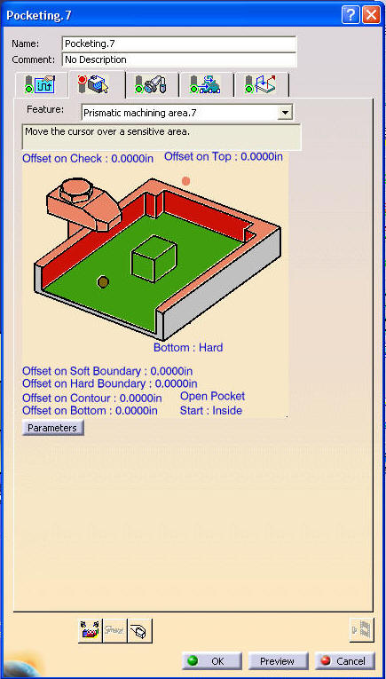
Machine Operation| Geometry Colors
Geometry Colors
Red- Not defined and required.
Orange- Not defined, but not required.
Green- Defined.
Brown-Definition element has been changed or deleted.
Purple- Tool path needs to be recalculated.
Blue- Editable parameters.
All surfaces are defined by clicking in the window and then selecting the surface in the geometry

Slide 12
Questions?

