Slide 1
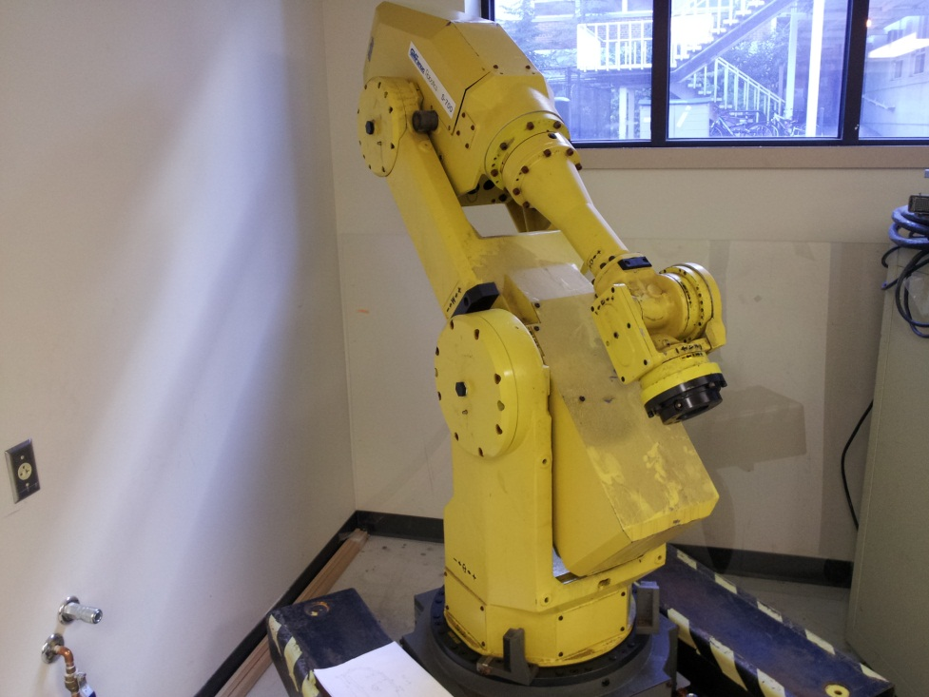
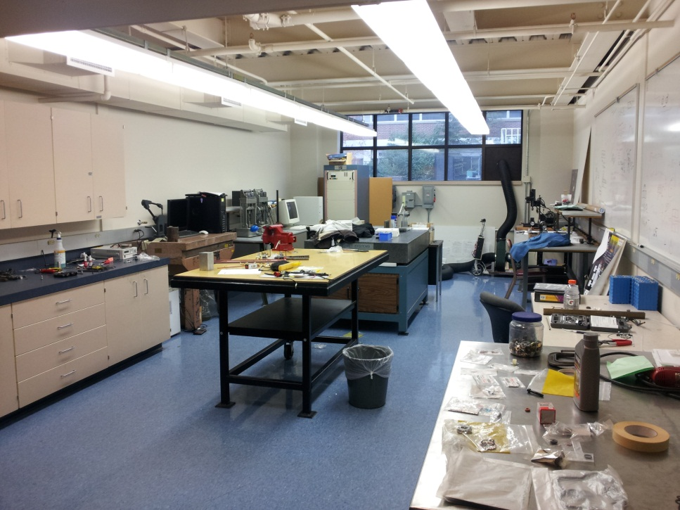
Work Cell For Robotic Machining
Vincent Colson, Jeremy Cuddihy, Travis Doerzaph

Slide 2
Proposed Metrology Lab Remodel

Slide 3
Metrology/Robot Control Station

Slide 4
Metrology Station/ 3-D Scanner

Slide 5
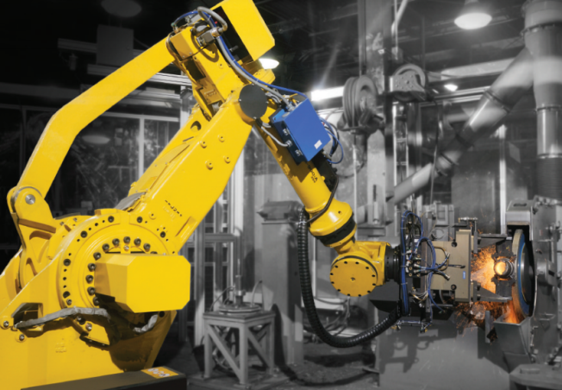
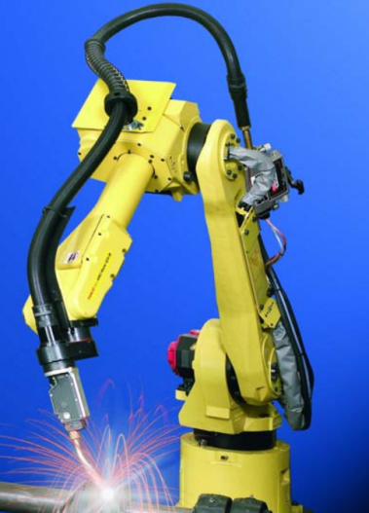
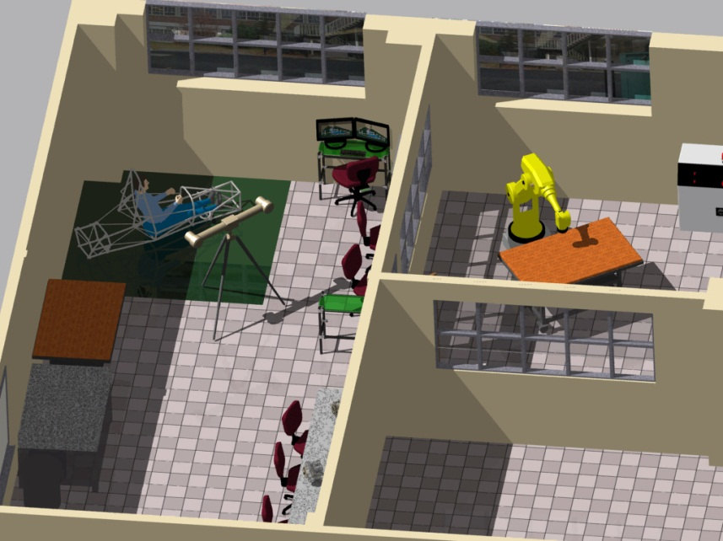
Robotics Room
Fanuc Robot Applications

Slide 6
Robot Control Station

Slide 7
Robotic Machining With Six Degrees of Freedom

