Slide 1
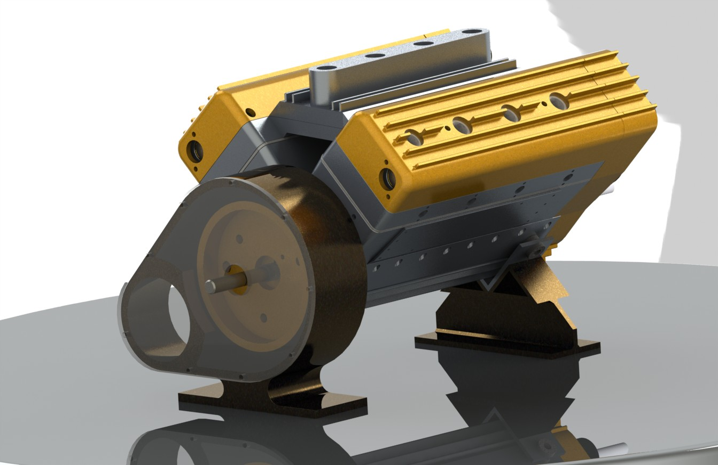
J.V. Thompson’s V8 Scorpion - Modeling in CATIA V5-Team
Jon Cotton
Gustavo Guillen
Mike Smith
Mentor: Ian Clarke

Slide 2
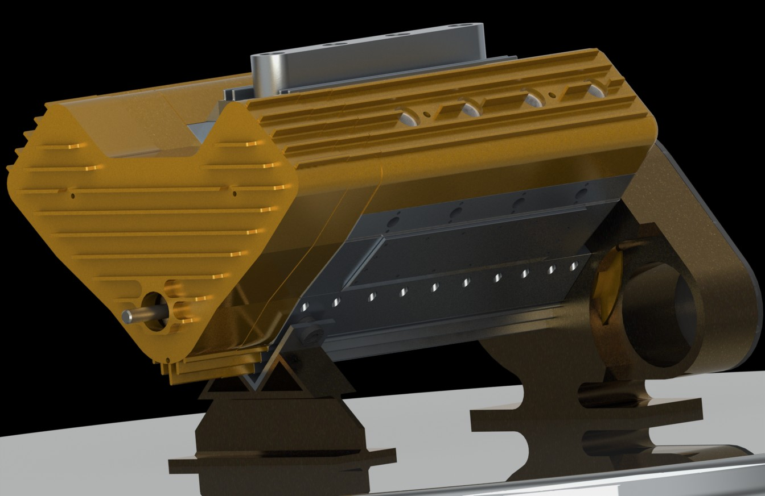
Objective
Create an accurate model of an operating V8 Scorpion engine
Demonstrate functionality and operation via animation
If working on a model, i.e. engine, provide a brief description/illustration of your starting point

Slide 3
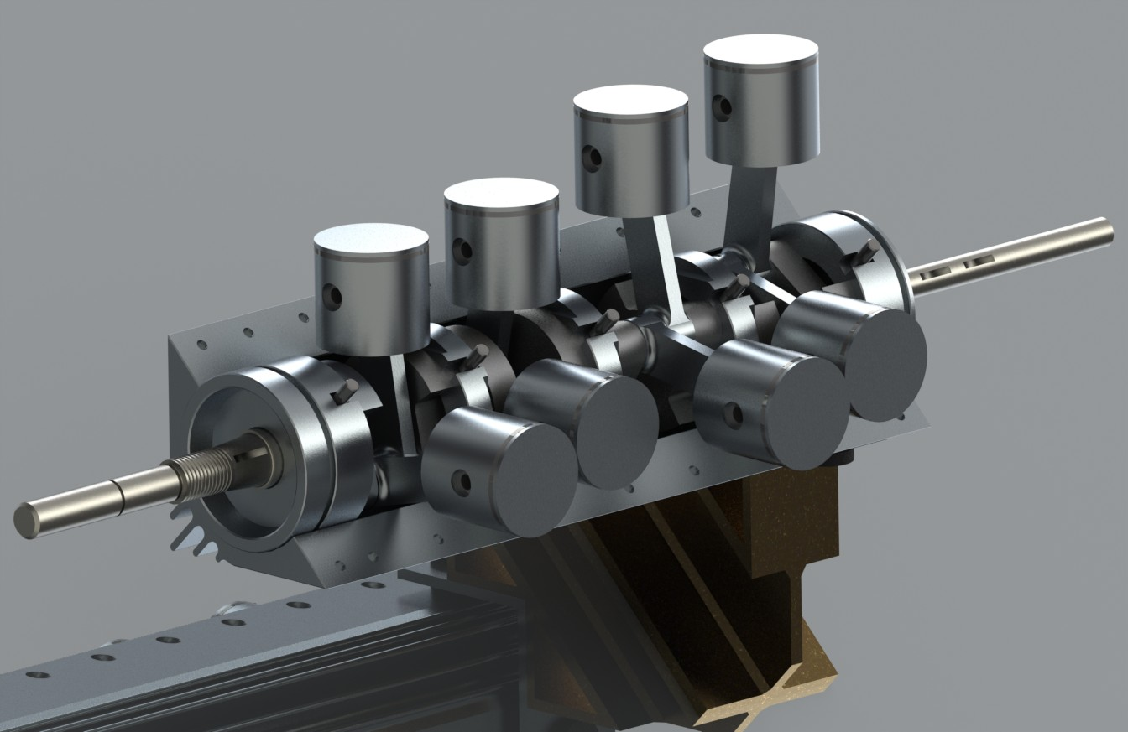
Full rotating assembly
Displayed are the rods, pistons with rings and wrist pins, main bearings, and crankshaft.
Standard V8 firing order. Crankshaft is multiple pieces to allow simplified rods.
All engine sections are created as sub-assemblies in the same manner as the engine would actually be assembled.

Slide 4
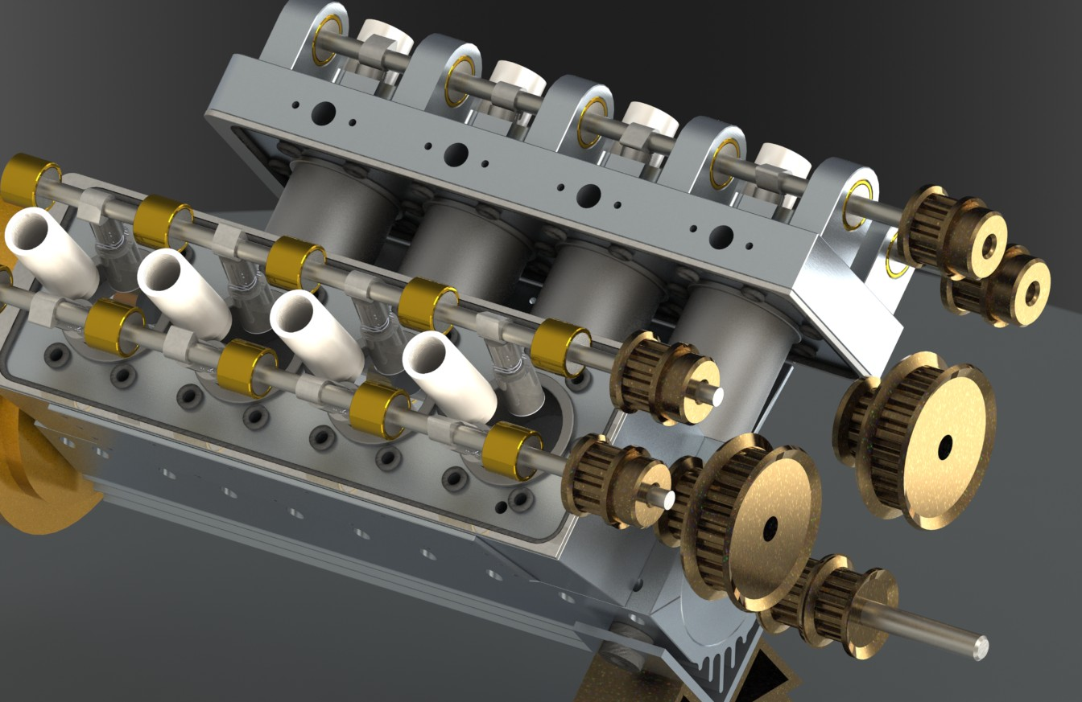
Challenges Encountered
Drawing package accuracy
- Not all components align, even when dimensions are followed exactly as per drawing package

Slide 5
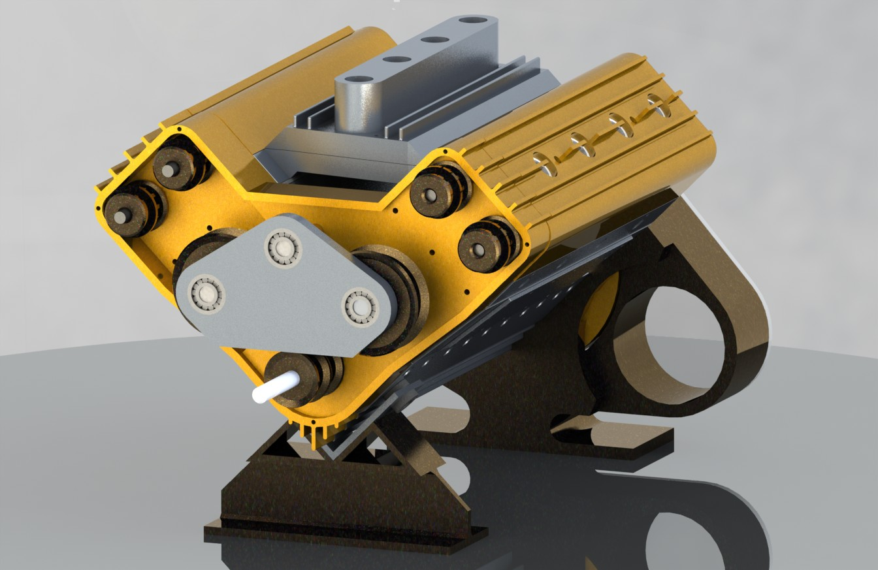
Solutions to Challenges
Select dimensions altered as necessary
Added small chamfers to rendered parts to display individual surfaces.

Slide 6
Lessons Learned
Supplemental literature can help clarify drawings
Review all relevant material thoroughly before beginning modeling
Strong teamwork catches mistakes and improves quality of design

Slide 7
Lessons Learned (continued) Technical problems encountered due to complex animations
An assembly animation was attempted with the entire engine; 59 steps, 2:55 mins, approx. 3Gb file size
When the rendering finished (about 3.5 hrs render time), the animation .avi file was completely lost; it was not found in the folder it was saved to. A search of the entire system came up with nothing as well.
Many alternatives were tested:
Tracks were shortened
Split the animation into two parts
Tried stopping the render a few frames before completion
The only thing that seemed to work was splitting the animation into three parts (1.33, .94, .80 Gb per video respectively)
It seems that there is an unknown file size cap to CATIA’s animation capabilities
Something that may help with video choppy-ness is compressing the videos to a more manageable file size for Windows.
Animation video files can be found here:
S:\Engineering\SeniorDesign\Catia Course\13. Fall 2012\Final Projects\V8 Scorpion\Renders\Assembly Animation Videos

