Slide 1
Remington 700 Modeling and Barrel Pressure FEA Analysis
Nathan Petersen
Tyler Marines

Slide 2
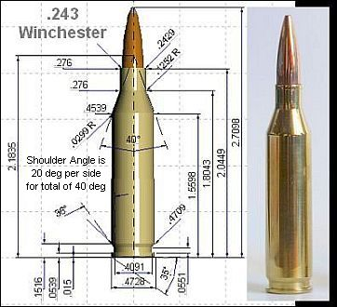
Objective/Starting Point
Our goal was to understand the stresses that a rifle barrel undergoes when firing a round.
Unlike other projects we did not have a drawing package but we did have a physical gun to work from and a few drawings.

Slide 3
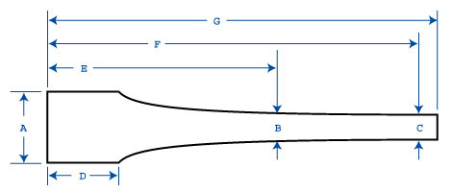
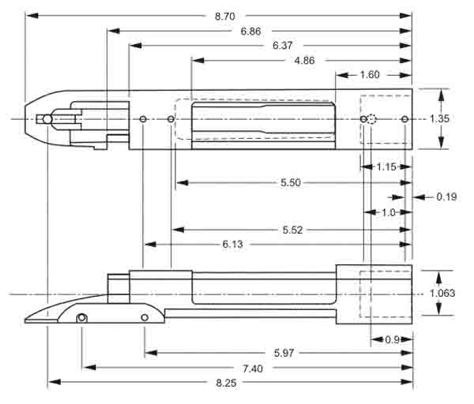
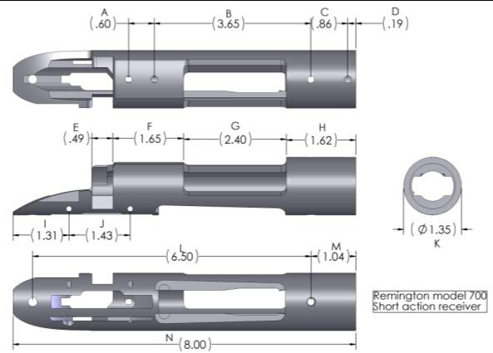
Drawings Found
Barrel and Receiver Drawings

Slide 4
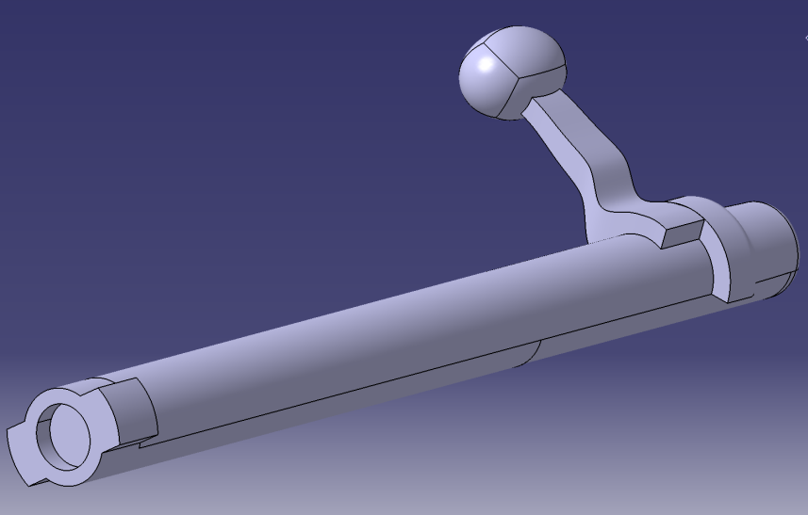
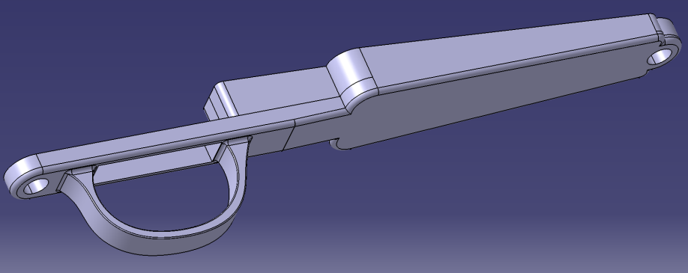
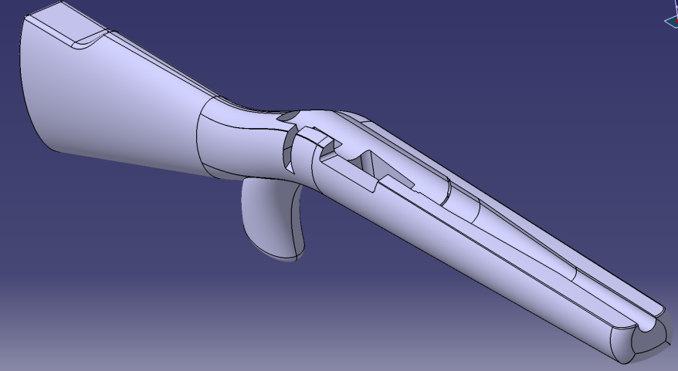
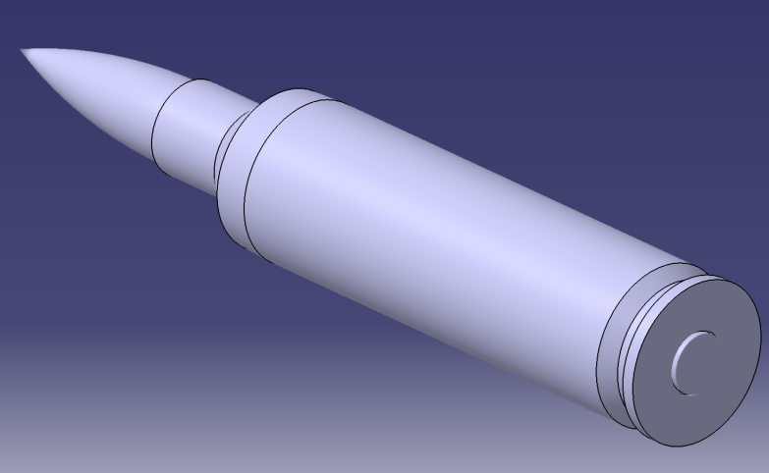
Modeling

Slide 5
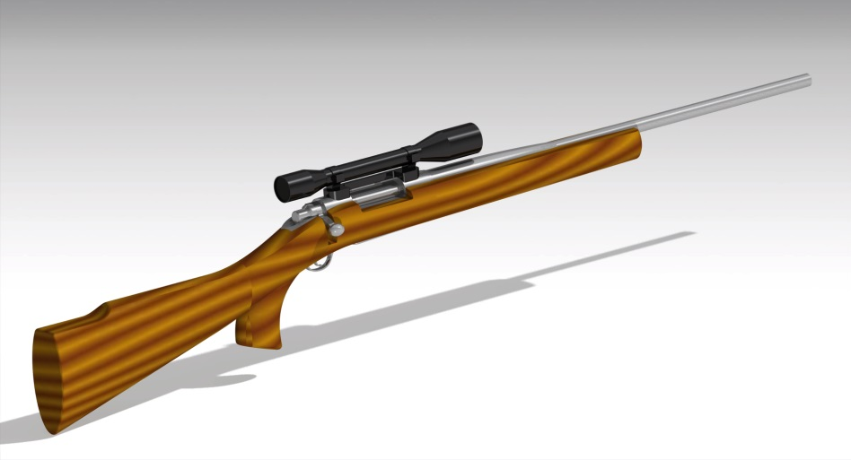
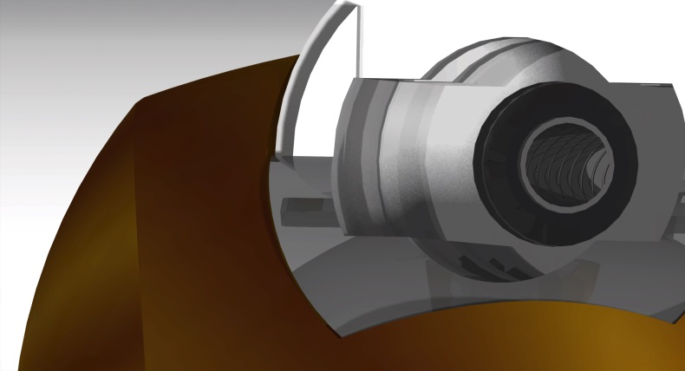
Renders

Slide 6
FEA Analysis
Preliminary FEA reveled that the highest stress was near where cartridge is fired. As seen in the max read out and in cross section view.

