Slide 1
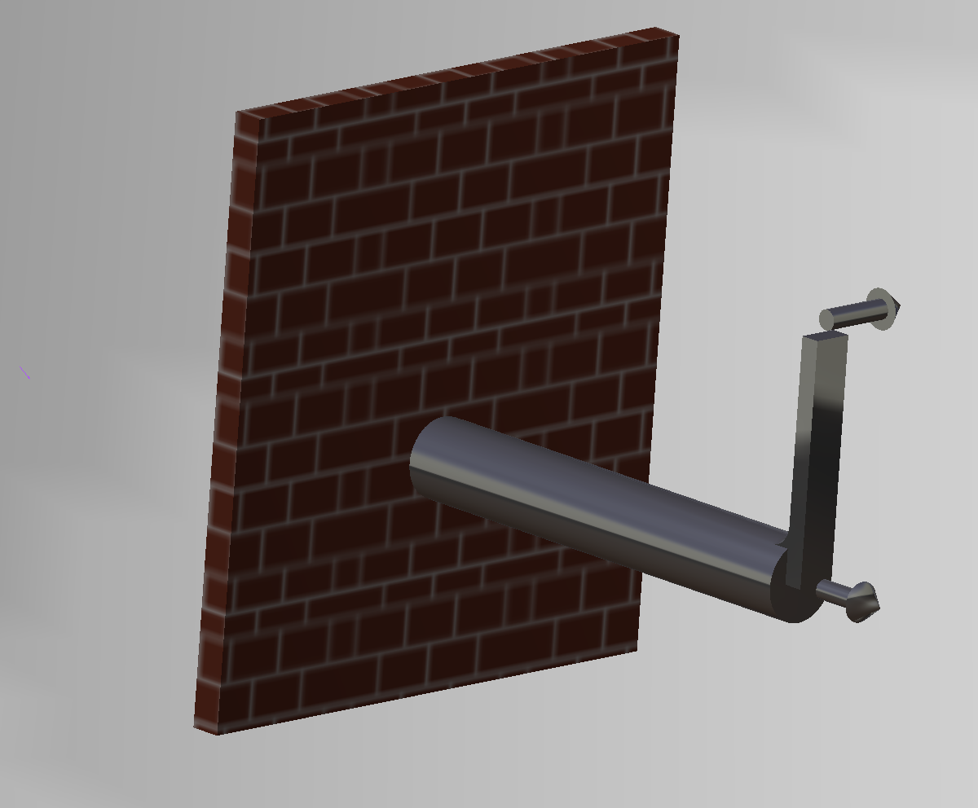
Stress Visualization
$$500lb$$
$$∅2in$$
$$6in$$
$$12in$$
$$500lb$$
Tate Bischoff & Joe Osborn

Slide 2
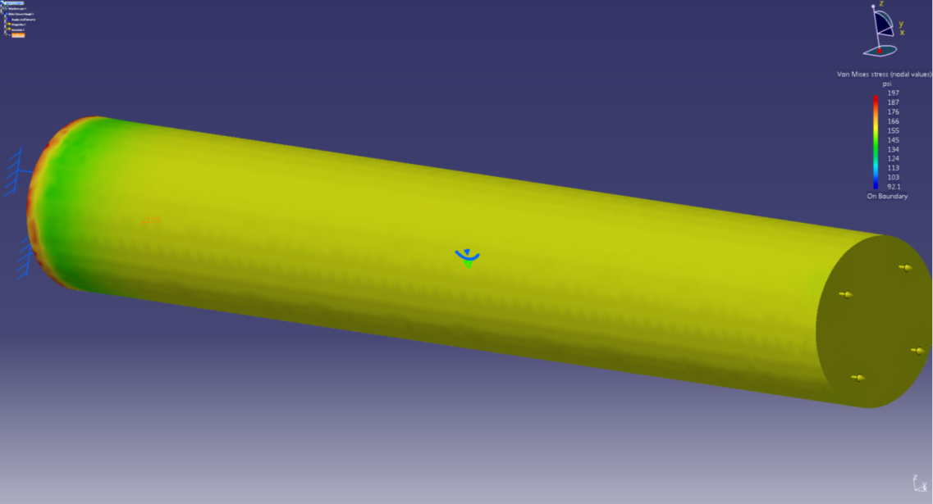
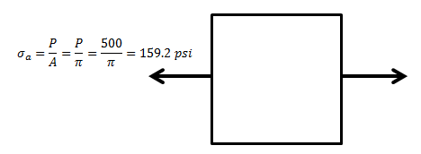
Axial Loading
Axial load of 500lbs
2in diameter shaft
Hand calculations of axial load results in a uniform stress of $159psi$
CATIA finite element analysis results in a uniform stress of $159psi$, neglecting the effects of the wall

Slide 3
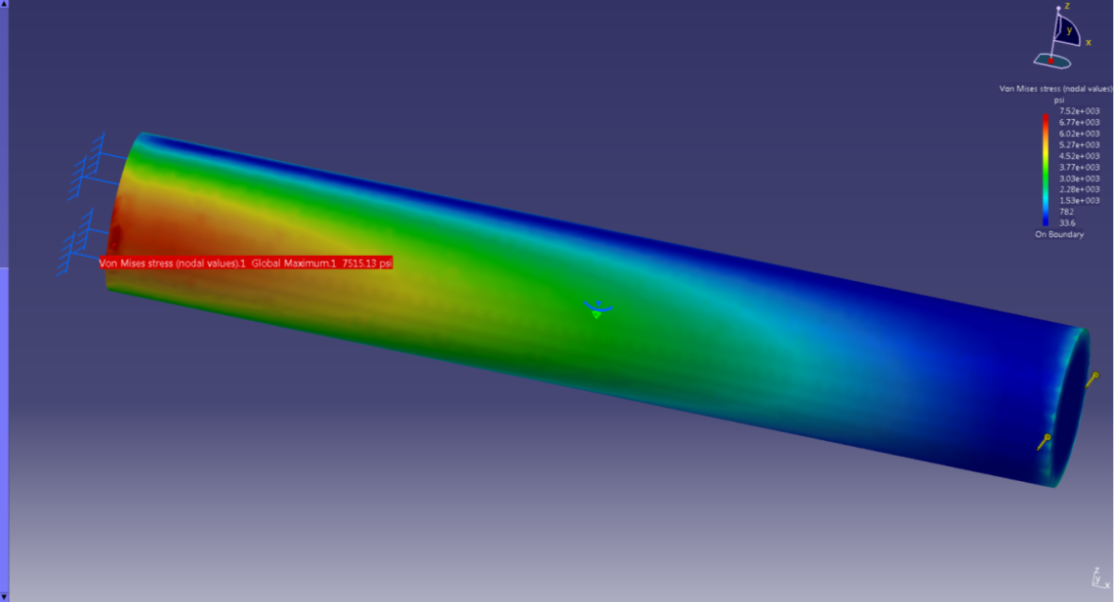
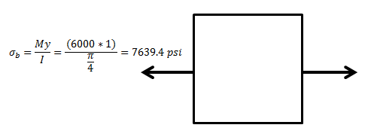
Bending Moment
12in long, 2in diameter shaft
Shear load of 500lbs creates a 6000in-lb bending moment at wall
Hand calculations of bending moment results in a stress of $7639psi$ at front edge against wall
CATIA finite element analysis results in a stress of $7515psi$ at this same point

Slide 4
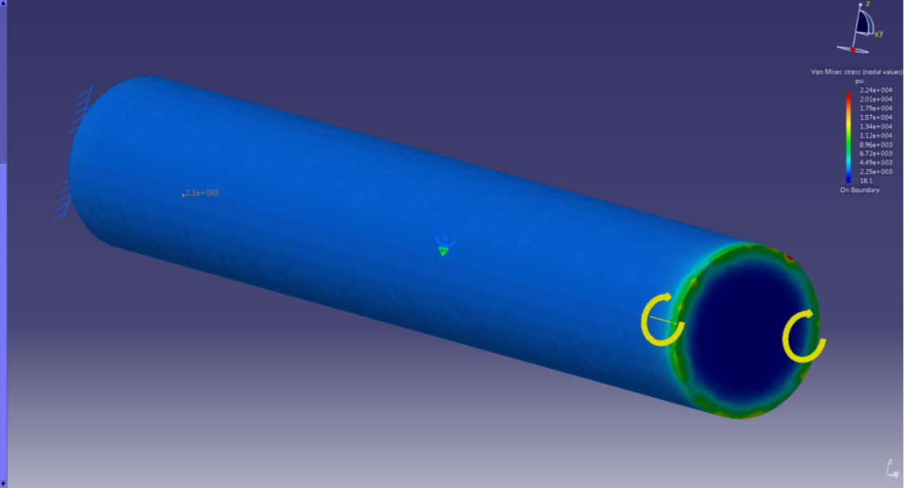
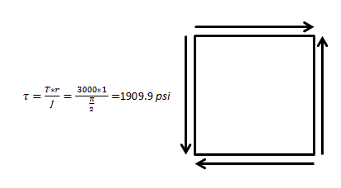
Torsion
500lb force applied 6in away from neutral axis of beam creates a 3000in-lb torsion moment
Hand calculation gives a shear stress of $1910psi$, which translates to a effective stress of $3308psi$ ($σ^{′}=\sqrt{σ^{2}+3τ^{2}}$ with $σ=0$)
CATIA finite element analysis results in a effective stress of $3110psi$, which translates to a shear stress of $1796psi$

Slide 5
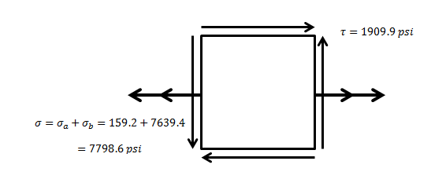
Combined Loading
Combining all the independent loadings into one analysis
Using the previously calculated values of $σ_{a}=159psi$, $σ_{b}=7639psi$, and $τ=1910psi, the effective stress$ comes out to be $σ^{′}=8471psi$ ($σ^{′}=\sqrt{σ^{2}+3τ^{2}}$ )
CATIA finite element analysis results in a effective stress of $8440psi$

Slide 6
Summary
 | Hand Calculations | CATIA FEA Results | Percent Difference
Axial Loading | $$159psi$$ | $$159psi$$ | $$0\%$$
Bending Moment | $7639psi$ | $7515psi$ | $$1.6\%$$
Torsion | $3308psi$ | $$3110psi$$ | $$6\%$$
Combined | $8471psi$ | $$8440psi$$ | $$0.4\%$$
As can be seen from the table above, CATIAs finite element analysis matches very closely with the hand calculations for each of the loading situations as well as the combined loading.

