Slide 1
CATIA- Sheet Metal Design
By: Steven Sainsbury, Garret Hall, Andrew Sedgwick

Slide 2
Project Learning
Four Different Work Benches
Sheet Metal Production
Older Sheet Metal software kept in CATIA for company's that have old designs
Sheet Metal Design
Used for rapid sheet metal design
Generative Sheet Metal- Recommended Use
Newer version of Sheet Metal Design and Sheet Metal Production
Aerospace Sheet Metal Design- Special Use
Options to create hydro-formed and brake-formed parts
Used for more complex contours

Slide 3
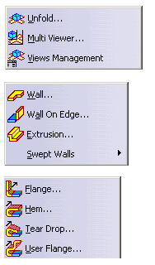
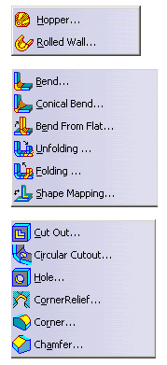
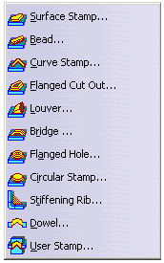
Generative Sheet Metal Design
Features of this workbench
Combines features of
Sheet Metal Design
Sheet Metal Production

Slide 4
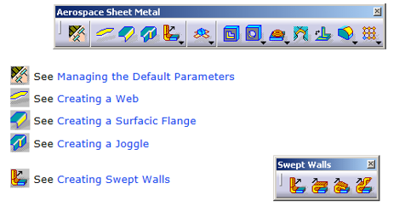
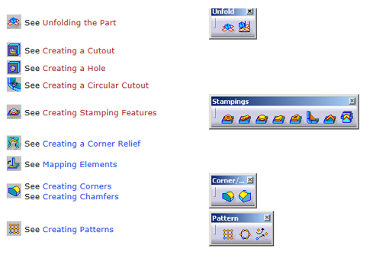
Aerospace Sheet Metal Design
Features of this workbench

Slide 5
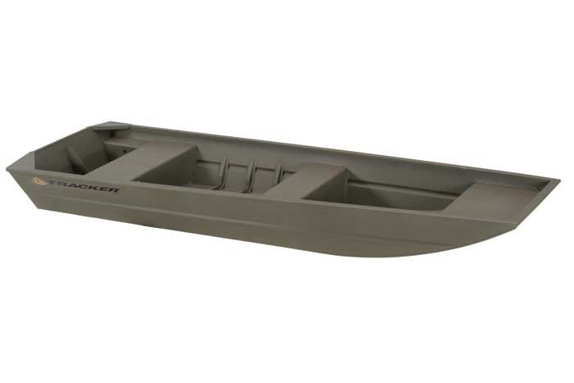
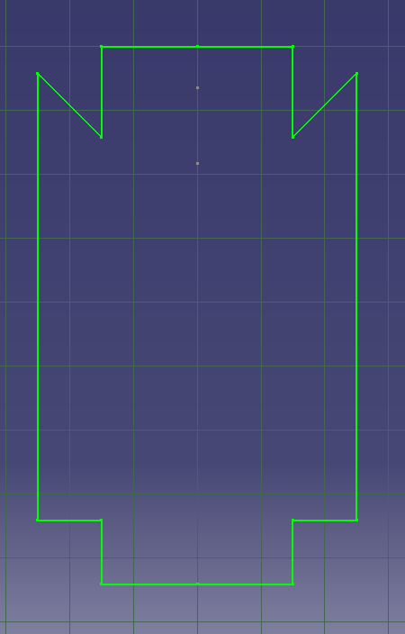
Case Study
Use Generative Sheet Metal Workbench
Modeling Methodology
Flat sheet cut into shape on plasma table
Formed into boat
Seams/Corners riveted

