Slide 1
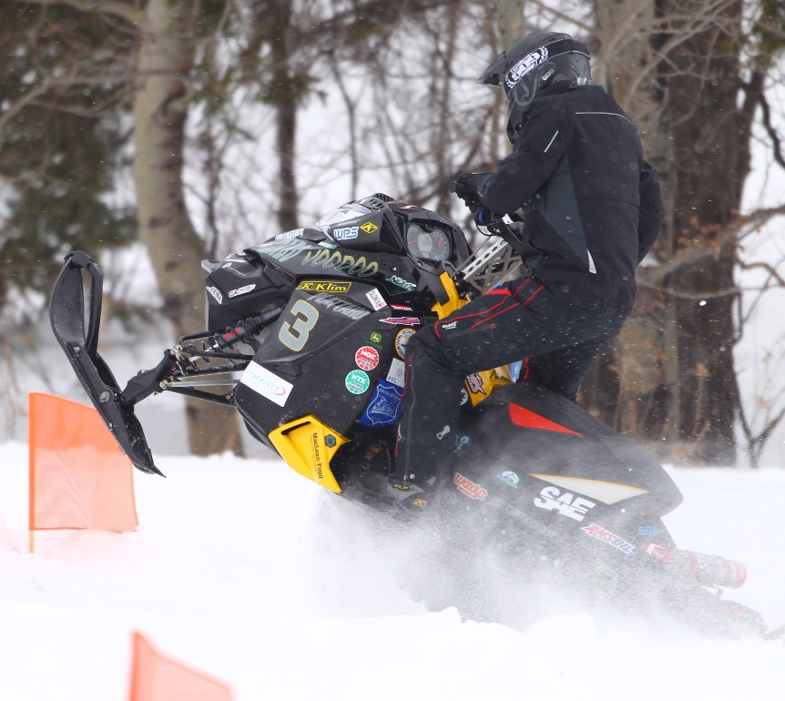
Snowmobile Modeling for Aerodynamic Testing
Chris Fraser
Crystal Green
Cody Hatch

Slide 2
Objective
Our main goal of this project is to get a basic model of the UICSC snowmobile in order to get a drag coefficient of it in the wind tunnel. This involves modeling the majority of the parts that affect the aerodynamics of the sled.
Our secondary goal is to model every part that you can see without opening anything up on the snowmobile.
There has never been a model of the snowmobile chassis itself just selected parts. We have basically started from scratch.

Slide 3
Engine Assembly
Two Stroke Snowmobile Engine Assembly

Slide 4
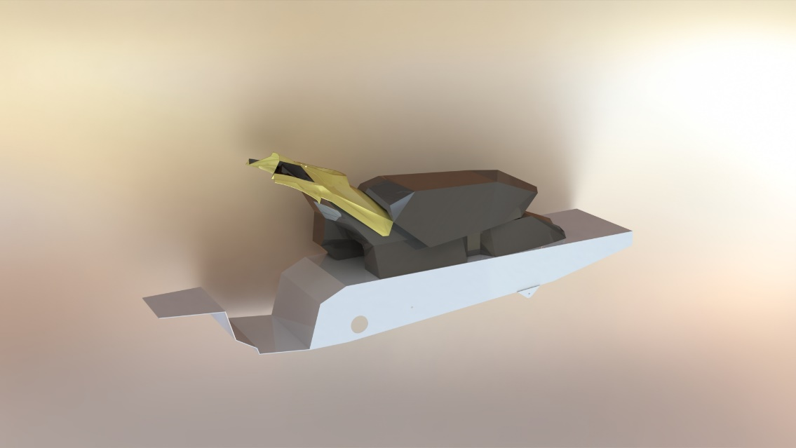
Snowmobile Body
Tunnel, Fuel Tank, Seat, and Rear Console Assembly

Slide 5
Hood Assembly
Hood and Headlight Assembly

Slide 6
Bottom Pan Cap Model

