Slide 1
4th Axis Lego CNC Rebuild
Coleton Bailey and Drew Thompson

Slide 2
Objective
Identify missing pieces of previous 4th axis Catia model
Rebuild missing Lego pieces and assemble Head sub-assembly based off of the images of original design
Innovate design by adding structural support, and motor tool gearing
Ensure certainty of bill of materials for design

Slide 3
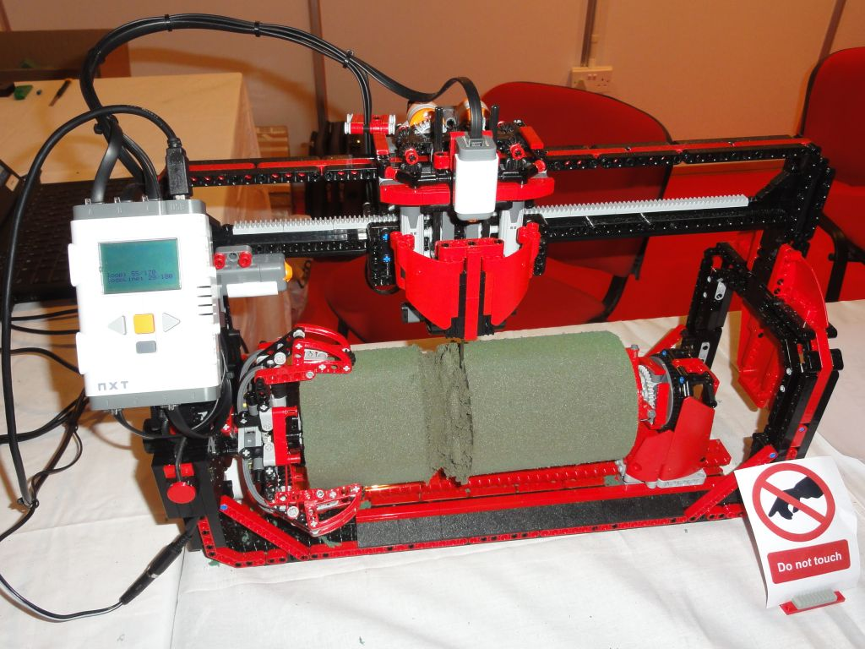
Original 4th Axis Lego CNC
An image of the Lego CNC Machine built

Slide 4
Previous State
The Start point for our project. The lack of parts required the assemblies to be recreated to be fully constrained.

Slide 5
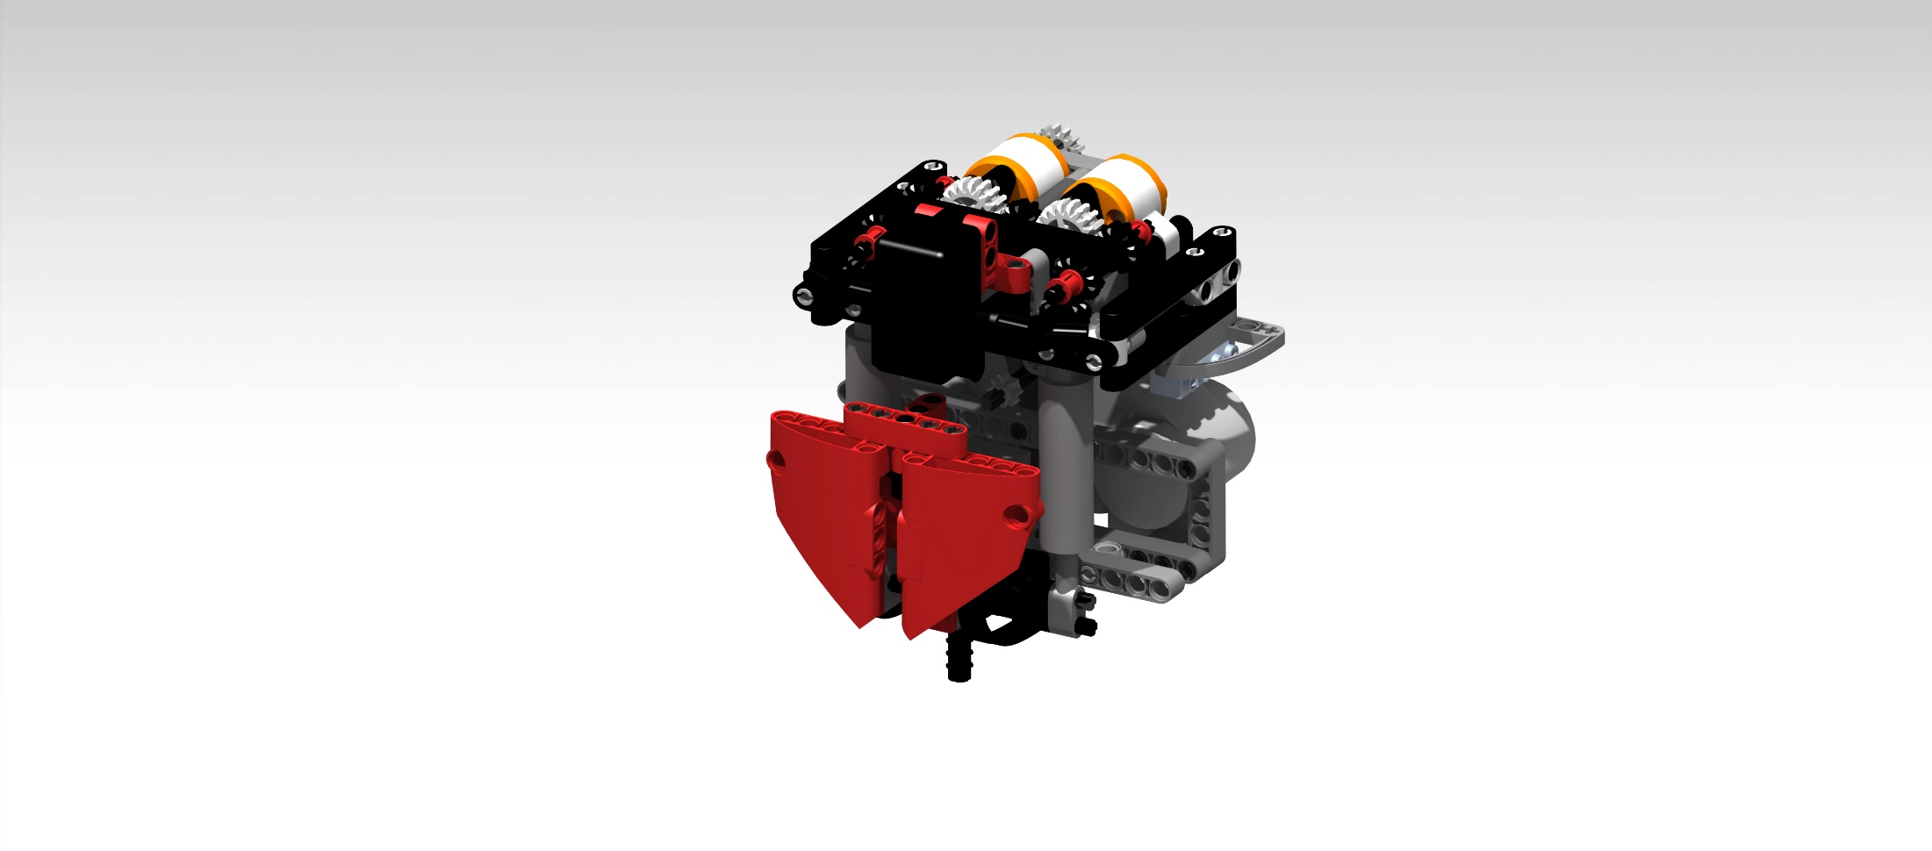
Head Sub-Assembly V2
Rebuilt Head Assembly With Structural Support. The reconstruction required parts to be created and edited. Assembly connections needed to be created and the structure slightly redesigned.

Slide 6
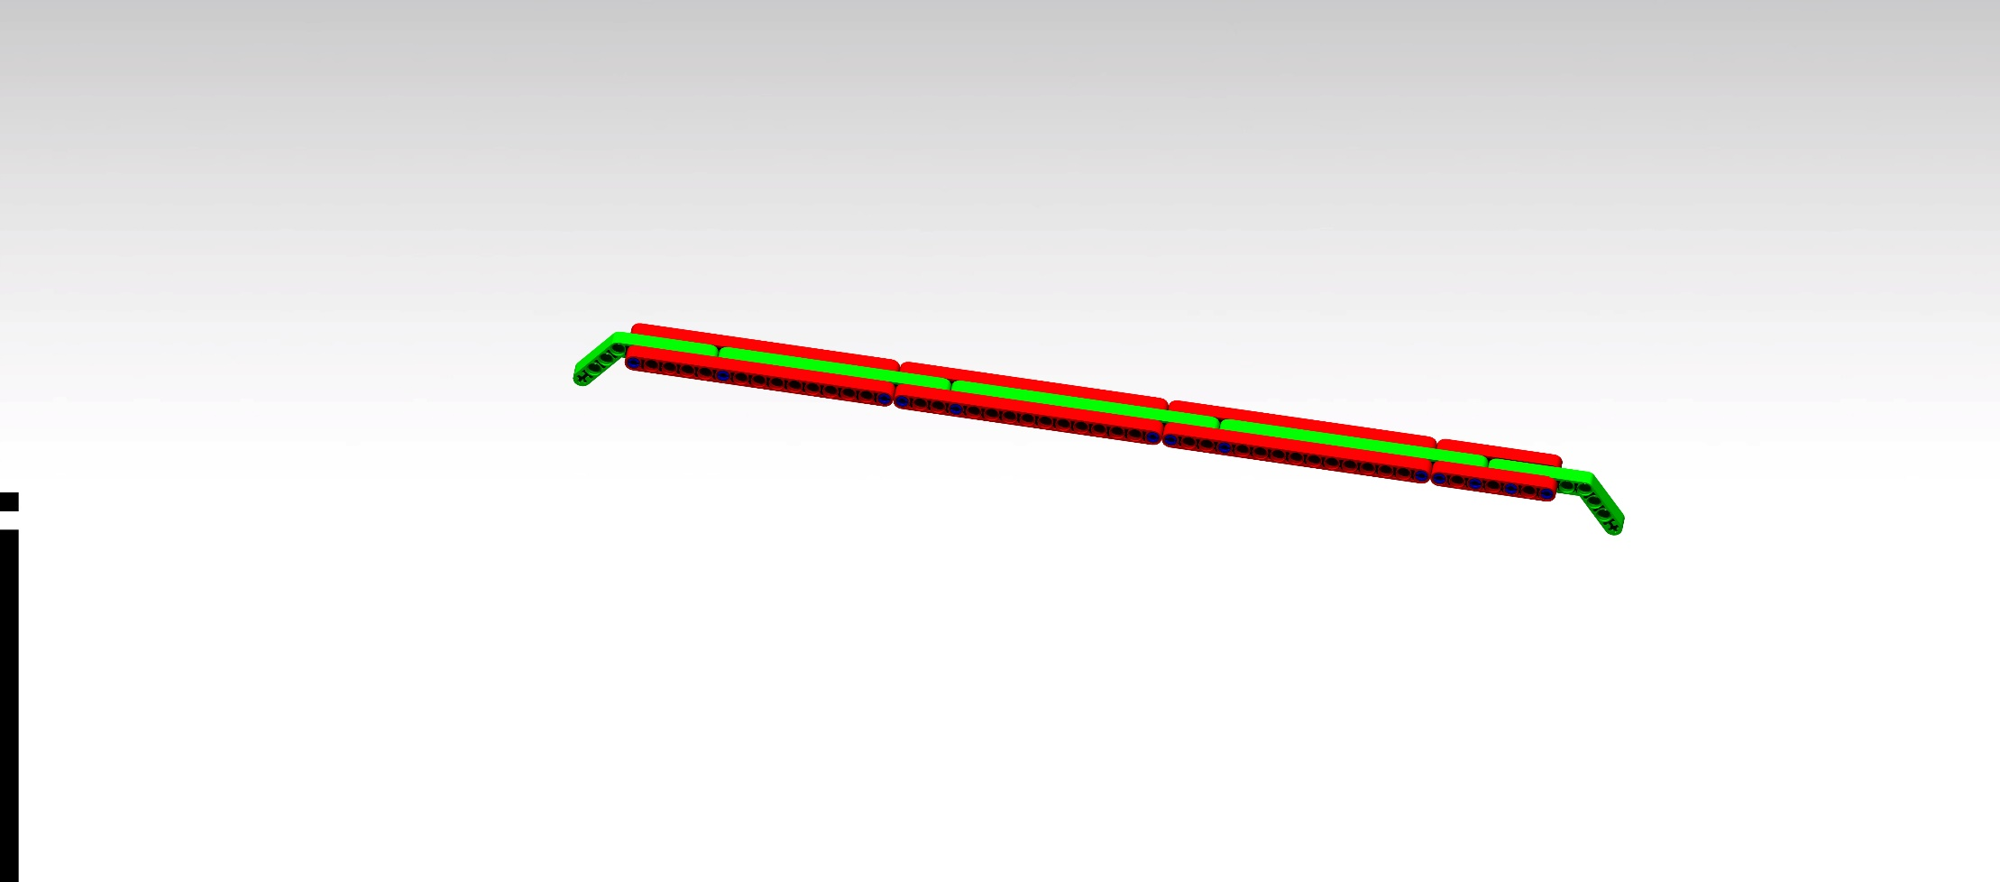
Top Rack Assembly V2
Rebuilt Top Rail of Structure

Slide 7
Lessons Learned
Detailed documentation is essential to convey ideas, and allow for a process to be repeated
How to correctly select off the self parts and implement them into design
Catia visualization and assemblies

