Slide 1
International Lego Design Project
Marc Compton
Chet McKinnon
Rob Regent

Slide 2
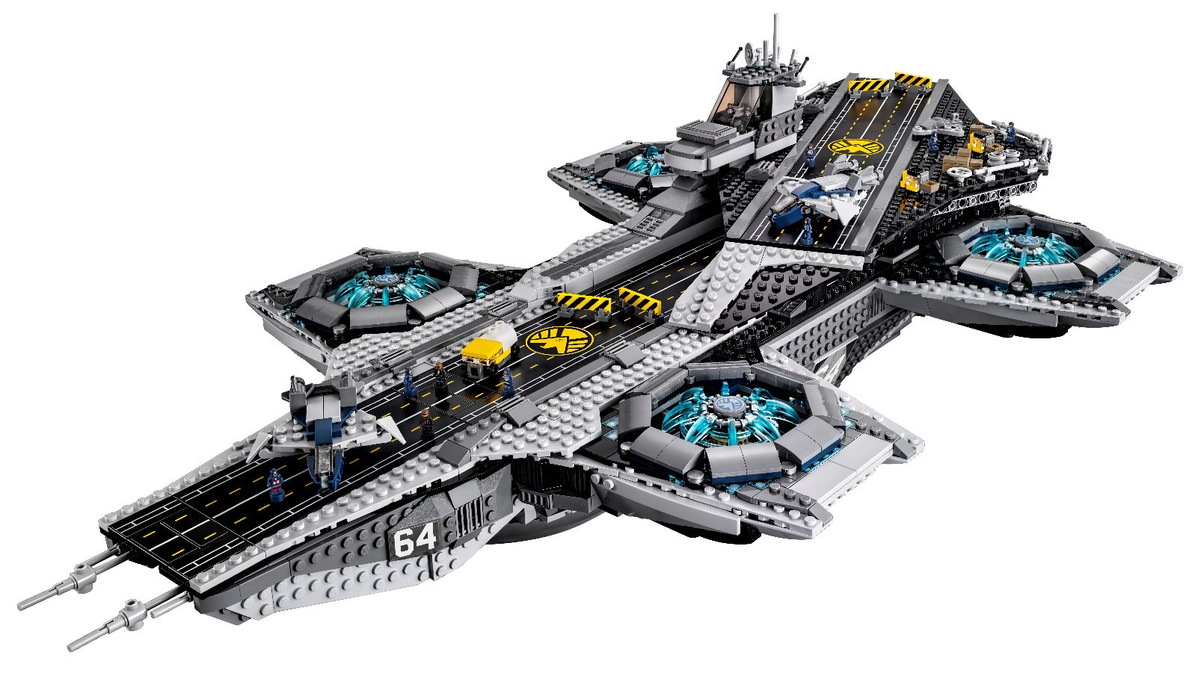
Objective
Create a 3D model of the Lego Marvels Hellicarrier in collaboration with a design team in Montreal, Canada

Slide 3
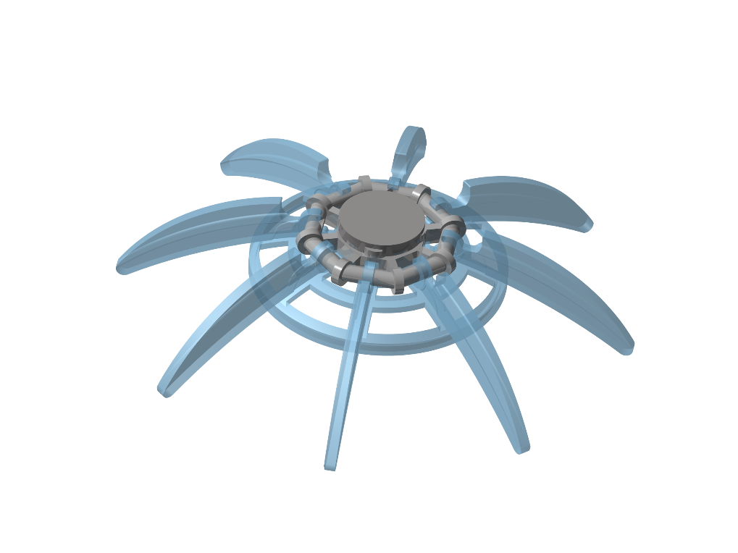
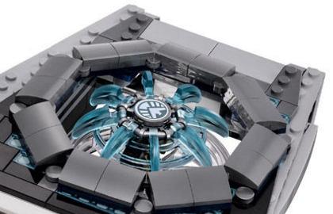
Front Engine Sub-Assembly
Working in conjunction with Ecole Nationale D'Aérotechnique to produce a working engine sub-assembly

Slide 4
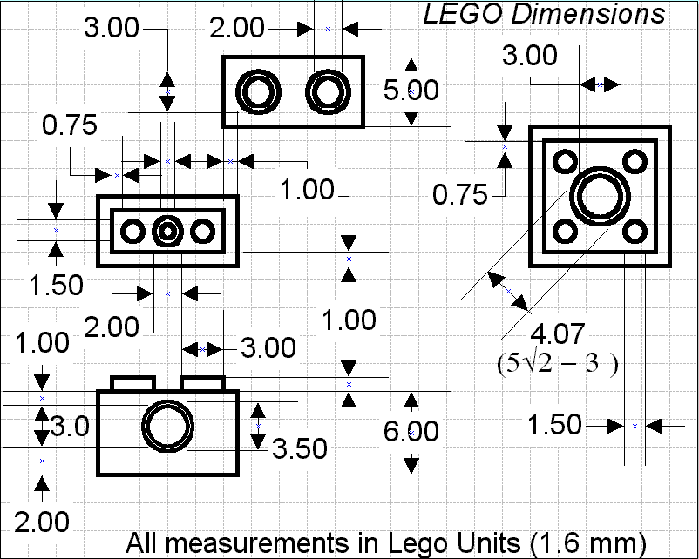
Modeling Techniques
Due to the complexity of assemblies in CATIA, our team used the SNAP function to constrain parts
This saves on file size allowing us to efficiently send/receive files to/from our partner school
Also used standard Lego units to simplify construction and maintain accuracy during part modeling phase of project

Slide 5
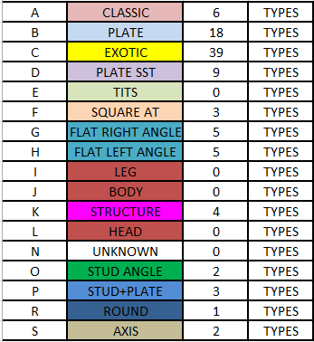
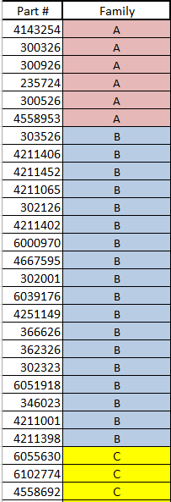
Bill of Materials
Since sharing parts was necessary, a standard naming convention needed to be in place
Each part was separated into families based on geometry
Part naming was based
off of the official Lego part numbers to
eliminate confusion across teams

Slide 6
Lessons Learned
Communicate early and often to make sure project goals/deadlines are understood
Confer with team to identify base dimensions and modeling techniques
Give yourself ample time to model parts – some have extremely complex geometries
Remember to have fun with whatever it is you’re doing – work hard and have a positive attitude!

