Slide 1
Magnetic Gear Clock Manufacturing
Diego A. Juarez & Brian Remsen

Slide 2
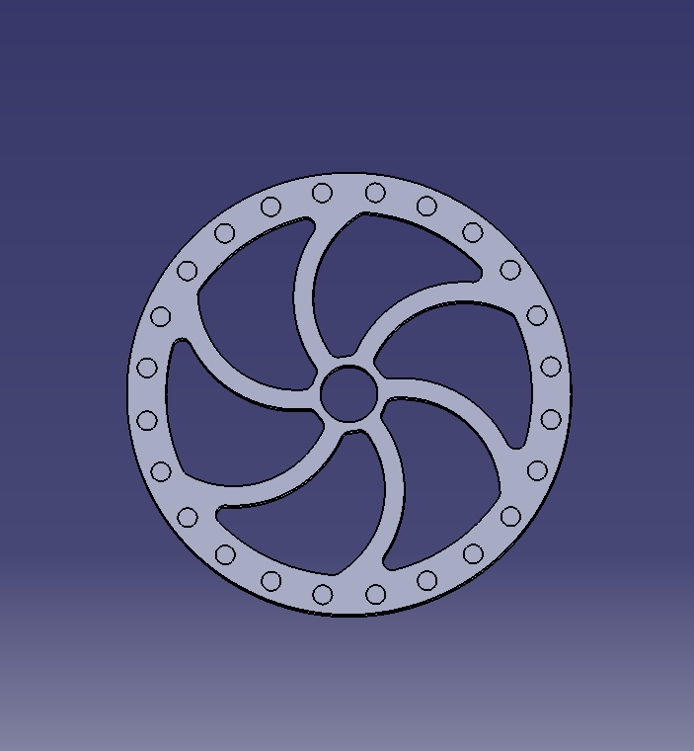
Objectives
Redesign: Rotor Spoke Plate, Magnet Wheels, and the Great Wheel.
Magnet Wheel
Original Design
New Design

Slide 3
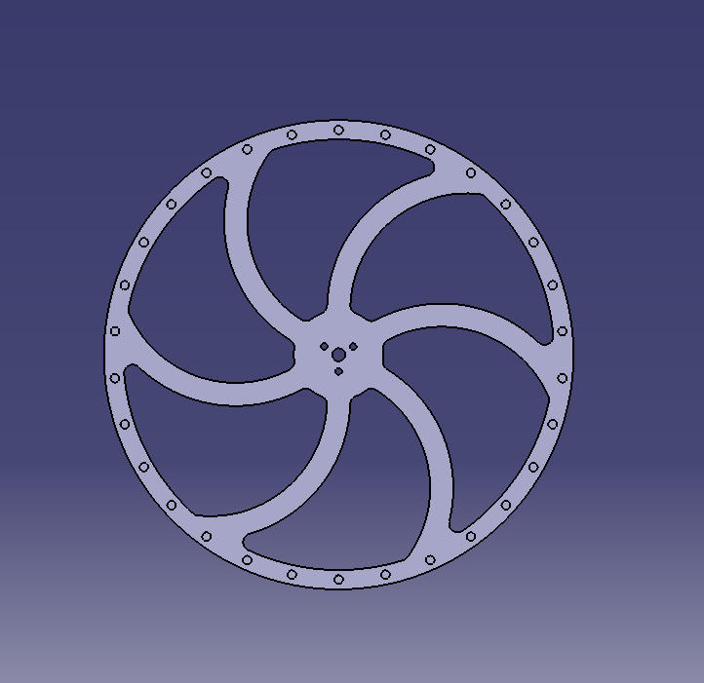
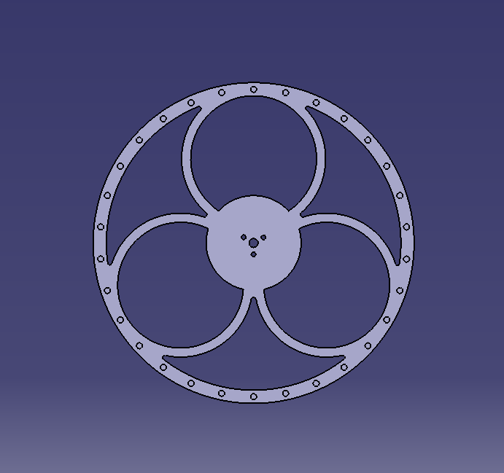
Objectives
Redesign: Rotor Spoke Plate, Magnet Wheels, and the Great Wheel.
Great
Wheel
Original Design
New Design

Slide 4
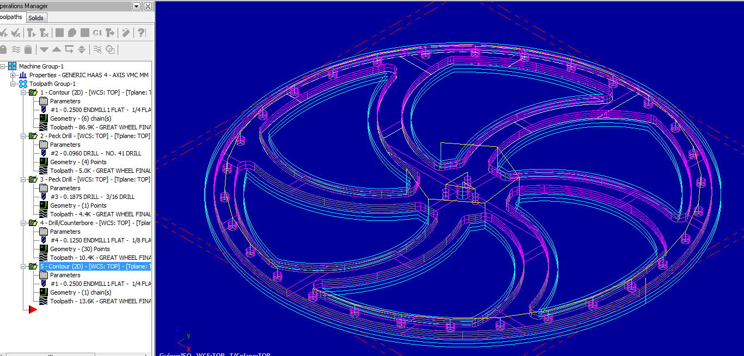
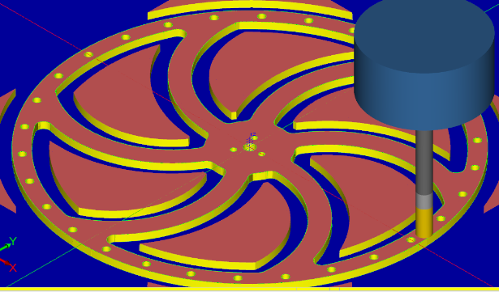
Objectives
Prepare parts in Master Cam for Manufacturing.
Final Result
MaterCam Setup

Slide 5
Objectives
Machine parts using the HASS CNC Mill
1
Mounting the Plate
3
End of Machining
2
Beginning of Machining
4
Final Product

Slide 6
Final Goal
Tasks Left
Create an aesthetically pleasing design for the base of the clock and machine it.
Final Product

