Slide 1
Exoskeleton Finite Element Analysis
Lane Matteson
Alex Leppek
Trevor Livingston

Slide 2
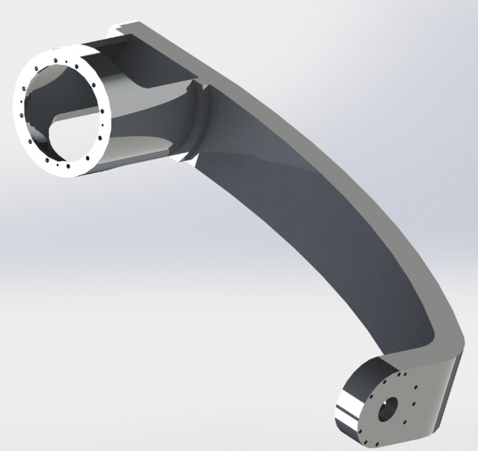
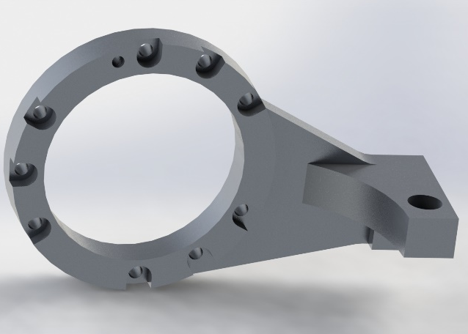
Project Outline
For this project, our goal was to analyze three components of the complete exoskeleton assembly to determine the magnitude of deflection at each component’s location.

Slide 3
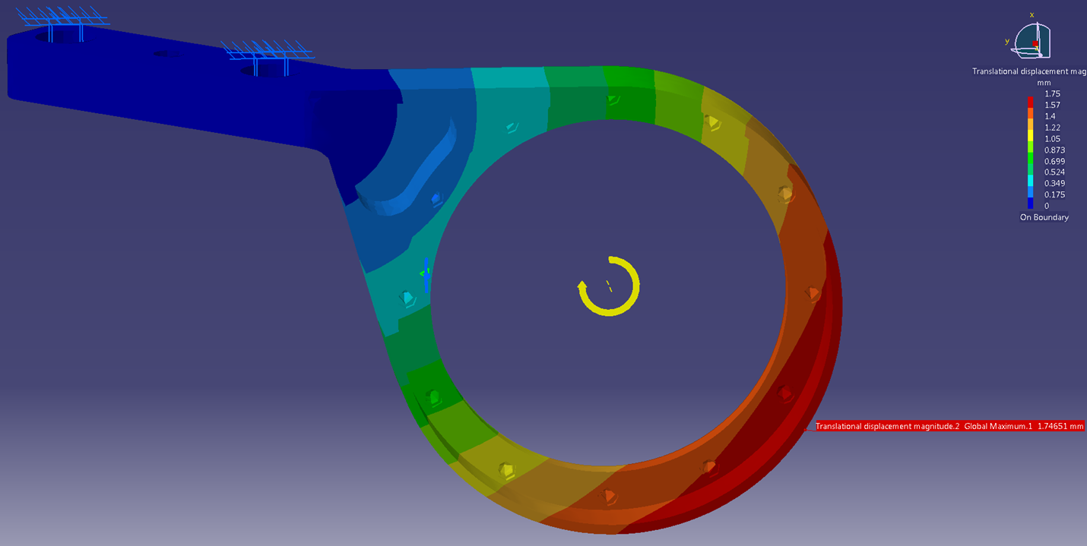
Elbow Link
Max Displacement 1.75 mm
Applied Moment 73.6 N-m
For this analysis, the flange bolt holes were fixed and a moment of 73.6 N-m was applied to the motor mounting portion of the part. This resulted in a 1.75 mm deflection.

Slide 4
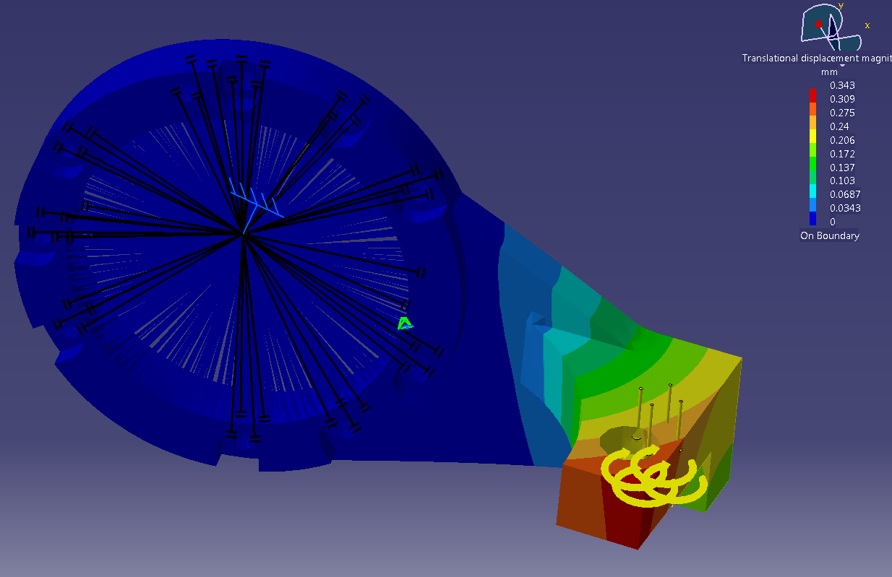
Arm Link
Applied Load:
276N
Max
Deflection:
.343 mm
Applied Moment: 21 N-m
For this analysis, the motor mounting portion of the part was fixed and a 21 N-m moment was applied along with 276 N force to the bolt hole. This resulted in a .343 mm deflection.

Slide 5
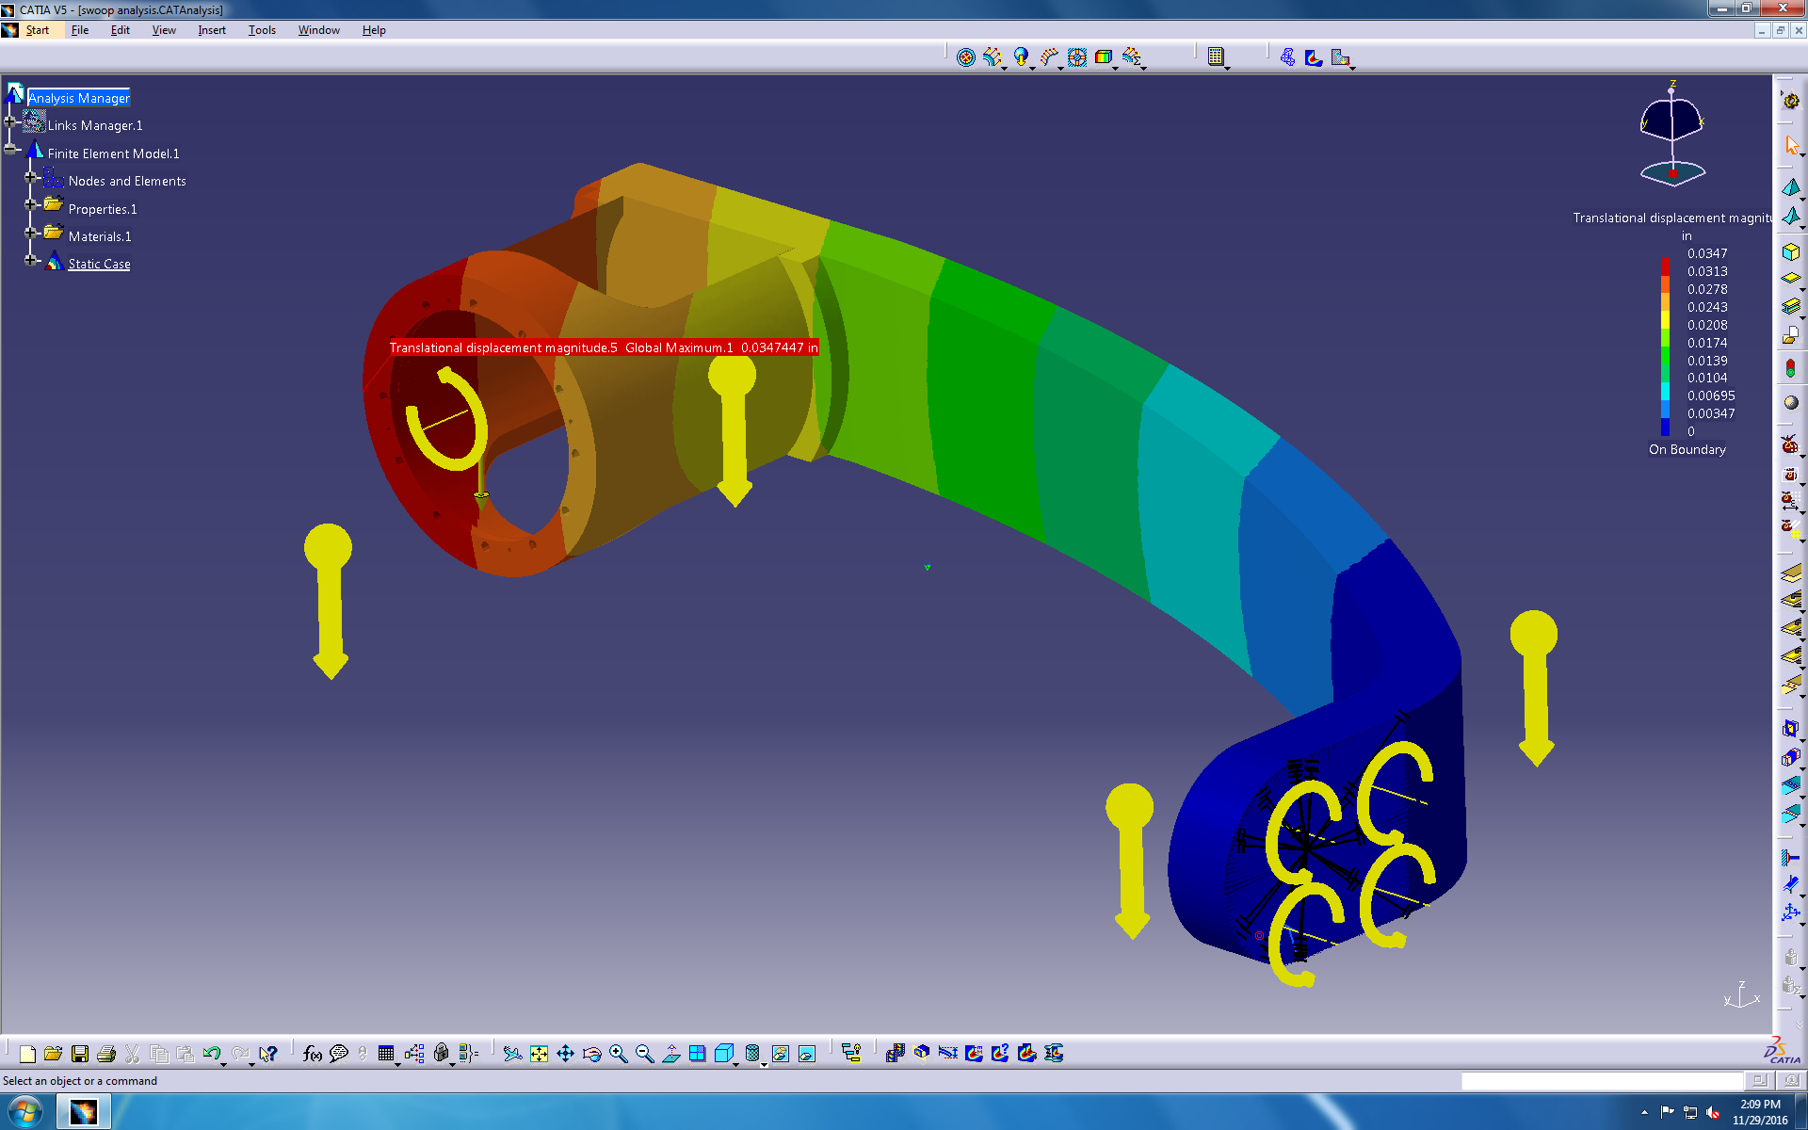
Main Link
Maximum Displacement:
.8825 mm
Applied Gravity
Applied Moments: 20 N-m
Applied Load: 147 N
For this analysis, moments of 20 N-m were applied to both motor mounting positions along with a force of 147 N applied to the protruding, circular mount. This resulted in a displacement of .8825 mm

Slide 6
Conclusions
By applying the maximum torques the motors can output, all three of the parts deflect 1-2 mm, which is above the 1 mm target maximum deflection.
However, if the expected torque for each respective part is applied, all three parts displace between .2-.95 mm, which is within the 1 mm target.

