Slide 1
Kinetic LEGO Sculpture
Project by Taylor Spence and Marc Dobson
Project by Taylor Spence and Marc Dobson
Project by Taylor Spence and Marc Dobson

Slide 2
Project Goal
Recreate kinetic LEGO Set in CATIA
Match material appearances
Perform full kinetic movement

Slide 3
Material Appearances
To obtain consistent material appearances between our parts we created our own material library.

Slide 4
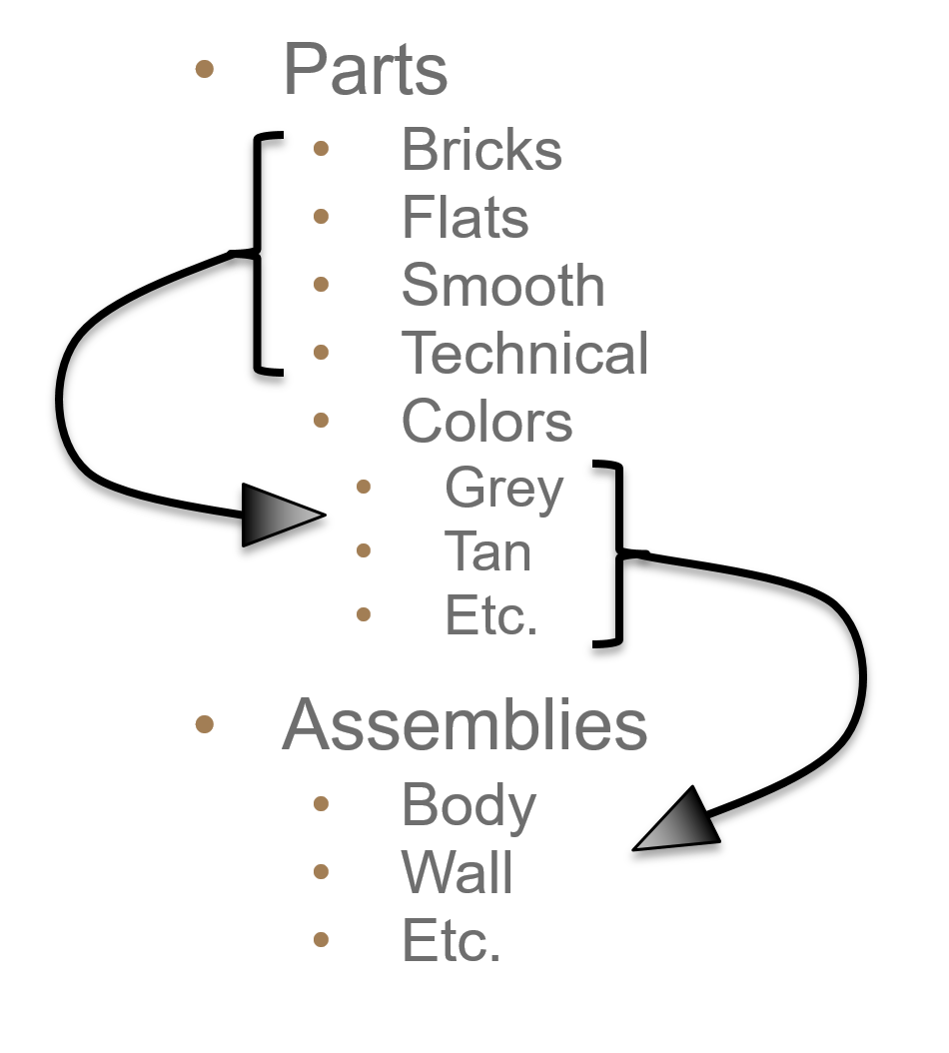
File Structure
Created unique file structure
Duplicate bricks sorted into their colors
Allowed for quick assembly

Slide 5
Part Design
186 different LEGO parts
120 parts modeled
66 parts copied into alt. colors

Slide 6
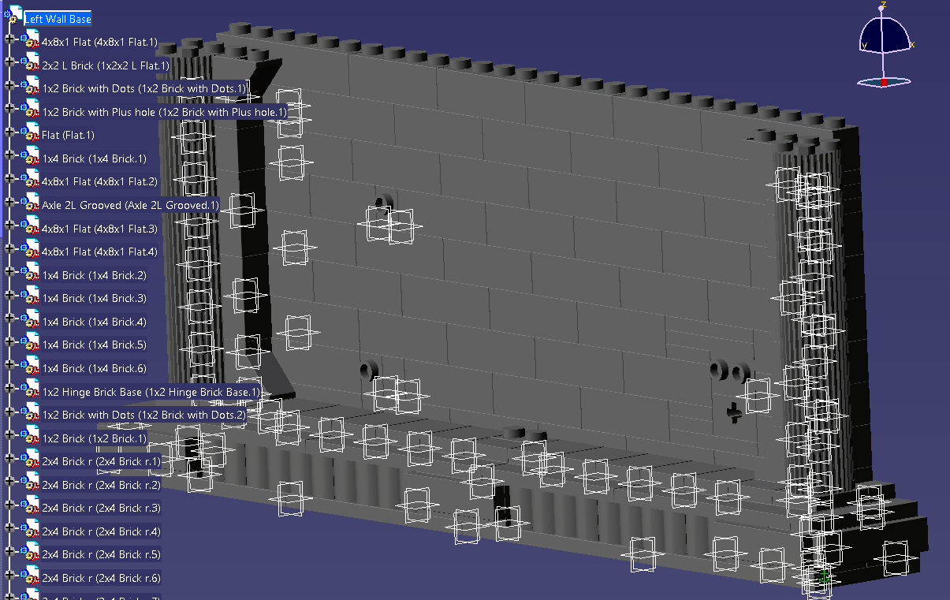
Assembly
Quickly assembled 1324 piece set
Used snapping for subassemblies
Snapping reduced processing needs
Constraints used on final assembly
Allowed kinetic functionality

Slide 7
Initial Renders

