Slide 1
CATIA Room Design
University of Idaho
A CATIA Approach to Floor Plan Architecture

Slide 2
The Plan
Explore CATIA’s feasibility for developing architectural structures in a non-engineering sense
Take the current classroom and lounge arrangement and transform it into the 21st century
Add new lights, windows, computers, and doors to achieve a feeling of art-technology
Section an area for an advising center to be used by all engineers

Slide 3
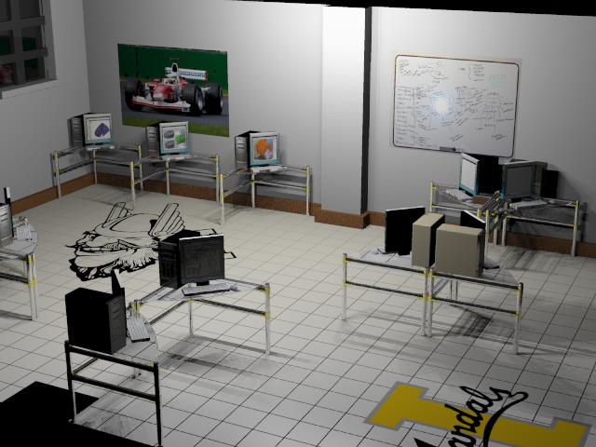
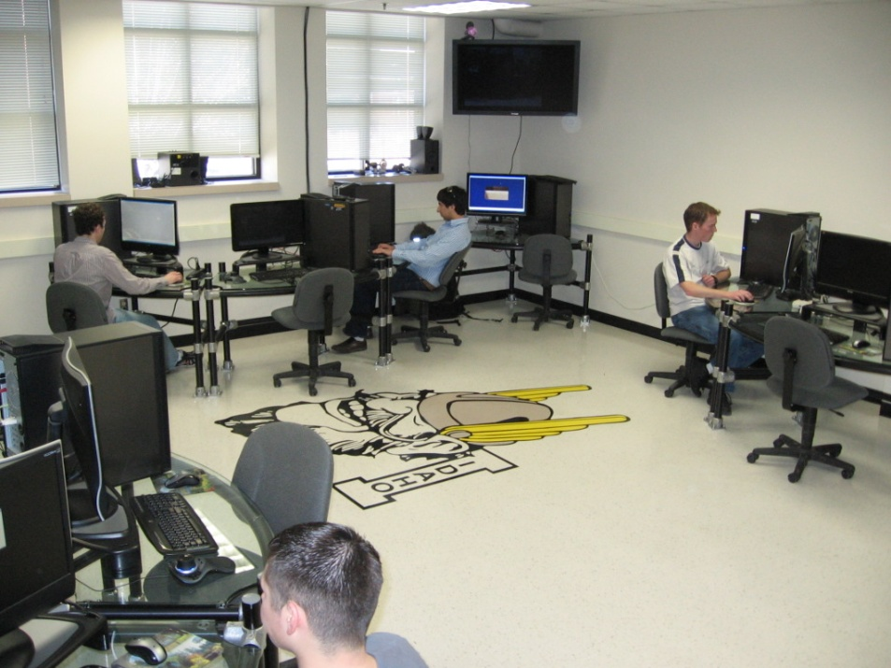
History
The University of Idaho’s CATIA lab was first proposed in a similar fashion using RHINO, and because of this was given the green-light.
Concept
reality

Slide 4
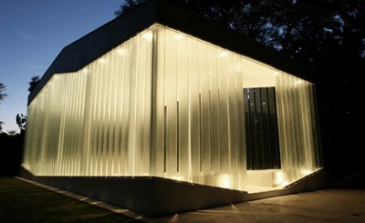
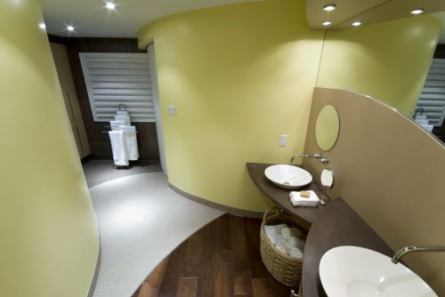
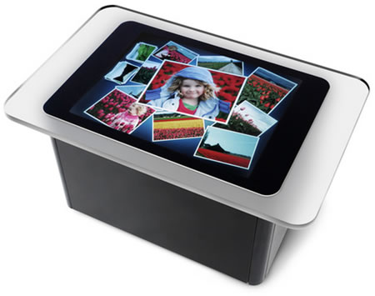
Lab Inspirations and Ideas
Lots of glass
Minimize corners while maximizing curves
High technology meets high style
Use Microsoft Surface ‘touch’ technology

Slide 5
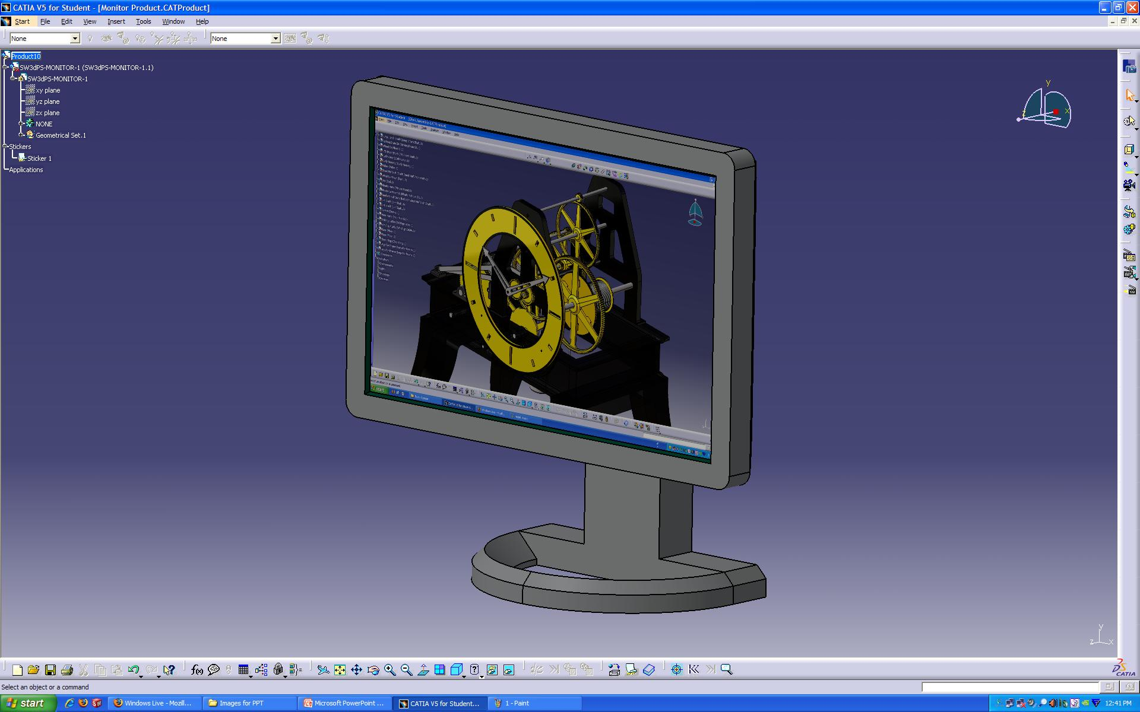
CATIA Workspace

Slide 6
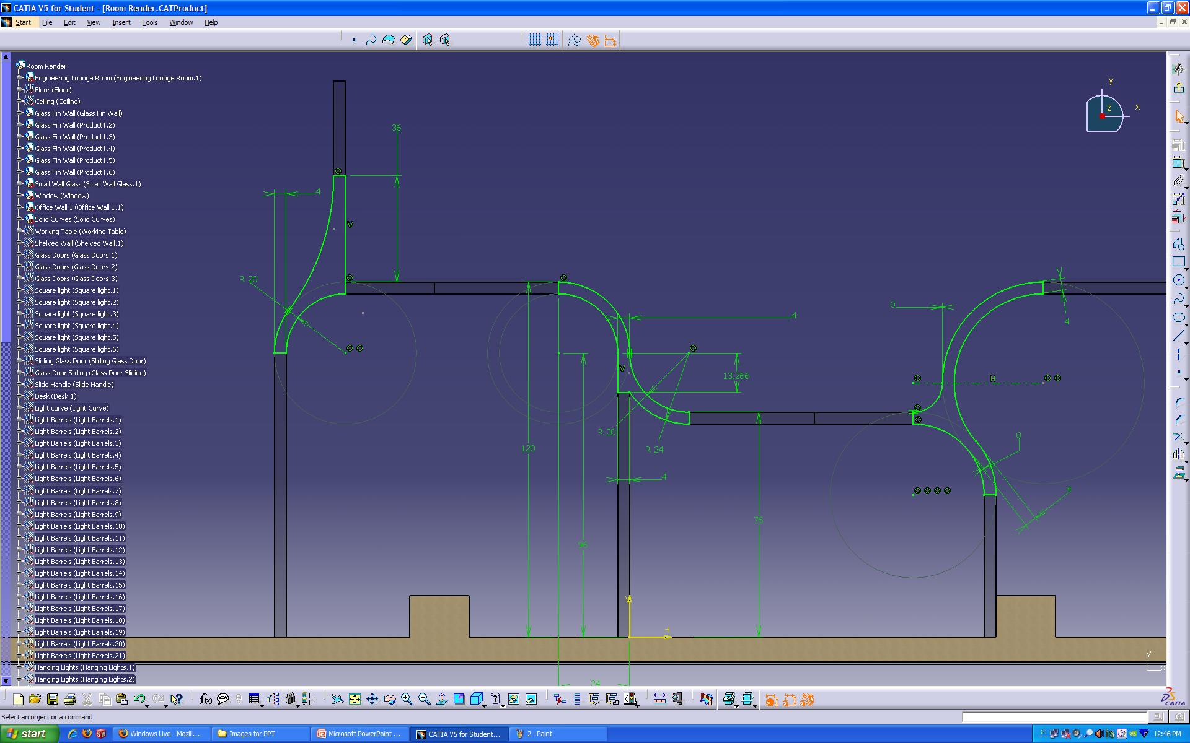
CATIA Workspace

Slide 7
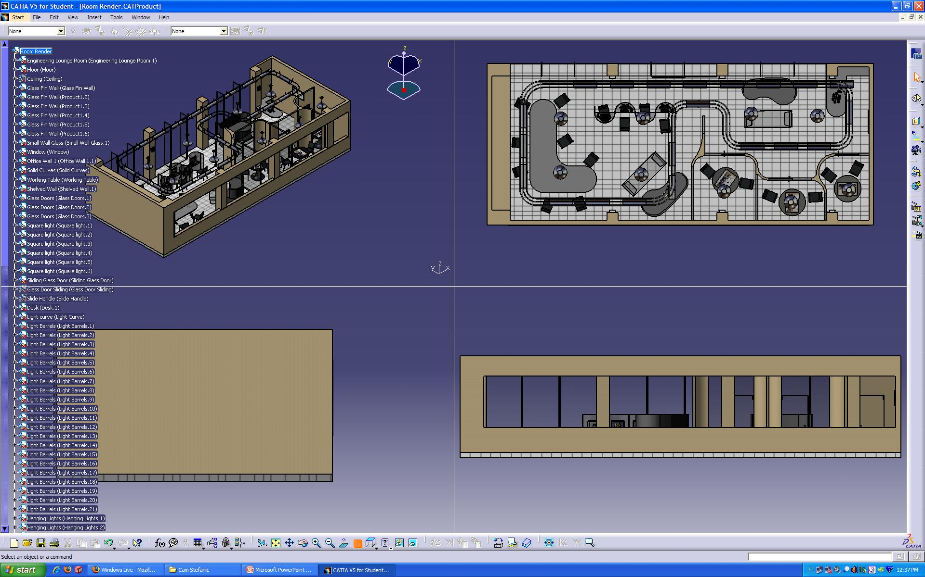
CATIA Workspace

Slide 8
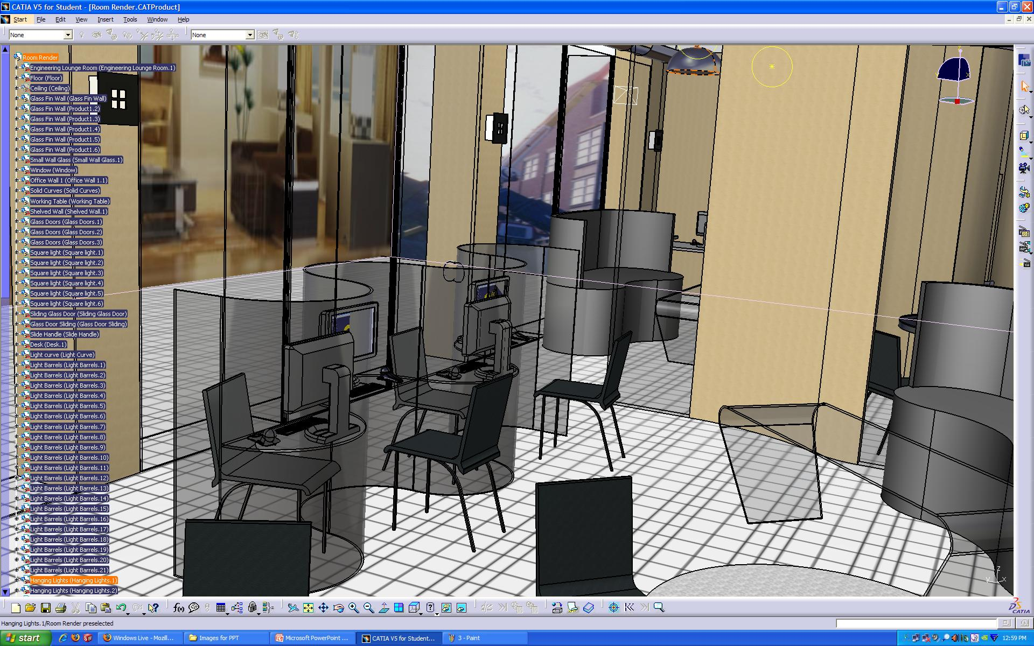
CATIA Workspace

Slide 9
Engineering Lounge
Computer desk with several engineering-specific programs installed for use
Curved table for team discussions and homework
Couch and curved glass table for lounging with friends or reading about the latest technology
42” LCD monitors playing engineering-specific television programs

Slide 10
Advising Center
Three separate advising ‘pods’ for one-on-one instruction
Each pod contains a Microsoft Surface table for a true hands-on advising experience
Curved walls with frosted glass dividers give feelings of both security and openness

Slide 11
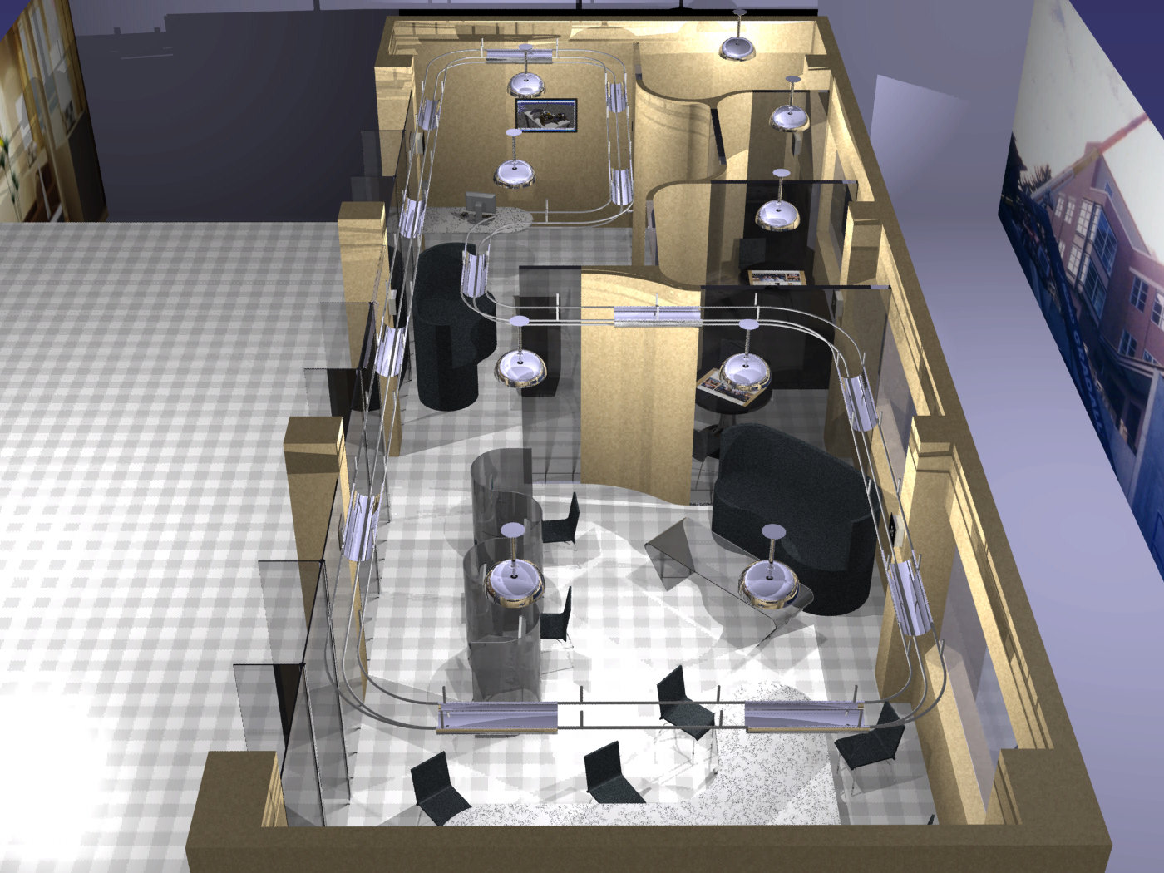
Overall Layout
ADVISING CUBICLES
ENGINEERING LOUNGE

Slide 12
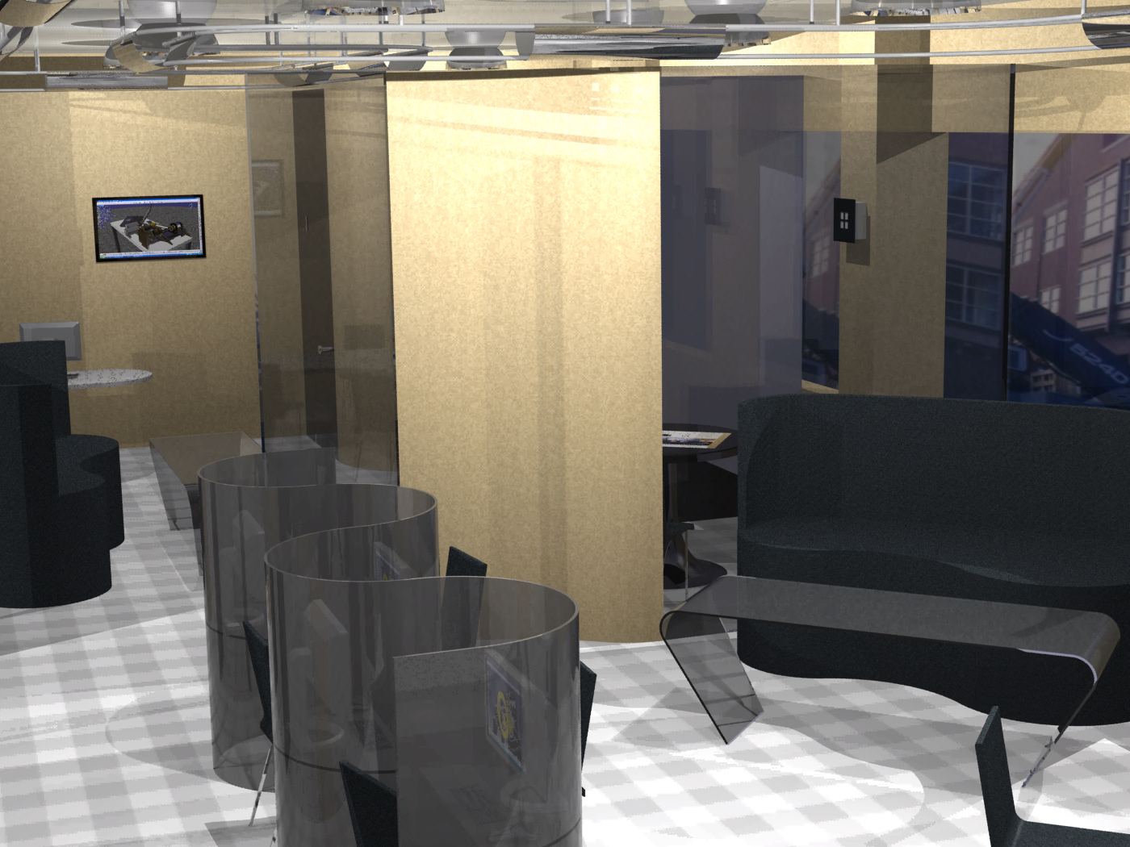
Detailed Shots

Slide 13
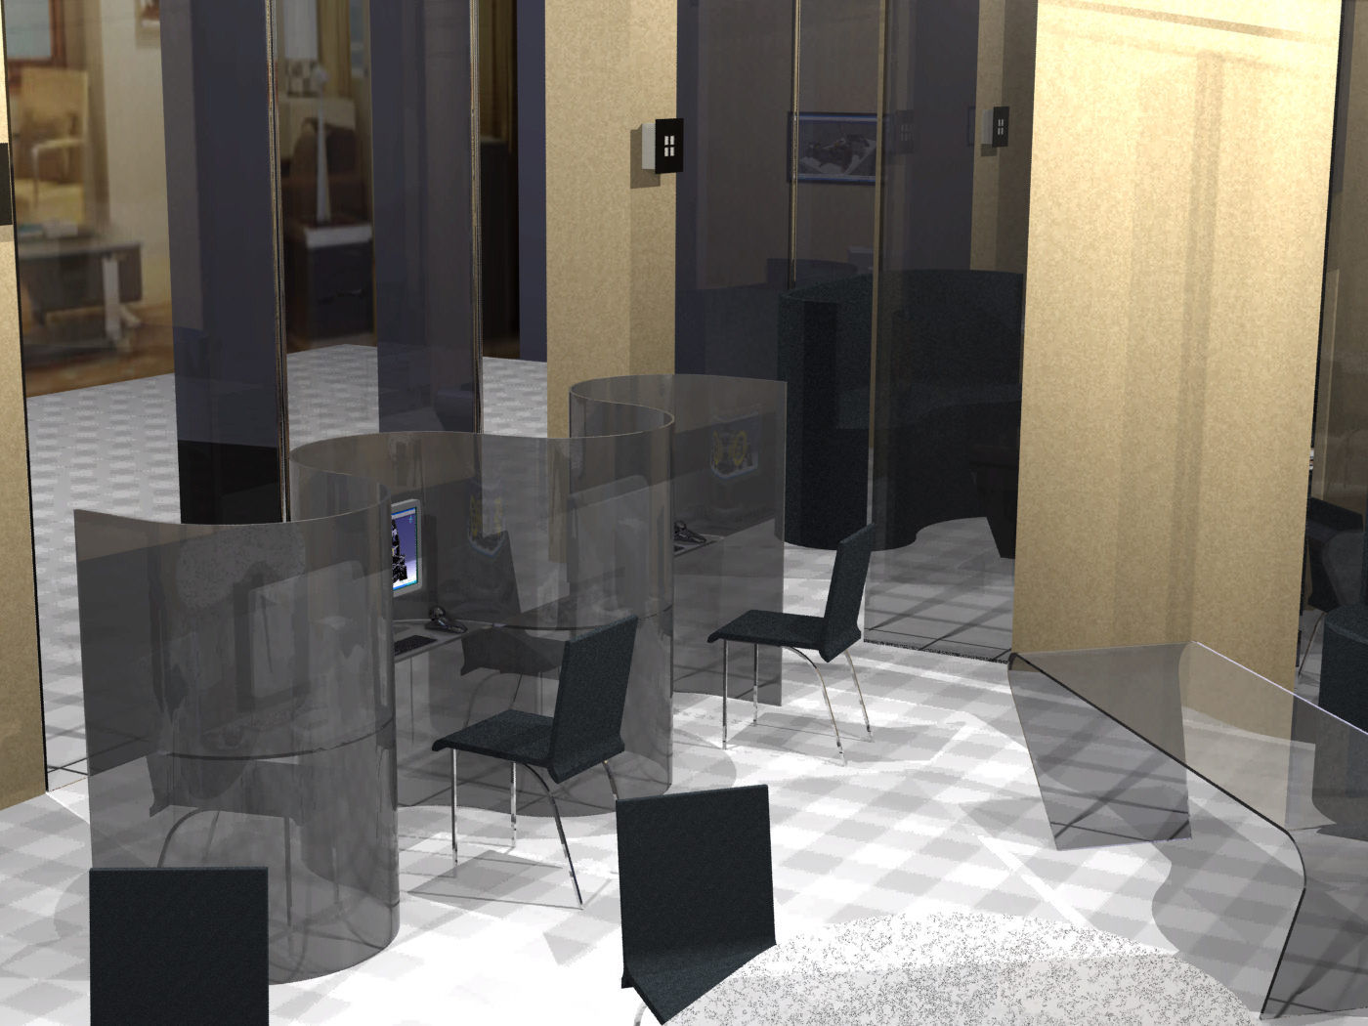
Detailed Shots

Slide 14
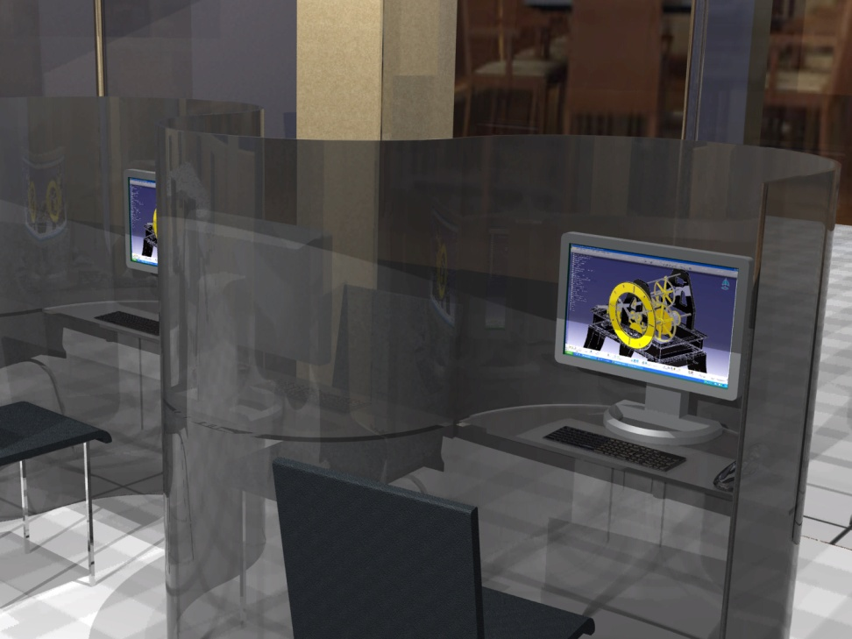
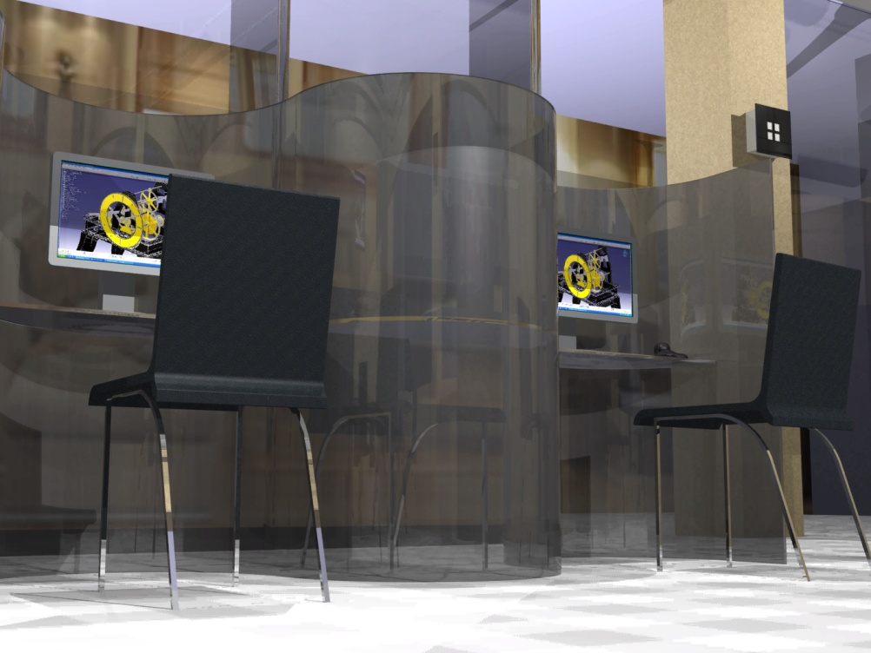
Curved Computer Station

Slide 15
Floor Design
The floor of the lab will prominently feature a University of Idaho College of Engineering logo and a curved detail to tie together the Advising Center and the Student Lounge

Slide 16
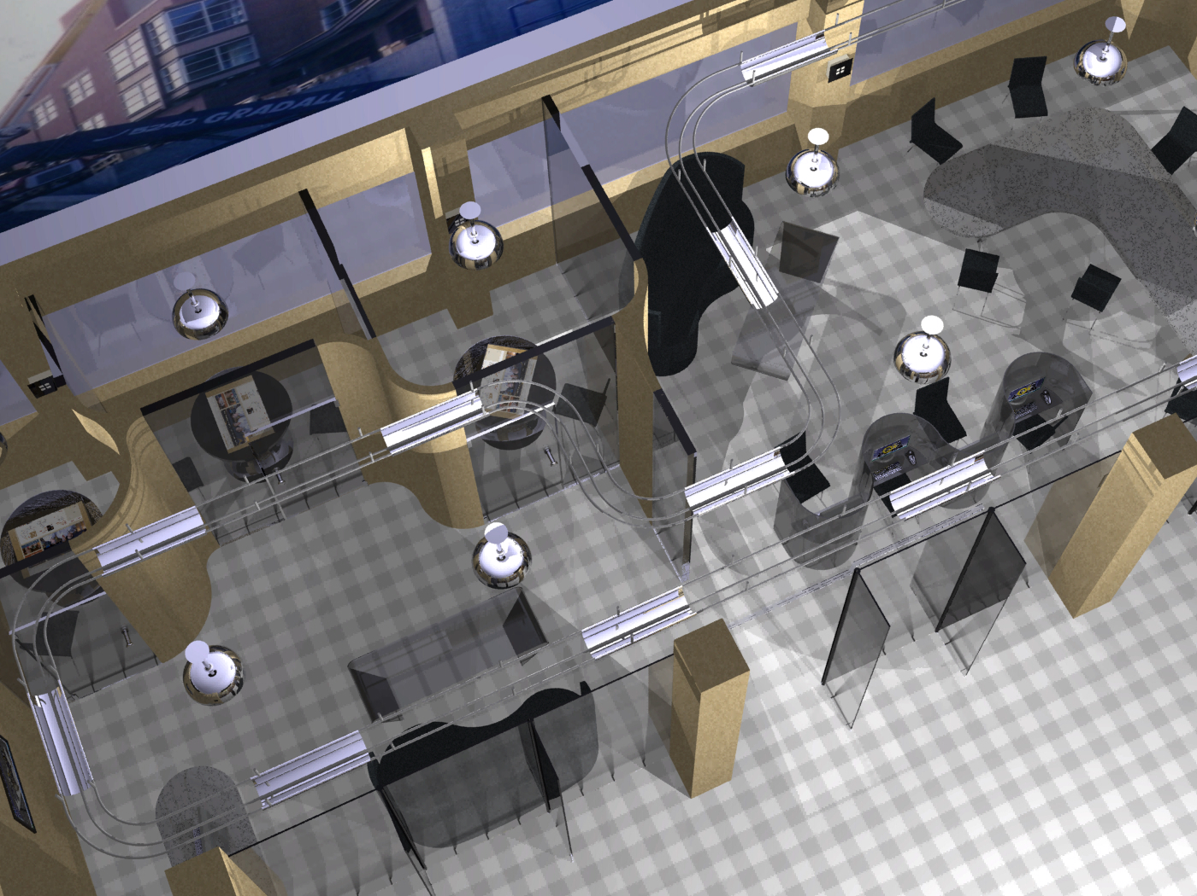
Rendered Overview

Slide 17
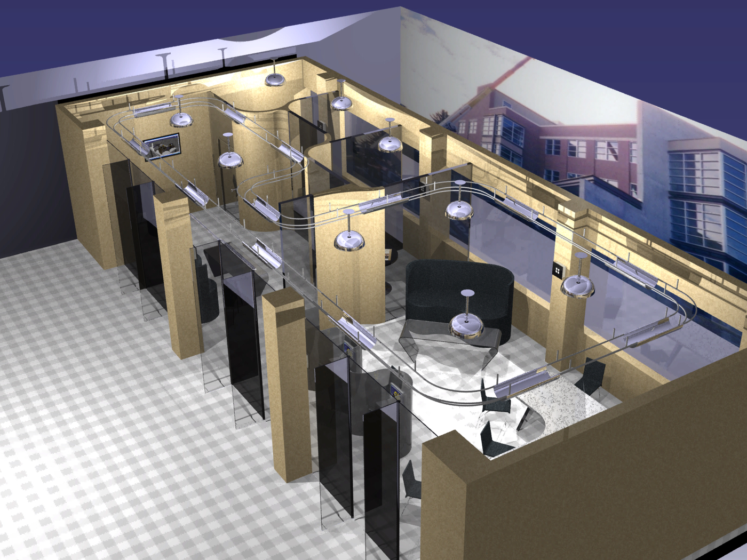
Rendered Overview

Slide 18
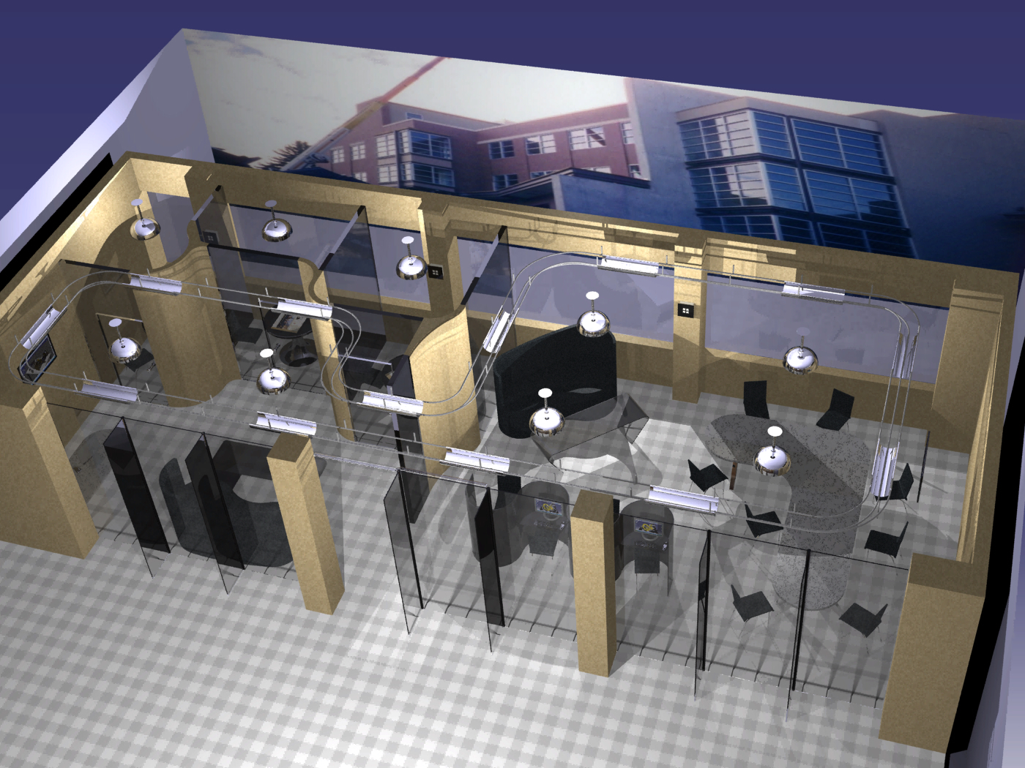
Rendered Overview
Notes:
Closing Slide, Tie all together

Slide 19
Conclusion
CATIA proved to be a valuable asset in this realm of art-based design versus engineering-based design
A final large assembly was handled with ease, and substitution of different furniture was simple with the add/replace component feature
Renderings came out well by exploiting CATIA’s advanced lighting features

