Slide 1
NC LATHING
By:
Matt Mihelish
Joe Winston

Slide 2
Overview
Creating the following during lathing tutorial:
NC Geometry
Stock
Part
Product from NC Geometry, Stock, & Part
Lathe operations in lathe workbench
Rough, groove, finish, &thread turning
Drilling
Simulation

Slide 3
NC Geometry
A point in space that is zero or ground for operation
This point allows the part and stock to be joined at a common reference point
Creating
Open New Part
Click Point button
This option then creates an X in the
axis cube seen in the figure to the right

Slide 4
Stock
The stock provides a desired form for lathe simulation from which the part is machined.
Creating
Open New Part
Draw and dimension desired stock form
Use pocket tool to generate desired stock length
Right click on stock and change the transparency in the properties option to 146.
Change stock to desired color

Slide 5
Part
Must be a round symmetrical part
Once part is made it must have a profile line defining half the part, this allows for tool path selection
To make a coherent process, i.e. not having to take the part out of the chuck and remount, all tool paths must be accessible from one side

Slide 6
Part Geometry Creation
Creating
Open New Part
Draw given profile
Use shaft tool to generate part
Sketch part profile on ZX axis
Pocket out a 1” hole through the part center
Profile
Alignment
Axis

Slide 7
Making the Product
Combining NC geometry, stock, and part
Open a new product and insert components
Fix NC geometry (anchor button)
Use contact constraint to constrain stock to NC geometry
Do the same for the face of the part to the face of the stock

Slide 8
Final product
All constrained about
Fixed NC geometry
-note all xy planes of
all three parts are
together

Slide 9
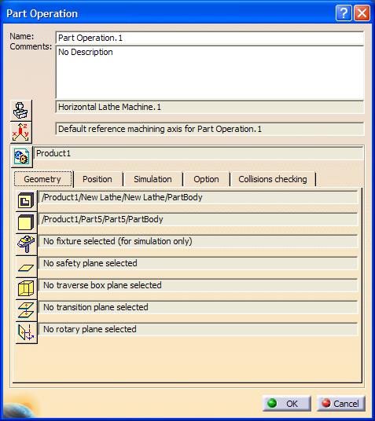
Lathe Machining Workbench
Open Lathe Machining Workbench
Start Machining Lathe Machining
Open Part Operation
Process Double click Part Operation
Setup Geometry
Specify Part
Specify Stock
Specify part
Specify stock

Slide 10
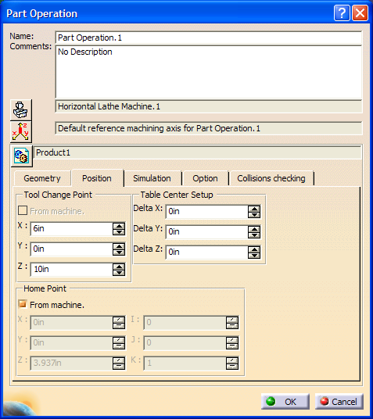
Machining lathe work bench
Setup Operation
Adjust tool change position as needed
Specify tool change point

Slide 11
Machine Editor
Setup Machine Option
Click Machine button
Click Horizontal lathe
Adjust axes as needed
Other things of note
-rotation type
-rotation direction
Horizontal lathe operation
Axis specification
Machine
Button

Slide 12
Adding Operations
Click in the manufacturing program to make an active item
Insert desired tool process by clicking operation buttons
Order of operation is key for the end simulation to run correctly
Start with final tool operation and finish with the first tool operation to keep order coherent
Operation Tool Bar

Slide 13
Operation Layout
The operations should be constructed in the following order:
Threading
Groove Finish
Finish Profile
Drill Operation
Groove Turning
Rough Turning

Slide 14
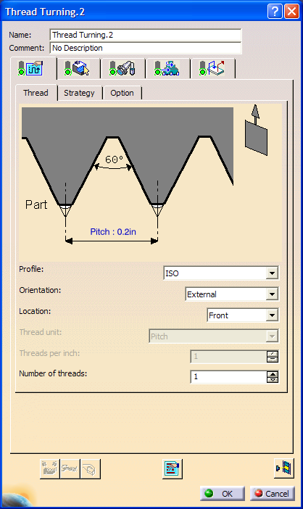
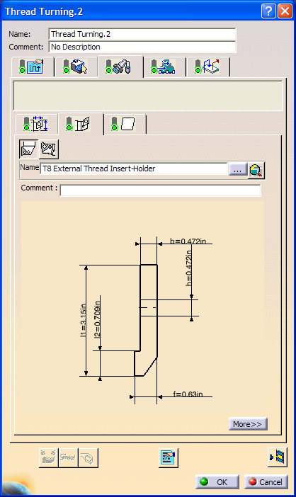
Threading
a
b
c
In Fig. a specify part material and end limitations. Fig. (b) specify pitch of thread
needing to be cut. Fig. (c the tool can be specified but wasn’t for this tutorial. Default
tool was used.

Slide 15
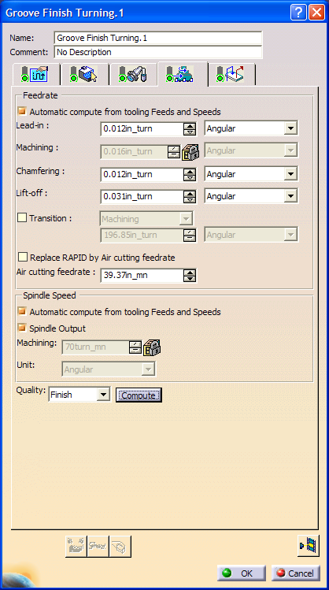
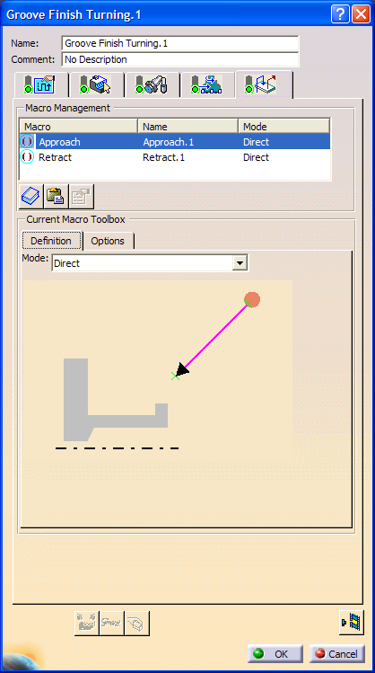
Groove Finish
b
c
a
Fig. a specify profile as shown. Fig. b show the feeds and speeds tab allows for specification of speeds for certain materials and tools Fig. c shows macros, used to minimize movement of the tool while machining.

Slide 16
Finish profile
Finish paths remove excess material and any scalloping. The tool, spindle speeds, and tool approach won’t change for tutorial during finishing and rough machining, but may during actual machining.

Slide 17
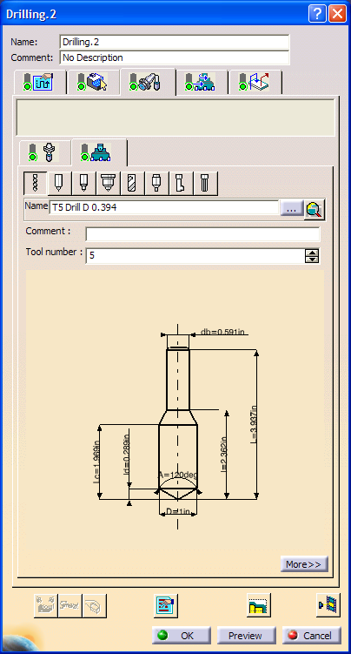
Drill Operation
a
b
Fig (a) is used to specify drill geometry and drill depth. Depth is changed by double clicking Extension and adjusting specification as desired. Fig (b) is used to change drill bit dimensions or other drill bit characteristics. Note: Spindle and feed speeds are default and will be changed during normal operations.

Slide 18
Rough Turning & Grooving
a
b
Fig (a) depicts the rough turning operation which turns out the entire part profile. The rough turning window requires the selection of the stock and part profile. All other operations such as spindle speed, tool approach were kept at the default setting for this operation.
Fig(b) depicts the groove operation enabling turning of groove profiles on part. The groove turning window requires both the stock and groove profile to be selected as indicated.

Slide 19
Final Design Tree
After constructing all operations, the final design tree should look like the following figure.

Slide 20
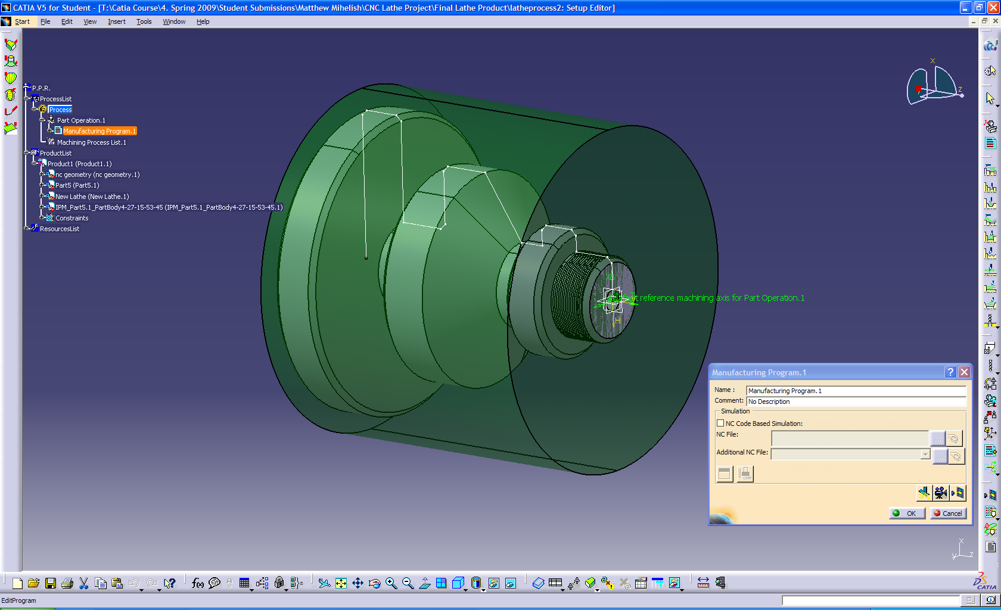
Simulation
Simulating the machining process requires double clicking the Manufacturing Program 1. The Manufacturing Program 1 box is displayed, by clicking the video camera an animation will commence depicting tool operations.

Slide 21
Simulation Movie

