Slide 1
ME Measurements Lab Redesign
Erik Duncan, Scotty Hardwick, Jake McLean

Slide 2
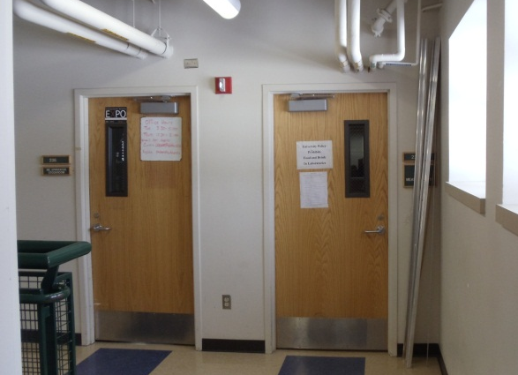
Entrance

Slide 3
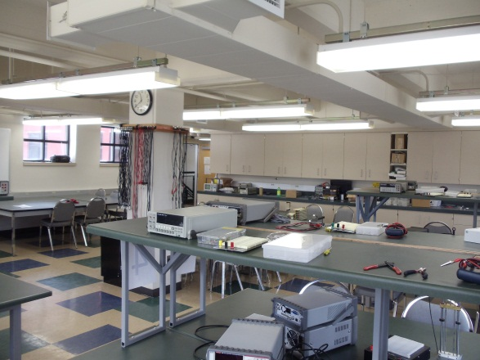
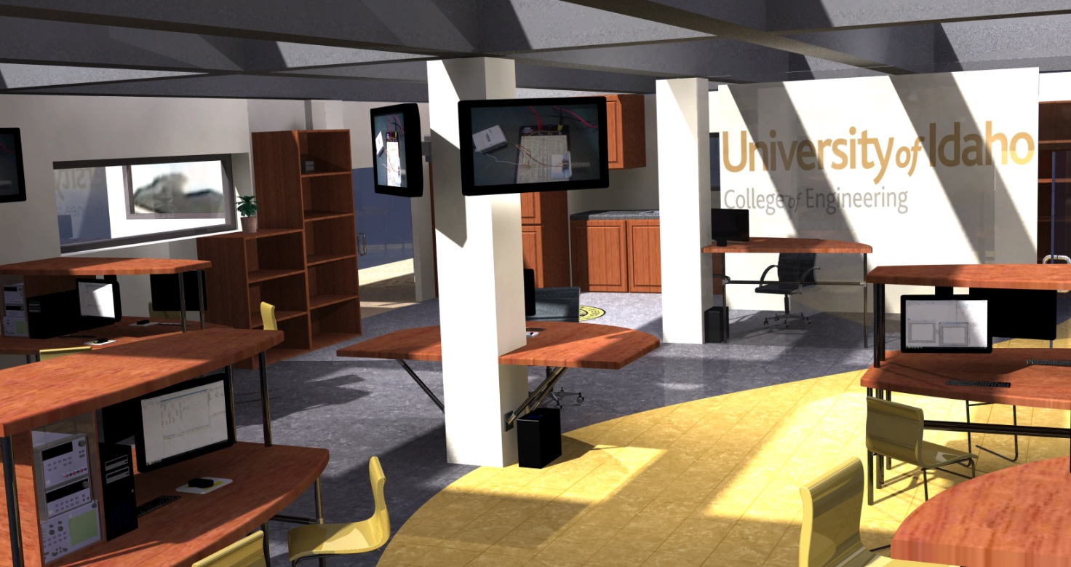
Room View

Slide 4
Office View

Slide 5
Desk

Slide 6
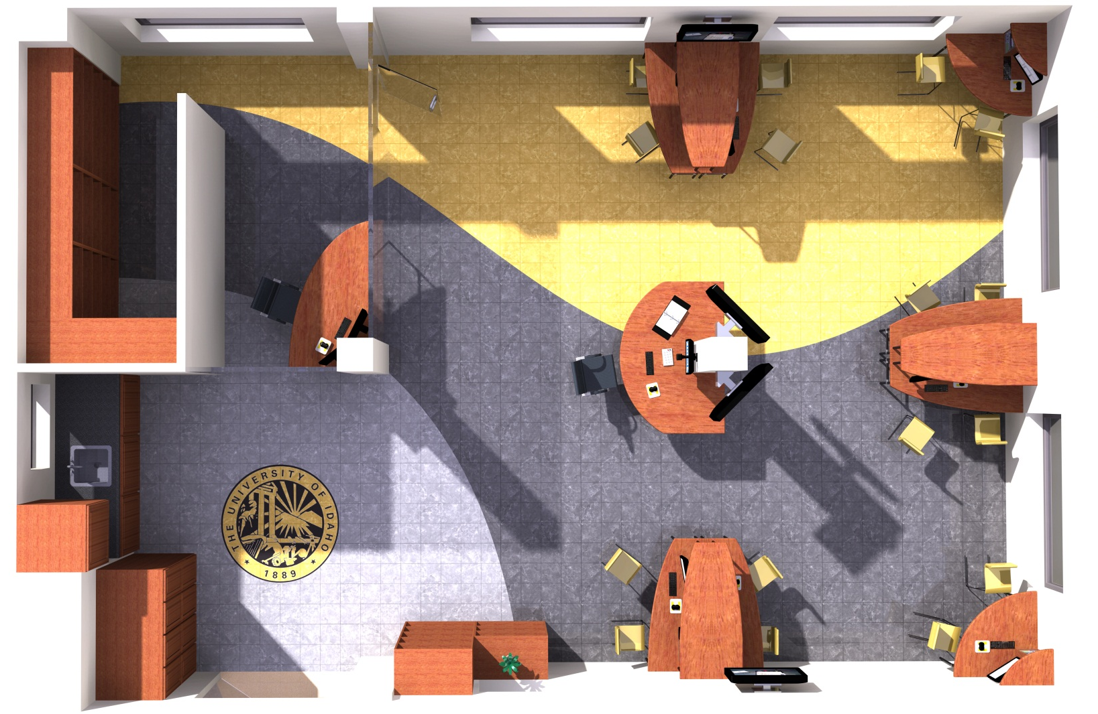
Floor Plan

Slide 7
Layout

Slide 8
Final View

