Slide 1
Rhino Rendering
Chris Pratt, Ruth Reeber, Justin Herrick

Slide 2
Objective
Our goal is to create tutorials and other materials to enable future students to make lifelike renders in Rhino.
Renders made in CATIA and SolidWorks lack realism and have few options. Rhino provides much broader rendering capability and creates more professional images.

Slide 3
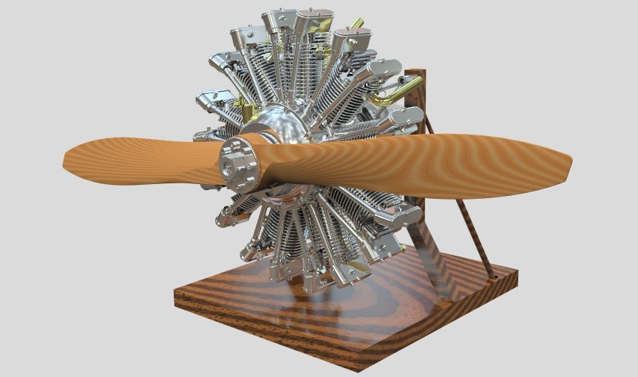
Radial Engine

Slide 4
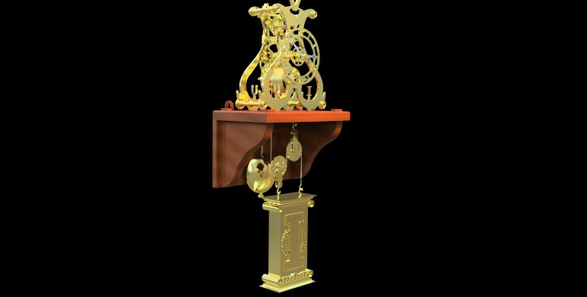
Skeleton Clock

Slide 5
LEGO Glider

Slide 6
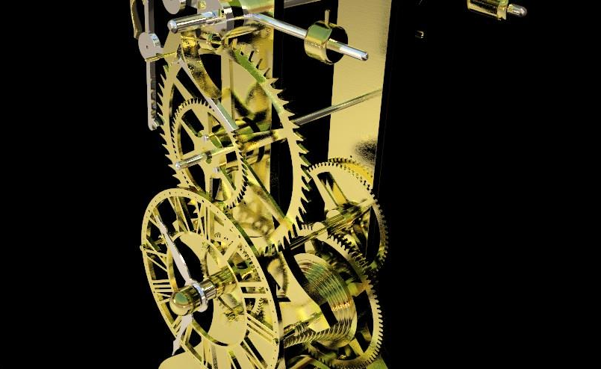
Grasshopper Clock

Slide 7
Tarantula

