Slide 1
Wright J5: A Nine Cylinder Radial Engine
Ingrid Kooda
Jacob Sabata
Luke Nelson

Slide 2
Objective
To create a Catia V5 3-D Model of the Radial Engine used to power the Spirit of Saint Louis derived from Legacy Drawings
To explore complex mating techniques to create accurate products

Slide 3
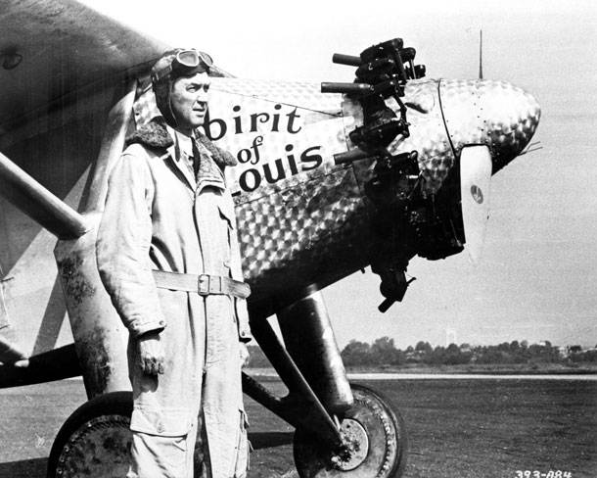
The Spirit of Saint Louis
On May 20-21, 1927, the Spirit of Saint Louis, piloted by Charles Lindbergh, flew from New York to Paris becoming the first non-stop flight across the Atlantic Ocean.
This Historic monoplane was powered by the Wright J5 nine-cylinder radial engine modeled.

Slide 4
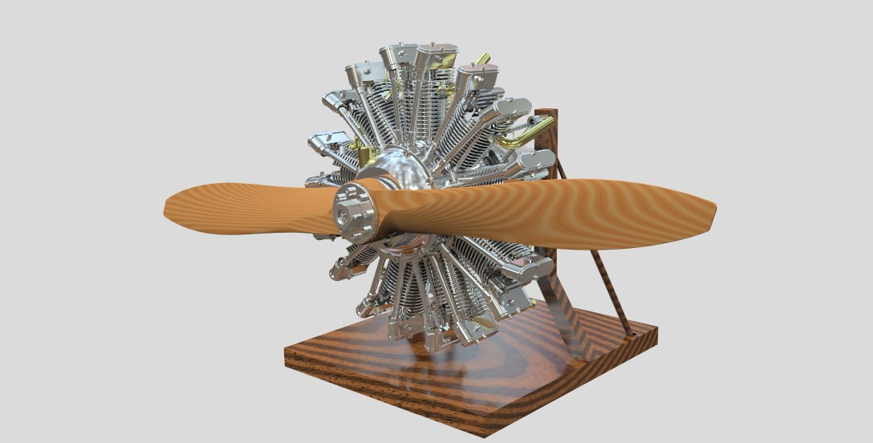
Wright J5 Nine Cylinder Engine

Slide 5
Nine Cylinder Crank Case

Slide 6
Cylinder Head Assembly

Slide 7
Rocker Box

Slide 8
Distributor Explode

Slide 9
Exploded Planetary Gear Assembly

Slide 10
Planetary Gears

Slide 11
Lessons Learned
To use complex features, like multi-section remove tool
CATIA is a powerful program because it has a lot of different types of design features that many other drafting programs do not have.
Use complex mates to create functioning products
Derive a product from legacy drawings
Error trapping
CATIA is not as intuitive as SolidWorks when creating products
An equal constraint does not exist in CATIA but would have made our lives much easier
Drawing features have to be told to be continuous (i.e. need to click the button multiple times)
CATIA doesn’t warn about over constraining, requiring on to be much more aware of mates while making them ☹

