Slide 1
Kibbie Dome Expansion
Nate Pueschel, Woovin Yi, Lazizjon Toshniyozov

Slide 2
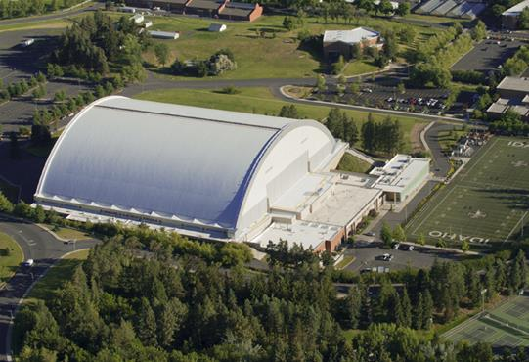
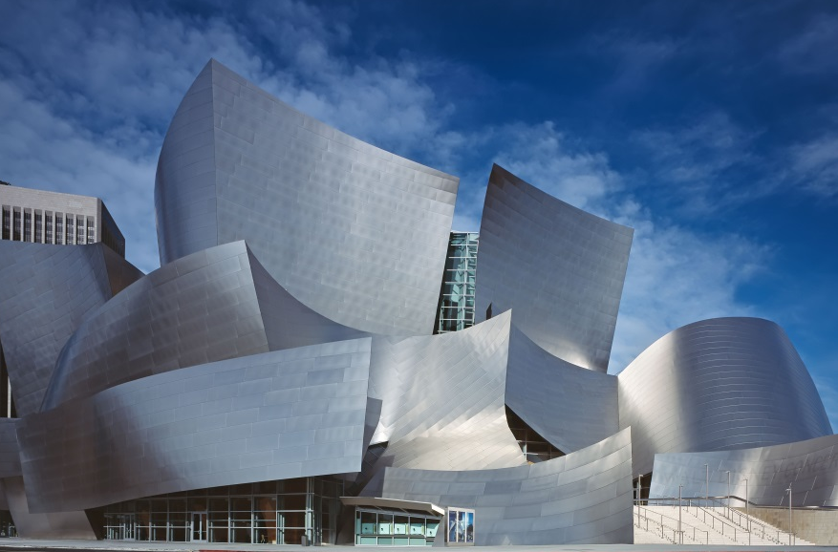
Objectives
The goal for this project is to come up with a basketball stadium
We are going to model a new sports complex
Major Focus will be building a basketball stadium
Modeling the stadium after architect Frank Gehry

Slide 3
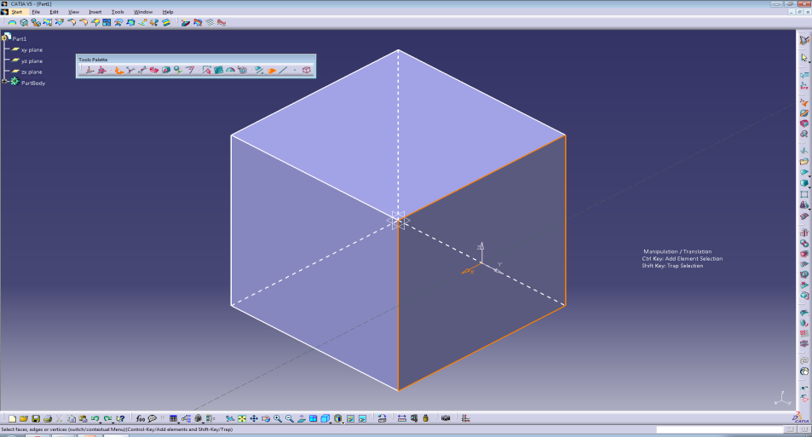
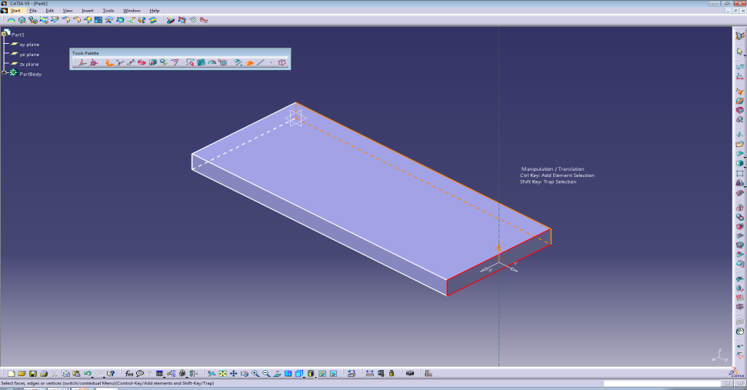
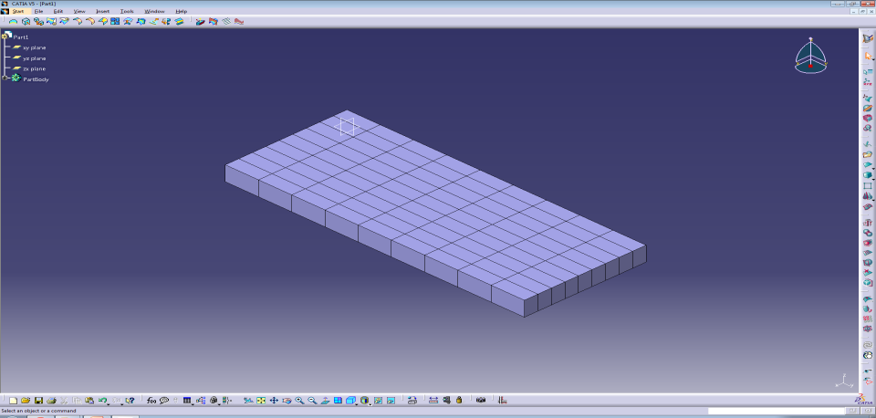
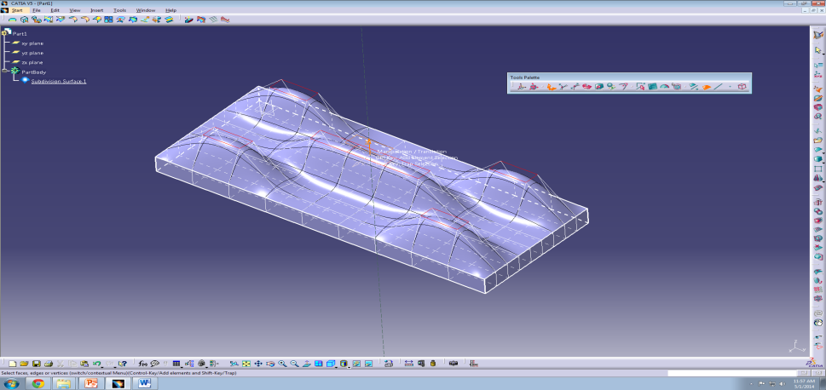
Imagine&Shape Catia workbench
Create a box
Manipulate using the translation tool
Face cutting
Manipulate using the face and vertex selections

Slide 4
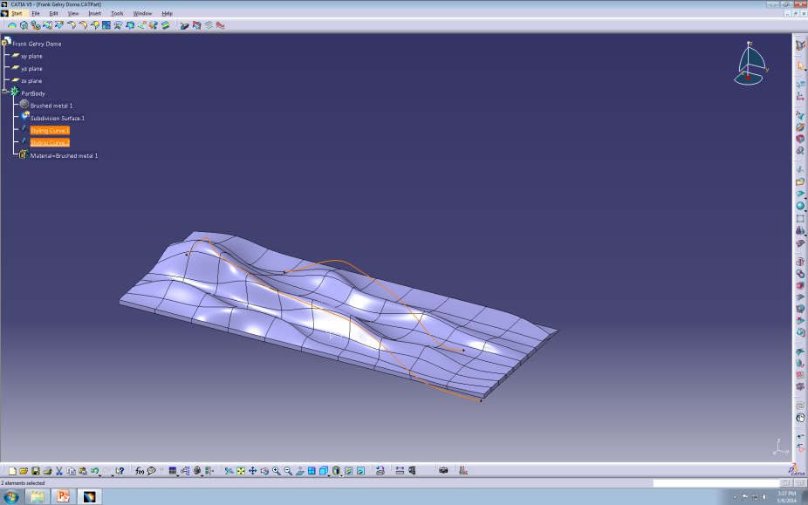
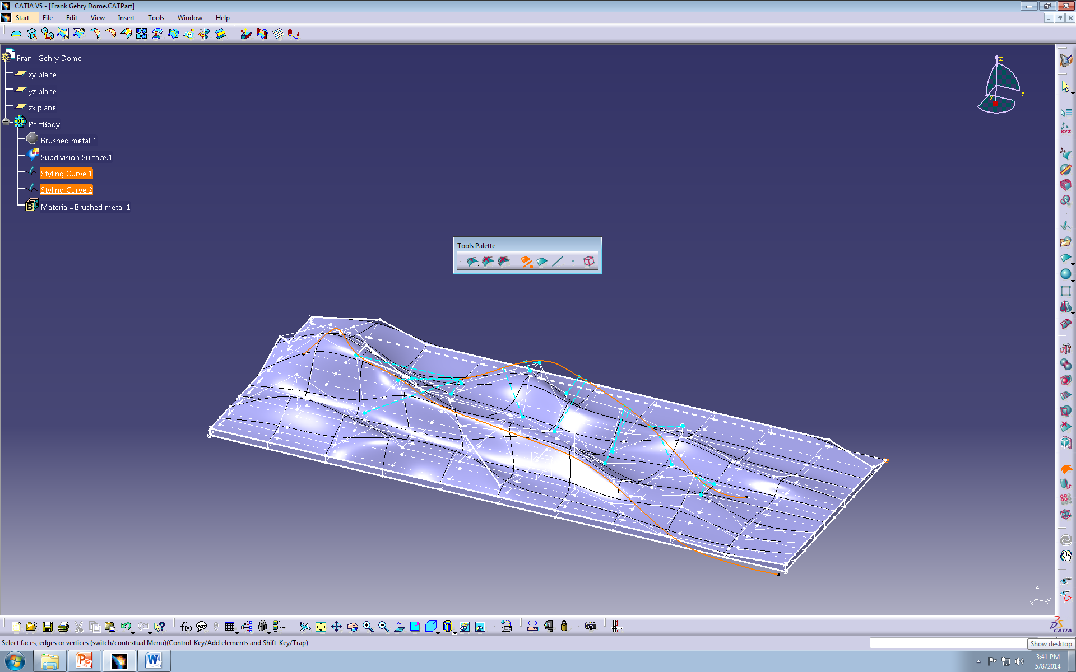
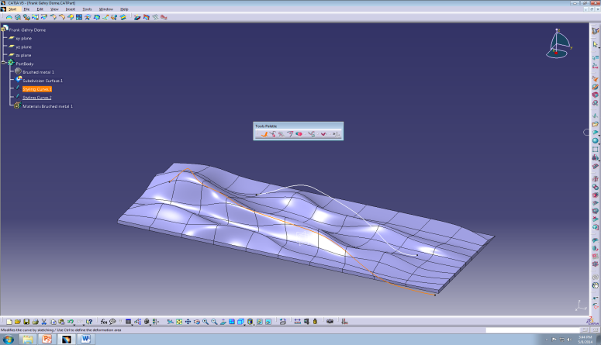
Imagine&Shape Catia workbench
Sketch a curve
Link it to a certain part of body
Manipulate the line to change the shape

Slide 5
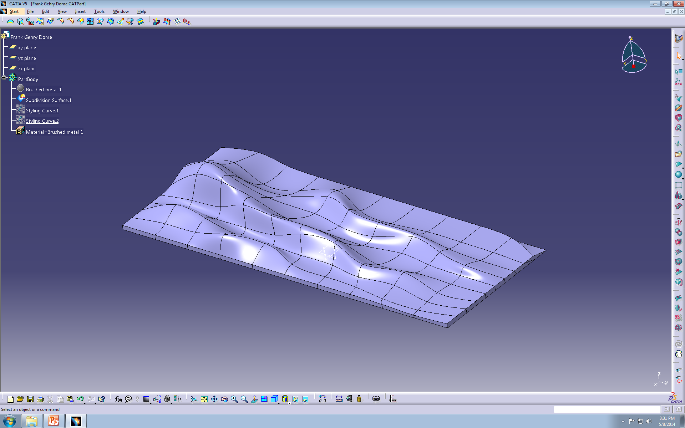
Imagine&Shape Catia workbench
Final Product

Slide 6
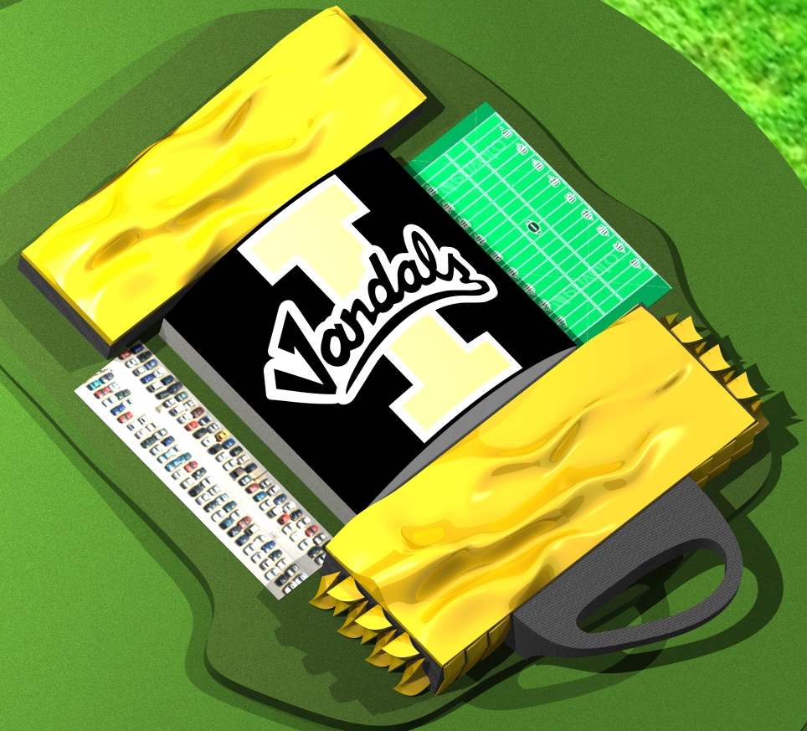
The new idea
Just a basketball stadium was the original idea but decided to add a sports complex
Added a new office/gym/swimming pool
Shaped like an “I” from an aerial view
Added a Hall of Fame and a new restaurant

Slide 7
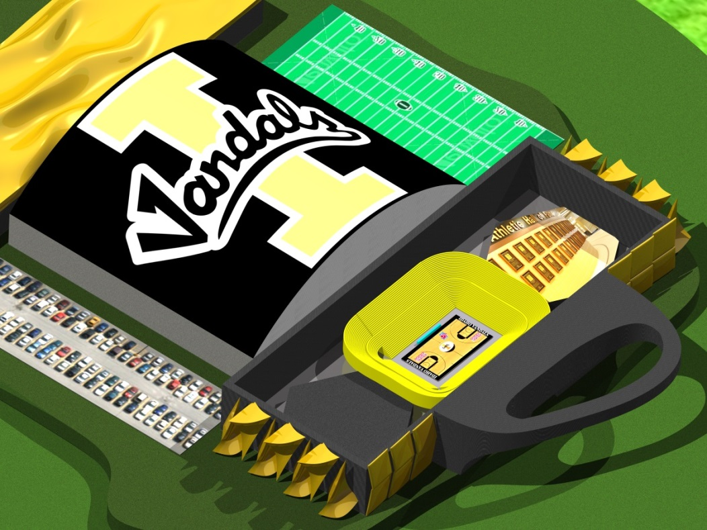
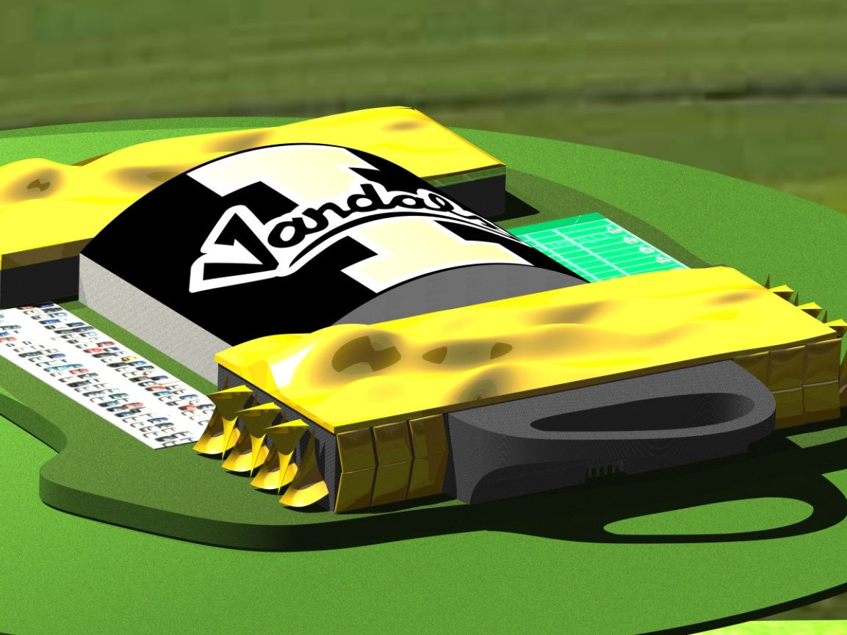
Final model

