Slide 1
Catia Generated FHSAE Wiring Harness
Alan McMurray , Austin Steiner, Thomas Stewart

Slide 2
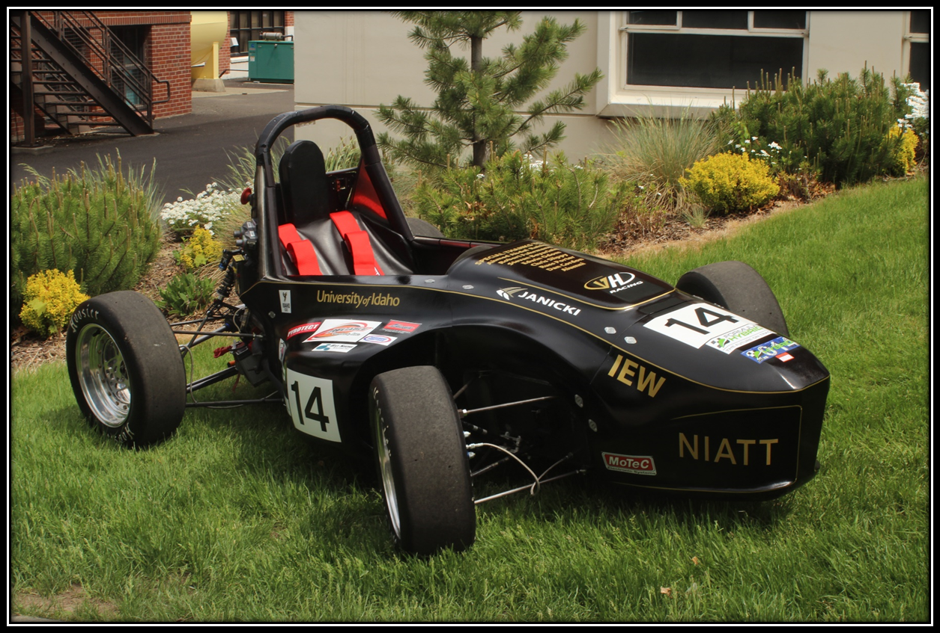
Objectives
Establish a model of the Formula Hybrid car’s wiring system using the CATIA electrical harness workbenches.
Document capabilities of electrical work-benches for use in future projects.

Slide 3
Finished Product

Slide 4
Dashboard Assembly

Slide 5
Engine Compartment

Slide 6
Finished Product

