Slide 1
EP Building Expansion (traditional theme)
Peter Frankenfield, Johnathan Baily

Slide 2
Objective
Develop and demonstrate concepts for an expansion of the EP building
Create a design that focuses on active learning and student interaction

Slide 3
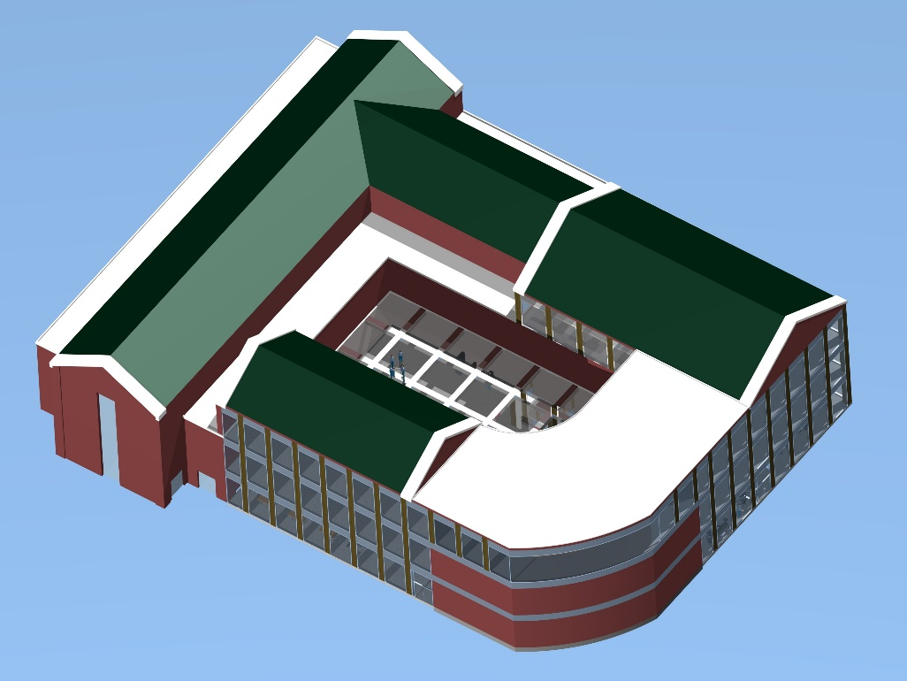
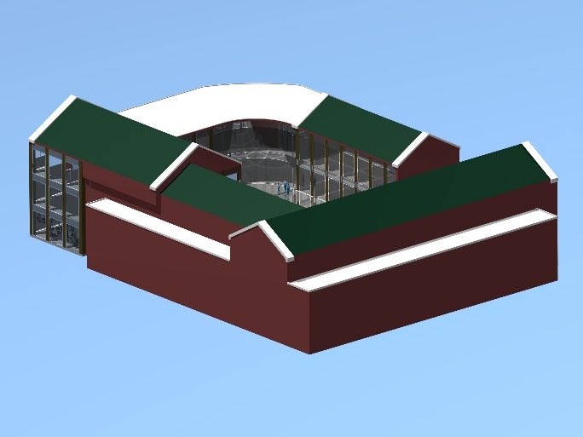
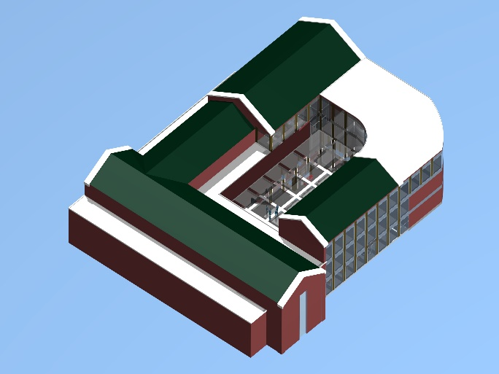
Full Expansion
The expansion is shown attached to the original building

Slide 4
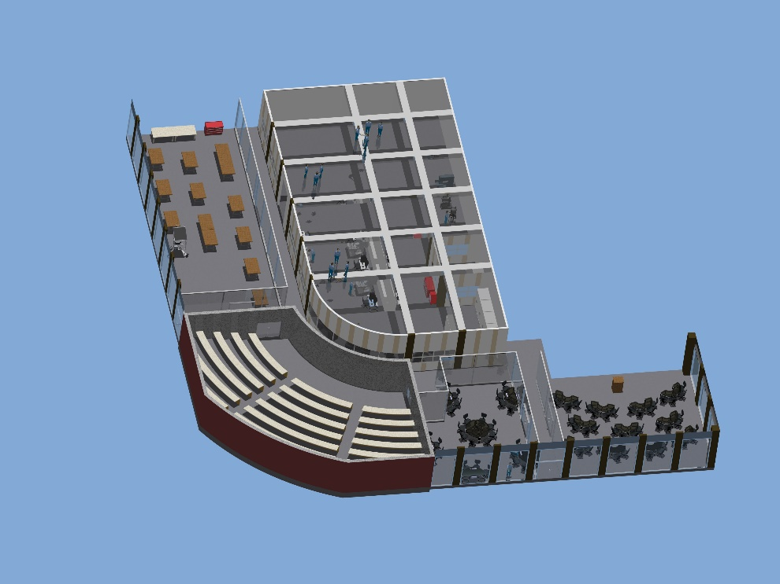
Floor Layout
Design Suite
Machine
Shop
1st Floor
3rd Floor
Offices
Offices/ Conference Rooms
Large Conference Room
Large Classroom
Active Learning Center
Active Learning Classroom

Slide 5
Active Learning Rooms
Tables can be moved to accommodate either a classroom or study room format
Opaque glass products can allow for projection onto glass surfaces

Slide 6
Machine Shop
Machine shop design is roughly 80% larger than Gauss Johnson’s
Room for more machines, more storage space, and a more open layout

