Slide 1
Lego CNC Machines
Augusto Siqueira, Jacob Lemmelin, Murilo Amaral, Nick Howe, Sam Childress, Thabata Müller, Tim Hammer, Tyler Hutten

Slide 2
Objectives
Create functioning CATIA lego models for both 4th axis and a 3-D printing CNC devices.
Replicate CNC functionality demonstrated by Arthur Sacek on Youtube. These include the 360 degree Milling Machine and the RCX Lathe.
152 unique Lego Technics parts were modeled from scratch amongst 8 students.
More than 1000 parts were assembled by our teams.

Slide 3
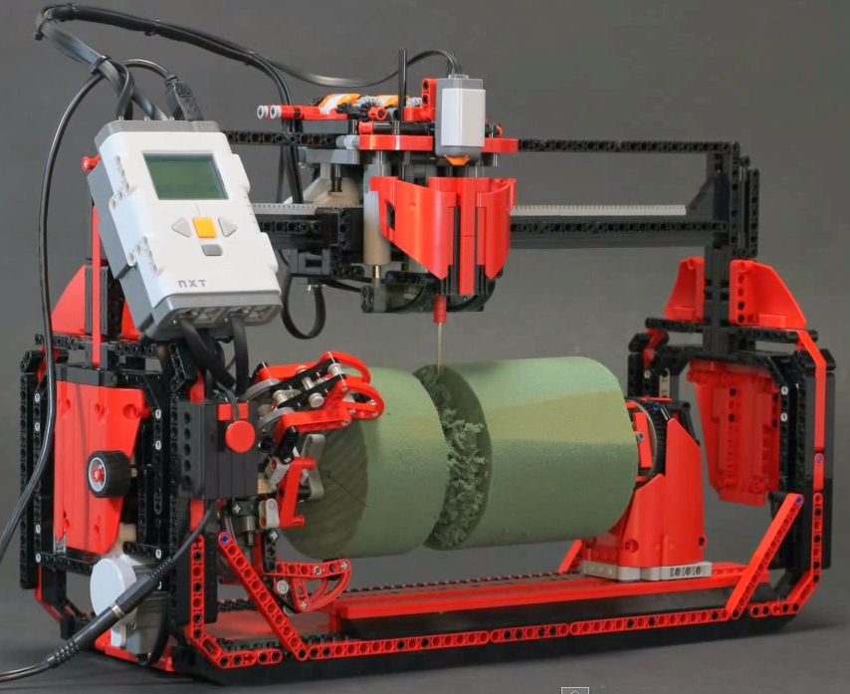
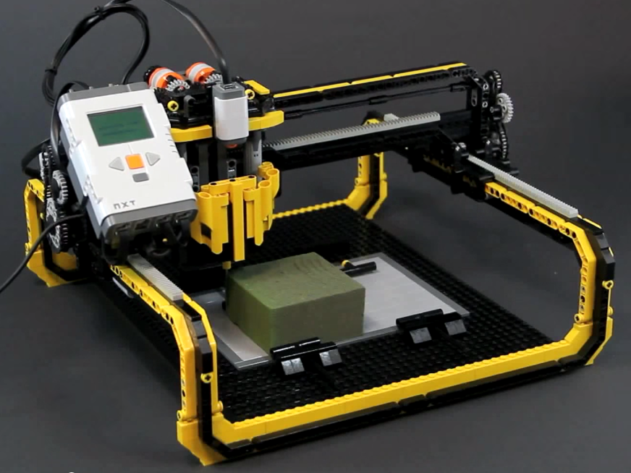
LEGO CNC Milling Machines
LEGO CNC I - 4 ^{th} axis version
LEGO CNC II – Gantry/ 3D printing

Slide 4
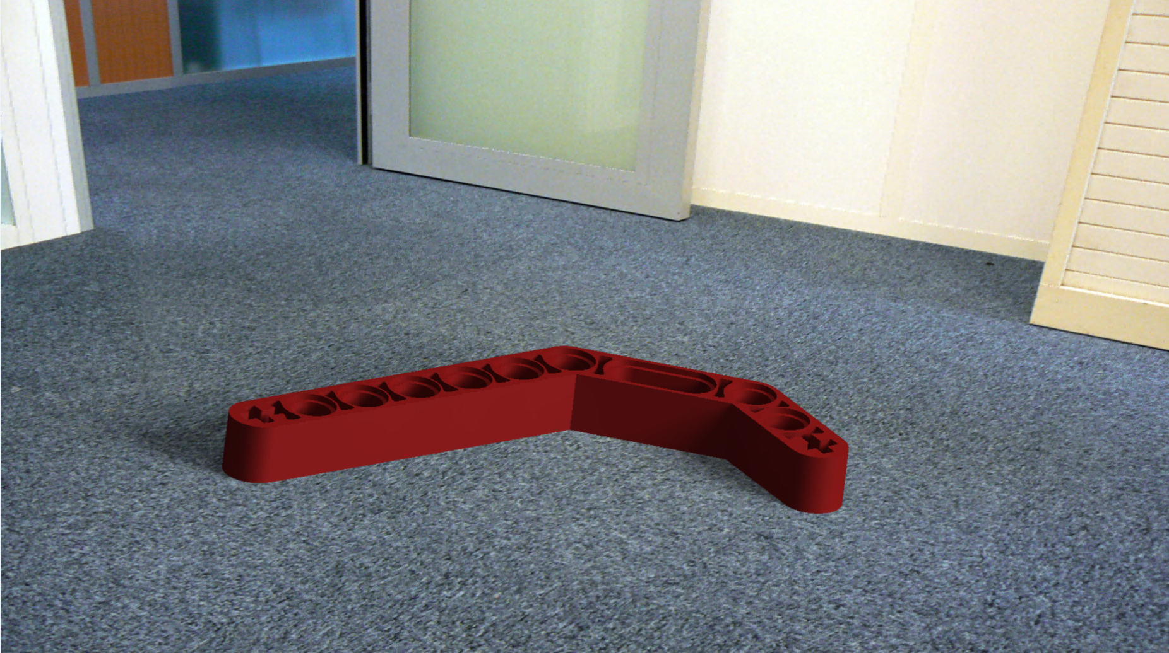
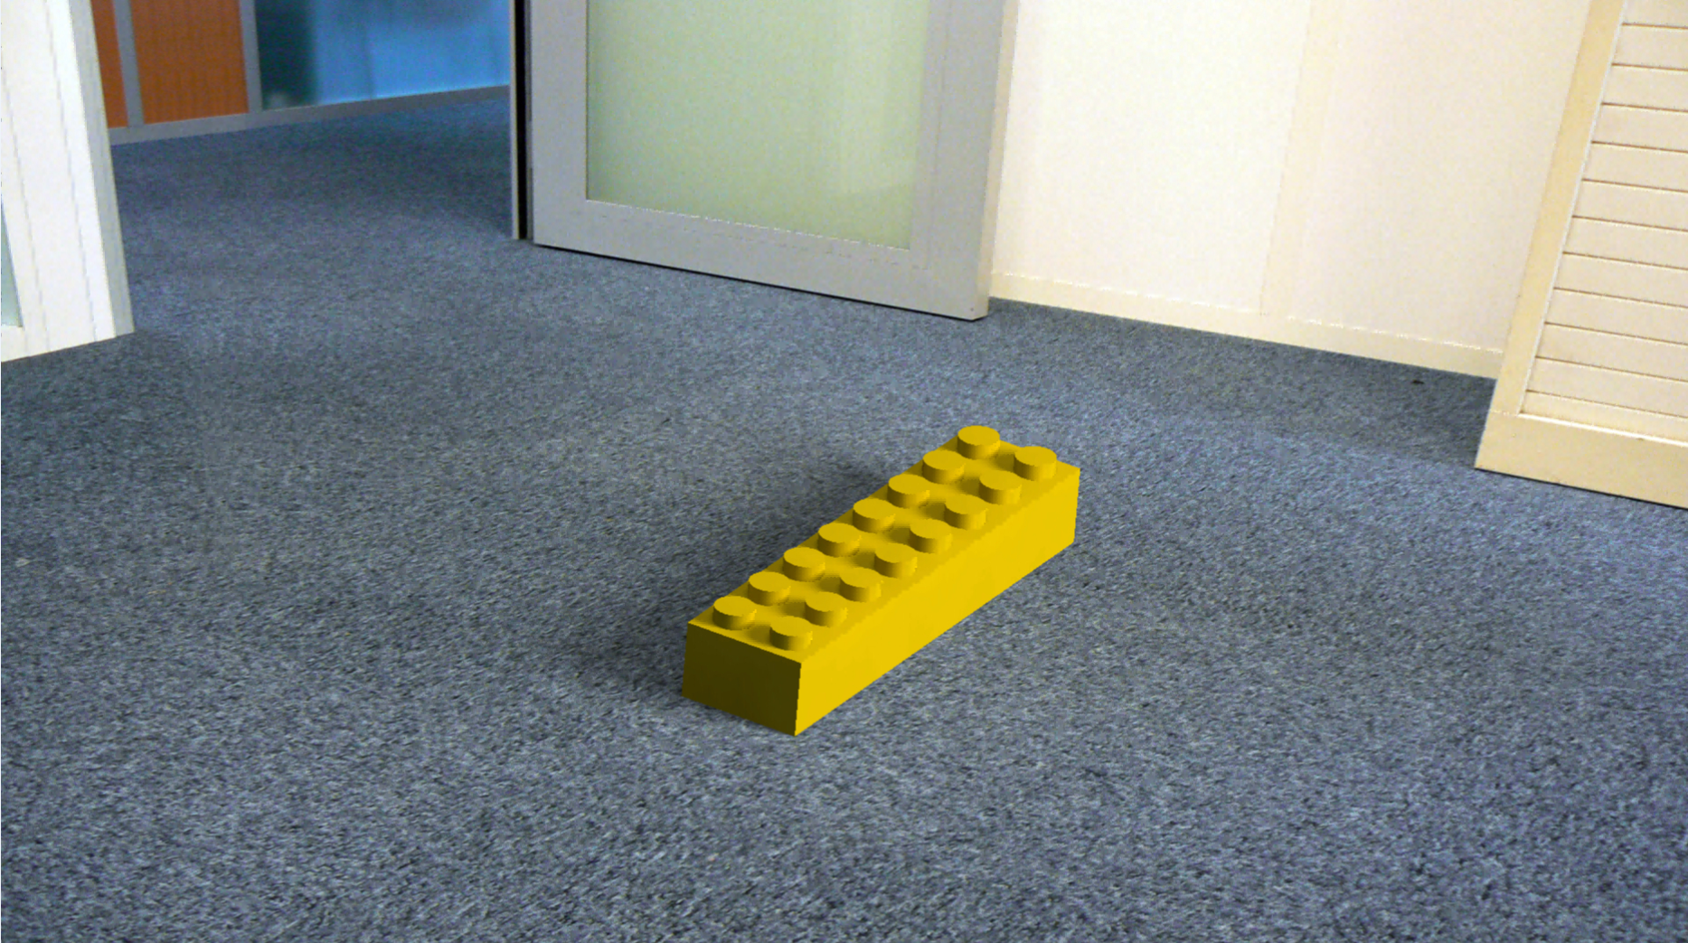
Examples of Lego Piece Models
Beam 3x3.8x7 Bent 45 degree.
LEGO code: 32009
2x8 Brick
LEGO code: 3007

Slide 5
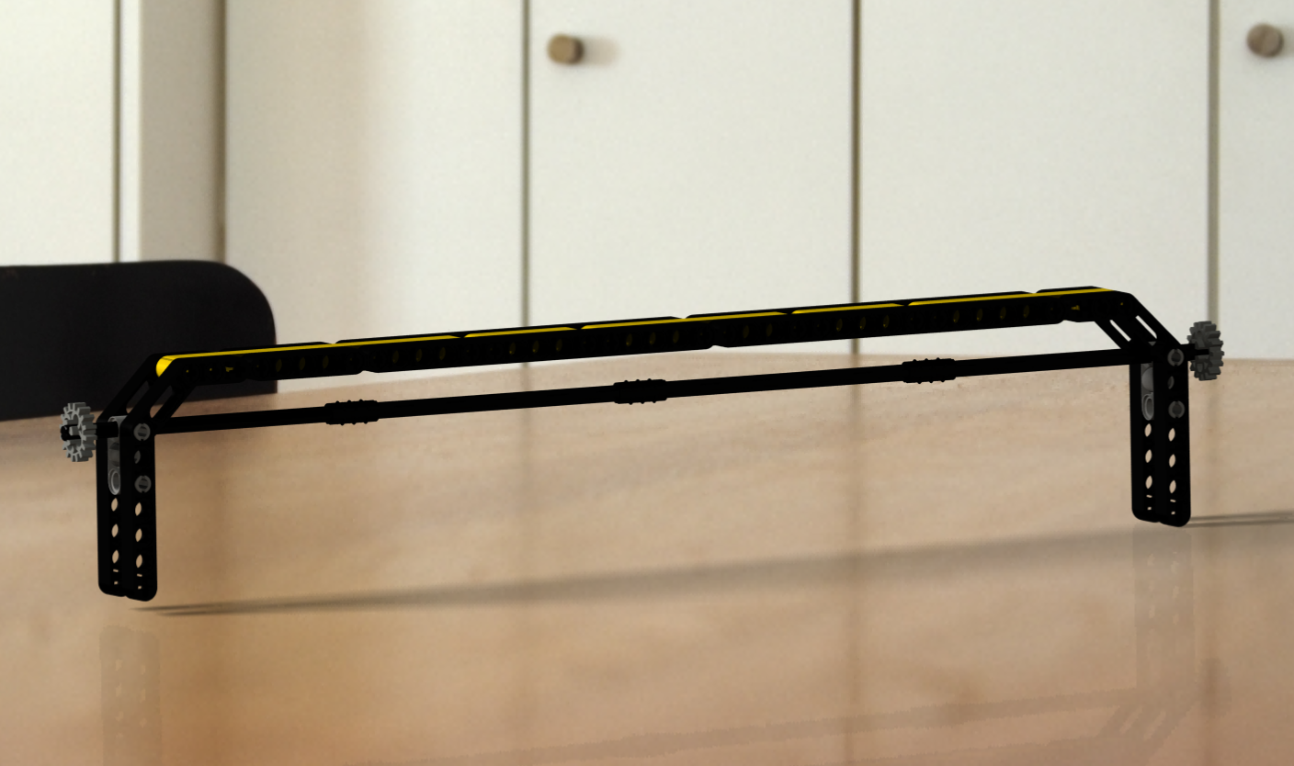
Upper track for mill head

Slide 6
Upper gantry for mill head

Slide 7
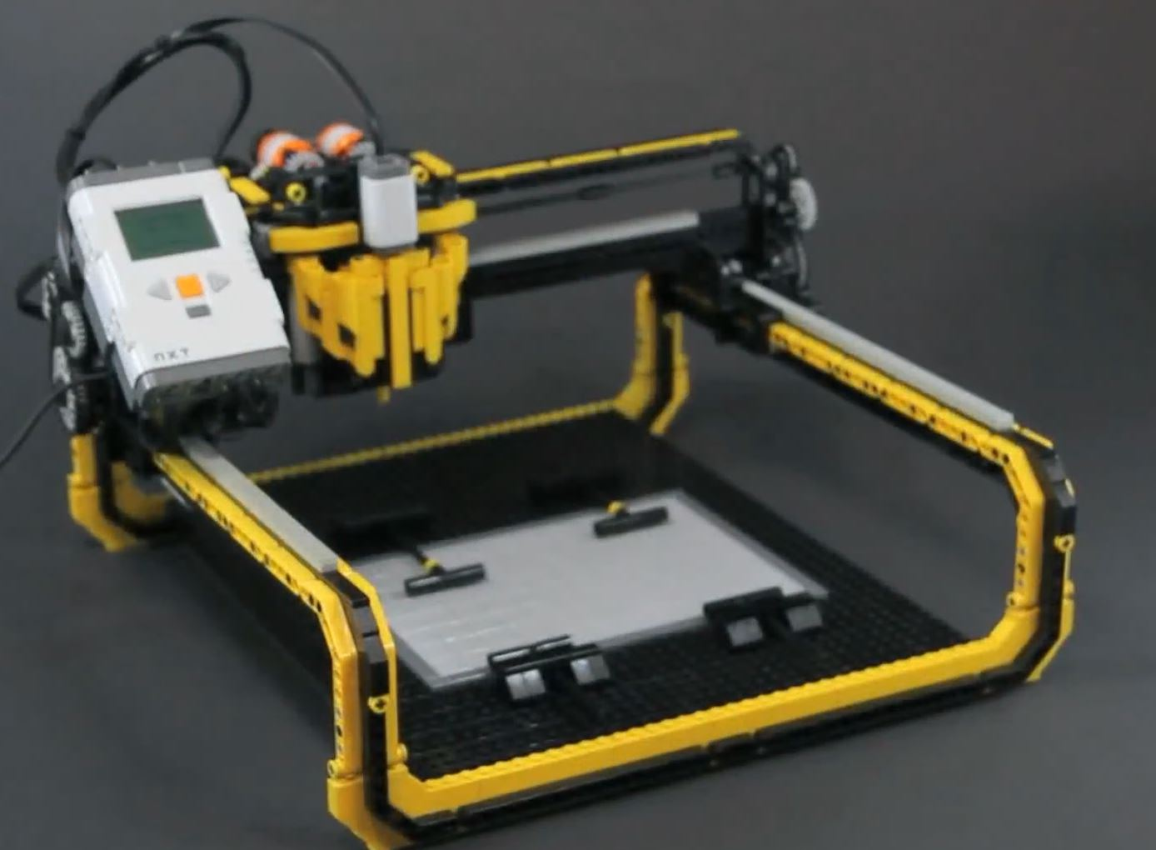
Milling machine base
Catia Model
You Tube Design

Slide 8
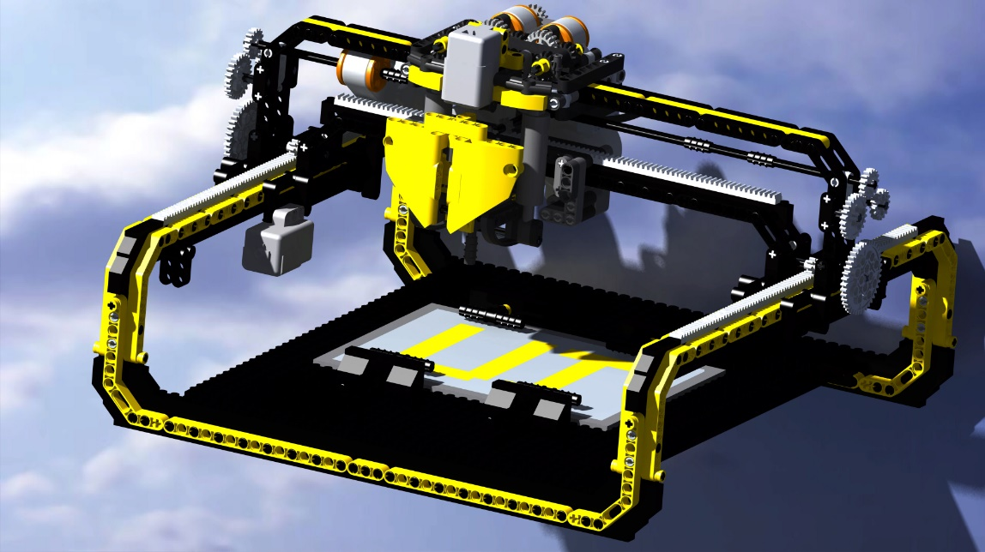
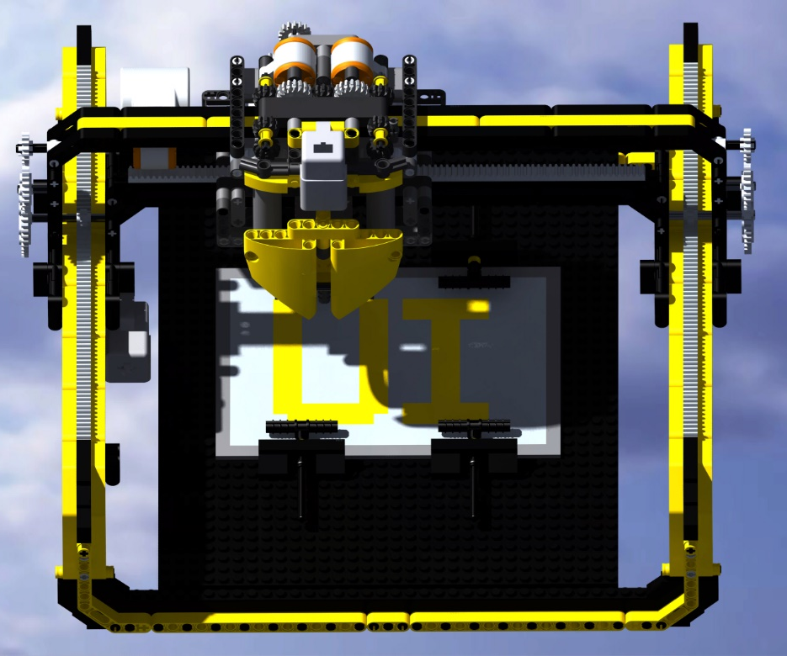
CNC Mill Final Product

Slide 9
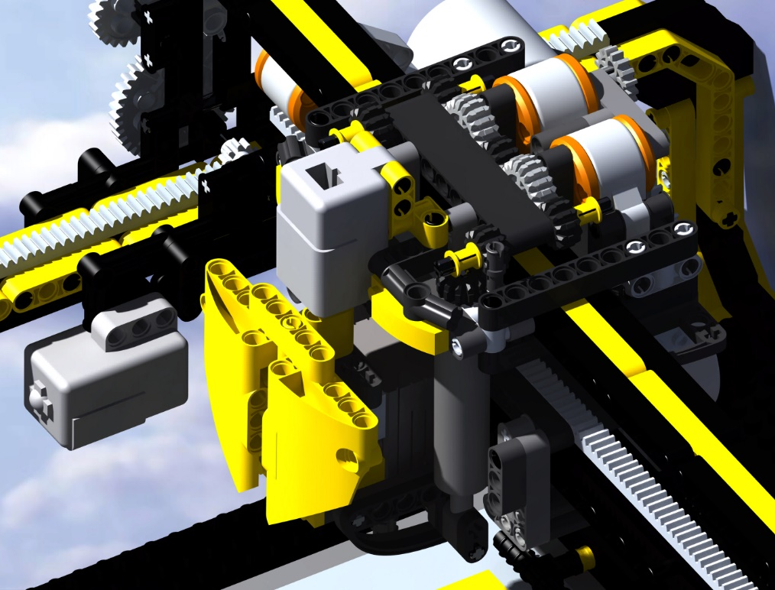
CNC Mill Final Product

Slide 10
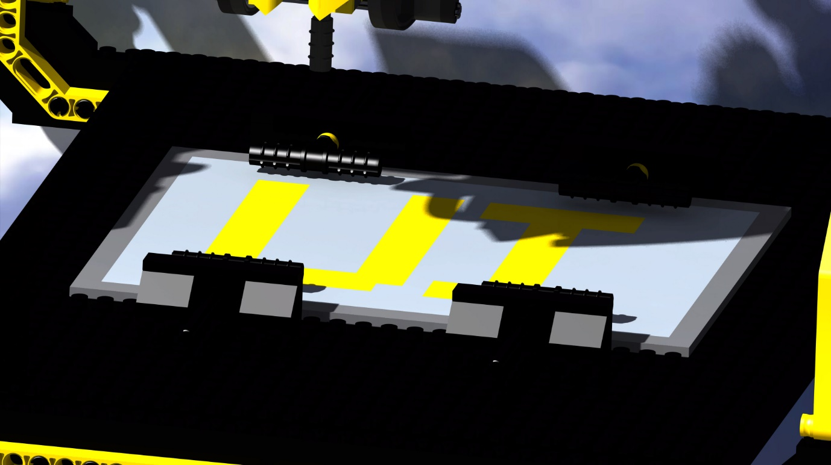
CNC Mill Final Product

Slide 11
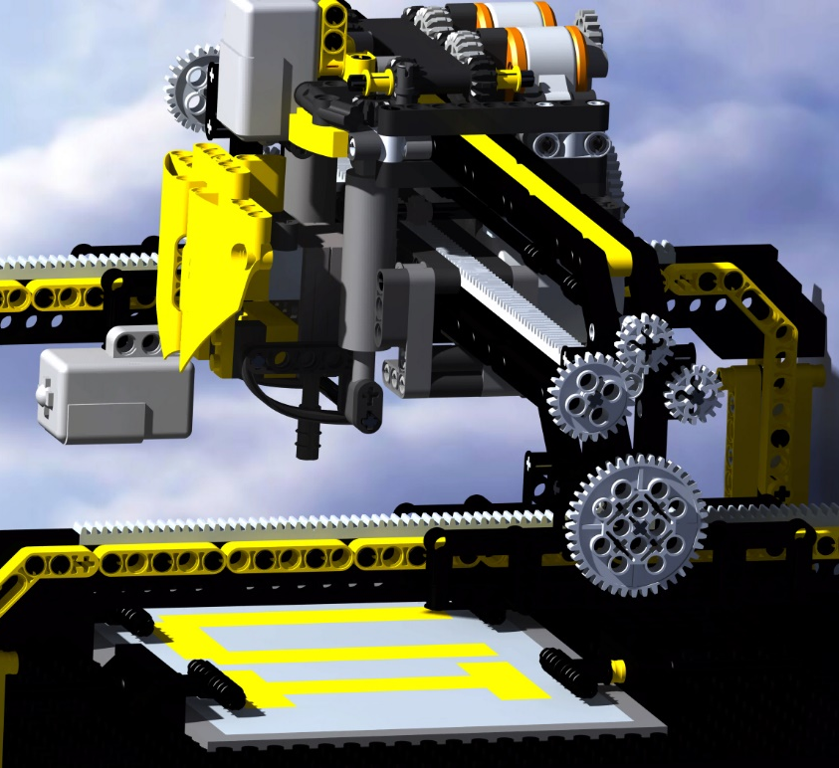
CNC Mill Final Product

Slide 12
CNC Mill Final Product

Slide 13
CNC Mill Final Product

Slide 14
Milling head
Supports the drill to cut the foam in both models

Slide 15
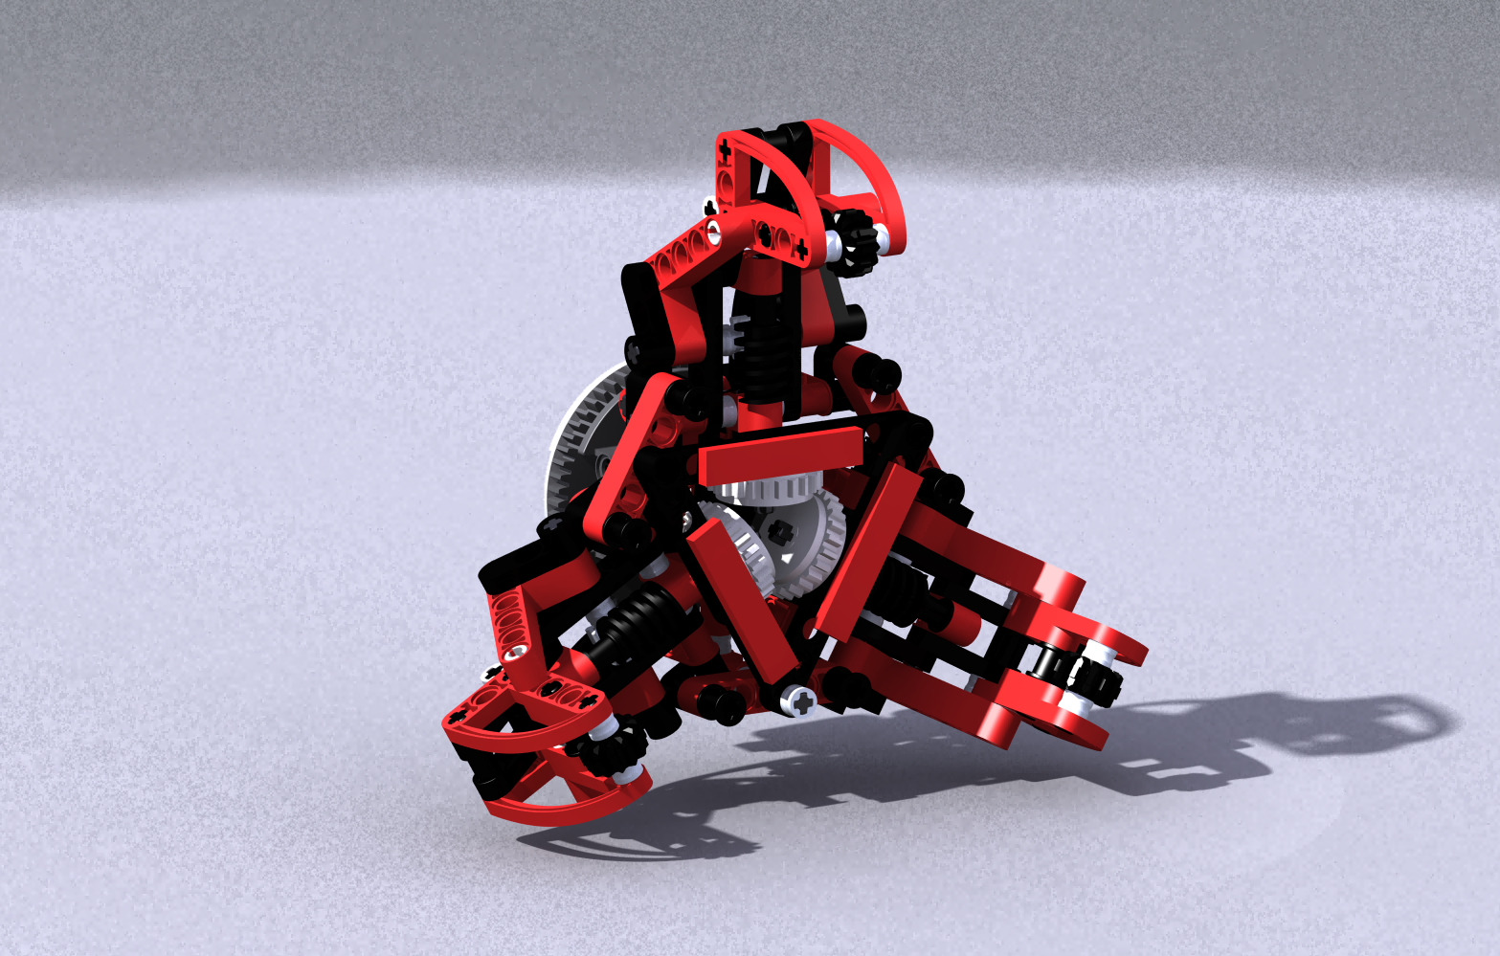
Claw
Holds the foam during turning operations

Slide 16
End Support
Fixes the center of the foam during turning

Slide 17
4th Axis Final Product

Slide 18
4th Axis Final Product

Slide 19
4th Axis Final Product

Slide 20
4th Axis Final Product

Slide 21
4th Axis Final Product

