Slide 1
EP Building Expansion (traditional theme)
Peter Frankenfield, Johnathan Baily

Slide 2
Objective
Develop and demonstrate concepts for an expansion of the EP building
Create a design that focuses on active learning and student interaction

Slide 3
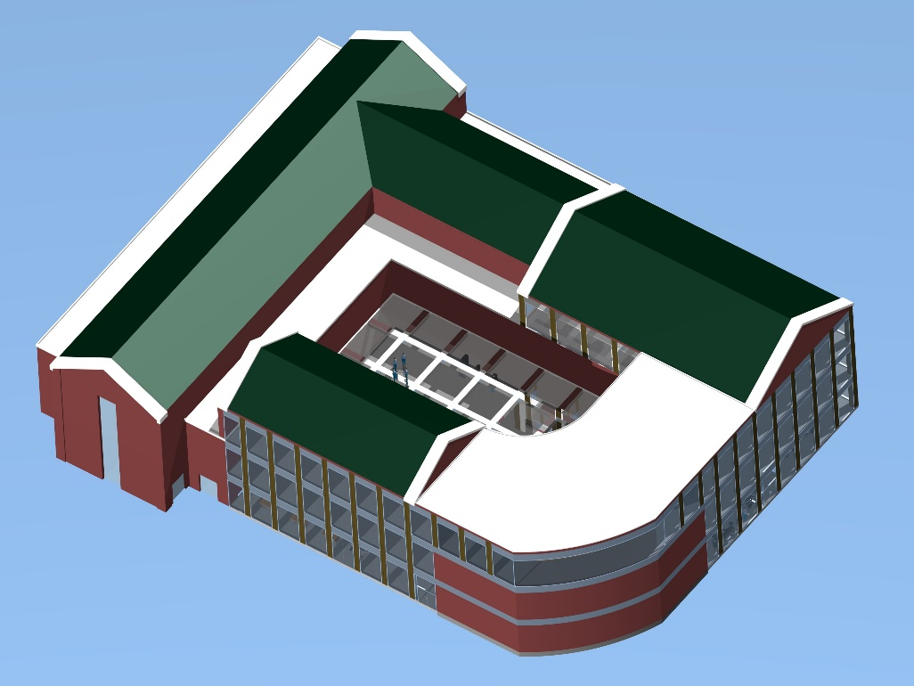
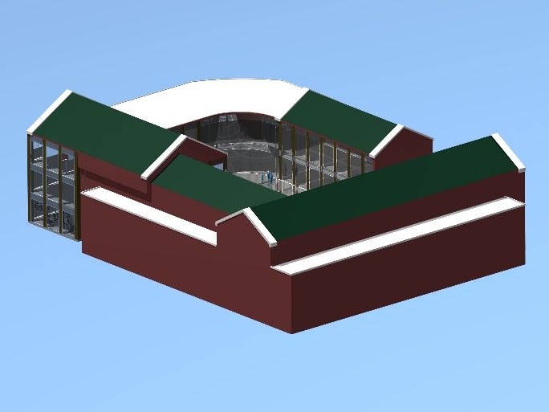
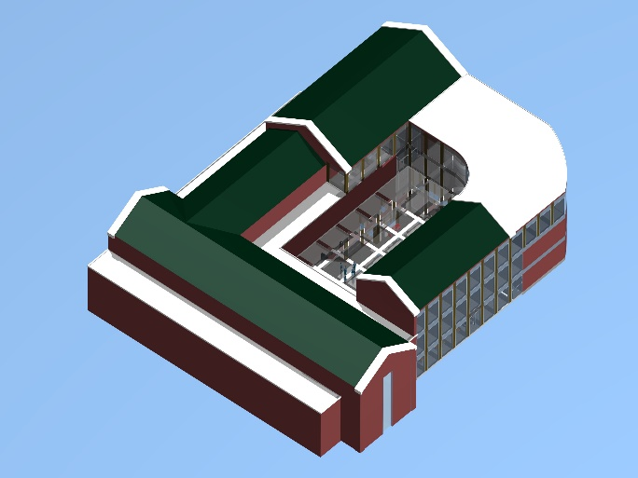
Expansion Full Model
The expansion is shown attached to the original building

Slide 4
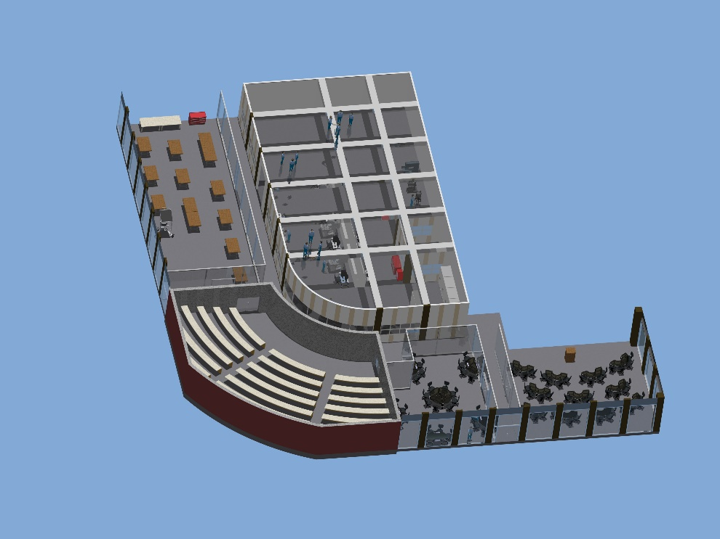
1st Floor Layout
Design Suite
Machine
Shop
1st Floor
Active Learning Center
Active Learning Classroom
Large Classroom

Slide 5
Machine Shop
Machine shop design is roughly 80% larger than Gauss Johnson’s
Room for more machines, more storage space, and a more open layout

Slide 6
Design Suite
Service door to outside
Service door to machine shop

Slide 7
Active Learning Rooms
Tables can be moved to accommodate either a classroom or study room format
Opaque glass products can allow for projection onto glass surfaces and use as a whiteboard

Slide 8
3rd Floor Layout
3rd Floor
Offices/ Conference Rooms
Offices
Large Conference Room

