Slide 1
Rhino Rendering
Alex Pinkham
Christian O’Bryan
Matt Wilson
Ronnie Ross

Slide 2
Objective
Develop tutorials on how to use Rhino/Flamingo to enhance SolidWorks and CATIA models in real-life renders.
Define best practices to transfer solid model data between CAD packages.
Illustrate Rhino/Flamingo rendering outcomes possible with four different modeling subjects.

Slide 3
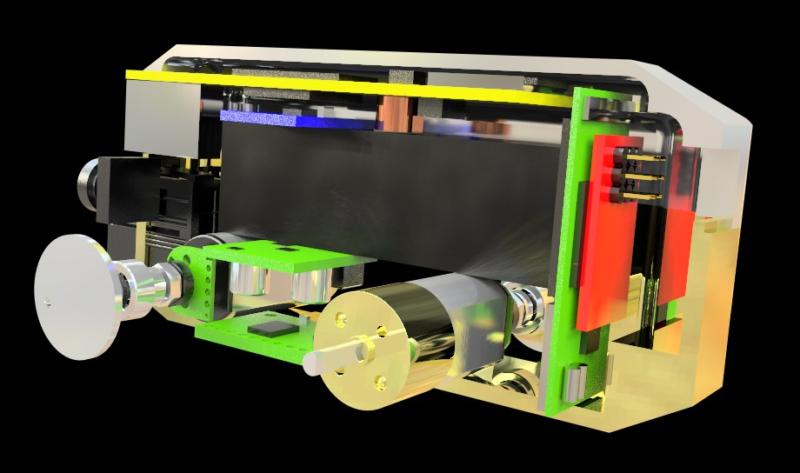
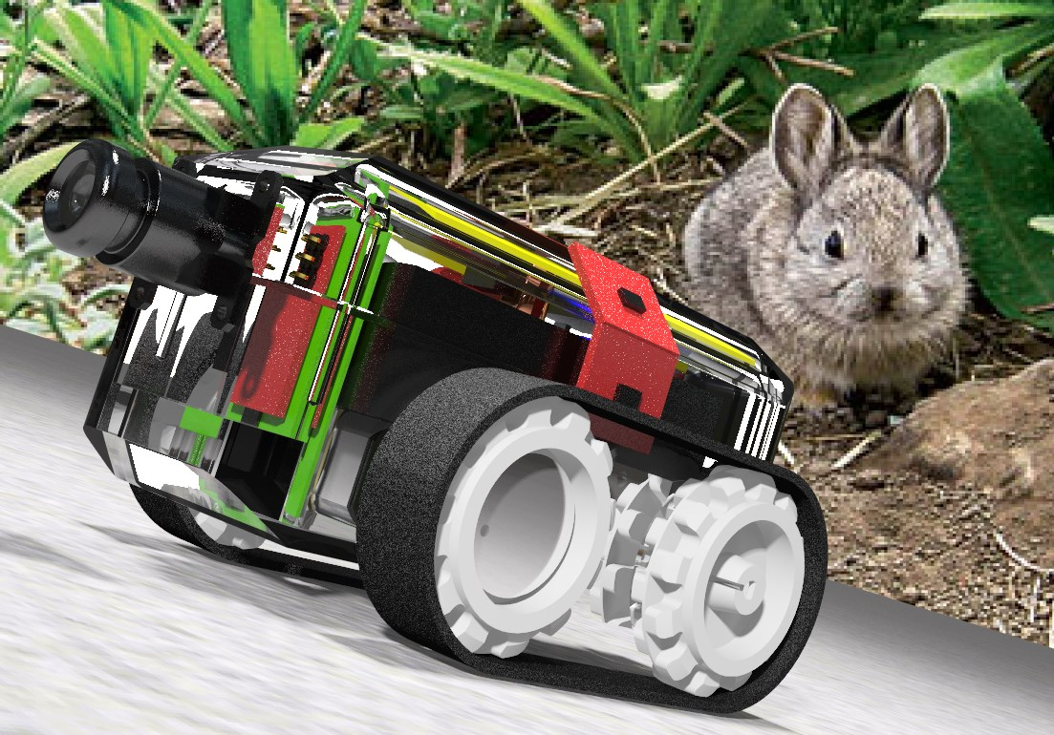
Rabbotix Robot

Slide 4
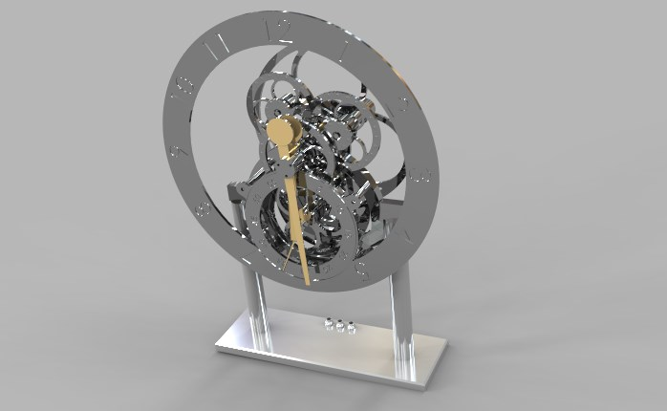
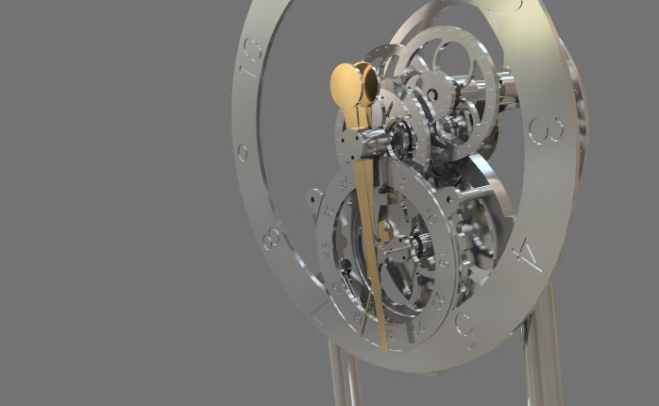
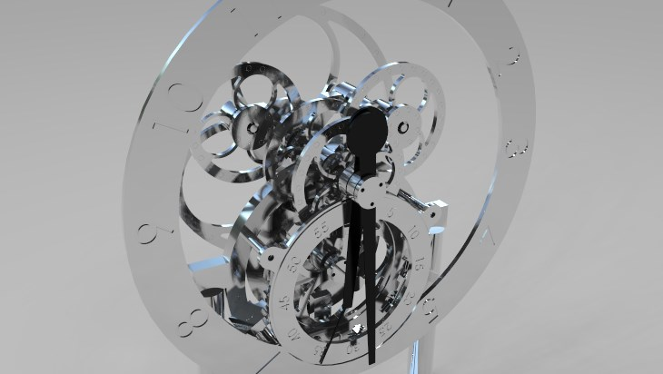
Magnetic Gear Clock

Slide 5
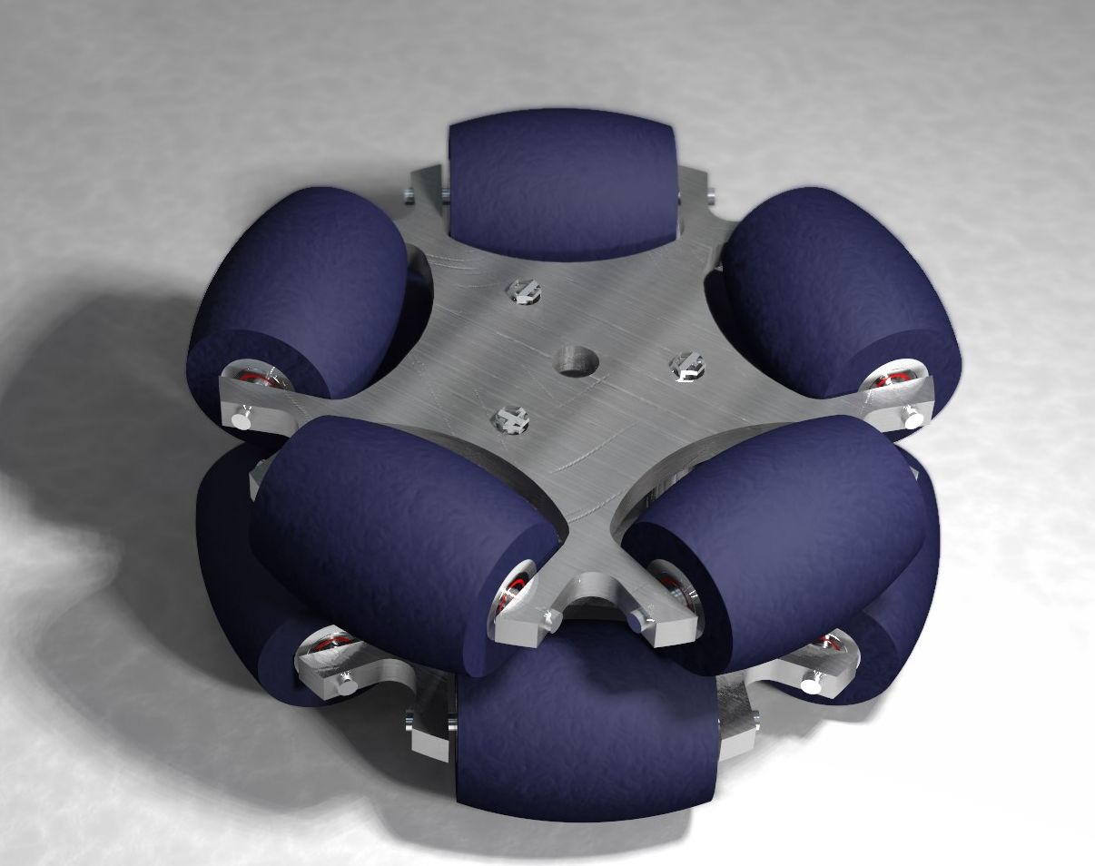
Band-Beesten

Slide 6
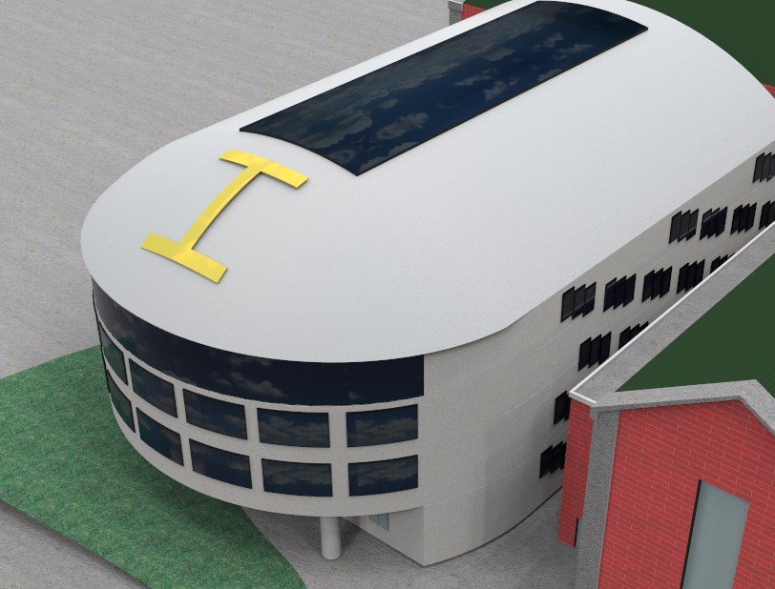
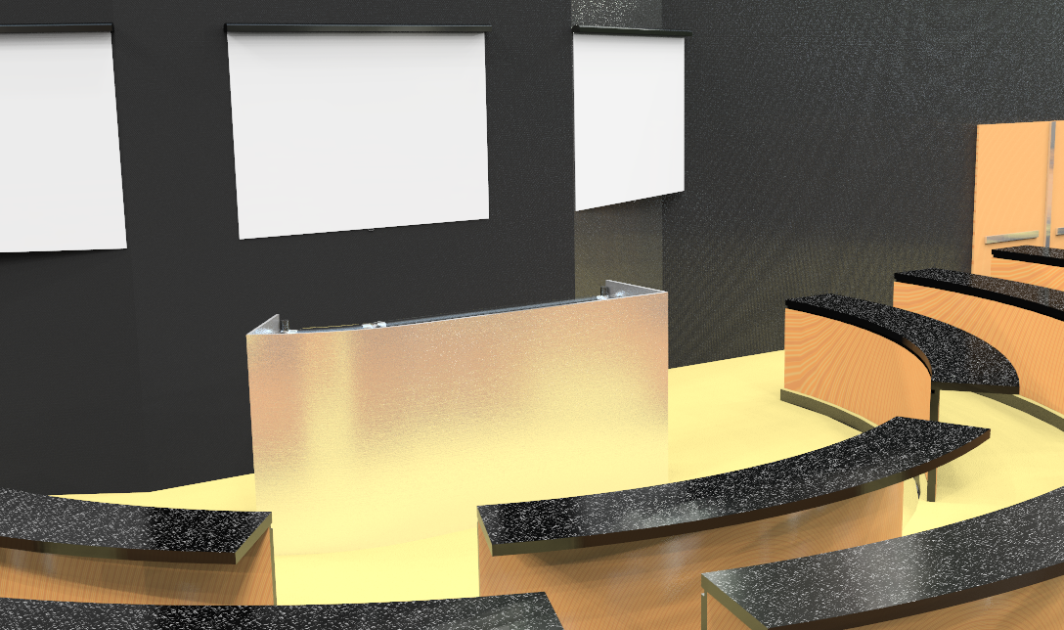
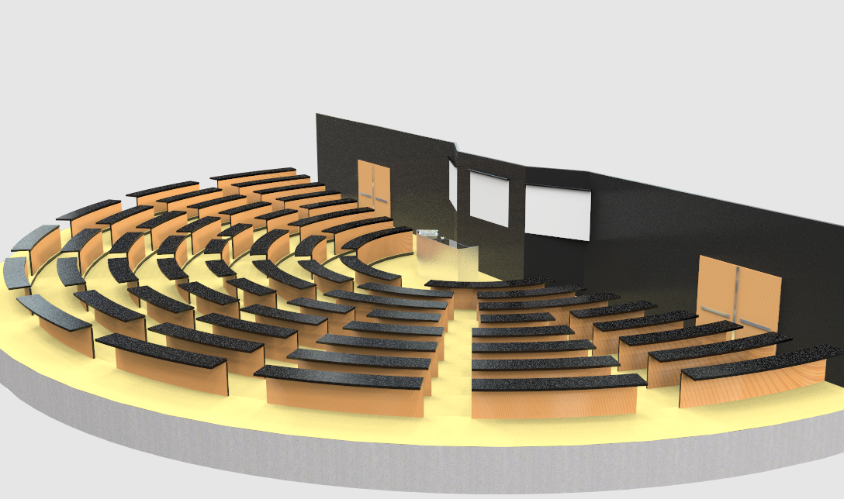
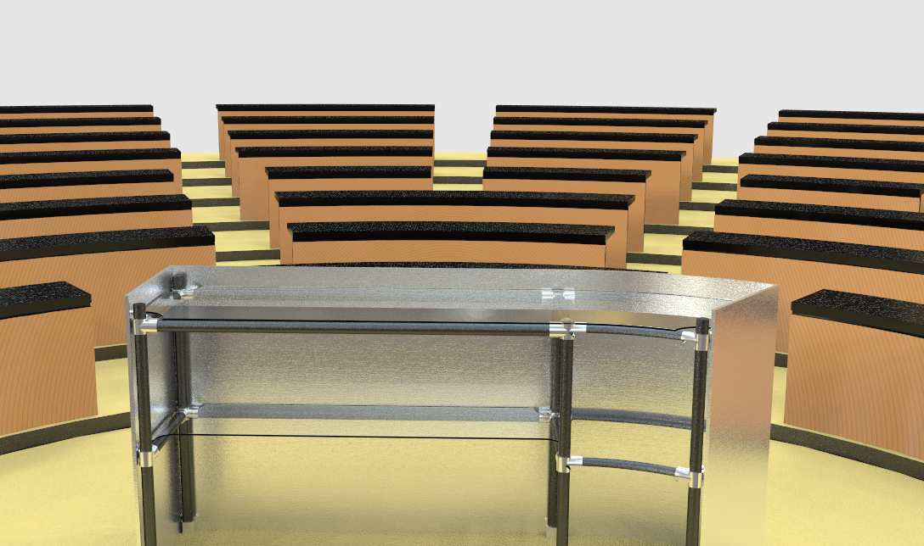
Building Proposal Project

