Slide 1
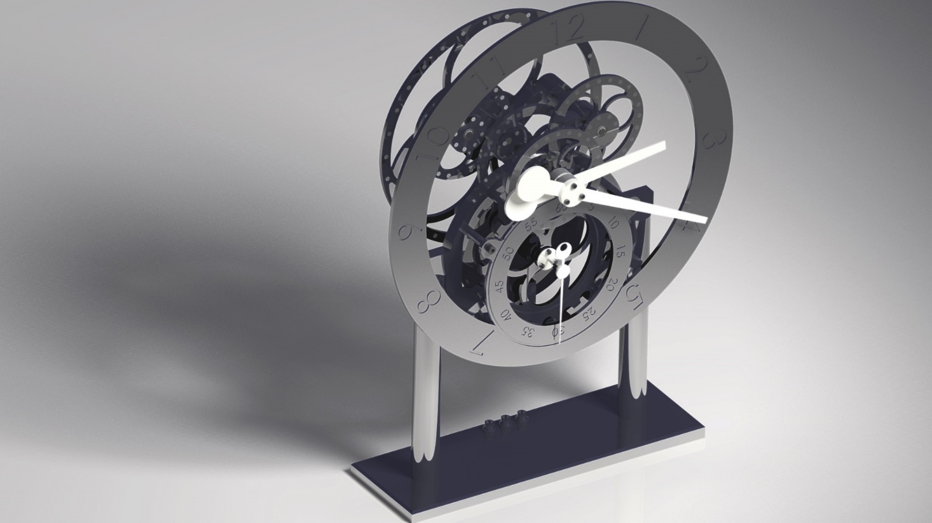
Magnetic Gear Clock
Team: David Smith, Connor Trulock, and Andrew Brackebusch

Slide 2
Objective
Finish the CNC machining.
Continue non CNC Machining from previous semesters .
Electronically document all progress in one location to make the future easier for others.

Slide 3
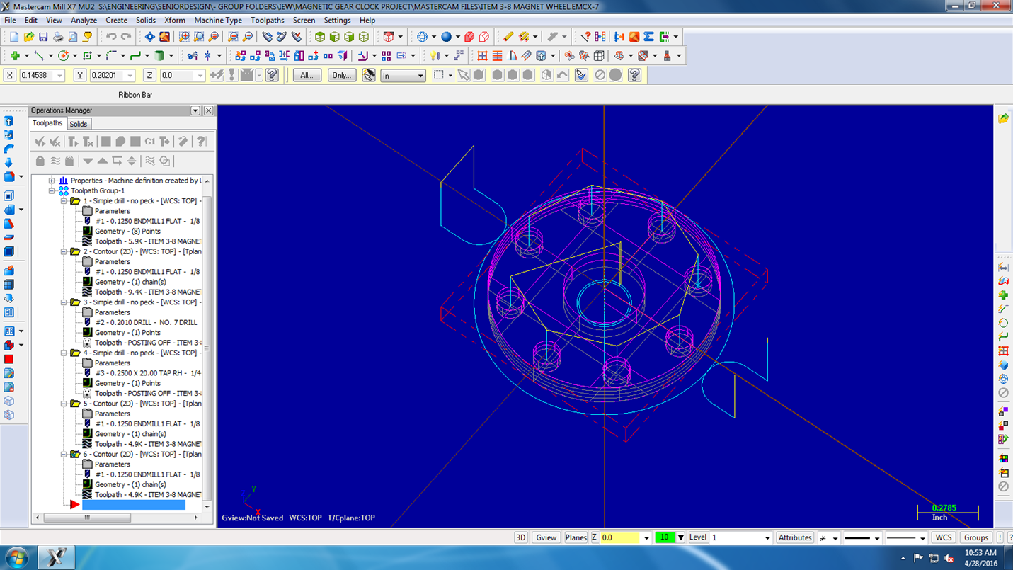
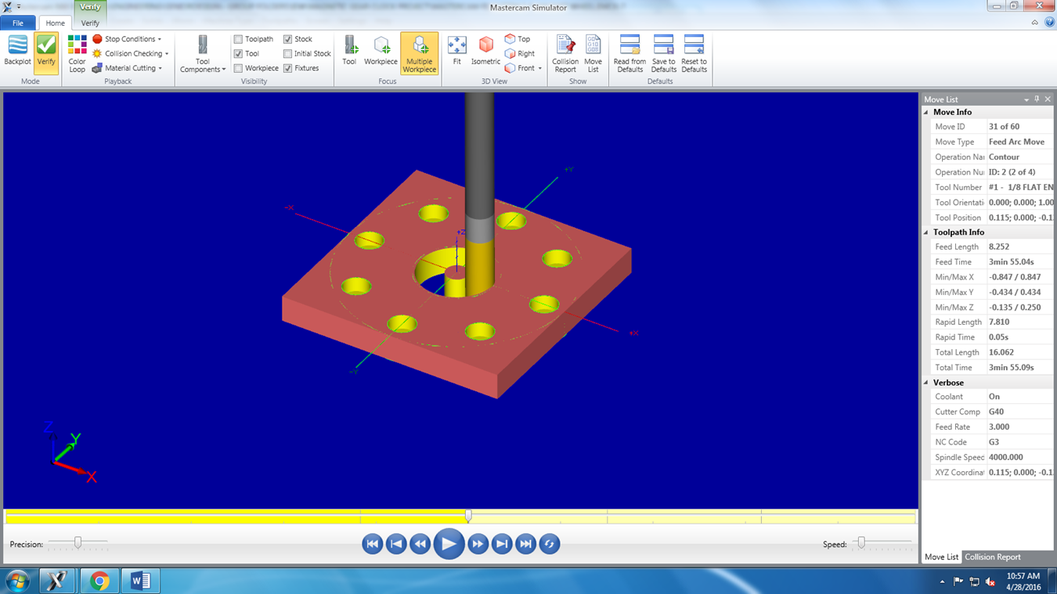
Master Cam 8 Magnet Wheel

Slide 4
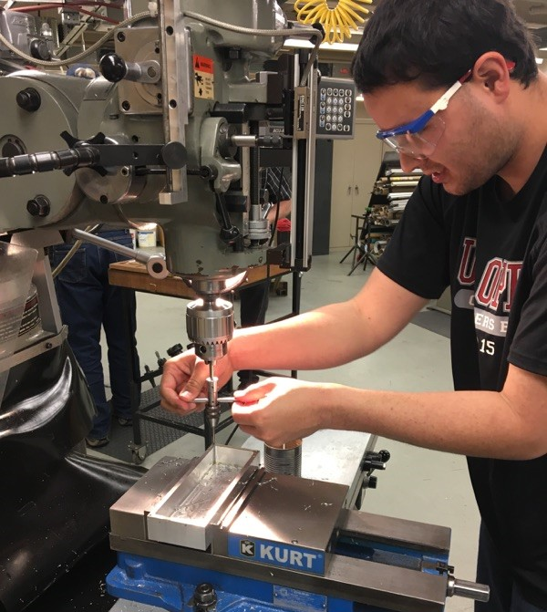
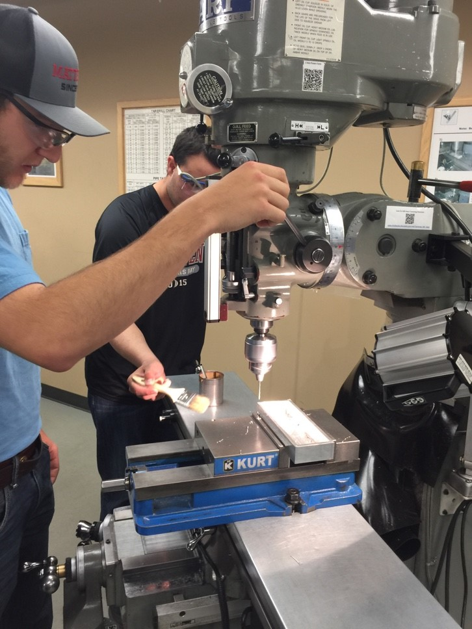
Shop Training and Machining

Slide 5
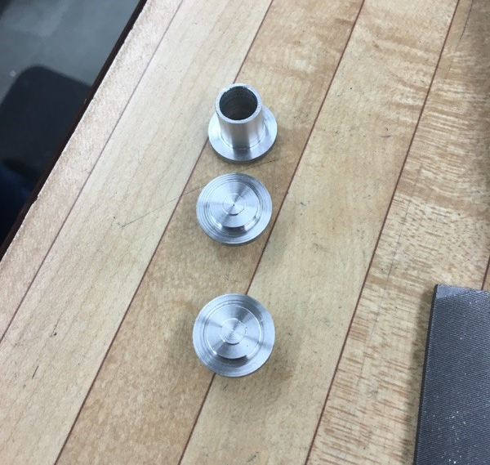
Parts Produced
Assorted Standoffs
Microcontroller Housing
8-Magnet Wheel

Slide 6
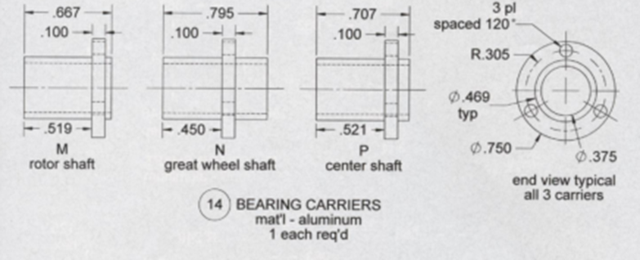
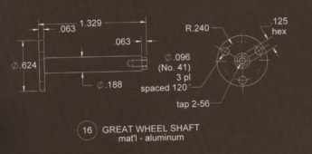
Summary
CNC parts are completed.
Microcontroller housing ready for installation of 12V female barrel jack power adapter.
All hard paper copies are scanned and stored for electronic access.

