Slide 1
REDESIGNING GJ 120
Krissy Buckler, Spencer Hauck, Jacob Middleton, Kierra Ryan

Slide 2
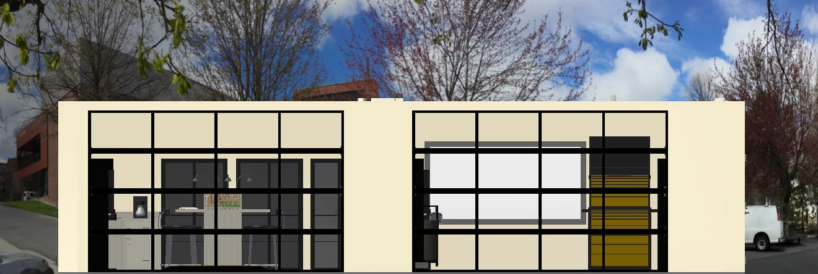
Project Objectives
Redesign GJ 120
Create Customizable Senior Design Suite
Provide Comfortable and Organized Work Environment
Remove Unnecessary Features
Add More Storage
Apply a More Modern Look to Inspire Prospective Vandals

Slide 3
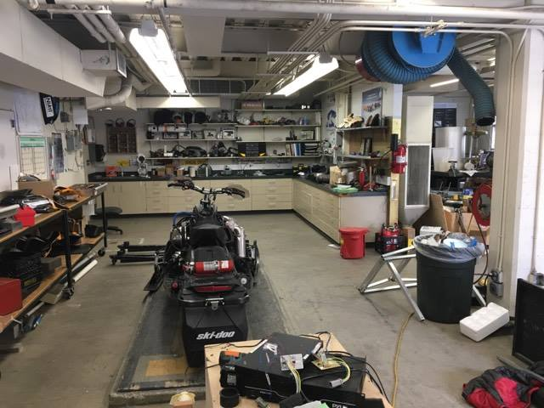
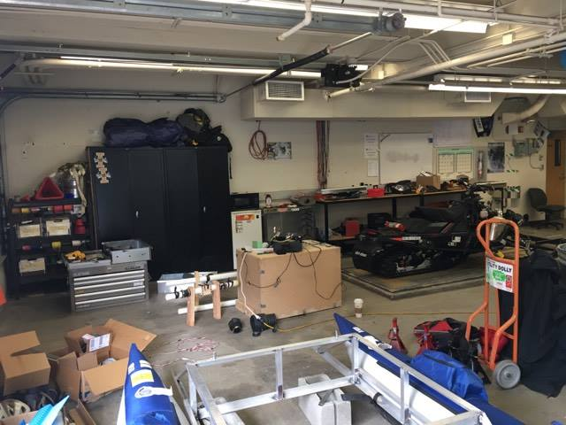
GJ 120 (Present)
Current State of GJ 120:
Disorganized
Crowded
Chaotic
Dirty
Current Uses:
Automotive Projects
Senior Design
Engine Testing
Misc. Storage

Slide 4
Stripping Down GJ 120
DOOR
HVAC
GARAGE DOORS
SEPARATION WALL
COLUMN
HVAC
BUILT-IN SHELF
WINDOW
DOOR
WINDOWS

Slide 5
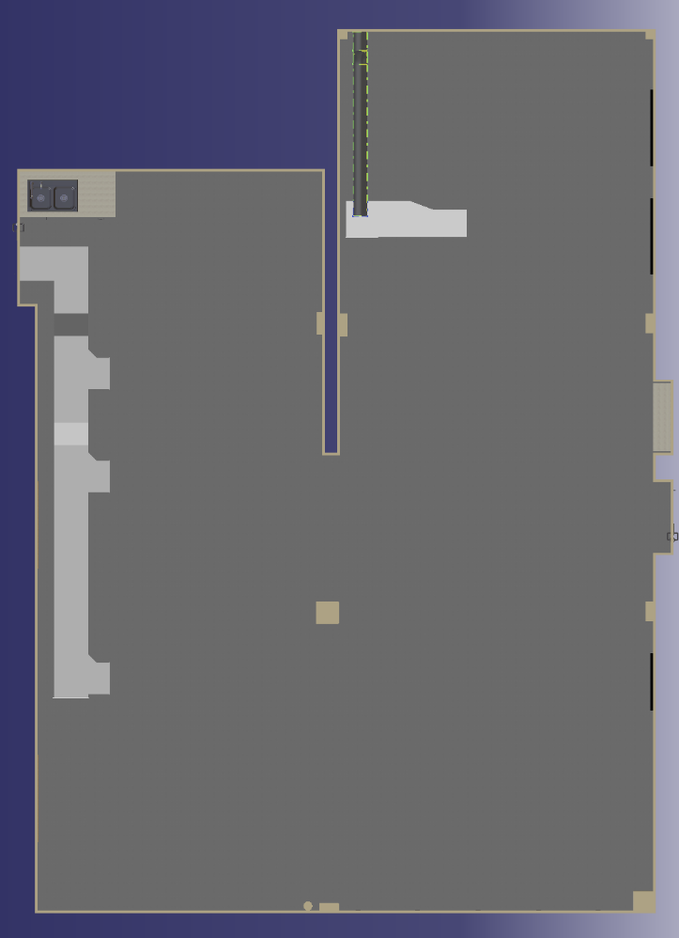
Room Considerations
Functionality: Can Accommodate 1,2,3 and even 4 Large Projects
Organized: Additional Area For Drafting & Project Planning
Customizable: Large Storage Units to Accommodate Personal Project Needs
Project Space 4
Project Space 3
Drafting Space
Project Space 2
Project Space 3
Project Space 1
Project Space 2
Project Space 1
Project Space 1
Project Space 2

Slide 6
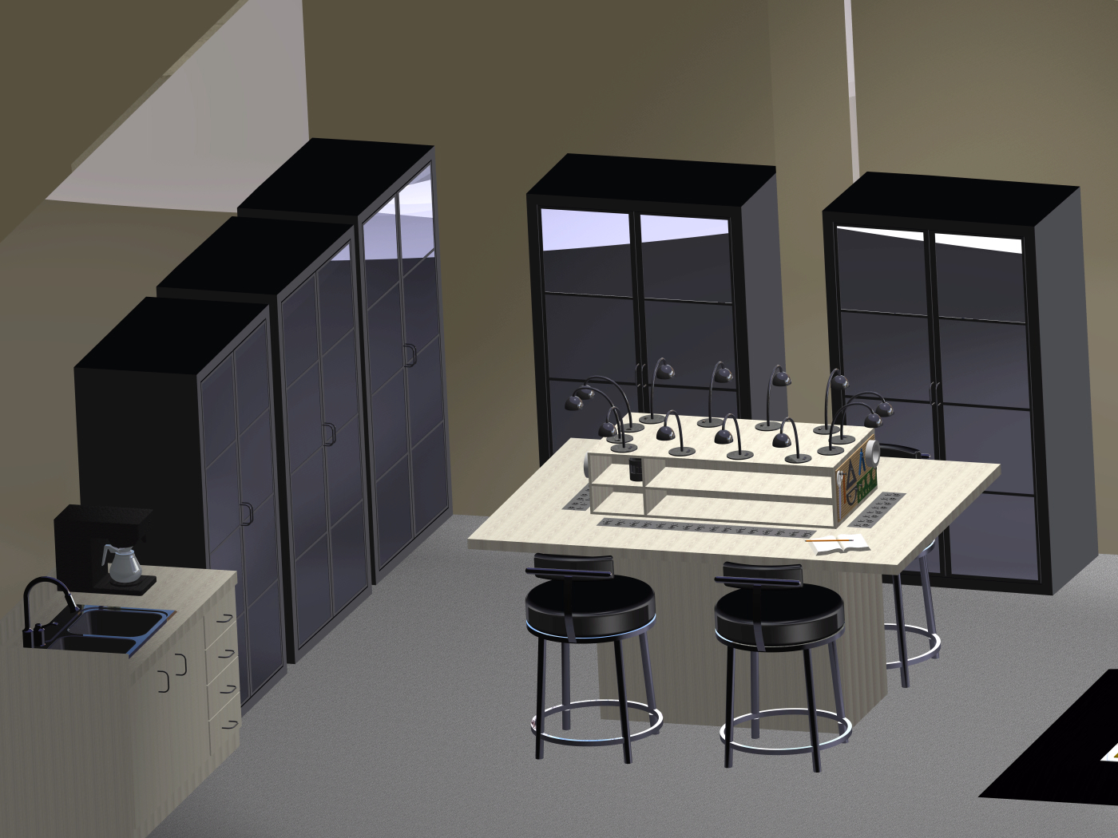
GJ 120 Redesigned
Glass Storage Units
Custom Drafting Table
Modern Furniture and Fixtures

Slide 7
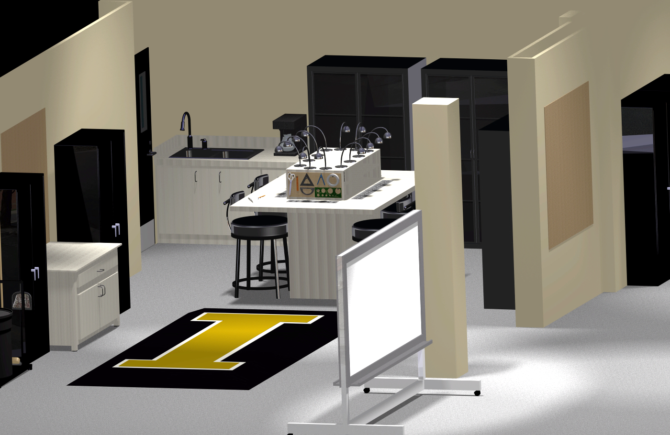
GJ 120 Redesigned
Custom Pit Cover
Mobile White Boards
Mobile Work Surfaces

Slide 8
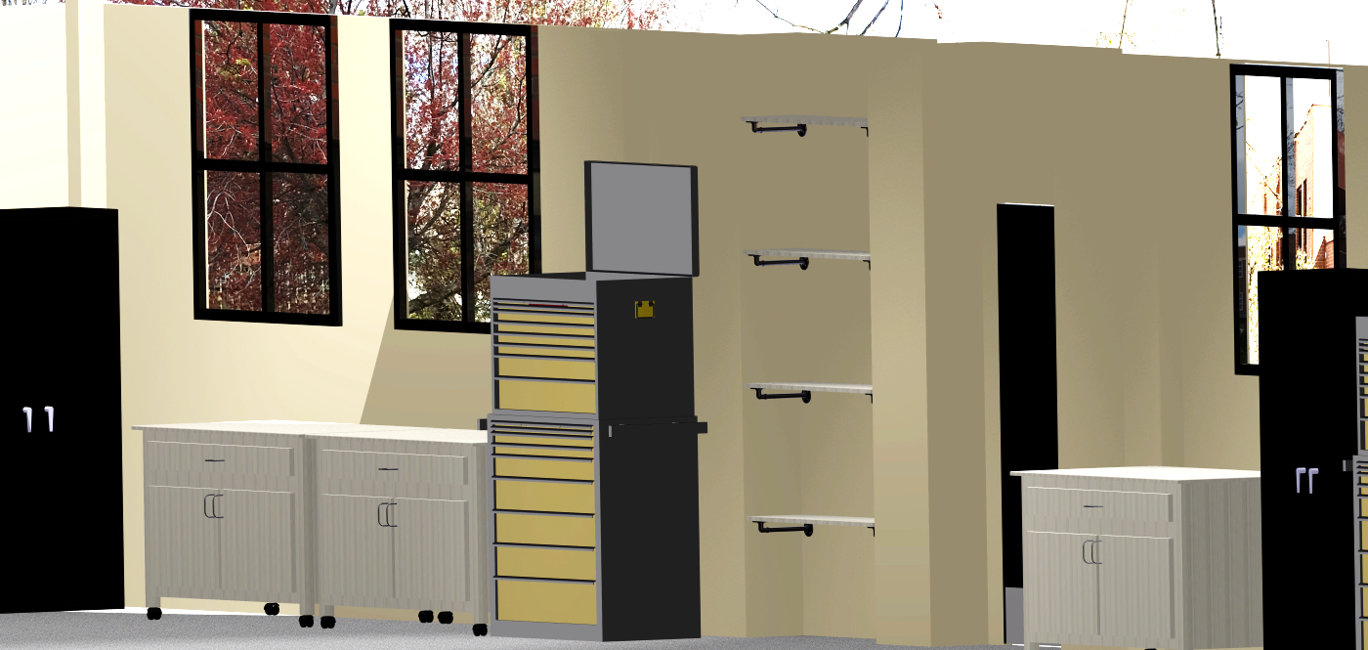
GJ 120 Redesigned
Plentiful Storage
Built-in Shelving
Vandal Themed Colors

Slide 9
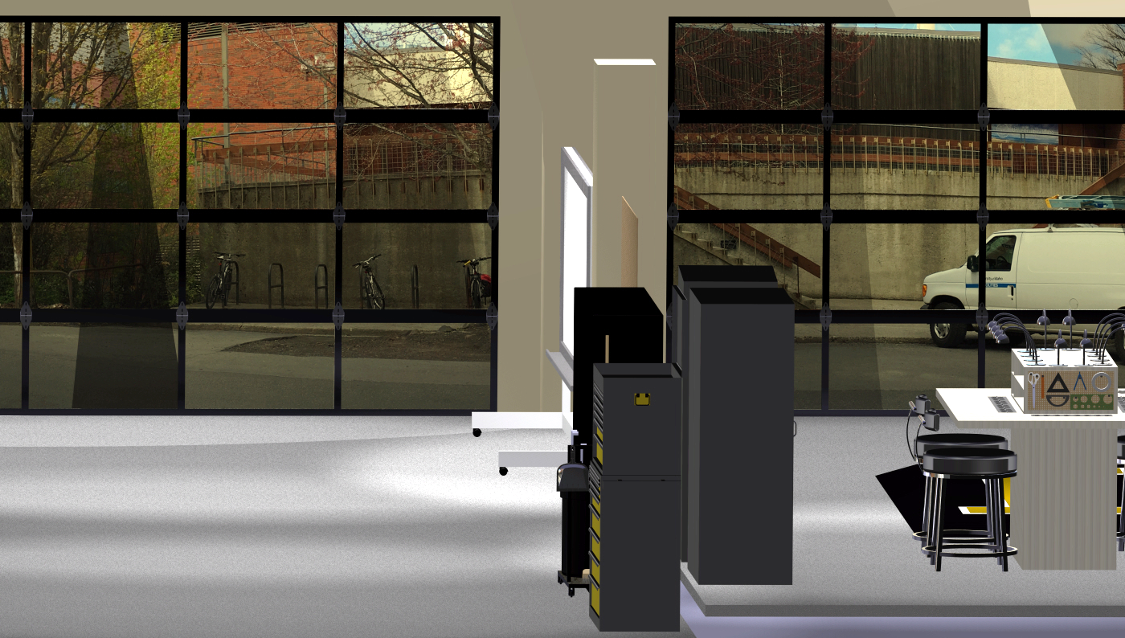
GJ 120 Redesigned
University of Idaho Engineering – Senior Design Suite
The Possibilities are Endless

