Slide 1
Modeling of a Single Stage Steam Turbine for U of I Steam Plant
Jake Hall, Liam Johnson, Brett Morris

Slide 2
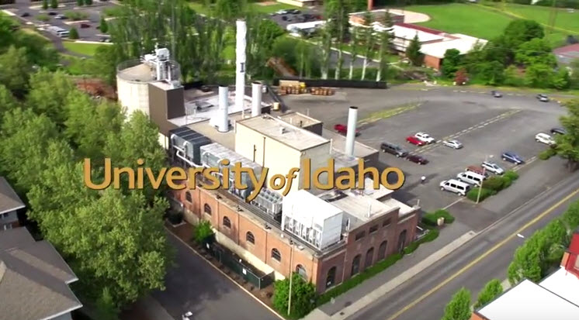
Objectives
Model a realistic interior/exterior of the steam plant
Position and model a theoretical 1 mega watt single stage steam turbine
Create presentation quality renders of the design

Slide 3
Exterior View
Exterior view of the steam plant and the model exterior showing the placement of the turbine and generator.

Slide 4
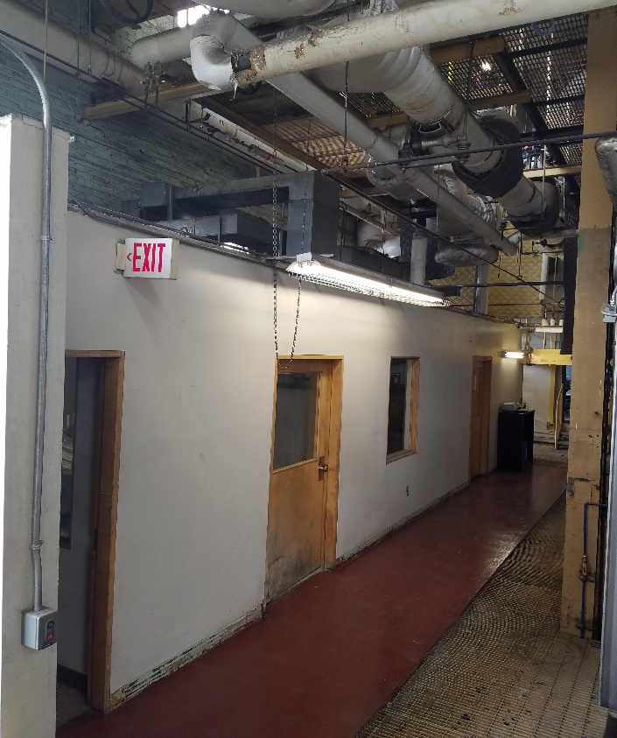
Before and After
Interior view of the given space.
Walls and ducting above will be removed.

Slide 5
Side Render
Side profile of model

Slide 6
Piping
Top view, showing the pipe layout and the various valve placements.

Slide 7
Final Model Render
Overall model layout, showing the possible inlet and outlet connections for the turbine.
Render shows the possibilities of installing a turbine and generator in the existing space.

