Slide 1
Boll-Aero Engine
Brad Morris, Michael Odell, Thomas White

Slide 2
Problem Statement
Interpret the Boll-Aero drawing package
Create 3D part models
Assemble parts
Document assumptions/problems regarding part construction and assembly
Make recommendations regarding package use in the ME301 SolidWorks course.

Slide 3
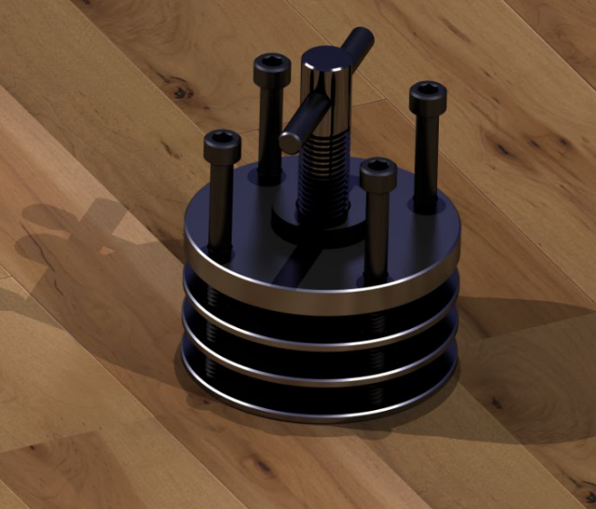
Cylinder Head Subassembly
Original Drawing
Final Render

Slide 4
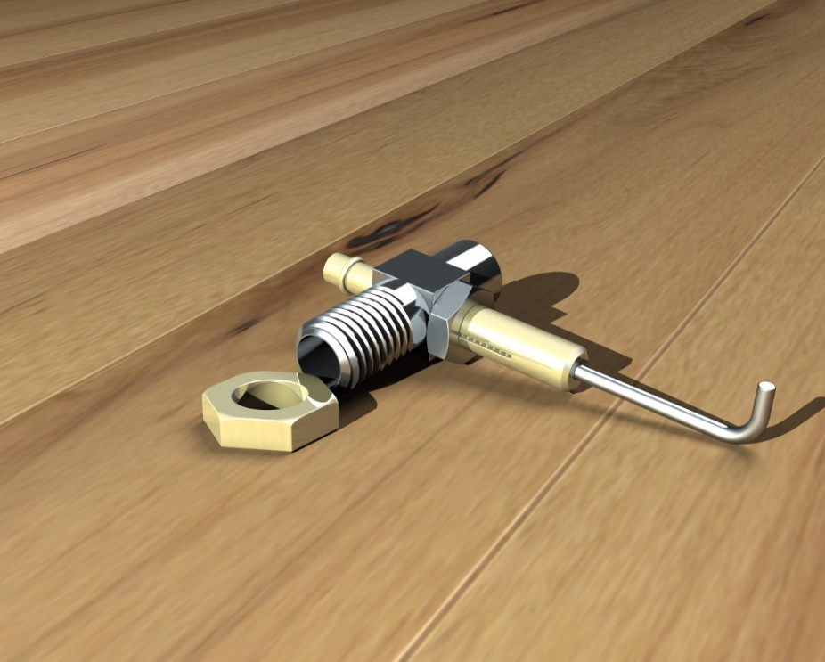
Fuel System Subassembly
Original Drawing
Final Render

Slide 5
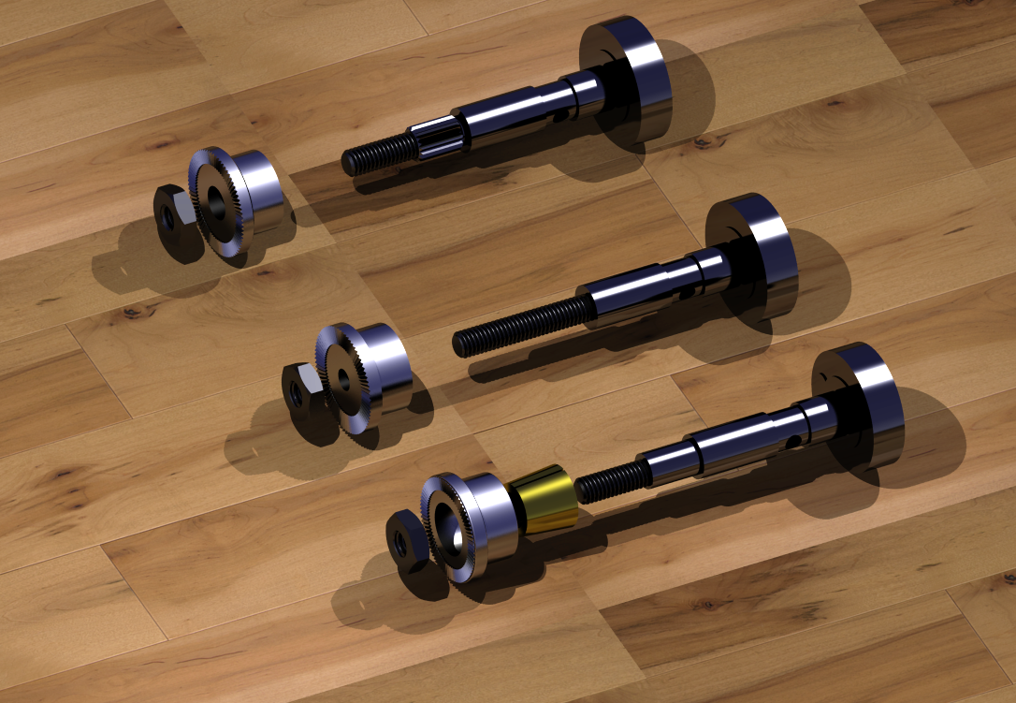
Alternative Crankshaft Designs
Crankshaft Alt 2 (top) :
Prop Drive attached to shaft with spline
Crankshaft Alt 1 (middle):
Prop Drive attached to shaft with threaded stud
Main Crankshaft (bottom):
Prop drive attached to shaft with tapered collet

Slide 6
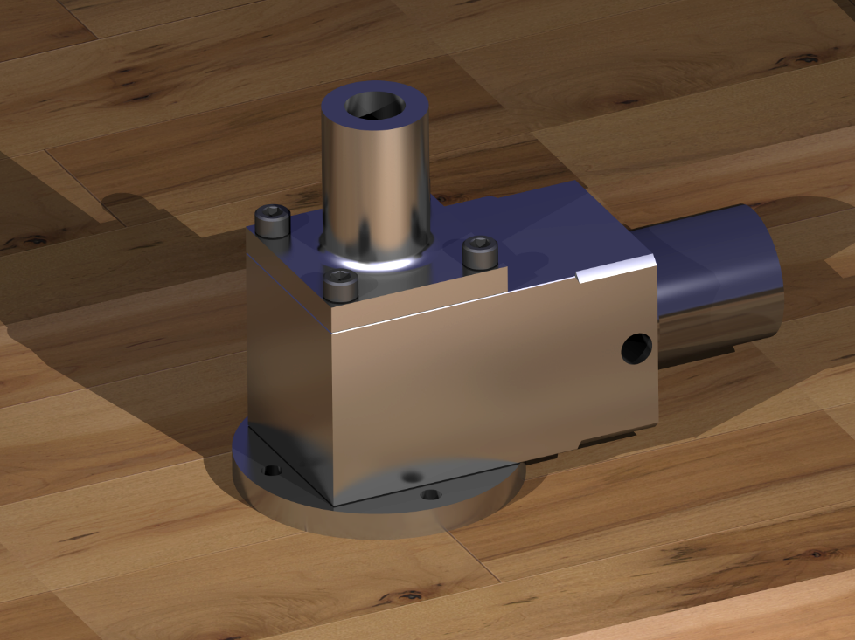
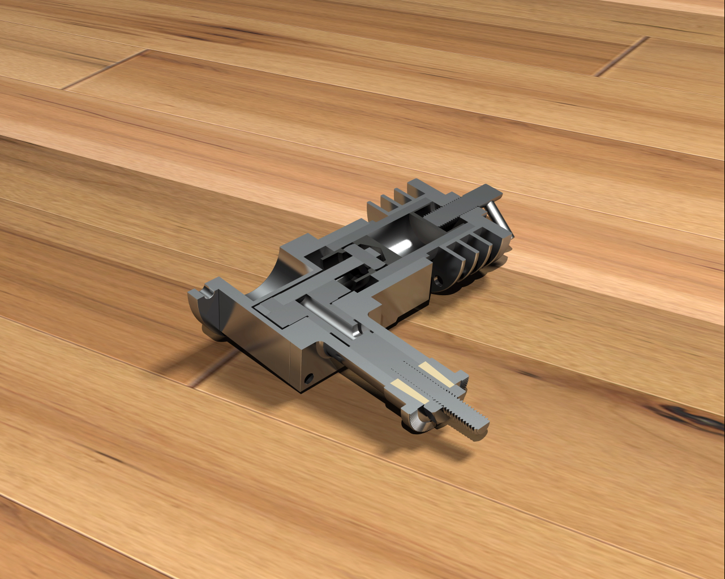
Additional Renders
Crankcase Assembly
Cross Sectional Assembly

Slide 7
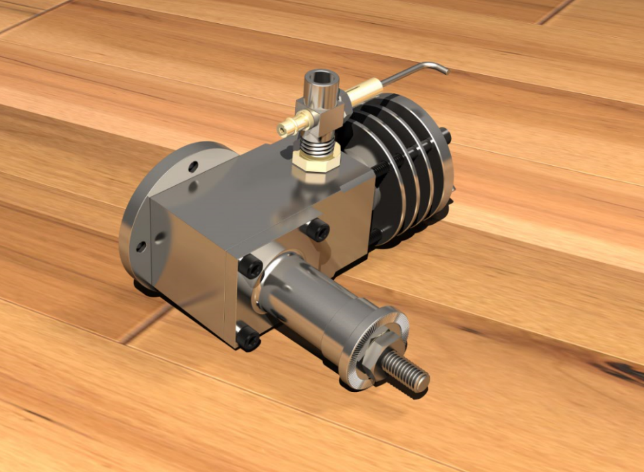
Assembly Renders
Front Side
Back Side

