Slide 1
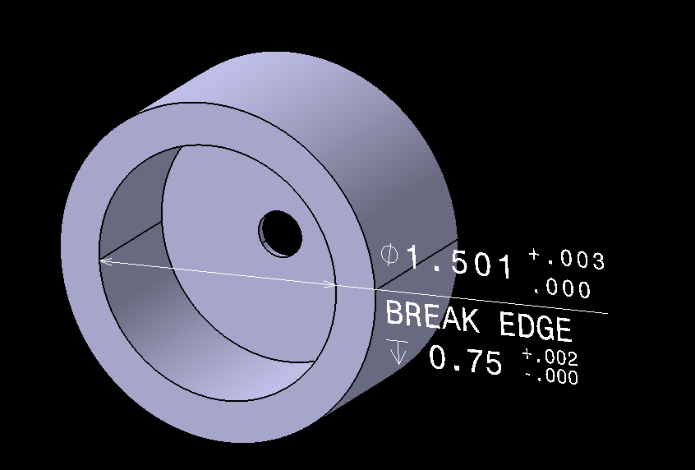
CATIA GD&T
Tysen Buster

Slide 2
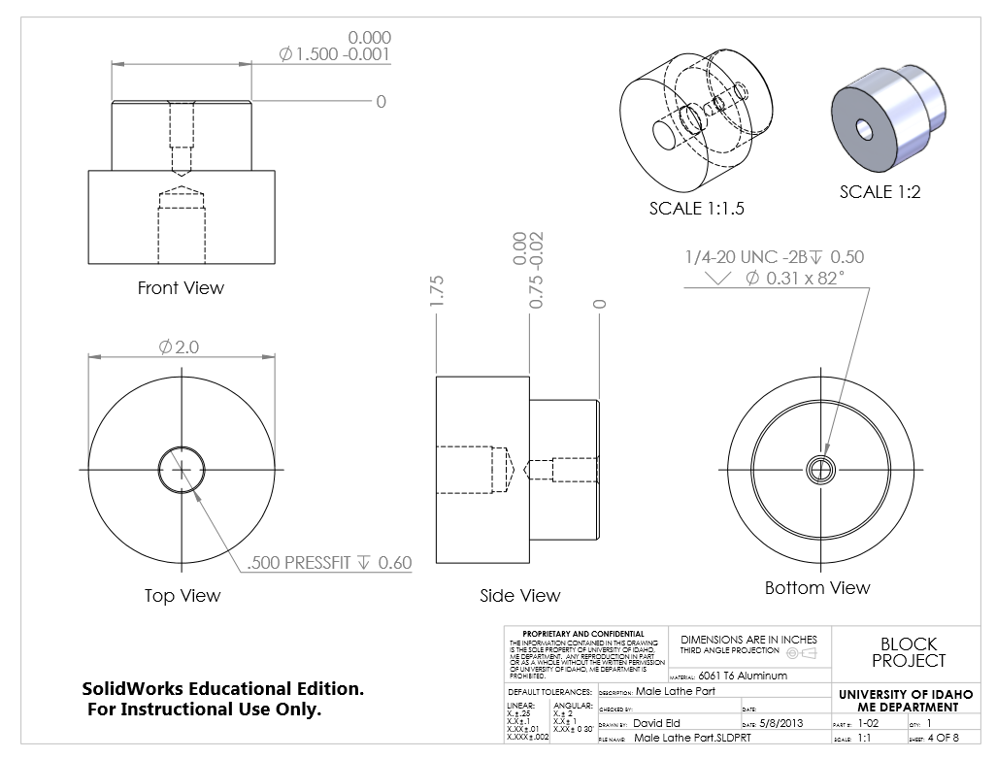
Objectives
Explore the Functional Tolerancing and Annotation workbench in CATIA
Recreate ME 410 Block Project
as Model Based Definitions (MBD’s)

Slide 3
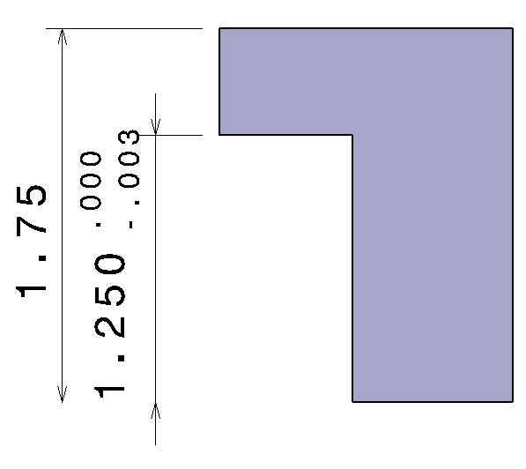
Process
Create parts based on
2D drawings
Dimension parts
Add desired tolerances

Slide 4
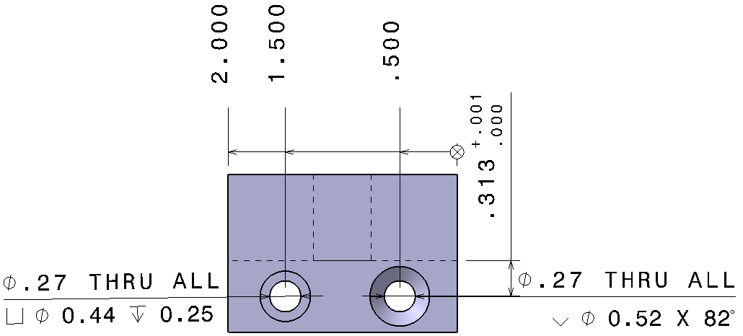
Process cont.
Add further annotation (hole callouts)

Slide 5
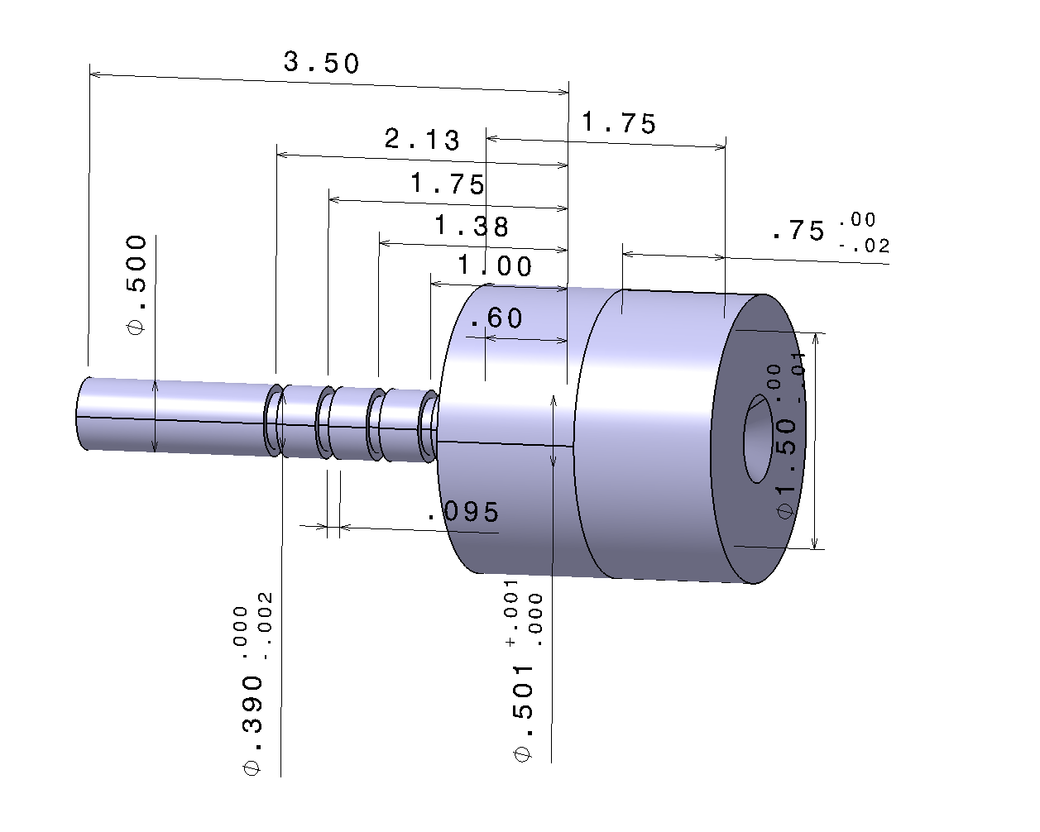
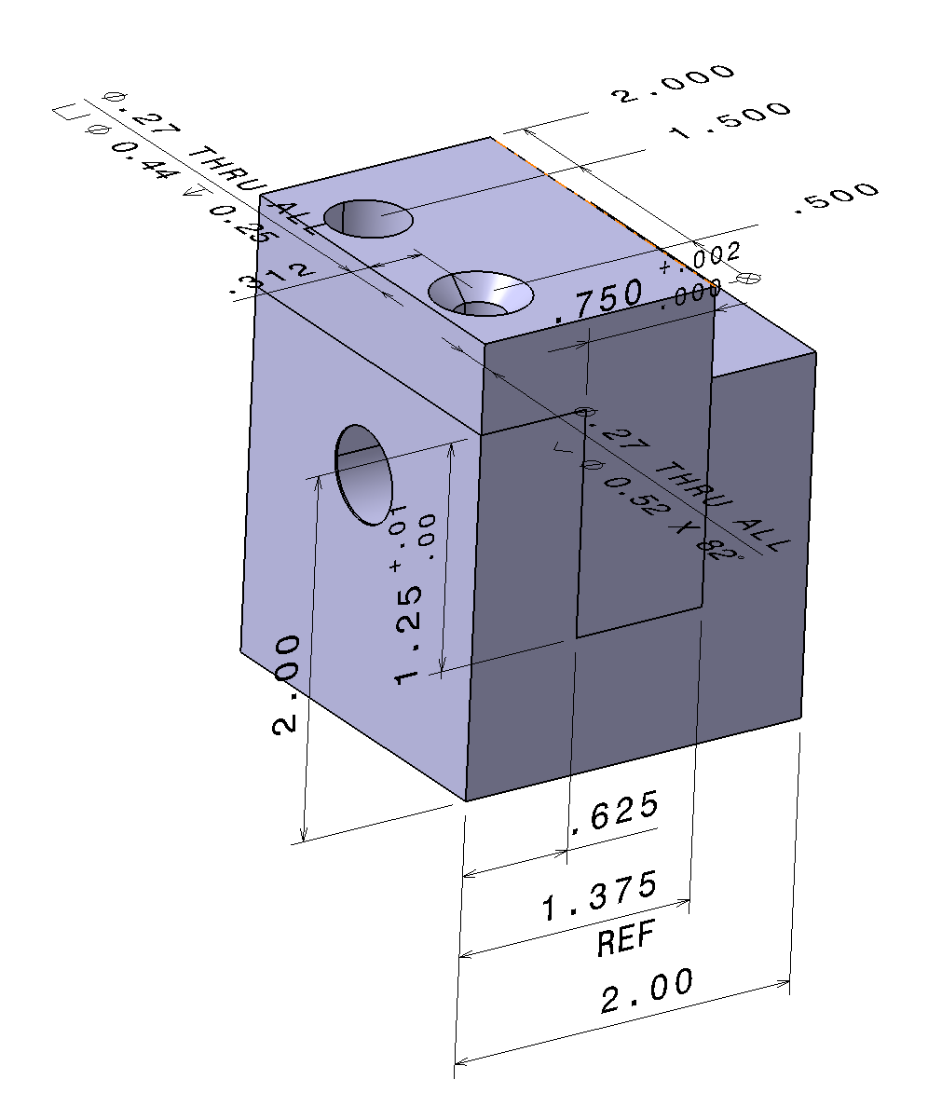
Results

