Slide 1
Catia Certification
Brian Aldrimk
Timothy Butler
Chase Dinning
Thomas Entwit

Slide 2
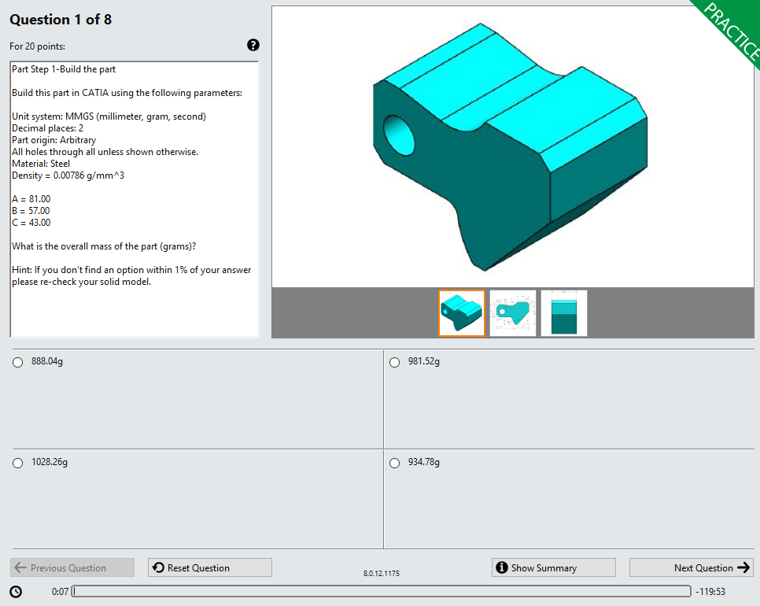
About CATIA Certification
Associate
-Part Design
-Assembly Design
-Surface Design
Specialist
-Any two of the Associate certifications
Expert
-Part Design
-Assembly Design
-Surface Design

Slide 3
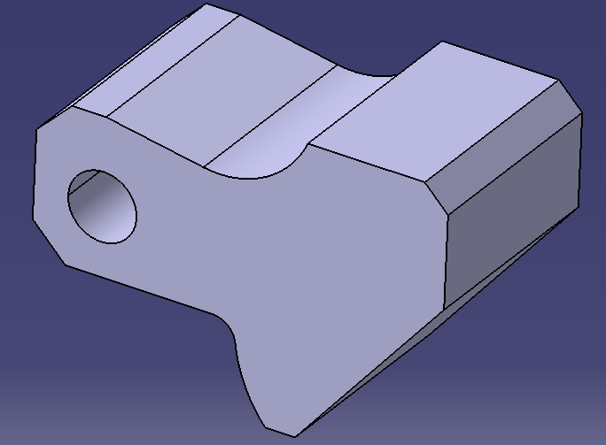
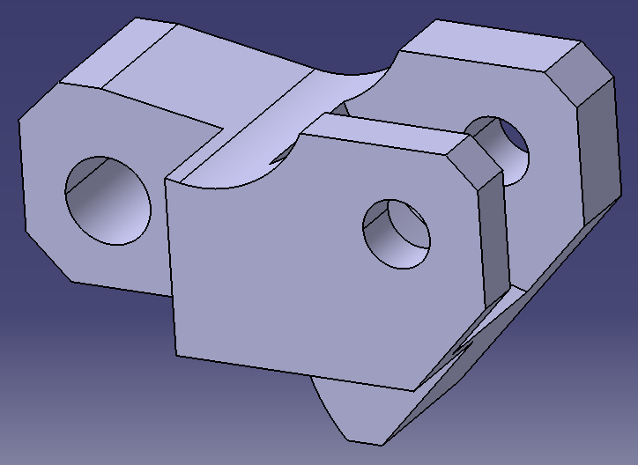
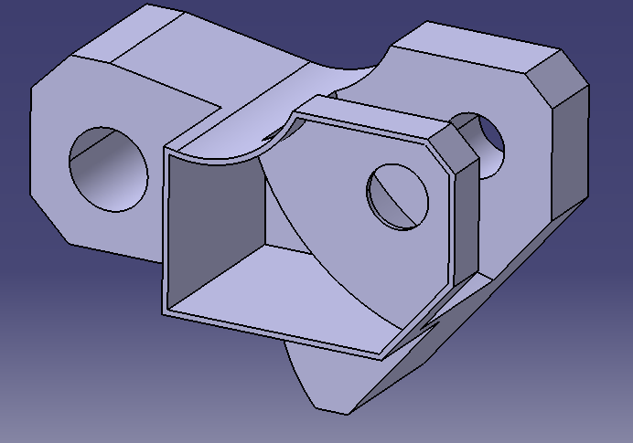
Part Design Exam
105 minutes
10 Question
Maximum Score of 155 points
Passing Score of 105 points
Covering: Sketch Features, Creating Constraints, Pads, Pocketing, Creating Planes, Drafting, Title Block Editing, Measurements
Most difficult aspect: I found assigning my origin to start my part was difficult, not overthinking it was key. Also creating points to assign geometry came very useful.

Slide 4
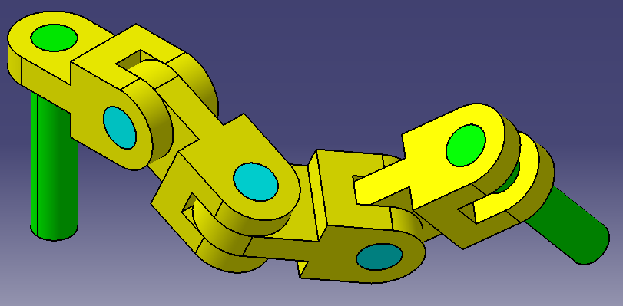
Assembly Design Exam
105 Minutes
9 Questions
Maximum Score of 155
Passing Score of 105
Covering: Inserting components, constraints, analysis, measure, interferences, replacement, bill of materials, views and exploded views
Most difficult aspect: makes sure origin is placed correctly in order to get the correct measurement, example: center of gravity. Angle constraint need to based on the correct surfaces.,

Slide 5
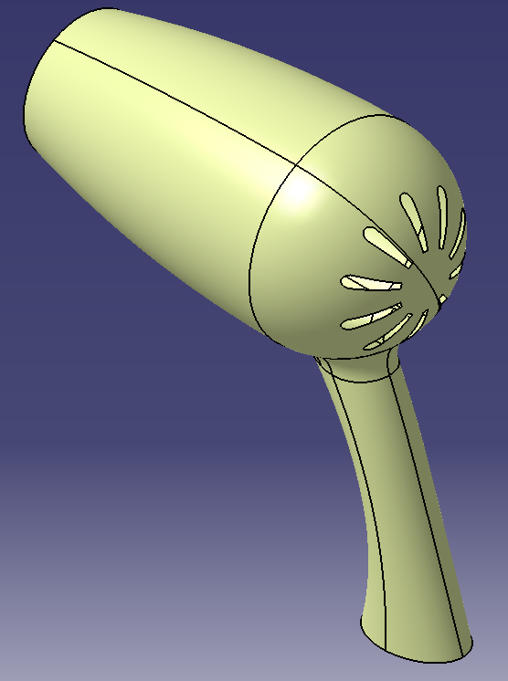
Surface Exam
120 Minutes
18 Questions
Maximum Score of 200
Passing Score of 135
Covering: Creation, modification, and analysis of wireframes and surfaces.
Most difficult aspect: Some tools that required searching and inserting new toolbars.

