Slide 1
Finishing Capstone
….because you only want to have senioritis once

Slide 2
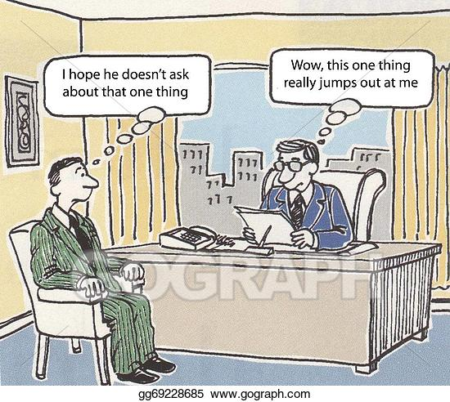
Final Report: Bare minimum
Needs to describe the problem that your team is solving (including specifications agreed on with client)
Full details necessary to recreate part or all of your design
  drawing package
  Uncompiled code
  Circuit diagrams
  Bill of materials
Description of system functionality
Testing done to show that your design meets the initial requirements

Slide 3
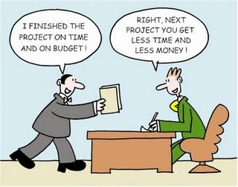
Project Closure
Confirm with client your hand-off plan
  Hardware
  Code
  Final report
  Electronic files
Design report (to lead instructor and/or client, and posted on wiki site and/or capstone shared drive)
Wiki page signed off by lead instructor and Dr. Beyerlein
Project poster for wall-mounting
Check-out from work area (Bill M.)
Capstone shared drive archive approved by lead instructor

